Slide 1
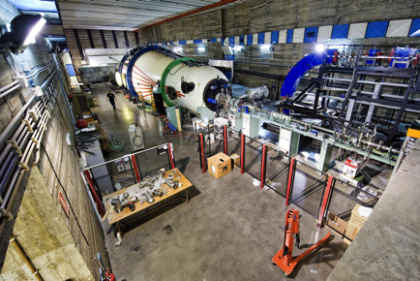
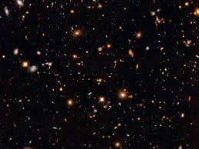
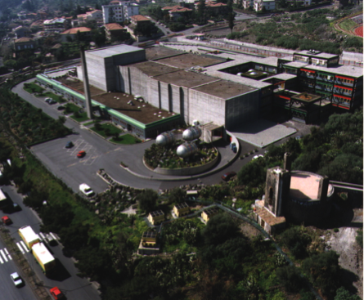


Probing the Early Universe through nuclear physics
New Aspects of the Hadron and Astro/Nuclear Physics
Tashkent - 2018
Rosario Gianluca Pizzone
INFN – LNS Catania – Italy
AStroFIsica
Nucleare

Slide 2
Happy 100 ^{th} anniversary to the National University of
Uzbekistan

Slide 3

INFN – Laboratori Nazionali del Sud @Catania Sicily- Italy
Nuclear astrophysics group active since 1992 on indirect methods, developing THM
Tandem @LNS ideal machine for stable beams and long living isotopes (¹⁰Be, ²⁶Al) for nuclear astrophysics with indirect methods

Slide 4

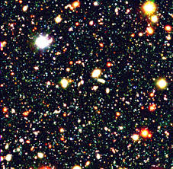
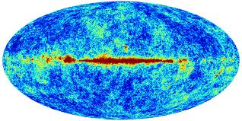
Primordial nucleosynthesis is one of the pillars of the current
Cosmological models.
Main evidences of Standard Big Bang scenario:
Galactic expansion (Hubble Law) from SN measurements,
Cosmic Microwave Background radiation probes the universe
at time around 3x10⁵ years after BB
Primordial nucleosynthesis probes the universe at around
1-20 minutes after Big Bang!!
The only in the radiation dominated era

Slide 5
Several eons can be defined in the Universe lifetime
BBN sets on when the
Primordial universe is
Radiation dominated.

Slide 7

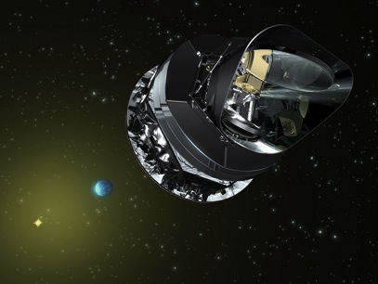
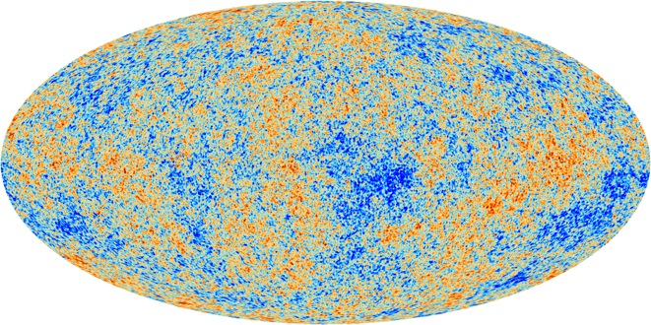
Anisotropies of the Cosmic Microwave Background
At t≈0.38 My, and T≈3000 K : recombination, the Universe becomes transparent (presently 2.725 K)
WMAP [Komatsu et al. 2011+….]
Planck [Ade+ 2013+]

Slide 8
Density components of the Universe
A natural reference : the critical density
= 1.88 h² × 10⁻²⁹ g/cm³ or 2.9 h² × 10¹¹ M/Mpc³
H₀ ≡ Hubble “constant” (h=H₀/100 km/s/Mpc h≈0.7)
Ω≡ρ/ρ_{C}
Some Ω values [Ade+ 2013+ (Planck)]
Radiation (CMB) | Ω_{R} | 5 10⁻⁵
Visible matter | Ω_{L} | ≈0.003
Baryons | Ω_{b} | 0.048
Dark Matter | Ω_{c} | 0.257
Vacuum | Ω_{Λ} | 0.691
Total | Ω_{T} | ≈1.0
Number of baryons per photon (free parameter): η ≡ n_{b}/n_{γ}
and Ω_{b}h²= 3.65×10⁷ η
Notes:
Corrigé 10-22 --> 10-29 (5 protons par m3 ou <1 galaxy par Mpc3
Ade xvi Table 5 Planck+lensing+WP+highL
Dunkley et al. 2008; Komatsu et al. 2008

Slide 9

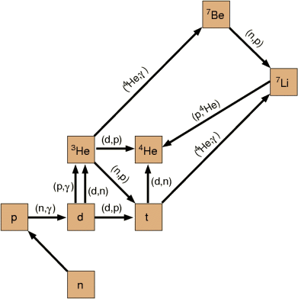
BBN network and observed isotopes
12 relevant reactions were Selected whose importance Is connected with formation And destruction of the “primordial” isotopes. 4 of them were studied by THM (marked in red)
Primordial Isotopes:
H and D
³He and ⁴He
⁷Li (partially)
By studying the abundances of those isotopes and
Retrieving their “primordial” abundance one can get
Hints on BBN and the baryon to photon ratio, thus
Testing the Big Bang Model.

Slide 10
Can we trace back the abundances of those elements
From the present value to the “primordial” ones??
Definition of “Metallicity”
In astrophysics:
“metals” = everything beyond helium
Metallicity:
  “metal” mass fraction (Z)
  [Fe/H] ≡ log(Fe/H) - log(Fe/H)
  Very roughly: the higher Z the younger the objects

Slide 11

Galactic chemical evolution
Z>2
Star formation from
condensation of gas
Abundances
Big-Bang
H, He, Li
Time
Cosmic rays
Stars
Li, Be, B
Interstellar gas
Compact remnants (white dwarves), neutron stars, black-holes
Supernovae, …...
Matter enriched in “heavy” elements

Slide 12
Determination of primordial abundances
Primordial abundances :
  Observe a set of primitive objects born when the Universe was young
    ⁴He in H II (ionized H) regions of blue compact galaxies
    ³He in H II regions of our Galaxy
    D in remote cosmological clouds (i.e. at high redshift) on the line of sight of quasars
    ⁷Li at the surface of low metallicity stars in the halo of our Galaxy
  Extrapolate to zero metallicity : Fe/H, O/H, Si/H,…. → 0

Slide 13
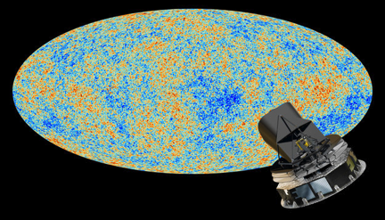
Observational status for Li
Different features can be extracted by studying the abundance.vs.metallicity scatter plot:
1)at lower metallicity, lithium abundances exhibit the so-called “Li-plateau” (Spite & Spite A&A, 1982) →Primordial Nucleosynthesis;
-4
-3
[Fe/H]
Primordial Lithium (Li/H) Observed ∼1-2*10-¹⁰ (Fields et al., ApJ, 2005)
Primordial Lithium (Li/H)WMAP ≈ 4.3*10⁻¹⁰
^{(Cyburt et al., PLB, 2005)}

Slide 14
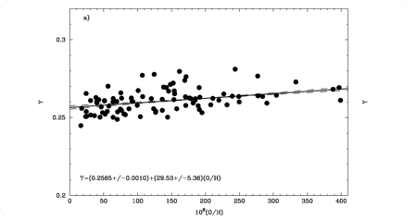
For the other baryometers…
Pettini et al. 2012
D from QSO absorbers,‘damped Lyman alpha systems’
WMAP value ≈ 2.55 x10⁻⁵
Obs. 2.82 (Pettini et al 2012)
⁴He in metal poor HII regions
WMAP value ≈ 0.2485
Obs. 0.2565 (Izotov et al.)
Pettini et al. 2012
Izotov et al. 2007

Slide 15
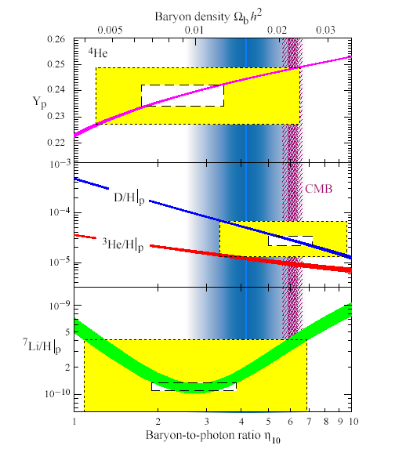
Before WMAP
From primordial abundances hints on the baryon-to-photon ratio and the baryon density.
Hints on eta from coupled measurements of D,Li and He primordial abundances (yellow boxes 2σ)
A wide range is found
3<η₁₀<7

Slide 16
After WMAP
From the CMB peaks information on the baryon density. This result is then compared to primordial abundances and agreement is found (except for Li).
A narrow range is found
5.9<η₁₀<6.9

Slide 17
The Role of nuclear cross sections
Reaction rate determination by means of the formula
(Rolfs & Rodney, 1988)
Thus the bare astrophysical S(E) factor must be known in the whole astrophysical range and then integrated numerically. It can be expressed as a function of T₉ as:
With a_{i} parameters which can be fitted and then used for
Astrophysics

Slide 18

Why TH measurements?
The direct measurements at low-energies have been performed and discussed by several groups in last 50 years. Several reliable data sets are available but…
Only extrapolations have been performed in correspondence of the energy window relevant for astrophysics in many cases (even if low energy experimental data are available extrapolations are required due to the presence of electron screening, Assenbaum 1987);
Thus, the indirect THM approach has been adopted to measure the bare nucleus S(E)-factor

Slide 19
Trojan Horse Method (outlook)
Quasi-Free mechanism
Basic idea:
It is possible to extract the astrophysically relevant two-body cross section σ
B + x → C + D
from quasi- free contribution
of an appropriate three-body reaction
A + B → C + D + S
Main application:
Charged particle bare nucleus cross section measurements at astrophysical energies
-The A nucleus present a strong cluster structure: A = x ⊕ S clusters
x
C
-The x cluster (participant) interacts with the nucleus B
B + x → C + D
B
D
A
S
x
-The S cluster acts as a spectator
(it doesn’ t take part to the reaction)
C
B
D

Slide 20
We can extract astrophysically relevant
two-body cross section σ
B + x → C + D
x
C
B
D
from quasi- free contribution of an appropriate three-body reaction
A + B → C + D + S
A
S
x
C
B
D
E_{A} > (E_{AB})_{Coulomb Barrier}

Slide 21
Quasi-Free mechanism Trojan Horse Method
The incoming energy E_{A} of the incident particle is larger than the Coulomb barrier energy (E_{AB})_{Coul. Bar.}
E_{A} > (E_{AB})_{Coulomb Barrier}
(This means that B and x have a non-negligible probability to be very close)
A
S
x
C
B
D
The nucleus A can be brought into nuclear field
of nucleus B and the cluster x induces the reaction
B + x → C + D
Coulomb effects and electron screening are negligible
Talks by S. Cherubini & M. La Cognata

Slide 22
BBN network and observed isotopes
12 relevant reactions were Selected whose importance Is connected with formation And destruction of the “primordial” isotopes. 5 of them were studied by Catania group with THM (marked in red) 2 under instigation (green, coll. R. Yarmukhamedov)
Primordial Isotopes:
H and D
³He and ⁴He
⁷Li (partially)
By studying the abundances of those isotopes and
Retrieving their “primordial” abundance one can get
Hints on BBN and the baryon to photon ratio, thus
Testing the Big Bang Model.

Slide 23
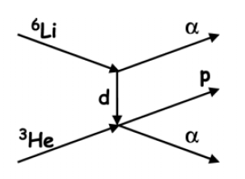

The ⁷Li(p,α)⁴He reaction rate
For the rate both direct
And THM data were taken
into account
Red: THM Data
Blue: Direct Data
- Azure R-Matrix fit
d
n
α
p
α
⁷Li
α
Extensive efforts for THM: Spitaleri et al.1999, Lattuada et al. APJ 2001, RGP et al A&A 2003, Lamia et al., A&A 2012
⁷Li(p,a)⁴He
²H(⁷Li,αα)n ⁷Li beam 19-21 MeV on CD₂ target
@ LNS Catania

Slide 24
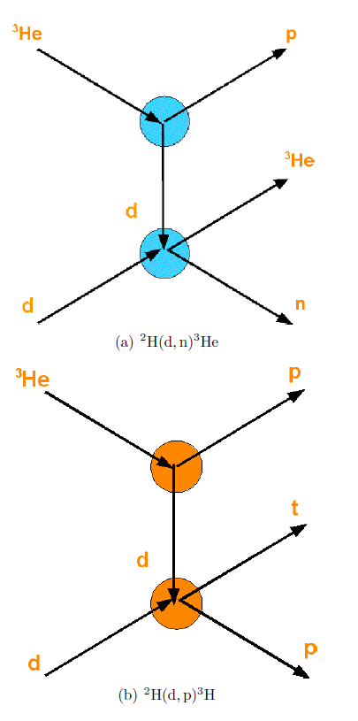

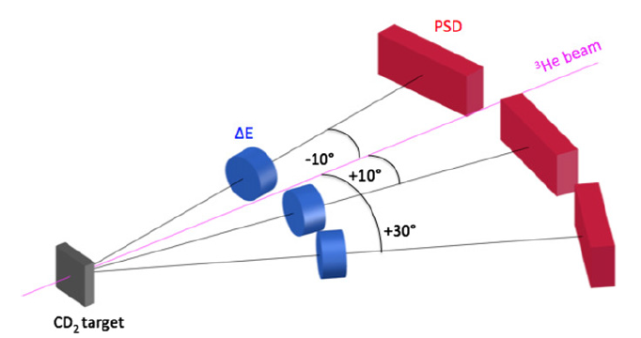
d(d,n)³He ²H(³He,n³He)H
d(d,p)t ²H(³He,pt)H
³He beam
(1° run 17 MeV – 2° run 18 MeV) on CD₂ target
@Nuclear Physics Institute – ASCR – Czech Rep.
TH data: [Tumino et al.2014, ApJ]

Slide 25
The updated d(d,n)³He reaction rate
Red: Direct Data
Blue: THM Data
- Azure R-Matrix fit
Extensive efforts for THM:
Tumino et al 2011, Pizzone et al 2013
PRELIMINARY RESULTS
for the reaction rate
For the rate both direct
And THM data were taken
into account

Slide 26
The updated d(d,p)³H reaction rate
Red: Direct Data
Blue: THM Data
- Azure R-Matrix fit
Extensive efforts for THM:
Tumino et al 2011, Pizzone et al 2013
PRELIMINARY RESULTS
for the reaction rate
For the rate both direct
And THM data were taken
into account

Slide 27
The updated ³He(d,p)⁴He reaction rate
³He(d,p)⁴He ³He beam 5 and 6 MeV on LiF target (⁶Li 95%)
@ Dynamitron Tandem Laboratorium in Bochum, Germany
α
⁶Li
α
p
d
³He
α
Extensive efforts for THM:
La Cognata et al. 2005
Red: THM Data
Blue: Direct Data
- Azure R-Matrix fit
For the rate both direct
And THM data were taken
into account

Slide 28
Applications to primordial Nucleosynthesis
The ⁷Li(p,α)⁴He reaction THM rate
Was adopted as a physical input for
the BBN model (Kawano 1988), in collaboration with Carlos Bertulani togheter with d(d,p)t & d(d,n)³He reaction rates
The results are in agreement with
Observations (except ⁷Li) and with
results obtained using direct nuclear
Inputs.
See Pizzone et al., APJ, 2014

Slide 29
The ⁷Be(n,a)⁴He reaction was studied
After ⁷Li(p,a)⁴He measurements with THM using
Charge simmetry
Further data from THM experiments at INFN LLN and
Riken Are are under analysis
Observed= 1.58 x 10⁻¹⁰

Slide 30
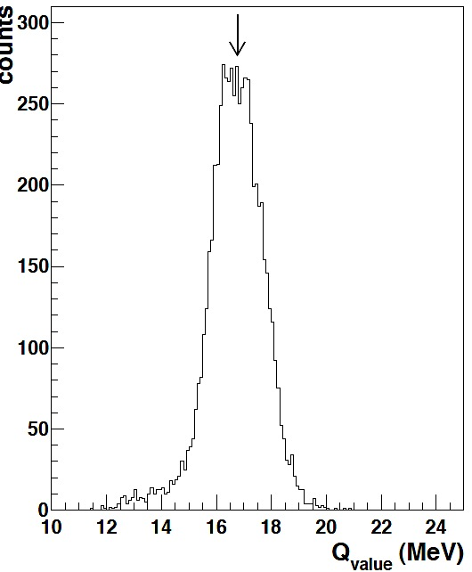
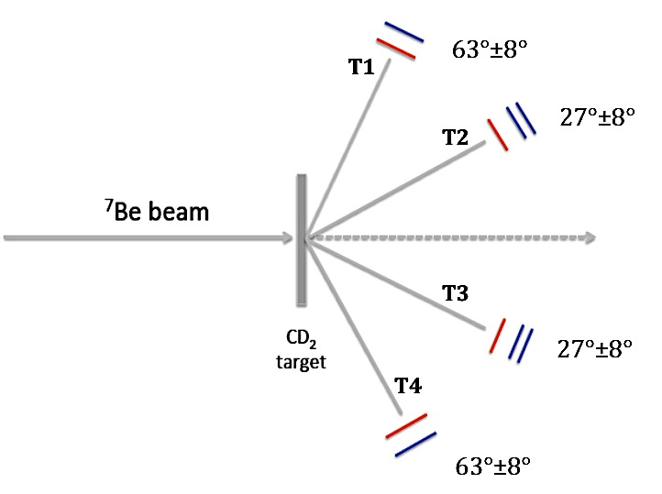
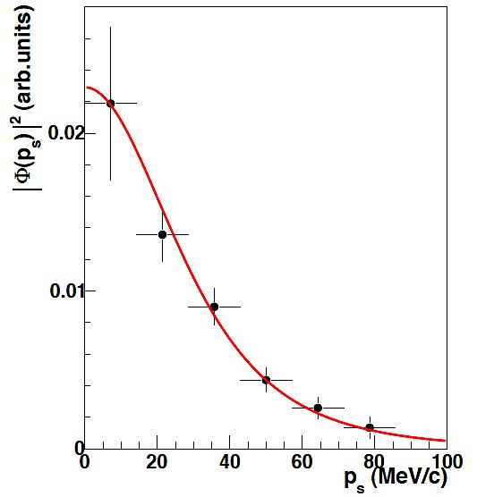
d
p
⁷Be(n,α)α reaction
²H(⁷Be,αα)p (LNS-Napoli-PD collaborations)
@LNL (7Be beam @20 MeV on CD2 target, primary beam of ⁷Li @33 MeV)
n
α
⁷Be
α
[Lamia, NPA2017 Conf. Proc., Submitted]
EXOTIC detection system
T1(T4)→ IC+DSSSD
T3(T2)→ IC+ 2 DSSSD
In progress

Slide 31
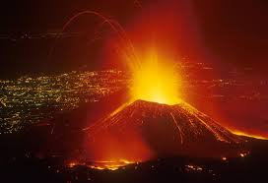
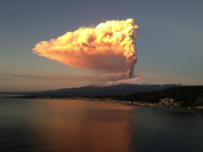
Extensive work done by the Catania Nuclear
Astrophysics group
AStroFIsica
Nucleare
Mount Etna and the Sicilian East Coast as seen from the ISS

Slide 32












The AsFin Group
@Catania C. Spitaleri, A. Anzalone, A. Bonasera, S. Cherubini, A. Kalanka, G. D’Agata, G.L. Guardo, M. Gulino, I. Indelicato, M. La Cognata, L. Lamia, G.G. Rapisarda, S. Romano, M.L. Sergi, R. Spartà, A. Tumino
@Perugia M. Busso, S. Palmerini, O. Trippella, M. Limongi, A. Chieffi, M.C. Nucci
Thanks for your attention
Collaborations
  Cyclotron Institute, Texas A&M, USA: R. Tribble, V. Goldberg
  C.N.S. Riken, Wako, Japan: S. Kubono, H. Yamaguchi, S. Hayakawa
  University of Taskent: B. Irgaziev, R. Yarmukhanmedov
  CIAE, Beijing, China: S. Zhou, C. Li, Q. Wen
  Nuclear Physics Institute, ASCR, Rez, Czech Rep.: V. Kroha, V. Burjan, J. Mrazek
  Texas A&M Commerce USA: C. Bertulani
  Nipne IFIN Bucharest: L. Trache
  ELI-NP Bucharest: C. Matei, D. Balabanski
  Atomki, Debrecen, Hungary: G. Kiss
  CSNSM, Orsay, France : A. Coc , F. Hammache, N. De Sereville
  Florida State University USA: I. Wiedenhofer
  Notre Dame University USA: M. Wiescher, M. Couder
  University of Catalunya: J. Jose
  Rudjer Boskovic Institute Zagreb Croatia: N. Soic, M. Milin
  INFN Sez. Padova e UniPD: M. Mazzocco
  INFN Sez. Napoli e UniNA: M. La Commara, D. Pierroutsakou, C. Parascandolo
  University of Pisa: S. Degl’Innoccenti, P. Prada Moroni

Slide 33
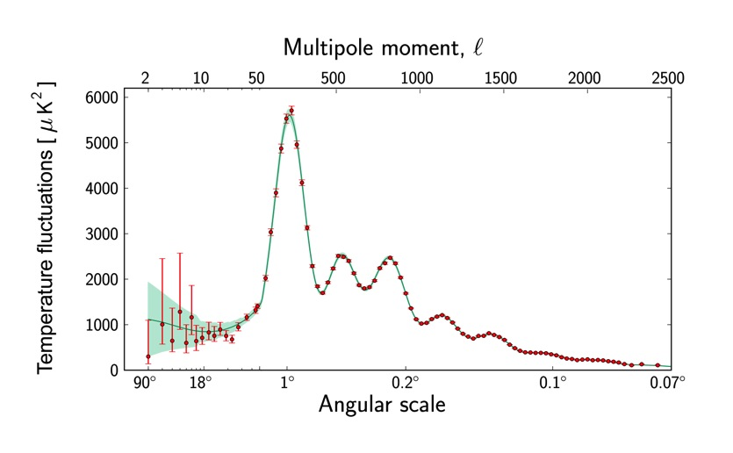
Anisotropies of the CMB
Spatial fluctuation spectrum of CMB generated by acoustic oscillations
Pressure : photons
Inertia : baryons
Geometry (Ω_{T}≈1), 1st peak
Ω_{b} (2nd/1st peaks)
[Ade+ 2013+ (Planck)]
Notes:
http://lambda.gsfc.nasa.gov/product/map/dr4/m_images.cfm
Komatsu et al. The Astrophysical Journal Supplement Series, 192:18 (47pp), 2011 February, Table 1, WMAP Seven-year Mean

