Slide 1


Investigating resonant reactions
of astrophysical interest
using indirect methods
Marco La Cognata
New aspects of the Hadron and Astro/Nuclear Physics
National University of Uzbekistan

Slide 2
resonances
Hard road to measure
resonances

Slide 3
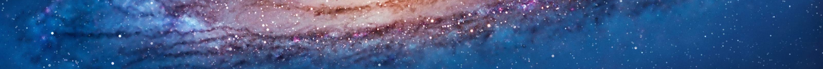
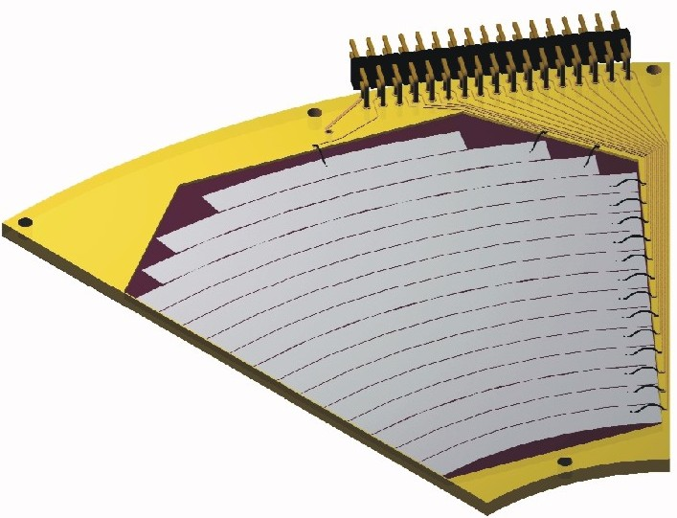
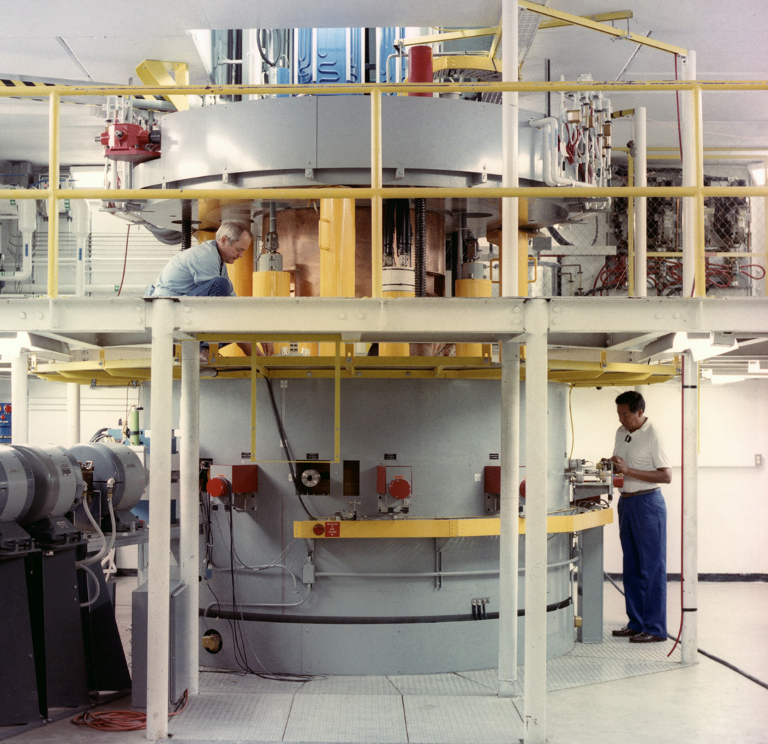
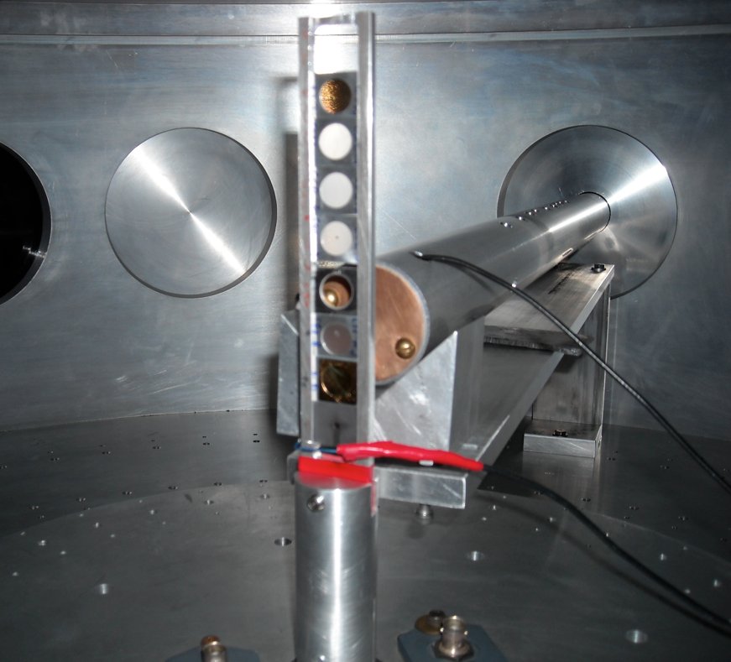
Recipe for direct measurements
How to measure the A+x→c+C reaction in a direct way?
Detector → kinematic observables
- Energy
- Emission angle
+ Particle identification
Reaction
product (c)
Beam (x)
Target (A)
It looks quite simple!

Slide 4
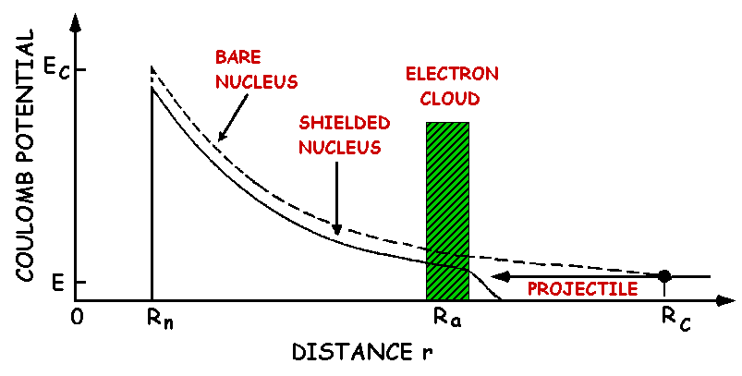
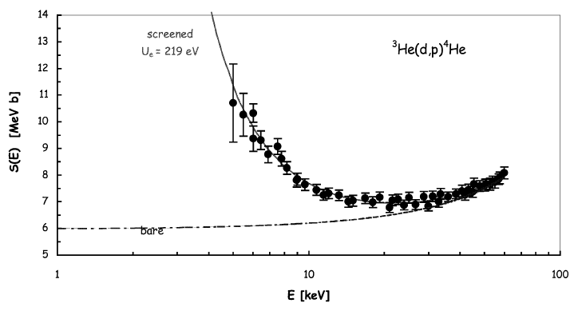
The electron screening effect.
Thanks to recent experimental developments, measurements have been extended to the energies of interest for several reactions.
This lead to the discovery of electron screening: a such low energies atomic degrees of freedom cannot be neglected.
Pictorial view: Experimentally:
Exponential enhancement!
∝
The electron cloud shields the nuclear charge thus the projectile meets a reduced Coulomb barrier → enhancement of the reaction probability as tunneling is more likely.
Bracci et al., NPA 513 (1990) 316
Rolfs & Rodney, Cauldrons in the Cosmos (Univ. Chicago Press) 1988
Strieder et al., Naturwissenschaften 88 (2001) 461

Slide 5
Direct vs. indirect measurements
Indirect measurements:
Complicated but rewarding
High energy experiments: up to several hundreds MeV
→ no Coulomb barrier suppression
→ negligible straggling
→ no electron screening
Indirect measurements are the only ones allowing you to measure down to astrophysical energies with the present day facilities
Nuclear reaction theory required
→ cross checks of the methods needed
→ possible spurious contribution
→ additional systematic errors (is the result model independent?)
... Indirect techniques are complementary to direct measurements
Examples: Coulomb dissociation, ANC and Trojan horse method

Slide 6

Indirect Techniques: a cartoon
Several reaction mechanisms link the two channels
Entrance channel:
A+a
Reaction products
C+c+…
Only one reaction mechanism has to be selected, for which the reaction theory we have developed applies. A careful experimental & theoretical investigation is necessary
To recall the previous sketch:
Nuclear reaction theory
R. Tribble et al., Rep. Prog. Phys. 77 (2014) 106901

Slide 7
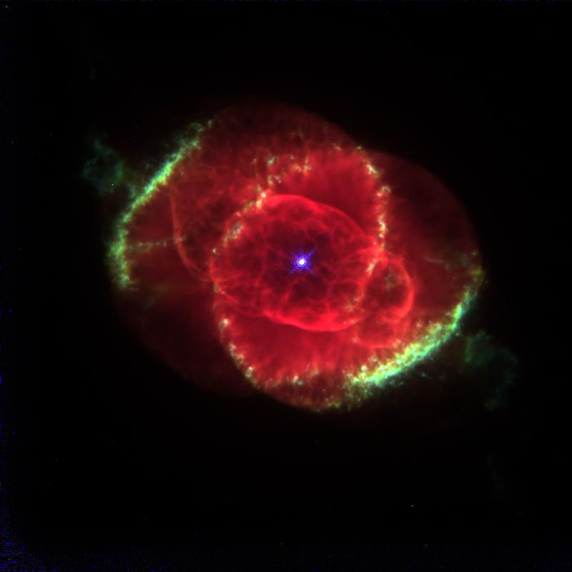
Indirect techniques: a comparison
In the Coulomb dissociation, a virtual photon beam is used to a photodisintegration reaction; the detailed balance principle is then used to recover the cross section of the relevant radiative capture reaction
a
a
γ
c
A
C
a
s
In the Asymptotic Normalization Coefficient (ANC) approach, a transfer reaction to a bound state is measured to deduce the normalization constant of the bound state wave function, prop. to the A(x,γ)F c.s.
x
A
F
a
s
In the Trojan Horse Method, a transfer reaction to an unbound system is used to measure the c.s. of the A(x,c)C process. C and c can be charged or neutral particles (no photons)
x
c
A
F*
C

Slide 8
The Trojan Horse Method: what you already know
Coulomb barrier → exponential suppression of the cross section at astrophysical energies
+ electron screening
→ low-energy, bare-nucleus cross section is experimentally available only through extrapolation OR indirect measurements
From
A+a(x⊕s) → b+B+s @ 10-60 MeV
A + x → b + B @ 5-20 keV
By selecting the QF contribution
a
direct break-up
s
THM reaction
x
b
Though E_{A} >> V_{Coul} it is possible to measure at the Gamow peak since:
E_{c.m.}=E_{A-x}-Q_{x-s}
A
B
2-body process
Additional advantages:
● reduced systematic errors due to straggling, background…
● magnifying glass effect
Baur PLB 178 (1986) 135
Spitaleri, in Problems of Fundamental Modern Physics II, World Sci. (1991) 21
Spitaleri et al., PAN 74 (2011) 1763
Typel & Baur, Ann. Phys. 305 (2003) 228
Mukhamedzhanov et al., JPG 35 (2008) 014016
But...
● off-shell cross section deduced (x → virtual particle)
● no absolute units

Slide 9
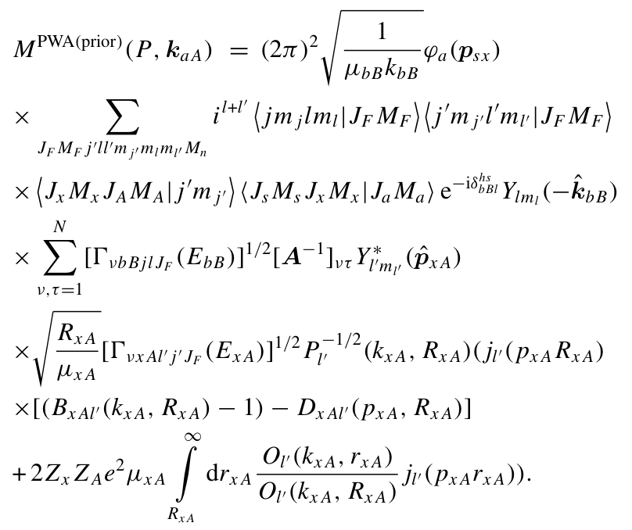
The full THM: the resonant case
a
s
R. Tribble et al., Rep. Prog. Phys. 77 (2014) 106901
x
In the latest years, large efforts were made to give a quantitative justification of THM, to estimate the uncertainties and improve the description of the 2→3 cross section
b
A
F*
B
Fourier transform of the s-x relative motion wave function
Amplitude of the TH reaction
Same R-matrix term as in OES cross section but for the appearence of the inverse penetration factor making it possible to observe suppressed resonances at low energies
Inverse penetration factor

Slide 10


THM: Basic features
Plane Wave Impulse Approximation:
● beam energy >> a = x ⊕ b breakup Q-value
● projectile wavelength k⁻¹ << x – b intercluster distance
+ plane waves in the entrance and exit channel
➔ the 3-body cross section factorizes:
From the experiment
Evaluated through a MC code
HOES 2-body cross section
● KF kinematic factor
● φ(p_{b})² spectator momentum distribution
● dσ^{off}/dΩ off-shell cross section
or “nuclear” (N) cross section
dσ^{off}/dΩ → dσ/dΩ (on shell)
The penetration factor P_{l} has to be introduced:

Slide 11



THM vs. OES astrophysical factor
Direct data:
THM data:
Remember that:
is the formal partial resonance width for the decay of this level into channel c=x+A or c=b+B.
Where:
It can be calculated (DWBA, CDCC, PWBA…) or taken from measurements
The matrix D⁻¹ and VνcC(EcC) are the same in the TH and OES astrophysical factors.
The THM S-factor does not contain the penetration factor, which has to be inserted for comparison with direct data

Slide 12




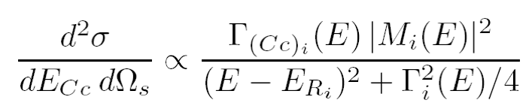
Moreover: exploring negative energies with the THM
Using the kinematics of three body reactions:
s-x Fermi motion
s-x binding energy
It is possible to achieve negative energies in the A-x channel
How to deal with negative energies? what is their meaning?
Standard R-Matrix approach cannot be applied to extract the resonance parameters of the A(x,c)C reaction because x is virtual —> Modified R-Matrix is introduced instead (A. Mukhamedzhanov 2010)
At negative energies M² is given by the product of the Whittaker function and the ANC of the F state populated in the transfer reaction
Merging together ANC and THM —> deep connection of these two indirect methods

Slide 13
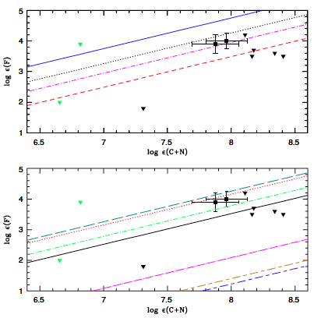
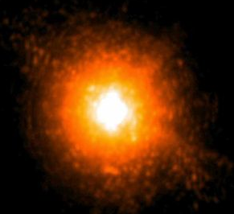
¹⁹F(p,α₀)¹⁶O
s-nuclei are produced and brought to the surface thanks to mixing phenomena, together with fluorine that is produced in the same region from the same n-source.
¹⁹F is a key isotope as it can be used to probe AGB star mixing phenomena and nucleosynthesis. But its production is still uncertain!
¹²C+¹²C fusion
Carbon burning marks the ignition of the third nuclear fuel supply after hydrogen and helium burning in the evolution of massive stars, i.e., M > 8Msun
Close to the energies of interest very uncertain and contradictory measurements, making extrapolation very risky

Slide 14
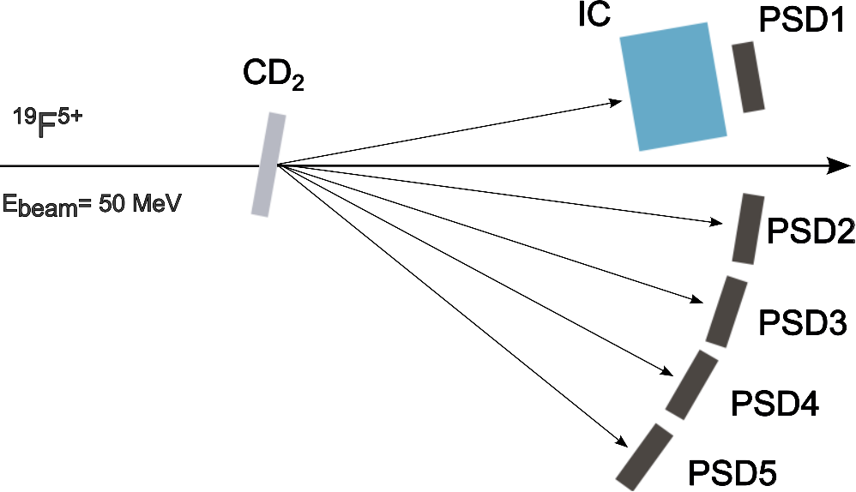
The experiment
d: Trojan horse nucleus p+n
B=2.2 MeV |p_{s}|=0 MeV/c
n: spectator
p: participant
d(¹⁹F,α¹⁶O)n Q_{3b}=5.889 MeV
¹⁹F(p,α) ¹⁶O Q_{2b}=8.113 MeV
15 MV Tandem at INFN-LNS Catania
(150 µg/cm² )
Butane gas ∼ 52mbar

Slide 15
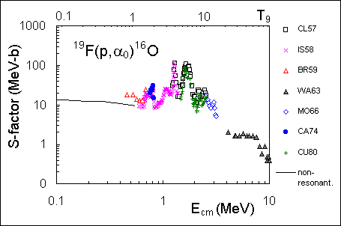
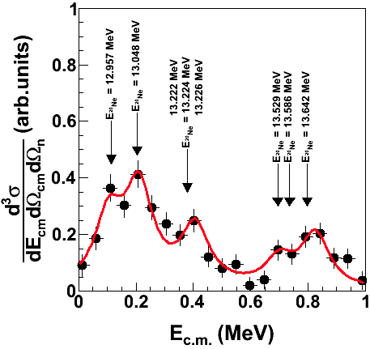
Measurement of the ¹⁹F(p,α₀)¹⁶O reaction using the Trojan Horse Method (THM)
The ¹⁹F(p,α₀)¹⁶O reaction is the main fluorine
destruction channel but no data are available
around ~100 keV (energy of astrophysical interest)
d
p
n
α
¹⁹F
²⁰Ne*
THM measurement
¹⁶O
Non resonant approximation
In the THM ²⁰Ne states are populated through p-transfer off deuteron and resonance parameters are deduced
THM x-section shows a rich resonant pattern!
Investigation of the α_{π} channel @ LNS under analysis

Slide 16
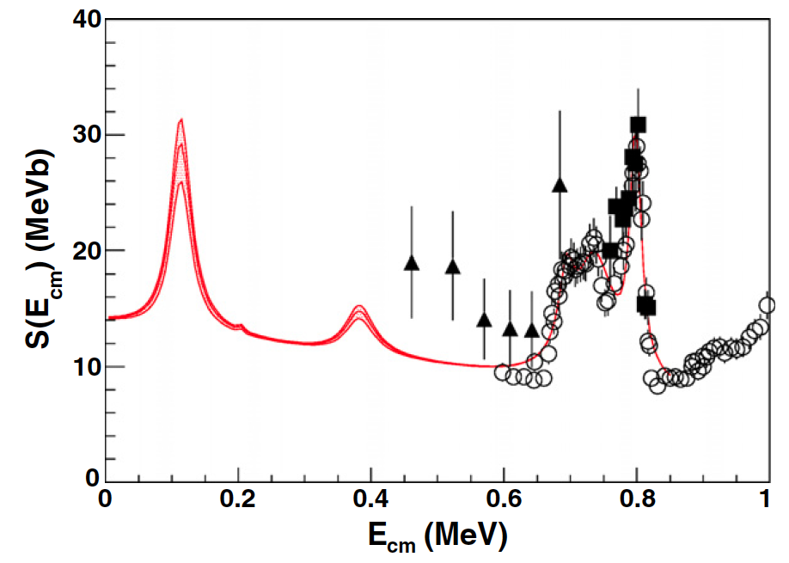
The ¹⁹F(p,α)¹⁶O cross section
M. La Cognata et al. ApJL 739, 54 (2011)
R-matrix parameterization of the ¹⁹F(p,α₀)¹⁶O astrophysical factor.
Above 0.6 MeV, the reduced partial widths were obtained through an R-matrix fit of direct data
Below 0.6 MeV, the resonance parameters were obtained from the modified R-matrix fit
The non-resonant contribution is taken from NACRE (1999).
The non-resonance contribution has been calculated for s-wave (see NACRE compilation), so no significant interference is expected.
Because of spin-parity, only the resonance at 12.957 MeV provide a significant contribution
Gamow window: 27-94 keV → this level lies right at edge of the Gamow window for extramixing in AGB stars

Slide 17
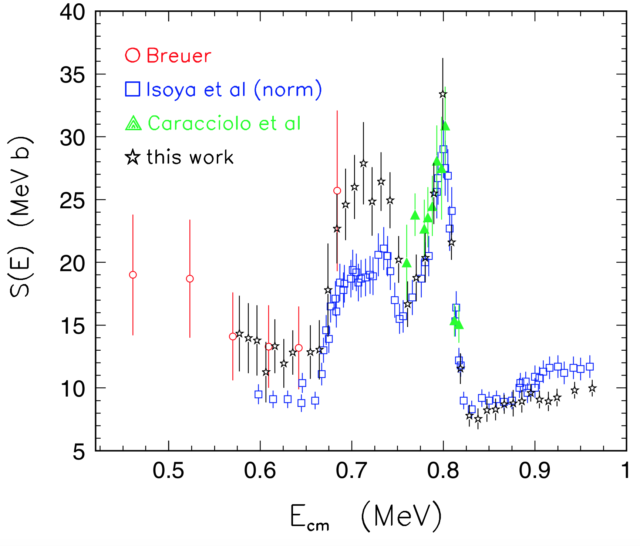
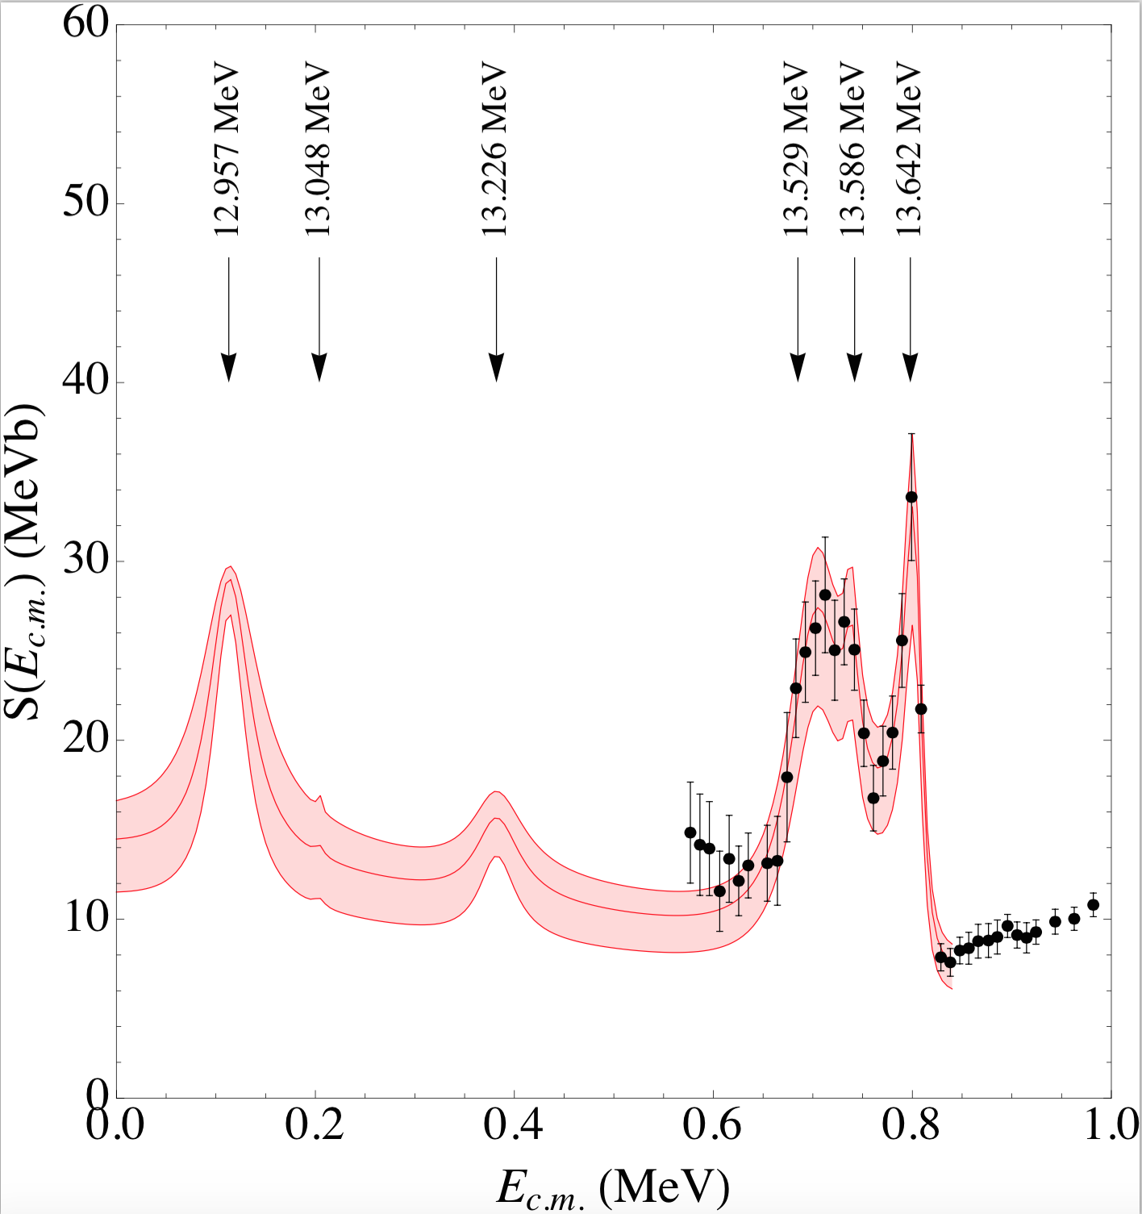
Robustness of the THM approach. Effect of normalization
- Larger S-factor below 0.75 MeV with respect to Isoya et al. (1958) data
- Better agreement with Breuer (1959) → Rising S(E) with decreasing energies
- 0⁺ assignement to the 800 keV resonance
A check of the change of the 113 keV resonance strength is mandatory
I. Lombardo et al., J. Phys. G: Nucl. Part. Phys. 40 (2013) 125102
New measurement by I. Lombardo et al. in 2013 challenges the accepted ¹⁹F(p,α₀)¹⁶O astrophysical factor in the 0.6-1 MeV energy region.
The new THM analysis has lead to a S(E) factor in agreement with the one previously published

Slide 18
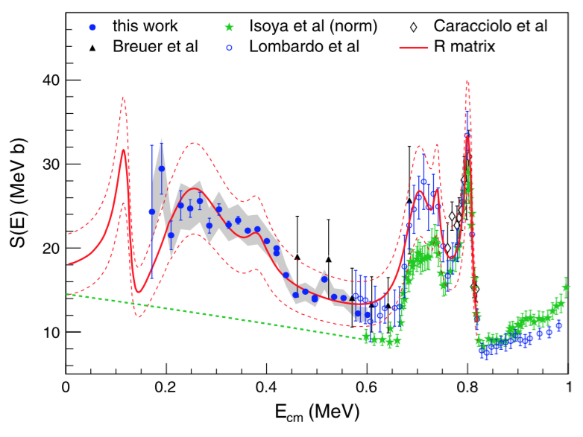
New direct measurement at low energies
I. Lombardo et al., Phys. Lett. B 748 (2015) 178
New measurement down to about 200 keV
R-matrix calculation: same levels as in the THM measurement, but the 251 keV broad 2⁺ state, probably missed because of the poor energy resolution in the 2010 experiment
Non resonant contribution taken from NACRE.
As a cross check, the NRC from Yamashita & Kudo was also tested → negligible difference
Direct data quality is still quite poor at low energies → More work is necessary
Blue points: new data with statistical error only
Gray band: systematic uncertainty
New THM experiments performed in INFN-LNL (Legnaro) aimed at covering the low energy region with better resolution. Results confirm our interpretation →

Slide 19
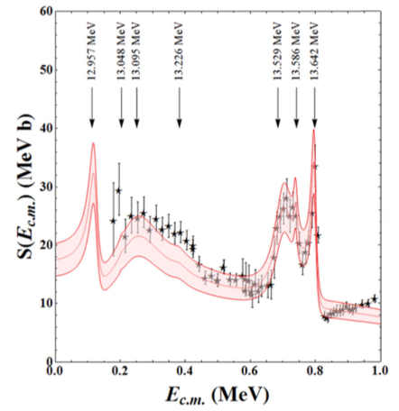
Results confirmed by a new THM measurement
I. Indelicato et al., ApJ 845 (2017) 19
A new THM measurement has been carried out to investigate the origin of the discrepancy. Improved energy resolution allowed for
better level separation
angular distribution analysis
The basic feature → 113 keV resonance is confirmed
Interference is also confirmed
Red band: new THM S-factor
What next? Exploring the role of ¹⁶O excited states → high resolution necessary
New experiment performed at the 2000 mm chamber @ LNS

Slide 20
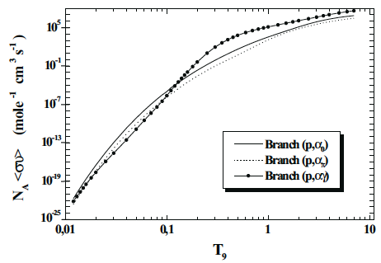
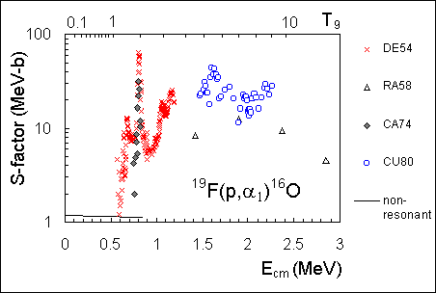
Measurement of the ¹⁹F(p,α_{π})¹⁶O channel
The contribution of the α₀ channel only has been addressed since this is currently regarded as the dominant one at temperatures relevant for AGB stars
← Spyrou et al. (2000)
α_{π} channel is even more uncertain!
An experimental campaign is ongoing to extract the cross section for the α_{π} channel and to improve the spectroscopy of the resonances discussed here.
→ STAY TUNED

Slide 21
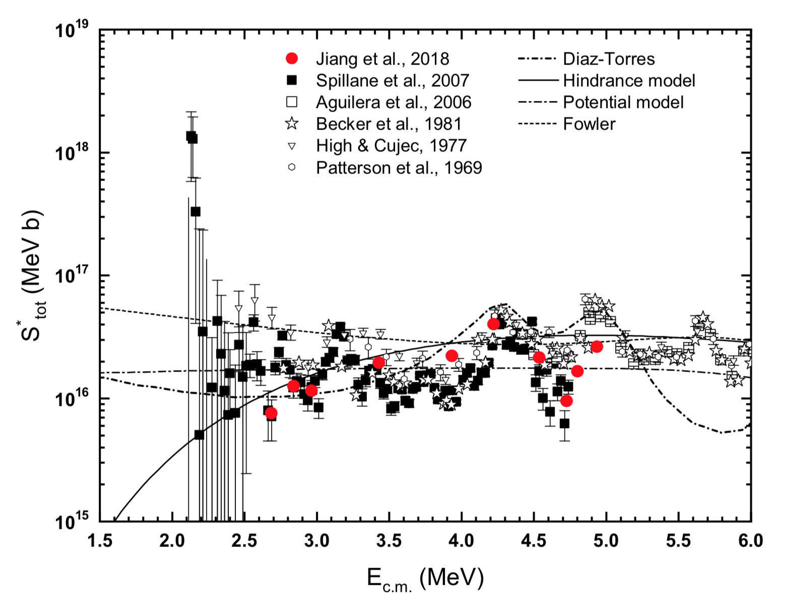
A recent example
Carbon burning marks the ignition of the third nuclear fuel supply after hydrogen and helium burning in the evolution of massive stars, i.e., M > 8Msun
The stellar reaction rates of carbon burning determine:
the properties of massive stars during the most advanced phases of their evolution
their contribution to the chemical evolution of the universe
the 12C+12C rate is the engine of type Ia supernovae and affects their outcomes.
Carbon burning temperature from 0.8 to 1.2 GK → E_{cm} from 1 to 2 MeV
Close to the energies of interest very uncertain and contradictory measurements
12C+12C modified S-factor
J. Zickefoose et al., Phys. Rev. C 97 (2018) 065806

Slide 22
Indirect measurement of the ¹²C+¹²C fusion
¹²C(¹²C,α)²⁰Ne and ¹²C(¹²C,p)²³Na reactions via the Trojan Horse Method applied to the ¹²C(¹⁴N,α²⁰Ne)²H and ¹²C(¹⁴N,p²³Na)²H three-body processes
²H from the ¹⁴N as spectator nucleus?
Observation of ¹²C cluster transfer in the ¹²C(¹⁴N,d)²⁴Mg* reaction in R.H. Zurmuhle et al. Phys. Rev. C 49 (1994) 5
QUASI-FREE MECHANISM
only ¹²C - ¹²C interaction
d = spectator
astrophysical energies can be reached thanks to the ¹²C-d binding energies
NO Coulomb suppression
NO electron screening
Direct breakup
¹⁴N
d
¹²C
α,p
¹²C
²⁴Mg*
²⁰Ne,²³Na
E_{14N} =30 MeV > E_{coul} in the c.m.
(about 8.5 MeV)
E_{QF} = E_{14N} -10.27 MeV
R. Tribble et al. Rep. Prog. Phys. 77 106901 (2014)

Slide 23
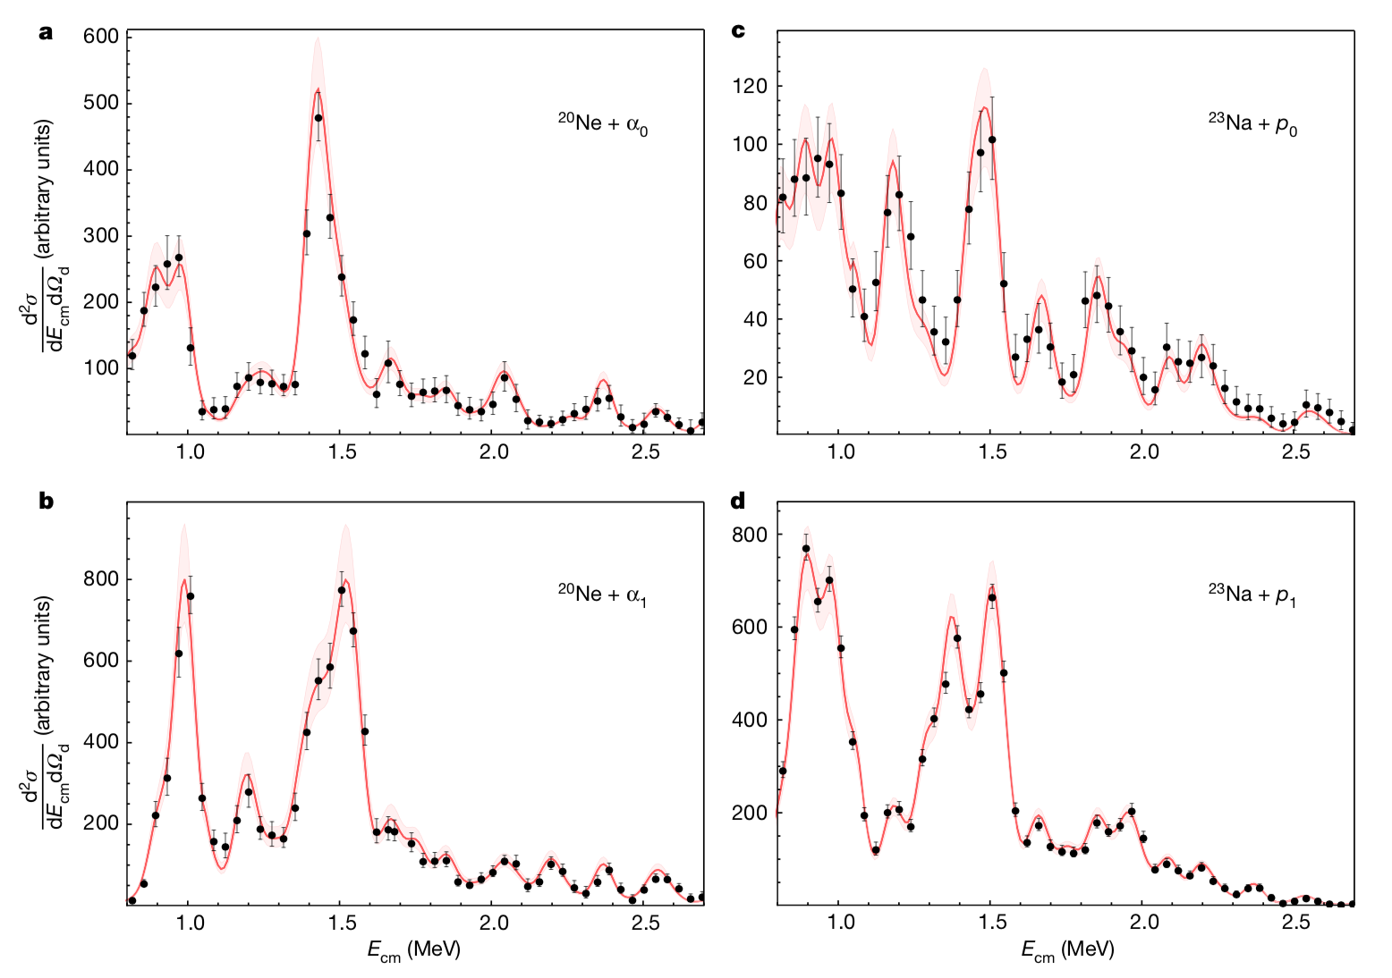
Indirect measurement of the ¹²C+¹²C fusion
We measured the 12C+12C HOES cross sections for 4 different channels, spanning the 1-2 MeV energy interval of astrophysical interest
Validity tests:
Q-values for the different channels have the shape of isolated peaks at the expected energy → no background and good energy reconstruction
D spectra agree with the ones in the literature and can be fit with PW (but the absolute value) → THM equations can be applied (see next slide)
A. Tumino et al. Nature 557 (2018) 687

Slide 24
Indirect measurement of the ¹²C+¹²C fusion
We measured the 12C+12C HOES cross sections for 4 different channels, spanning the 1-2 MeV energy interval of astrophysical interest
However:
Only p₀, p₁, α₀ and α₁ channels were observed, assumption on the contributions of more excited states necessary
Only partial angular distributions were measured, so Blatt & Biedenharn theory was used to extrapolate angular distribution (reduced sensitivity thanks to sine)
A. Tumino et al. Nature 557 (2018) 687

Slide 25
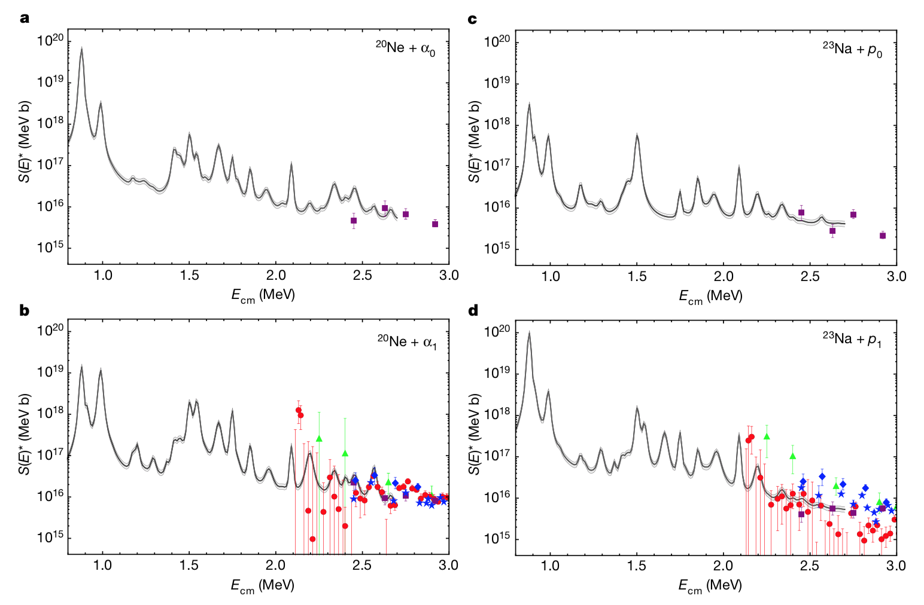
Reconstructing the ¹²C+¹²C fusion S*
In the R-matrix framework we parameterize che S* factor for 4 diffrent channels:
Additional validity check: agreement with direct data where available.
Direct data are used for normalization: many sets → less sensitivity to flawed ones
We could observe individual resonances leading to and enhancement of the reaction rate as large as a factor of 30 at the tempearatures of interest
Becker, H. W., et al., Z. Phys. A 303, 305 (1981).
Aguilera, E. F. et al., Phys. Rev. C 73, 064601 (2006).
Mazarakis, M. G. & Stephens, W. E., Phys. Rev. C 7, 1280 (1973).
High, M. D. & Cujec, B., Nucl. Phys. A 282, 181 (1977).
Kettner, K. U., Lorenz-Wirzba, H. & Rolfs, C., Z. Phys. A 298, 65 (1980).
A. Tumino et al. Nature 557 (2018) 687

Slide 26
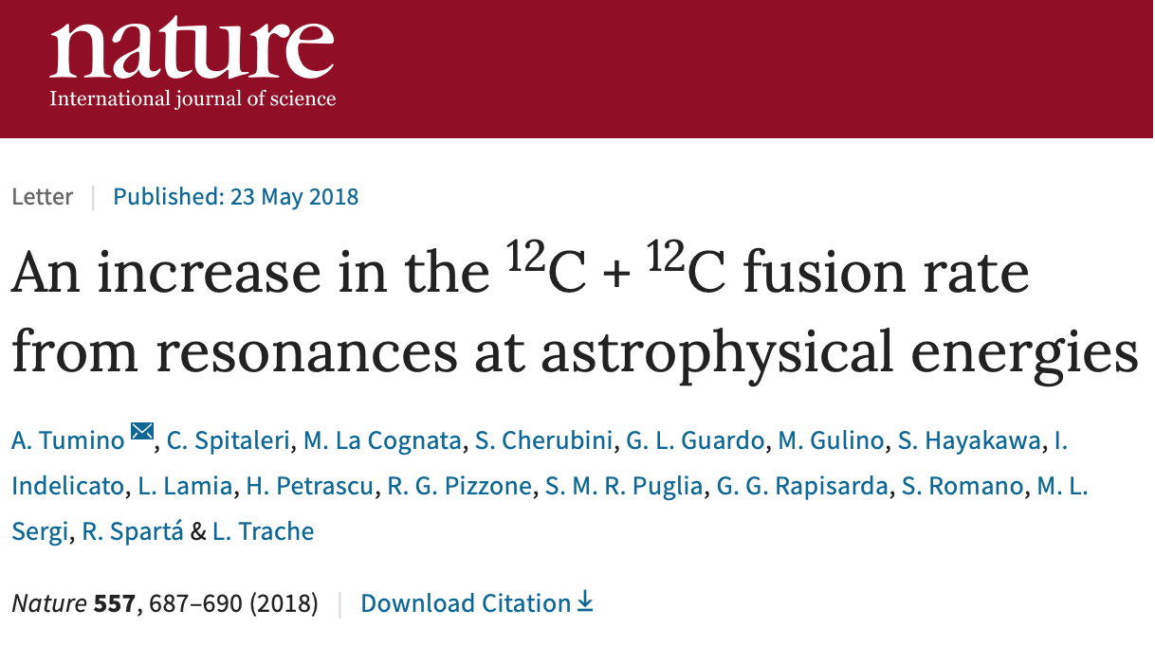
Notes:
Io in particolare mosterò due esempi, il metodo del cavallo di troia e del coefficiente di normalizzazione asintotica. Nel metodo del cavallo di troia la particelle con la quale si vuole indurre la reazione, per esempio un protone, è nascosta all’interno di un nucleo, ad esempio un neutrone, per cui è possibile studiare una reazione alle energie astrofisiche anche se la misure è effettuata ad energie di qualche decina di MeV, dove la misura è più semplice. Ad esempio nel caso risonante è possibile ricavare I parametri delle risonanze e quindi calcolare il rate di reazione nelle stelle

Slide 27
Summary
- Resonant reactions play a key role in astrophysics and in nuclear physics. The presence of a resonance can have dramatic consequences on nucleosynthesis
- Indirect measurements are precious tools to investigate reactions or energy ranges difficult to study otherwise
- Fields of interest: astrophysics, applied physics, nuclear structure, fundamental interactions
- However, guidance by direct data and normalization to them is necessary not to incur in systematic errors
- A synergic application of direct and indirect approaches is the best guarantee of accurate reaction rates for astrophysical application
Thanks for your attention

