Slide 15
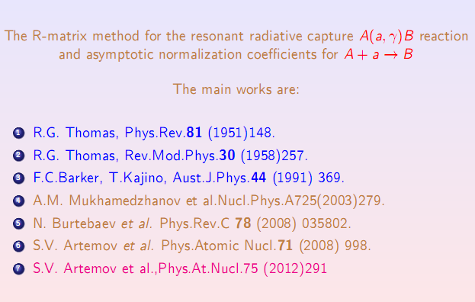

Slide 18
THANK YOU FOR ATTENTION

