Slide 1
³He(α, γ)⁷Be and ³H(α, γ)⁷Li reaction rates and
its implications for Big Bang nucleosynthesis
E.M. Tursunov, S.A.Turakulov
Institute of Nuclear Physics, Uzbekistan Academy of Sciences
International workshop “New aspects of the Hadron and Astro/Nuclear Physics”, 5-10 November, 2018, NUUz

Slide 2
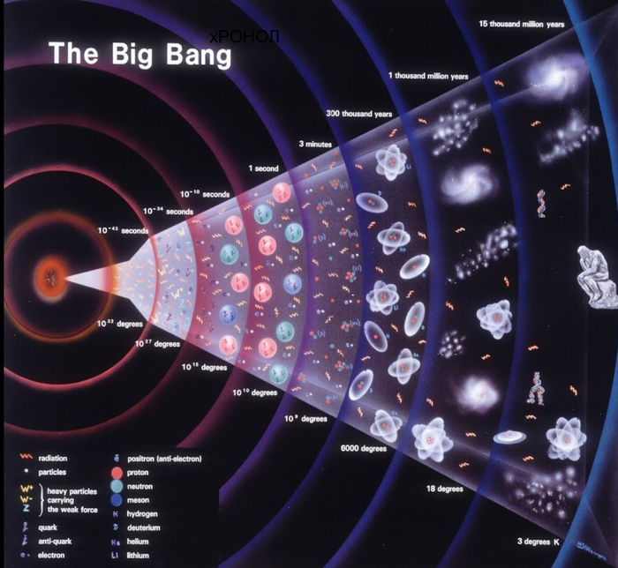
Introduction/Motivation
⁷Li/H=(1.58 ± 0.31)x10⁻¹⁰ - astronomical observation data
L. Sbordone et al., Astron. Astrophys. 522, 26 (2010).
⁷Li/H=(4.68 ± 0.67)x 10 ⁻¹⁰
- Estimation of the Standart Big Bang Model
R.H. Cybert, B.D. Fields Rev.Mod.Phys. 88, 015004 (2016)

Slide 3
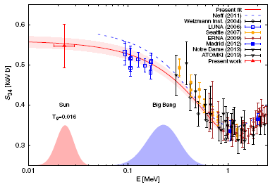
M.P. Takacs et al., Physical Review, D91, 123526 (2015) S₃₄(23 ± 6 keV)=0.548 ± 0.054 keV b.
Introduction/Motivation
Scenario | Reaction | Е (keV)
The Sun (16 МК) | ³He(α, γ)⁷Be | 23
Primordial nucleo-synthesis (300 МК) | ³He(α, γ)⁷Be | 160
 | ³H(α, γ)⁷ Li | 100
³He(α, γ)⁷Be

Slide 4
Purpose of work
The aim of the present work – detailed theoretically analysis astrophysical S–factor and reaction rates of direct radiative capture processes ³He(α, γ)⁷Be and ³H(α, γ)⁷Li in the framework two-body model with potential of a simple Gaussian form, which describe correctly the phase shifts in the s, p, d, and f waves, as well as the binding energy and the asymptotic normalization coefficient of the ground p_{3/2} and the first excited p_{1/2} bound states. Obtained results of both reaction rates to implicate for estimation primordial abundance ⁷Li/H in the Universe .

Slide 5
Two-body problem α-³He and α-³H
Solving Shrodinger equation for two cases:
Initial: scattering Final: bound state
Here - wave function and - potential Gauss type and Coulomb part in following expressions :
S.B. Dubovichenko, PHAN, V73, 1526 (2010)

Slide 6
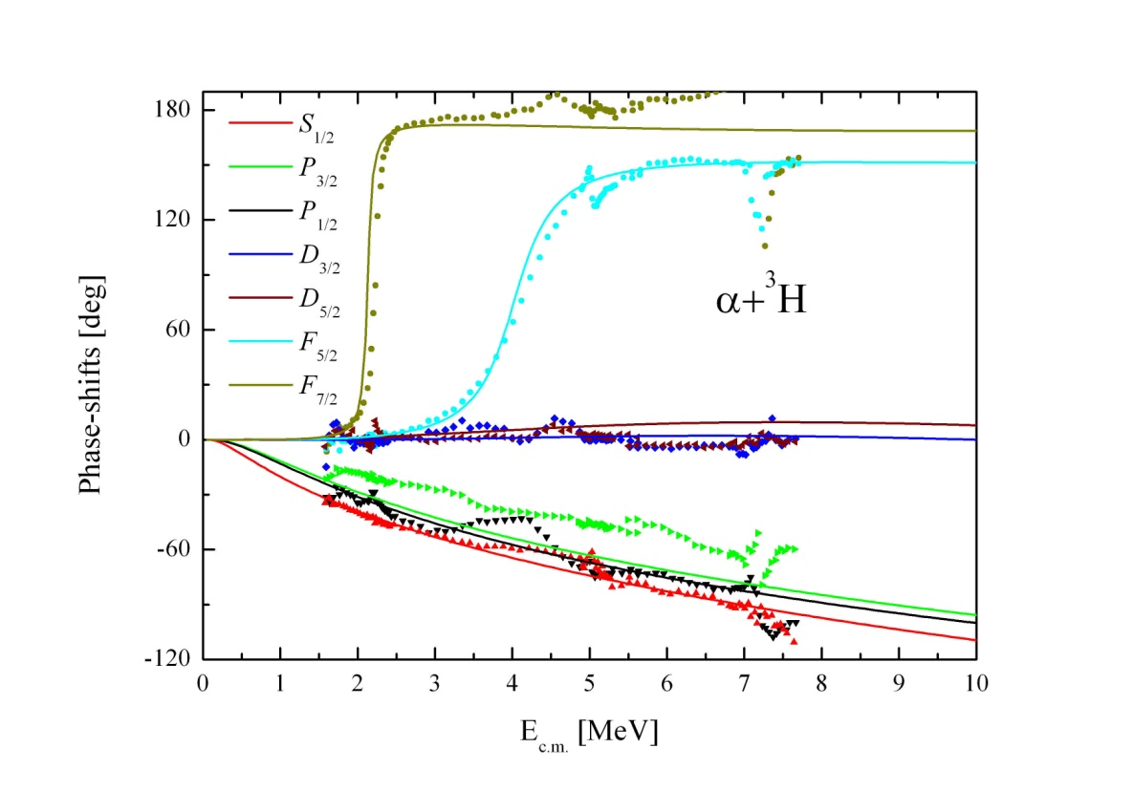
α-³He phase-shifts
α-³H phase-shifts

Slide 7
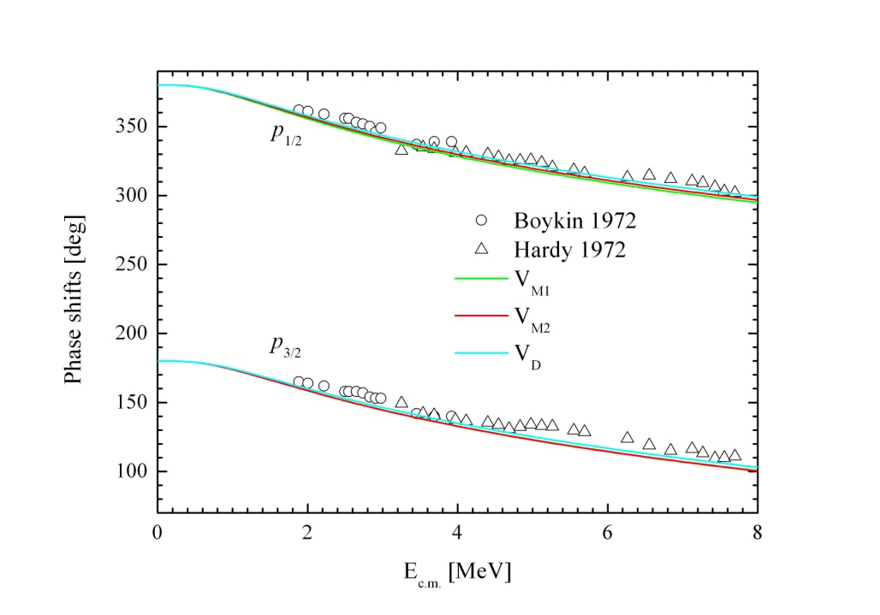
Parameters of modificated potential
L_{J} | V₀, MeV | α, fm⁻² | ε, MeV | С, fm-^{1/2}
P_{1/2} | -75.59760 | 0.13974 | 1.58660 | 4.785
P_{3/2} | -70.75751 | 0.13308 | 1.16080 | 4.242
L_{J} | V₀, MeV | α, fm⁻² | ε, MeV | С, fm-^{1/2}
P_{1/2} | -75.17585 | 0.13884 | 1.58660 | 4.813
P_{3/2} | -75.60171 | 0.14354 | 1.16080 | 3.985
R.Yarmukhamedov, O.R. Tojiboev, S.V.Artemov, Nuovo Cimento C39, 364 (2016)
Q.I. Tursunmahatov, R.Yarmukhamedov, Physical Review C39, 045807 (2012)

Slide 8
Astrophysical S-factor
Total cross section of radiative capture process is expressed as:
(Angulo et al., NPA656, 3 (1999)
E.M. Tursunov, S.A. Turakulov and A.S. Kadyrov. PRC97, 035802 (2018)

Slide 9
Matrix elements of electric and magnetic transitions

Slide 10
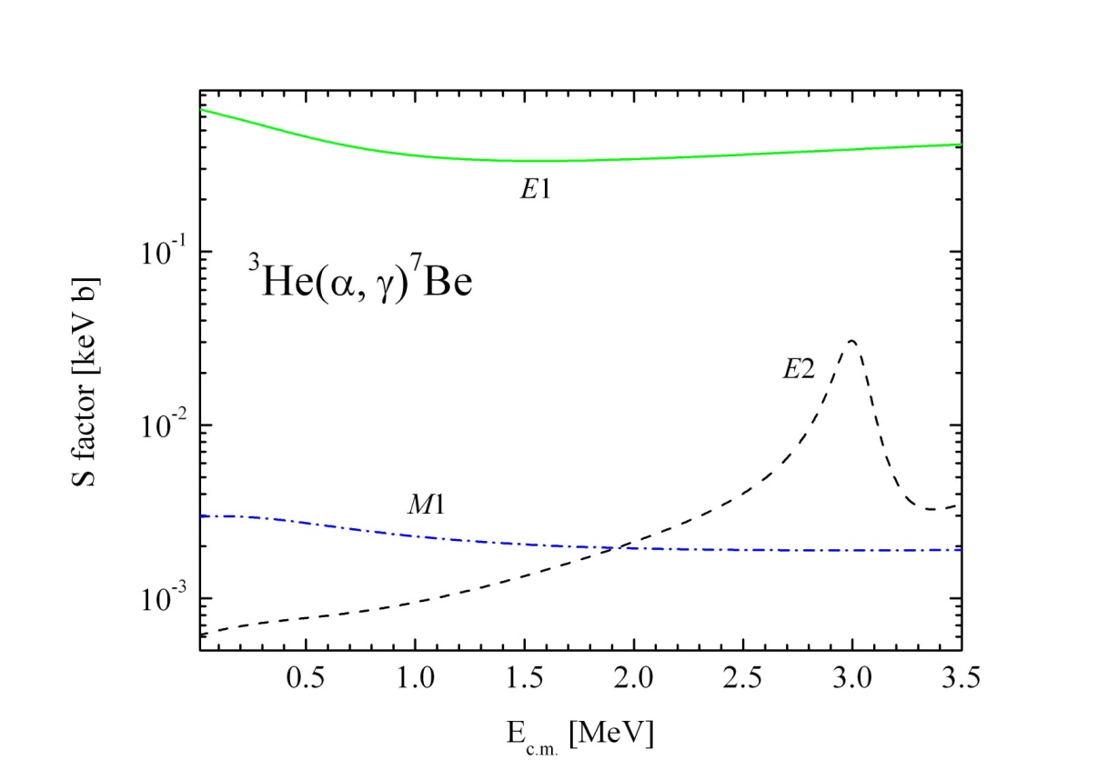
Numerical results of electric and magnetic transitions

Slide 11
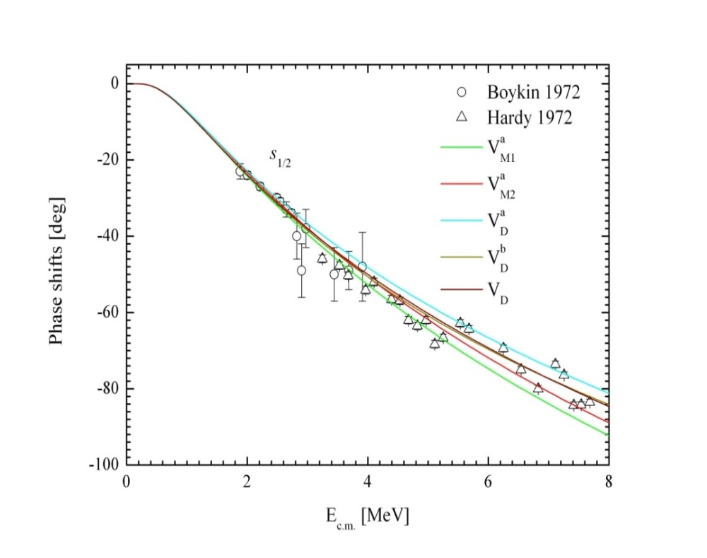
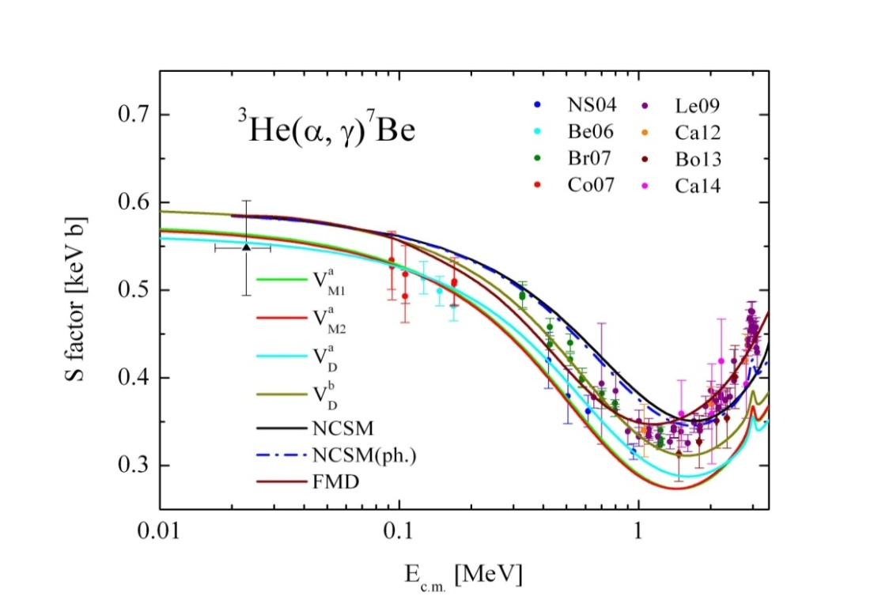
Astrophysical S-factor radiative capture process ³He(α, γ)⁷Be

Slide 12
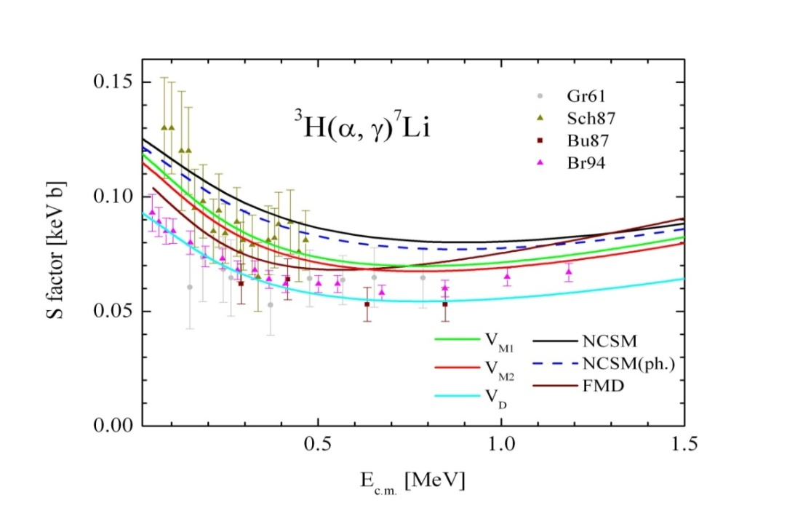
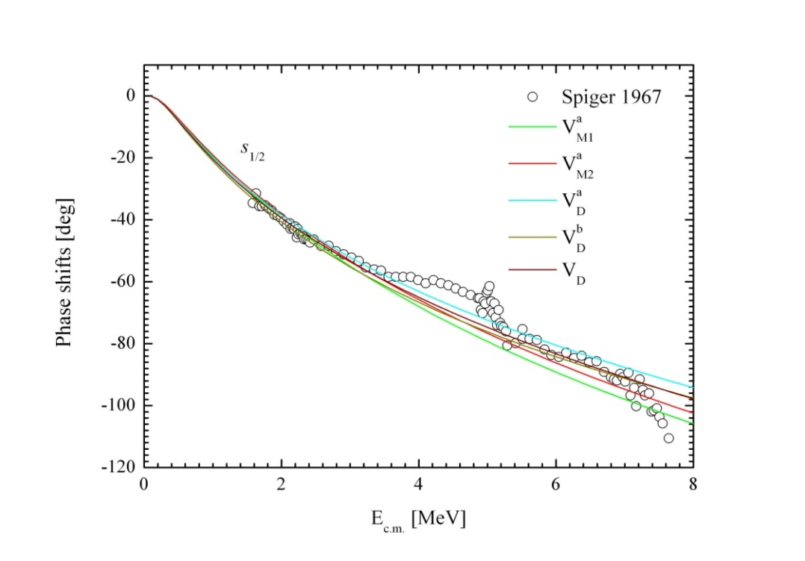
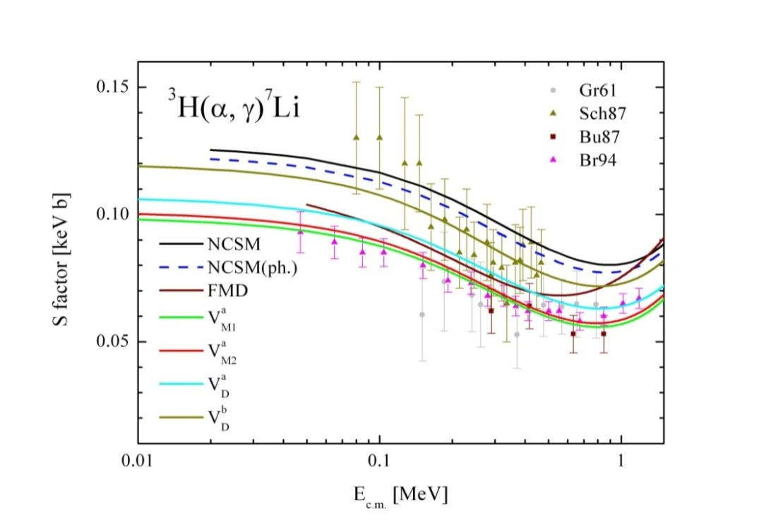
Astrophysical S-factor radiative capture process ³H(α, γ)⁷Li

Slide 13
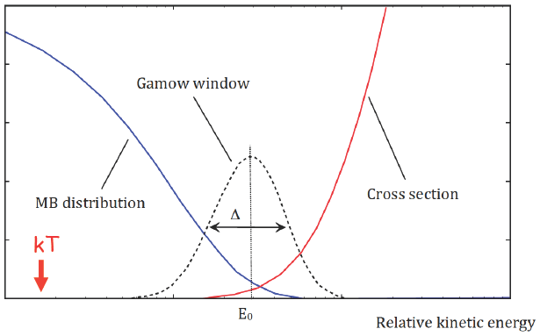
Reaction rate N₃₄(σv) [cm³ mol⁻¹ s⁻¹] (Angulo et al., NPA656, 3 (1999)
Here N_{A}=6.0221 x 10²³ mol⁻¹, k_{B}T=T₉/11,605 МeV и Т₉=10⁹ К. Substituting of these values we will get following expression:
Most effective energy
- Gamow peak
Width of Gamow peak

Slide 14
Results of reaction rates(10⁶ ≤ Т ≤ 10⁹ К)
Т₉ | ³He(α, γ)⁷Be |  | ³H(α, γ)⁷Li
0.001 | 9.545Е-48 | 9.358Е-48 | 5.594E-28 | 6.129E-28
0.005 | 4.771Е-25 | 4.682Е-25 | 7.496E-14 | 8.218E-14
0.010 | 1.613Е-18 | 1.585Е-18 | 8.193E-10 | 8.987E-10
0.015 | 2.305E-15 | 2.267E-15 | 7.199E-08 | 7.901E-08
0.020 | 2.221E-13 | 2.186E-13 | 1.191E-06 | 1.308E-06
0.025 | 5.676E-12 | 5.591E-12 | 8.677E-06 | 9.531E-06
0.030 | 6.684E-11 | 6.589E-11 | 3.919E-05 | 4.307E-05
0.050 | 3.045E-08 | 3.010E-08 | 1.629E-03 | 1.793E-03
0.10 | 2.493E-05 | 2.477E-05 | 9.313E-02 | 1.028E-01
0.14 | 3.692E-04 | 3.680E-04 | 4.648E-01 | 5.139E-01
0.16 | 9.836E-04 | 9.822E-04 | 8.310E-01 | 9.195E-01
0.18 | 2.244E-03 | 2.244E-03 | 1.352E+00 | 1.498E+00
0.2 | 4.551E-03 | 4.559E-03 | 2.050E+00 | 2.272E+00
0.4 | 2.487E-01 | 2.523E-01 | 2.087E+01 | 2.326E+01
0.6 | 1.621E+00 | 1.660E+00 | 6.028E+01 | 6.750E+01
0.8 | 5.115E+00 | 5.278E+00 | 1.143E+02 | 1.284E+02
1 | 1.136E+01 | 1.179E+01 | 1.773E+02 | 1.998E+02

Slide 15
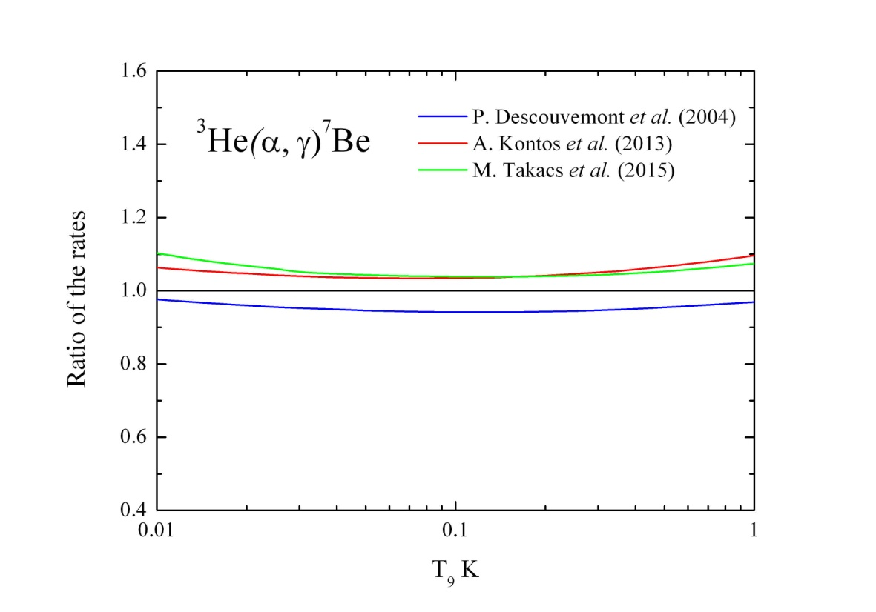
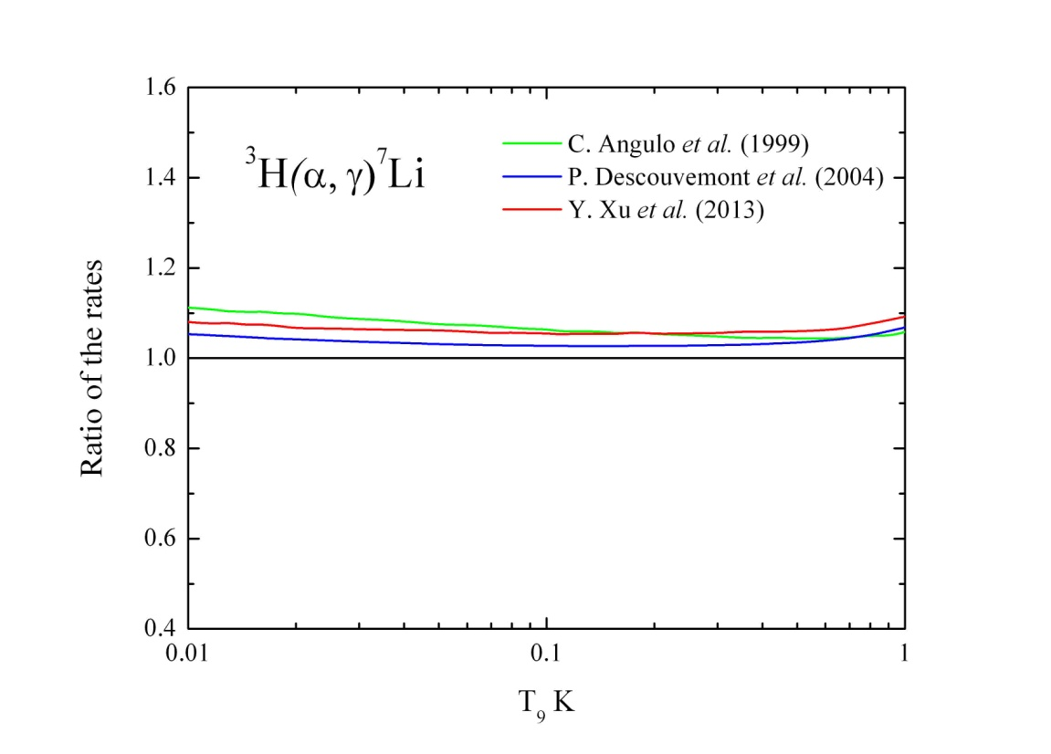
Results of reaction rates in different model, normalized to results of model V_{M1}ª

Slide 16
O. Pisanti et al., Comput. Phys. Commun. 178, 956 (2008).
http://parthenope.na.infn.it/
For the estimation of the primordial abundance of the ⁷Li/H element we use the well-known
PArthENoPE public code

Slide 17
Input parameters for program code PArthENoPE
Analytical fit of reaction rates
Potential | p0 | p1 | p2 | p3 | p4 | p5 | p6
 | 2.691х10⁶ | 8.140 | -26.747 | 43.336 | -35.678 | 11.504 | 438.432
 | 2.636х10⁶ | 8.128 | -26.559 | 43.243 | -35.608 | 11.445 | 453.245
³He(α, γ)⁷Be
Potential | p0 | p1 | p2 | p3 | p4 | p5 | p6
 | 4.951х10⁵ | 4.034 | -13.145 | 20.845 | -17.355 | 5.765 | 39.687
 | 5.429х10⁵ | 4.012 | -13.001 | 20.703 | -17.285 | 5.747 | 41.245
³H(α, γ)⁷Li
P.A.R. Ade et al.(Planck Collaboration), Astron. Astrophys. 594, A23 (2016).
K.A. Olive (Particle Data Group), Chinese Physics,
C38, 090001 (2014).

Slide 18
Results of estimation primordial abundance of ⁷Li/H (х10⁻¹⁰)
Potential | ³He(α, γ)⁷Be | ³H(α, γ)⁷Li | [1] | [2]
 | 4.81±0.12 | 5.06±0.13 | 5.0 ± 0.3 | 5.61 ± 0.26
 | 4.92±0.13 | 5.08±0.13 | 5.0 ± 0.3 | 5.61 ± 0.26
[1]. M.P. Takacs et al., Physical Review, D91, 123526 (2015)
[2]. A.Coc et al., Physical Review, D92, 123526 (2015)

Slide 19
Conclusion
It is shown that potential model can successfully describe energy dependence of the existing experimental data for the astrophysical direct ³He(α, γ)⁷Be and mirror ³H(α, γ)⁷Li capture reactions.
Estimated ⁷Li/H abundance ratio of (5.08±0.13) x 10⁻¹⁰ is in a very good agreement with the recent measurement (5.0 ± 0.3) × 10⁻¹⁰ of the LUNA collaboration.
Processes ⁷Be(n,α)⁴He, ⁷Be(n,p)⁷Li, ⁷Li(p,α)⁷He are investigated in the literature for the solution of ⁷Li/H abundance problem.

Slide 20
Thank you for your attention!

