Slide 1
Electron PID & trigger using EMCal
Shingo Sakai (Univ. of Tsukuba)

Slide 2
ALICE-EMCal
Consist two Calorimeters
EMCal
|y|<0.7, Δφ ~110
DCal
Δφ ~60
Opposite side of EMCal
Lead-Scintillator sampling Calorimeter
Measure energy of particles
Physics interesting
Photon
Electrons
Jets (dijet)

Slide 3
Electron identification
Electron identification
First select electron candidates with dE/dx in TPC
Check matching energy in EMCal and momentum (p)
Electrons deposit all energy in EMCal : E/p~1

Slide 4
E/p for electrons and hadrons
Electrons
Deposit most of energy in EMCal : E/p~1
Hadrons
Usually deposit MIP ~260 MeV in EMCal : E/p~ 0.26/p ~ 0.2

Slide 5
Shower shape

Slide 6
Shower shape (MC)
Shower shape
Electrons : narrower
Hadrons : broader
Additional rejection between electrons and hadrons

Slide 7
E/p with/without shower shape
E/p with/without shower shape cut
Shower shape cut is a powerful cut at high p_{T} electron identification

Slide 8
Hadron contamination
An example of hadron contamination
In PbPb collisions (most central)
Control the contamination ~10% up to 25 GeV/c
TPC dE/dx, E/p and shower shape cuts

Slide 9
E/p in very high p_{T}
In pp collisions (13 TeV)
Clear electron signal up to 50 GeV/c in E/p distribution

Slide 10
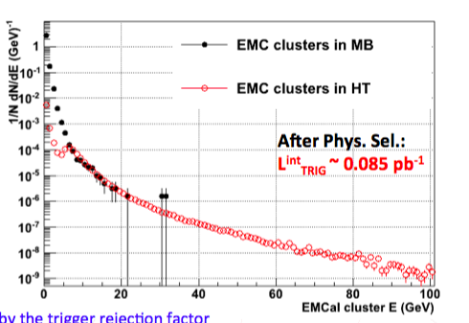
Trigger
Collisions rate : ~Order of 100 kHz
MB trigger in ALICE
Limited the trigger rate <~1000 Hz due to mainly TPC read out
Can’t take all the data from collisions
Suffer the statistics at high pT
Trigger
Put a threshold to reduce trigger to take event (data)
An example : threshold 10 GeV
Probability have>10 GeV particle 10⁻⁴
~100 kHz x 10⁻⁴ ~ 10 Hz << 1000 Hz
Possible take all events there there are particles deposit energy above 10 GeV

Slide 11
L0 & L1 trigger
EMCal trigger
High energy single shower trigger
Photon, electrons
4x4 (L0 & L1)
Jet trigger (L1)
Sum energies (ADC) in trigger patch
L1 : generally there are two trigger thresholds (lower and higher)

Slide 12
Electrons in trigger
In MB trigger, there are ~20 electrons in 14 GeV/c
In EMCal trigger, there are ~100 electrons in 14 GeV/c
Trigger is efficient to measure high p_{T} electrons

Slide 13
Efficiency of the EMCal trigger
Trigger efficiency
L0 trigger
Efficiency ~1
Most events above
threshold took trigger
by EMCal

Slide 14
Trigger performance in PbPb for electrons
Trigger performance for electrons in PbPb collisions
Above threshold, the ratio (trigger/MB) is constant
Trigger is efficient for high pT electron measurement

Slide 15
HFE in pp at 13 TeV
HFE in MB : pT reache up to ~ 6 GeV/c
HFE in EMCal trigger : pT reach up to 50 GeV/c

Slide 16
J/Ψ in pp at 13 TeV
Clear J/Ψ peak above 10 GeV/c in EMCal
With electron identification with EMCal

Slide 17
HFE in PbPb collision at 5.02 TeV
HFE in MB : up to ~10 GeV/c
HFE in trigger : up to 26 GeV/c with good statisitcs

