Slide 1
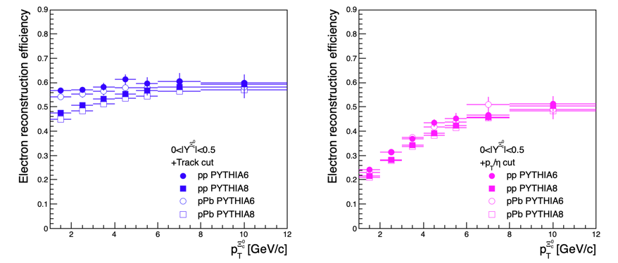
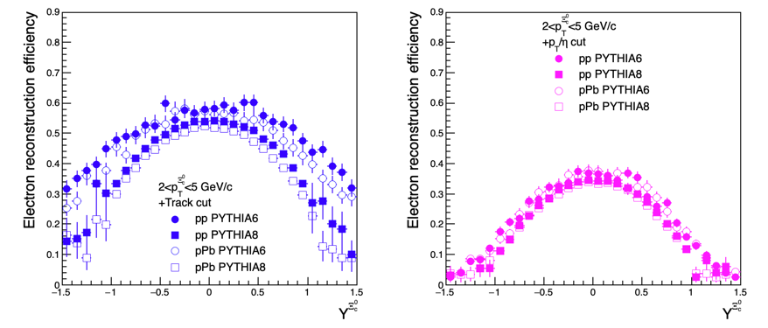
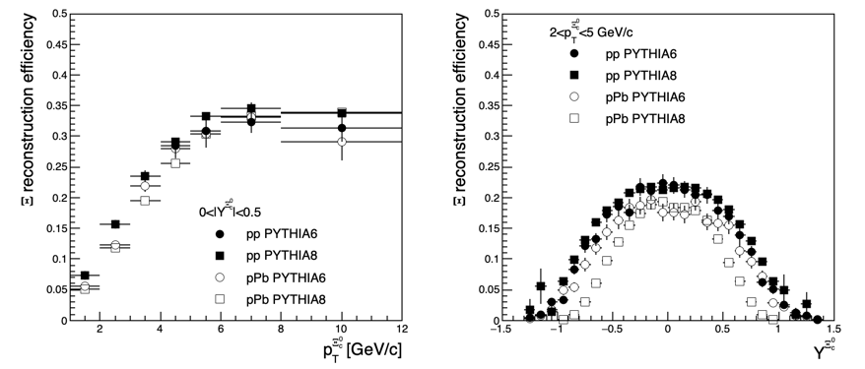
Efficiency in pPb
Electron rapidity cut in PYTHIA6
w/o SDD in pPb
Significantly lower efficiency for Xi at forward rapidity

Slide 2
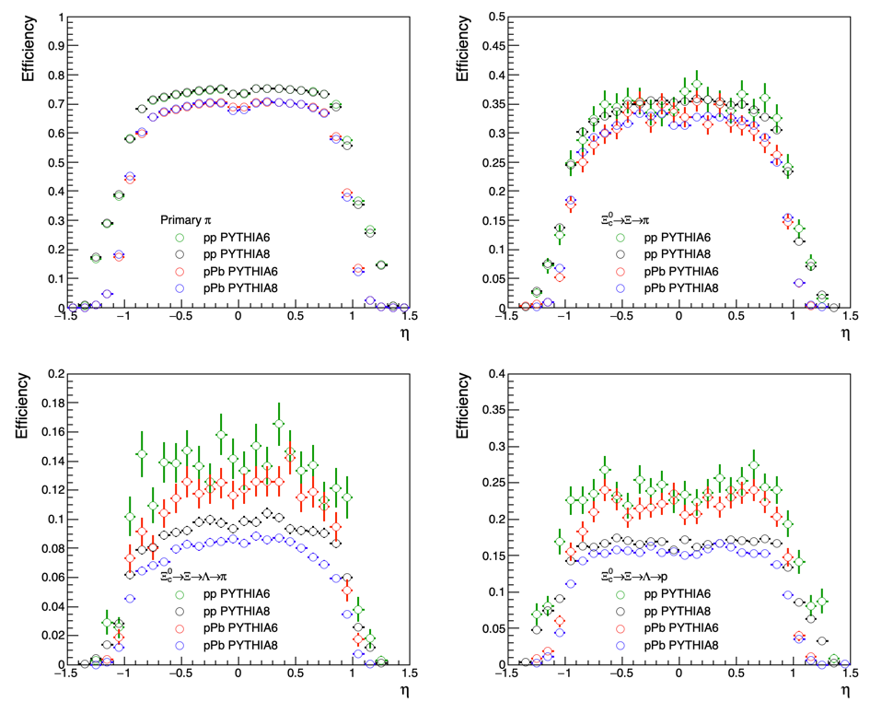
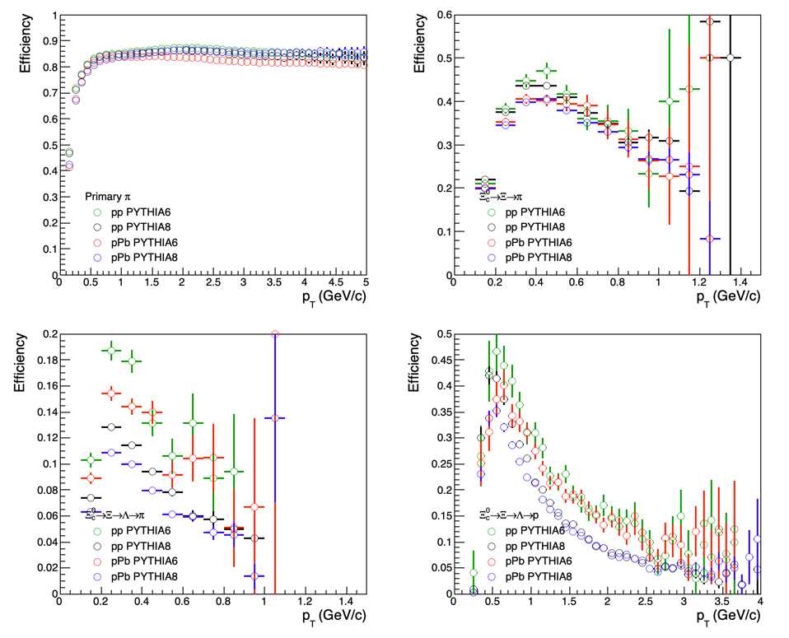
Efficiency in pPb
Reconstruction efficiency of secondary hadrons from Xic0 (Xic0 2<pT<5 GeV/c, |y|<1.0)
Primary pion and pion from Xi ➔efficiency pp > efficiency pPb
Pion and proton from Lambda ➔efficiency PYTHIA6 > efficiency PYTHIA8
Significantly lower efficiency for Xi at forward rapidity

Slide 3
Efficiency in pPb
Different lifetime for lambda

