Slide 1
Polarization-controlled PVDF-based hybrid nanogenerator
for an effective vibrational energy harvesting from human foot
이동우ª, 정동근ª, 김종훈^{b,c}, 김현수^{a,f},
Murillo Gonzalo^{g}, 이관형^{b,c,d,e}, 송현철^{f}, 정종훈¹
a Department of Physics, Inha University
b Department of Materials Science and Engineering, Seoul National University
c Research Institute of Advanced Materials (RIAM), Seoul National University
d Institute of Engineering Research, Seoul National University
e Institute of Applied Physics, Seoul National University
f Center for Electronic Materials, Korea Institute of Science and Technology (KIST)
g Department of Nano and Microsystems, Instituto de Microelectronica de Barcelona
Inha University, Dept. of Physics
Quantum Functional Materials Lab..

Slide 2
Outline
Ⅰ. Motivation
Triboelectric and piezoelectric nanogenerator
PVDF properties
PVDF based triboelectric and piezoelectric nanogenerator
Ⅱ. Results and discussion
PVDF based triboelectric nanogenerator & piezoelectric nanogenerator
Triboelectric and piezoelectric hybrid generator
Vibrational energy harvesting from human foot
Ⅲ. Conclusion

Slide 3
Motivation : Triboelectric and piezoelectric nanogenerator
Triboelectric nanogenerator (TENG)
Pressing
↑
↑
+
-
+
-
+
-
Releasing
+
-
+
-
↑
↑
Dielectric
Electrode
Charge
Piezoelectric nanogenerator (PENG)
Pressing
-
-
↑
↑
-
+
+
+
+
+
+
+
-
+
p
+
p
Releasing
-
-
-
-
↑
-
-
↑
+
-
-
+
+
Piezo Material
Electrode
Polarization

Slide 4
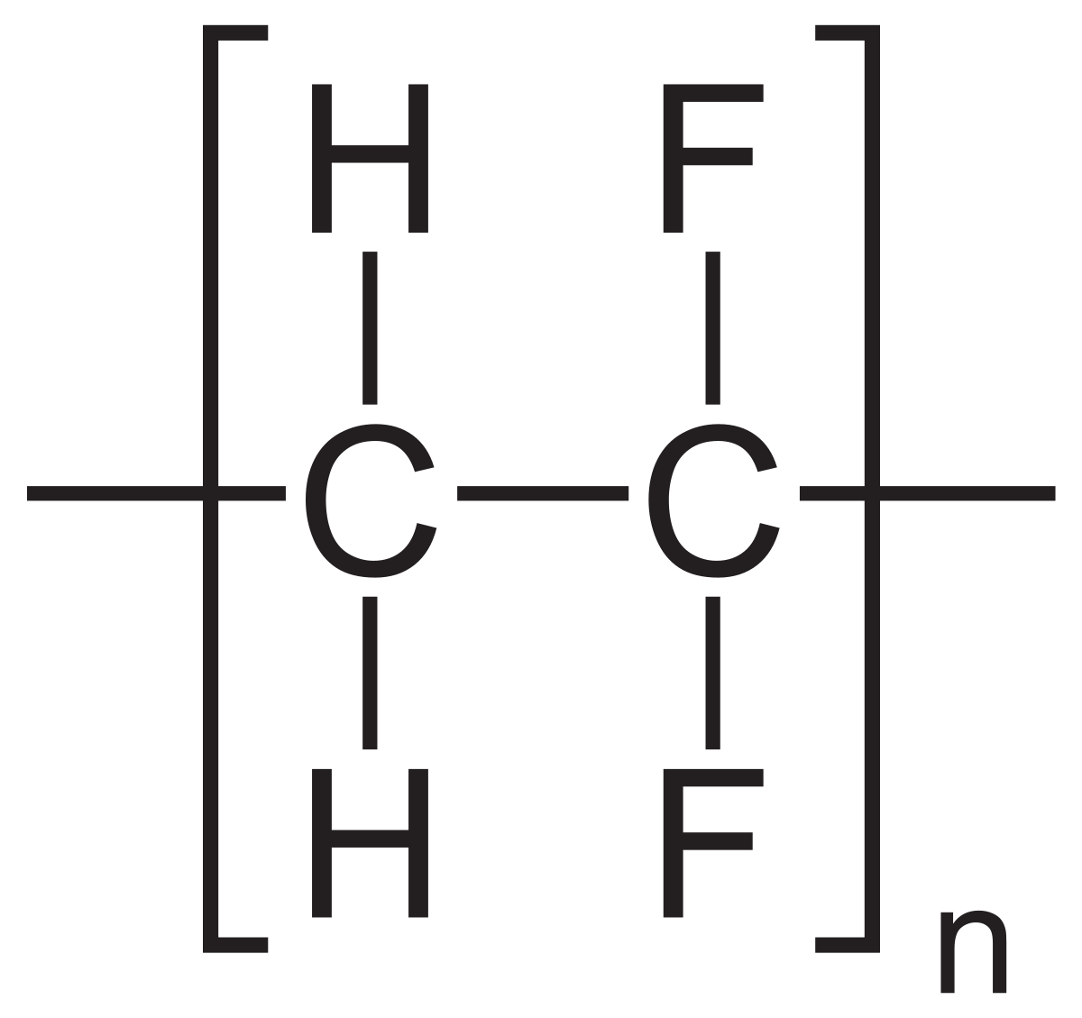
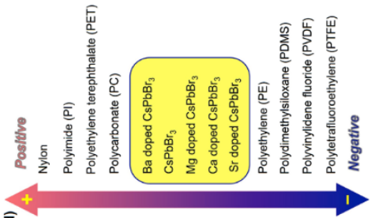
Motivation : PVDF Properties
Fluorine
Hydrogen
Carbon
α-phase PVDF
β-phase PVDF
(Ferroelectric Phase)
γ-phase PVDF
PVDF’s three phases
Dipole ↑
Dipole ↓
Chemical structure of β-phase PVDF
PVDF Triboelectric series
Q-D. Shen et al., Adv. Electronic Mater. (2017).
Q. Tang et al., Nano Energy (2020).

Slide 5
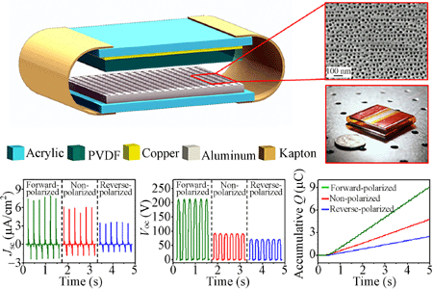
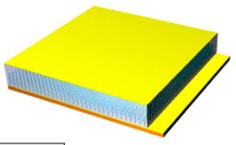
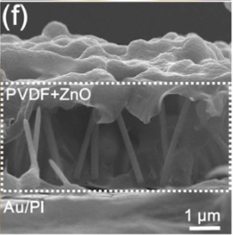
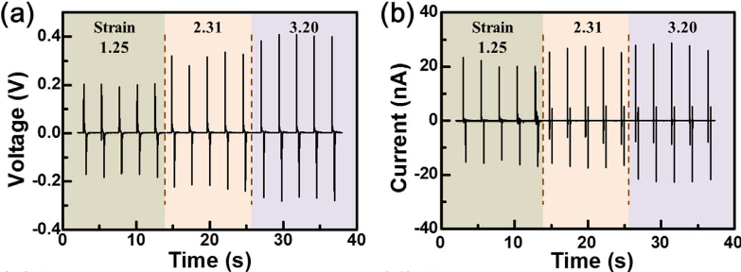
Motivation : PVDF based triboelectric and piezoelectric nanogenerator
PVDF based triboelectric nanogenerator
P. Bei et al., Nano Research (2014).
PVDF based piezoelectric nanogenerator
M. Choi et al., Nano Energyt (2019).

Slide 6
Result : PVDF based triboelectric nanogenerator & piezoelectric nanogenerator
PVDF based triboelectric nanogenerator
Al
PVDF
Al
PVDF based piezoelectric nanogenerator
Al
PVDF
Al

Slide 7
Result : Triboelectric & piezoelectric hybrid generator

Slide 8
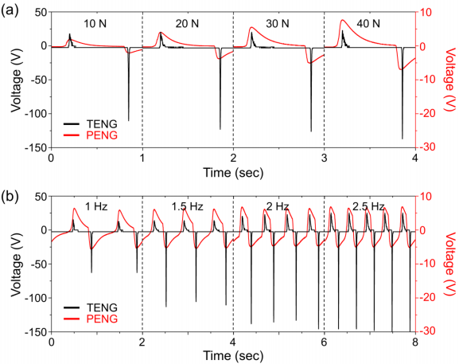
Result : Triboelectric & piezoelectric hybrid generator

Slide 9
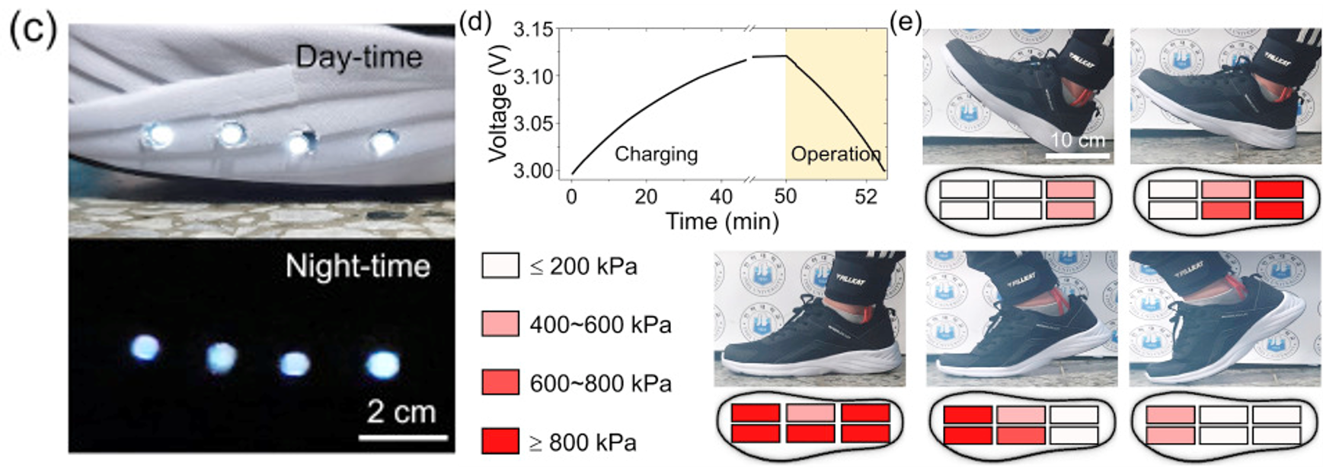
Result : Vibrational energy harvesting from human foot

Slide 10
Conclusion
We fabricate a PVDF film-based hybrid TP-NG in order to effectively harvest the random and irregular vibrational energy from the human foot.
The layout provides in-phase power generation from each TENG and PENG during one cycle of vibration.
The up-down polarized hybrid TP-NG generates the largest power of 20 μW/cm² due to the modulated surface potential and ferroelectricity of PVDF.
The hybrid TP-NG sensitively generates output powers from various human motions.
In addition, the shoe insole containing TP-NG generates sufficient power to lighten LEDs and operate a wireless pressure sensor network.

Slide 11
Thank you for listening my presentation !!!

