Slide 1
Highly durable direct-current power generation in polarity-controlled and soft-triggered rotational triboelectric nanogenerator
Han Jae Yeon
Department of Physics, Inha University

Slide 2
Table of Contents
Introductrion (Triboelectric Nanogenerator)
Fabricated device structure & working mechanism
Result & Discussion
Conclusion
Quantum Functional Materials Laboratory

Slide 3
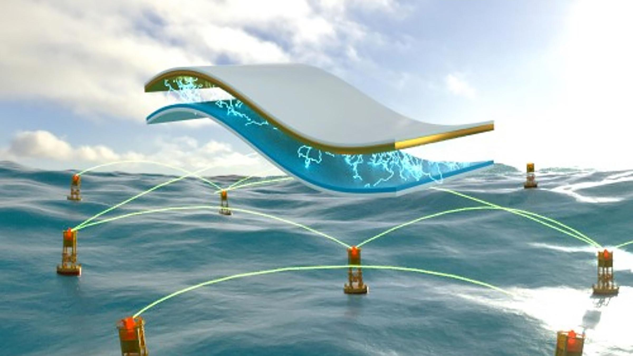
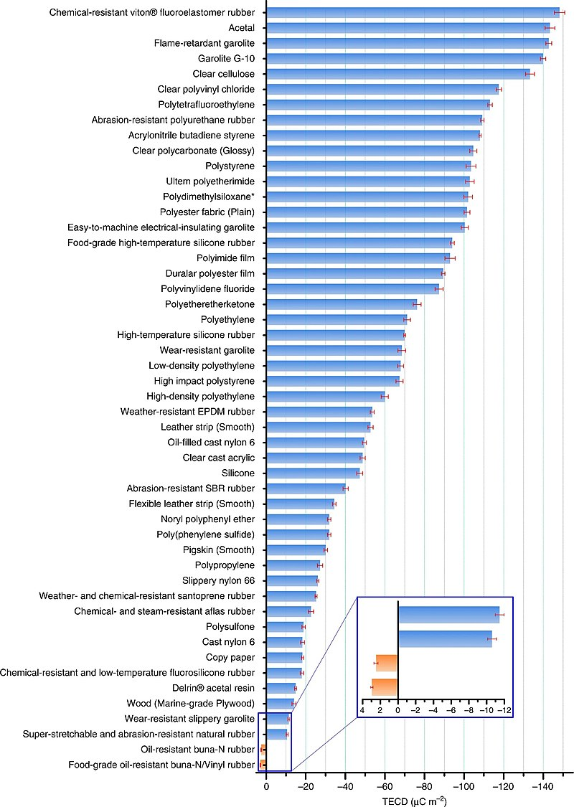
Triboelectric Nanogenerator (TENG)
Triboelectric
물질간 마찰에 의해 발생하는 접촉면들 사이의 전위차
Polymer
Electrode
Mechanical energy
Electric energy
e⁻
e⁻
H. Zou. at al, Nat. Commun.(2019)
Quantum Functional Materials Laboratory

Slide 4
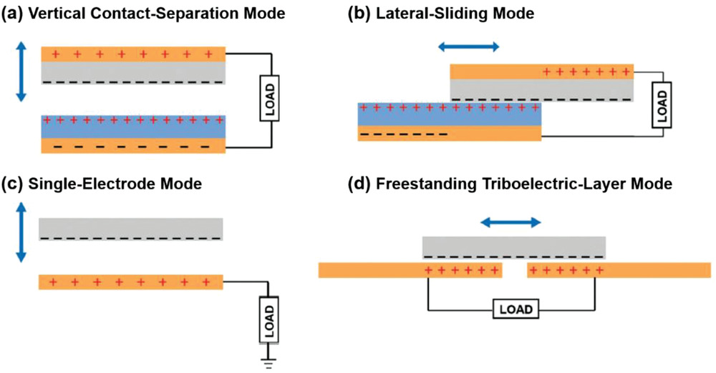
Triboelectric Nanogenerator (TENG)
C. Wu. at al, Adv. Energy Mat.(2018)
Quantum Functional Materials Laboratory

Slide 5
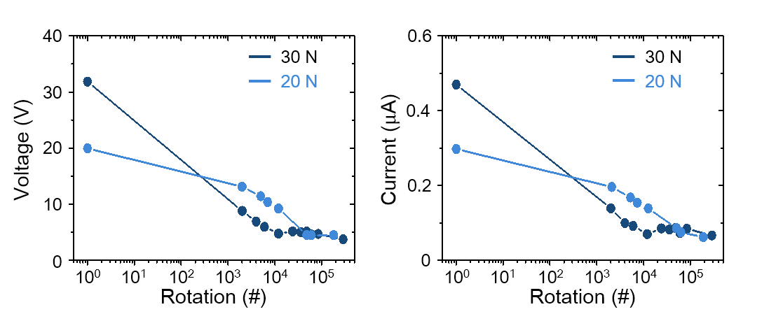
Result & Discussion
Sliding TENG(S-TENG)
D.S. Kong at al, Energies 14, 1120 (2021)
Quantum Functional Materials Laboratory

Slide 6
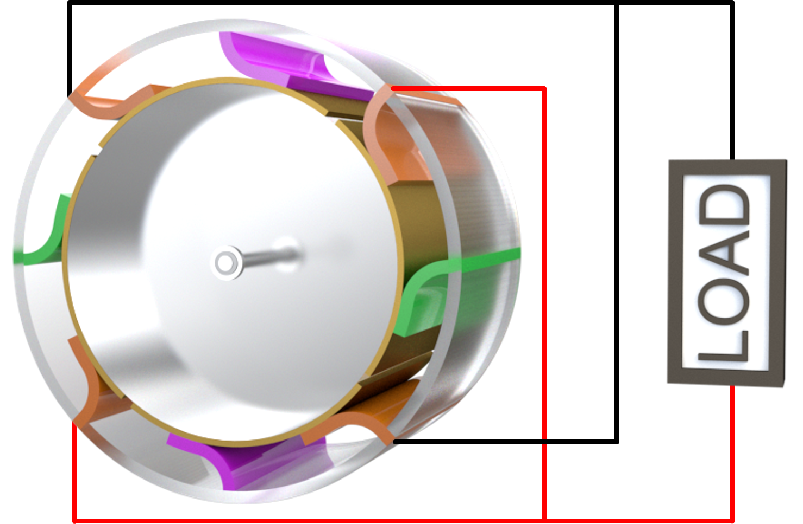
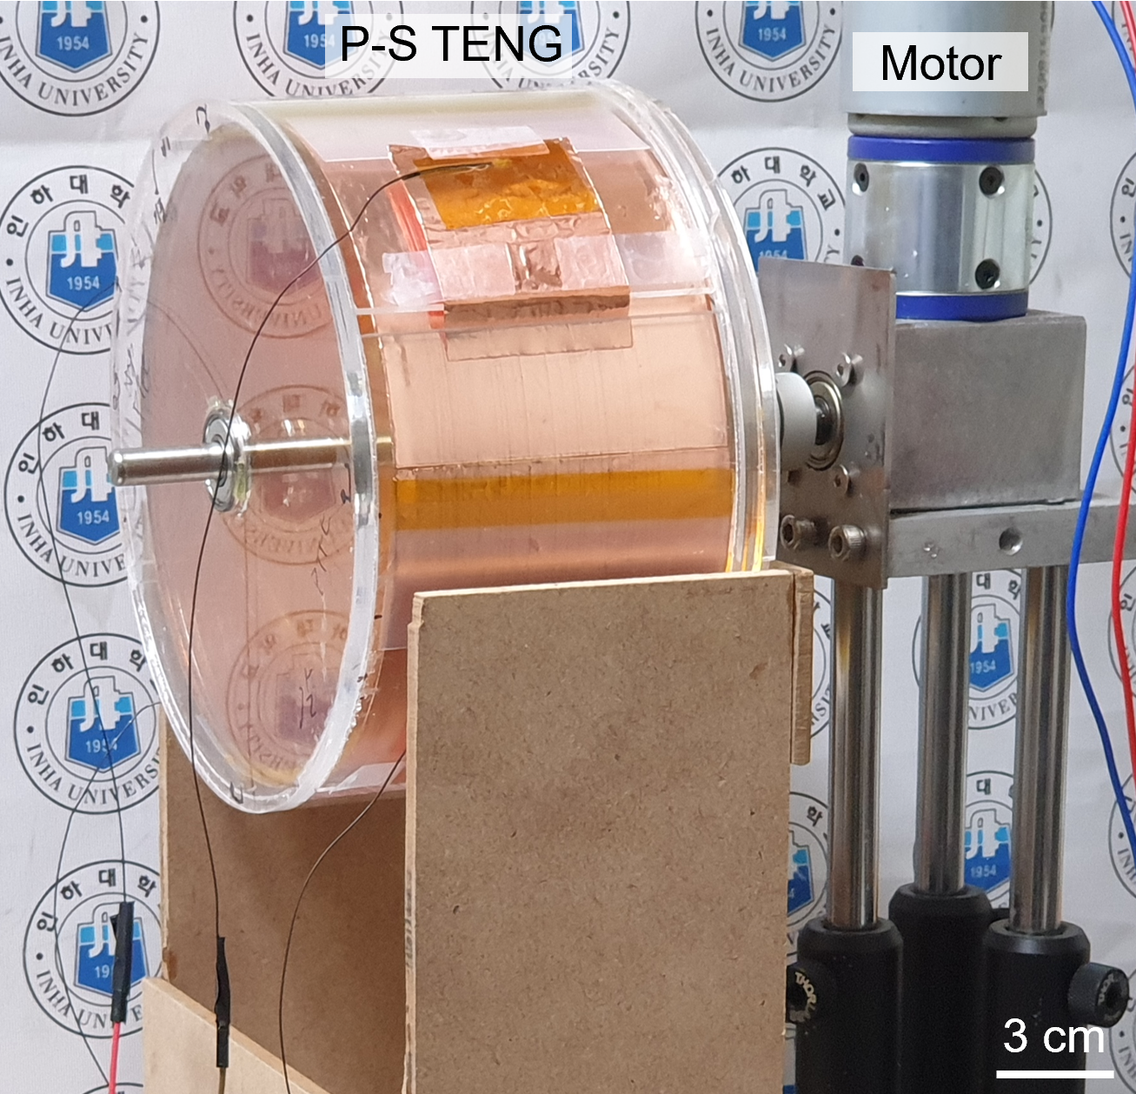
Fabricated device structure and working mechanism
Polarity-controlled and Soft-triggered TENG (P-S TENG)
Acrylic
Nylon
PTFE
Electrode-Cu
Contacting-Cu
Quantum Functional Materials Laboratory

Slide 7
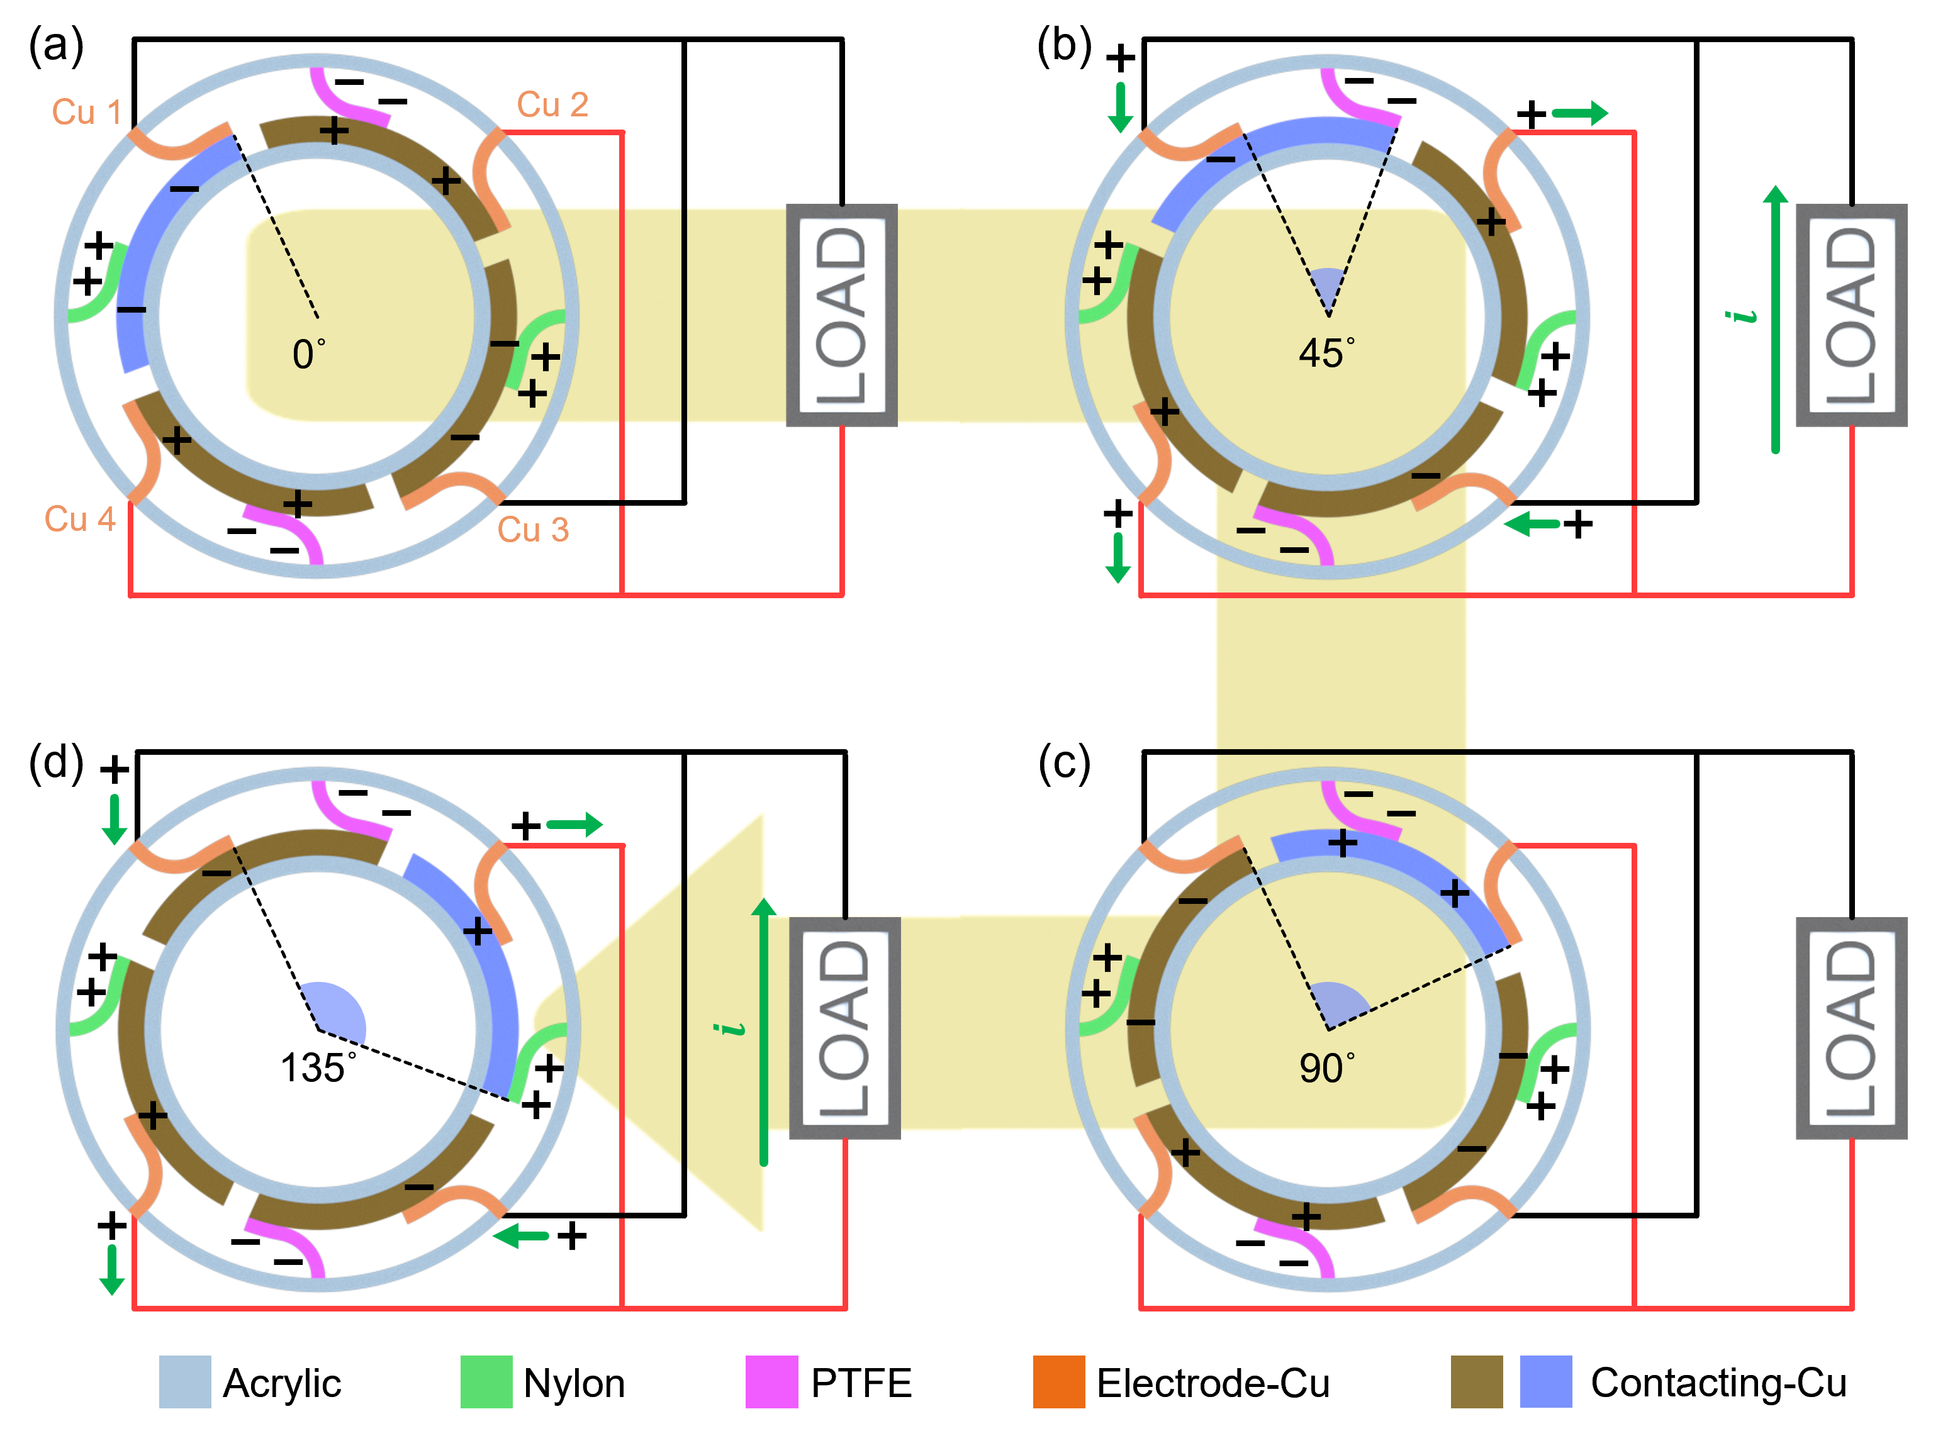
Fabricated device structure and working mechanism
Quantum Functional Materials Laboratory

Slide 8
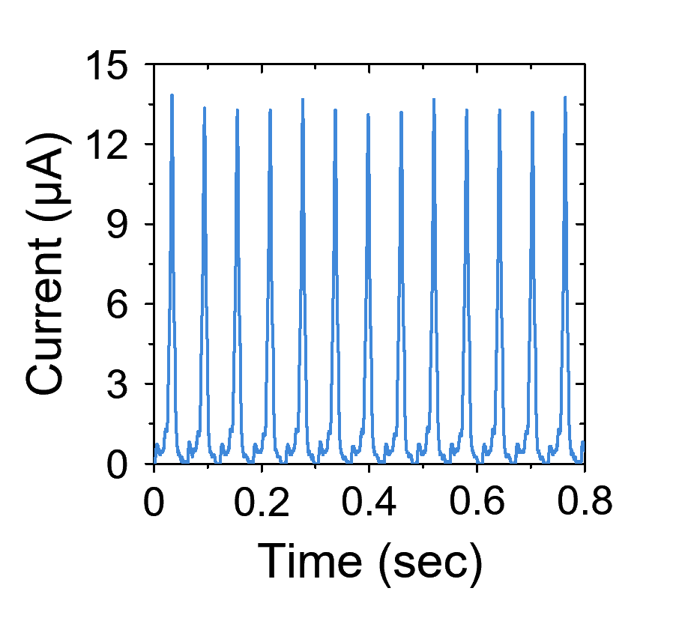
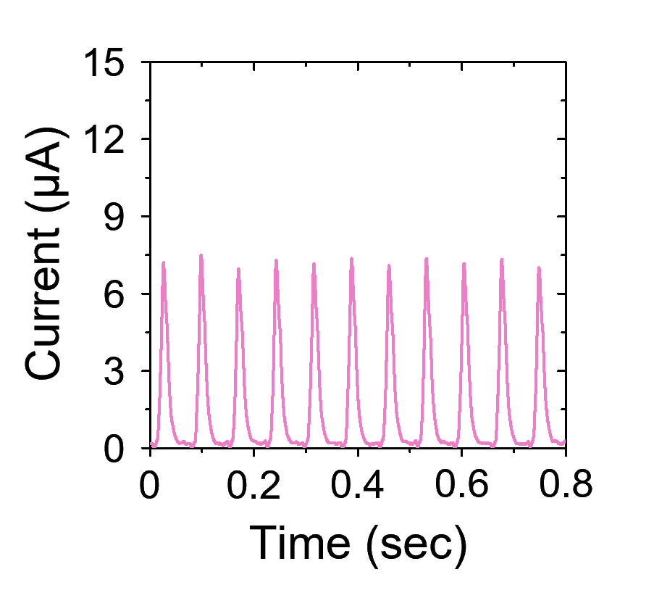
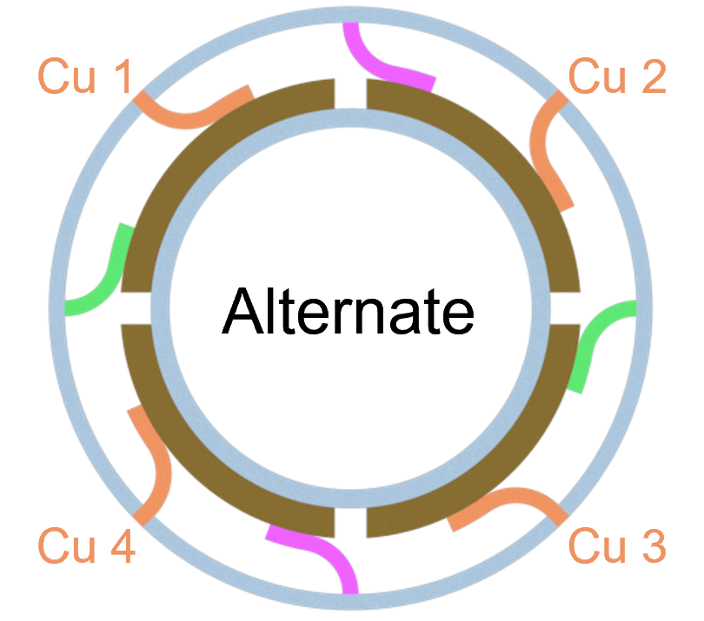
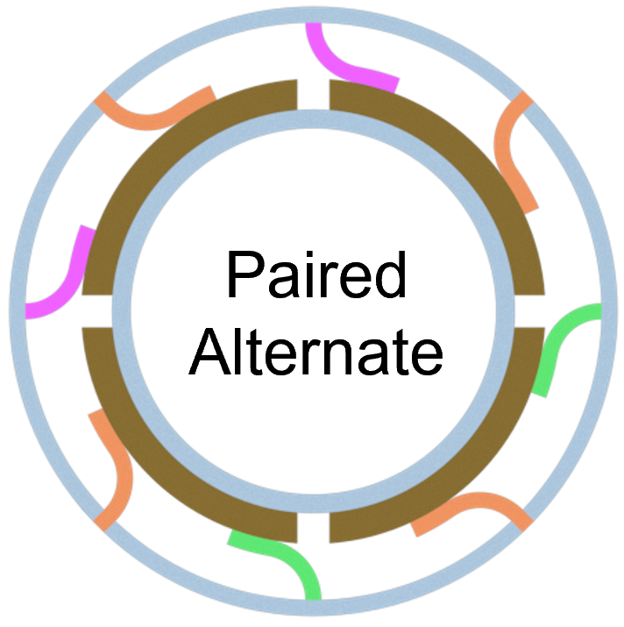
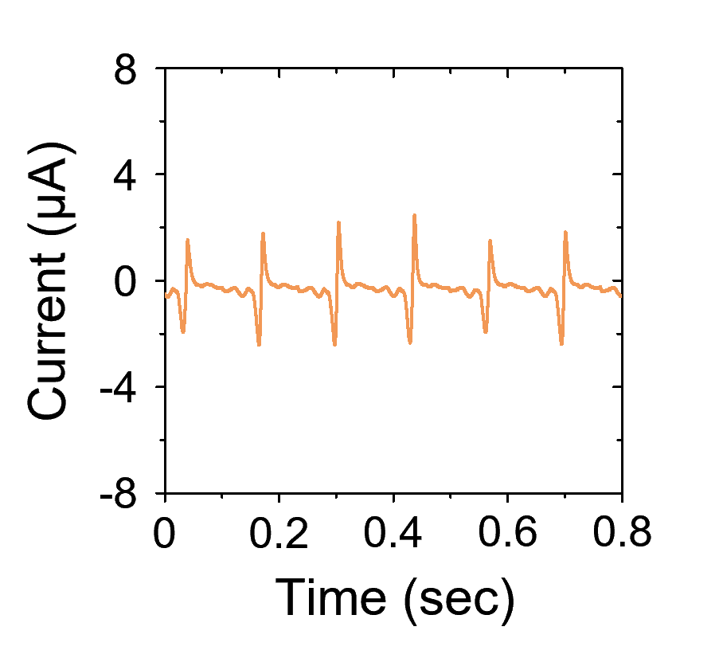
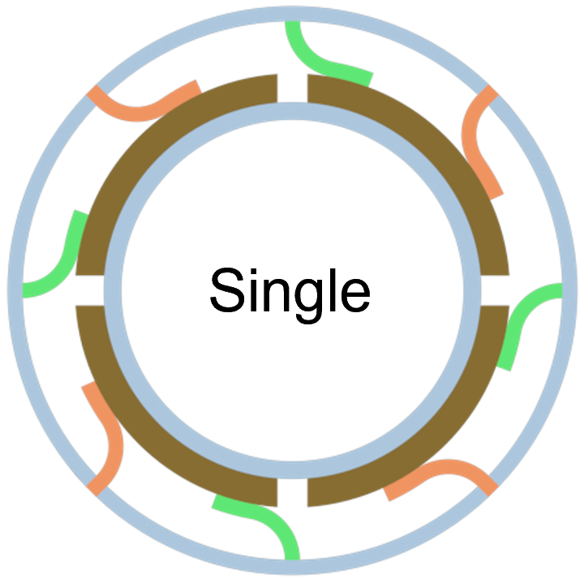
Result & Discussion
DC output through polarity control
Acrylic
Nylon
PTFE
Electrode-Cu
Contacting-Cu
Quantum Functional Materials Laboratory

Slide 9
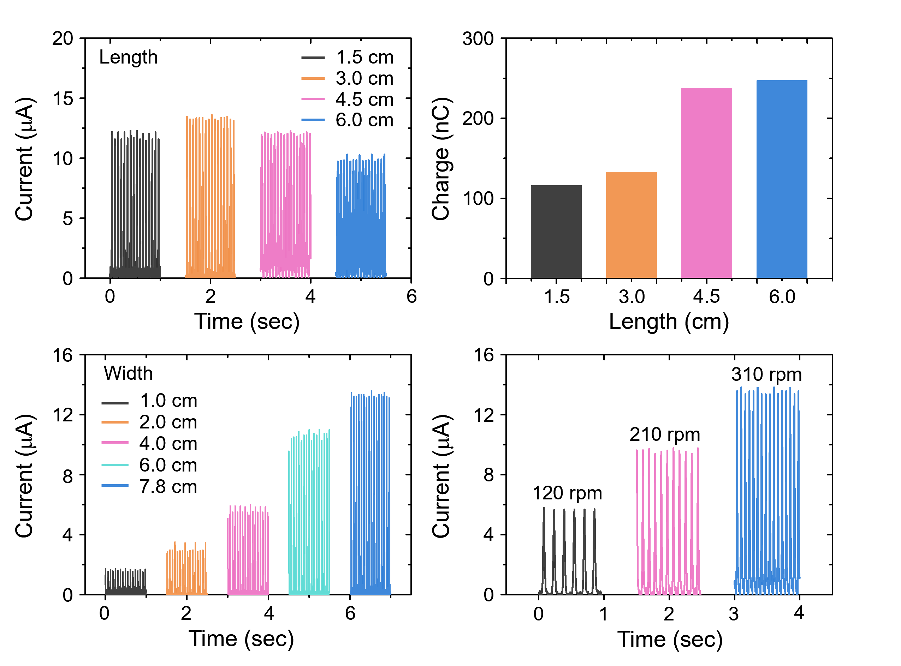
Result & Discussion
Device optimization
(a)
(b)
(c)
(d)
Quantum Functional Materials Laboratory

Slide 10
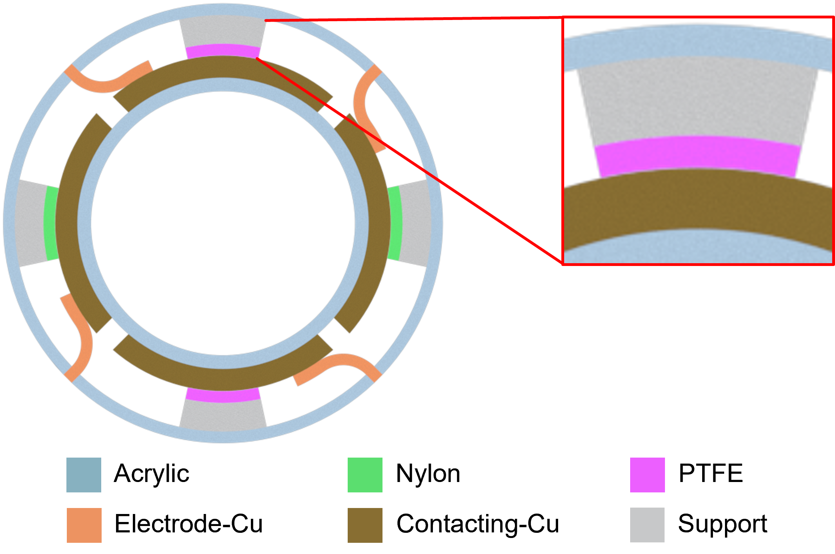
Result & Discussion
Hard-triggering TENG
670 g weight mechanical support
(Soft-triggered TENG – 0.37 ~ 0.62 g weight mechanical support)
Quantum Functional Materials Laboratory

Slide 11
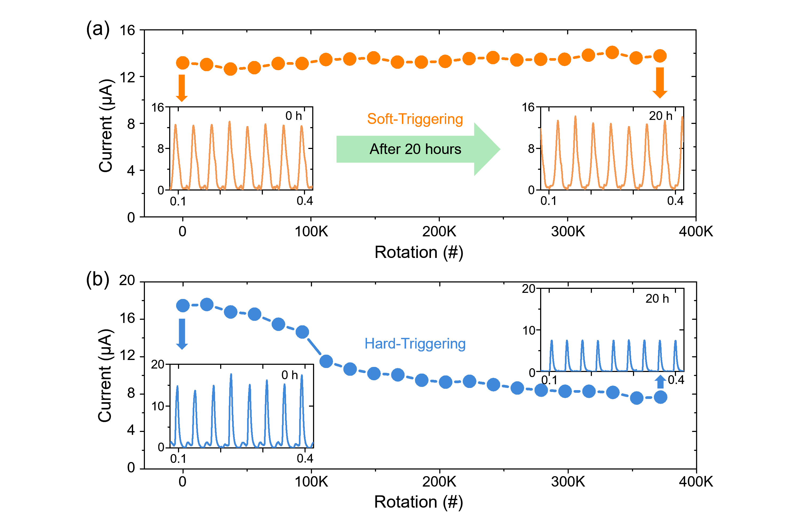
Result & Discussion
High durability through Soft-triggering
Quantum Functional Materials Laboratory

Slide 12
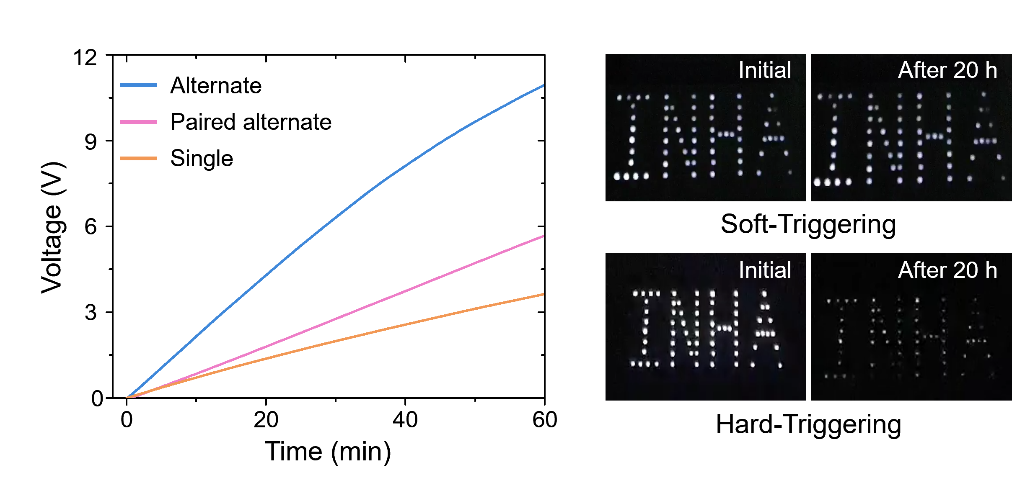
Result & Discussion
Capacitor Charging & LED brightness comparison
470 μF Capacitor
Quantum Functional Materials Laboratory

Slide 13
Conclusion
We have developed a highly durable P-S TENG with an in-plane sliding mode for DC power generation. The PTFE and nylon films were alternately attached to an outer acrylic cylinder and softly contacted from contacting-Cu
The P-S TENG generated 620 V of open-circuit voltage, 14 µA of short-circuit current, and 0.32 mW/cm² of instantaneous power density. The power output of P-S TENG with alternate arrangement was 4-fold and 32-fold larger than that with paired alternate and single arrangements, respectively.
The triboelectric outputs of P-S TENG with soft-triggering remained almost constant even after 372,000 continuous rotations, whereas that with hard-triggering decreased to 44% of its initial value.
Quantum Functional Materials Laboratory

