Slide 1
Analysis of Internal Quantum Efficiency in InGaAsP Multiple Quantum wells
Chibuzo Onwukaeme

Slide 2
Content
Introduction and Theoretical Modelling
Experimental Setup
Experimental Results
Conclusion

Slide 3
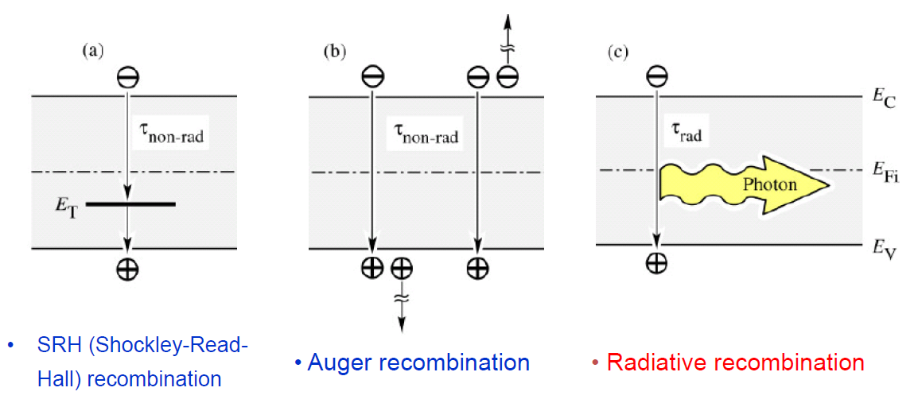
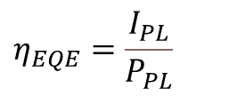
Introduction and Theoretical Modelling
The internal Quantum efficiency is expressed as
$$η_{IQE}=\frac{Bn^{2}}{An+Bn^{2}+Cn^{3}}$$
(1)
The external Quantum efficiency is expressed as
$$η_{EQE}=\frac{η_{2}Bn^{2}}{η_{1}\left(An+Bn^{2}+Cn^{3}\right)}$$
(2)
The numerator and denominator of $η_{EQE}$ are related to the integrated intensity and the laser excitation power as
$I_{PL}=η_{2}Bn^{2}$,
$$P_{PL}=η_{1}\left(An+Bn^{2}+Cn^{3}\right)$$
(3)
So that $η_{EQE}$ becomes
$$η_{EQE}=\frac{I_{PL}}{P_{PL}}$$
$I_{PL}$and $P_{PL}$ are experimentally determined quantities

Slide 4
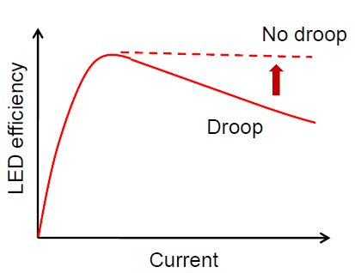
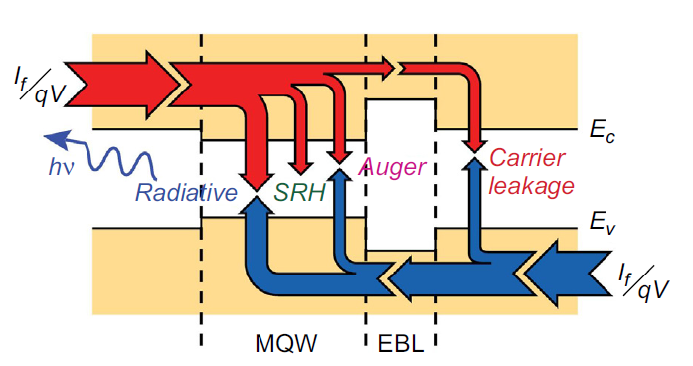
Introduction and Theoretical Modelling
$${η_{IQE}}_{max}$$
$$I_{max}$$
Factors responsible for the efficiency droop might be non-radiative recombination processes or the carrier leakage out of the well.

Slide 5
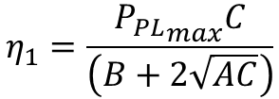
Introduction and Theoretical Modelling
J. Cho, E. F. Schubert, and J. K. Kim, Efficiency droop in light-emitting diodes: challenges and countermeasures. Laser Photon Rev (2013)
In a quantum well structure, the leakage recombination rate should be included in the total recombination rate. So that the denominator in
$η_{EQE}$ becomes
Carrier leakage recombination rates
$$An+Bn^{2}+Cn^{3}+αn+βn^{2}+εn^{3}+γn^{4}+…$$
(4)
The laser excitation can then be written as
$$P_{PL}=η_{1}\left(An+Bn^{2}+Cn^{3}+αn+βn^{2}+εn^{3}+γn^{4}+…\right)$$
Using
$n=\sqrt{\frac{η_{EQE}P_{PL}}{η_{2}B}}$ ,
$η_{2}=\frac{{I_{PL}}_{max}C}{AB}$ ,
$$η_{1}=\frac{{P_{PL}}_{max}C}{\left(B+2\sqrt{AC}\right)}$$
(5)
The injection current is the sum of the ABC recombination current and the Leakage current
${I_{PL}}_{max}$ is the maximum integrated intensity, ${P_{PL}}_{max}$ is the laser power at the maximum integrated intensity
Substituting Eq. (5) into
$$η_{EQE}=\frac{I_{PL}}{P_{PL}}$$
$$EQE=\frac{{η_{EQE}}_{max}}{{η_{IQE}}_{max}}−\frac{\left(1−{η_{IQE}}_{max}\right)\sqrt{{η_{EQE}}_{max}η_{EQE}}}{2{η_{IQE}}_{max}}\left[\sqrt{\frac{{P_{PL}}_{max}}{P_{PL}}}+\frac{η_{EQE}}{{η_{EQE}}_{max}}\sqrt{\frac{P_{PL}}{{P_{PL}}_{max}}}\right]−\frac{β}{B}η_{EQE}−\frac{\left(1−{η_{IQE}}_{max}\right)\sqrt{{η_{EQE}}_{max}η_{EQE}}}{2{η_{IQE}}_{max}}\left[\frac{ε}{C}\frac{η_{EQE}}{{η_{EQE}}_{max}}\sqrt{\frac{P_{PL}}{{P_{PL}}_{max}}}+γ\frac{\sqrt{A}}{C^{3/2}}{\left(\frac{η_{EQE}}{{η_{EQE}}_{max}}\right)}^{3/2}\frac{P_{PL}}{{P_{PL}}_{max}}\right]$$

Slide 6
Introduction and Theoretical Modelling
$$η_{EQE}=\frac{{η_{EQE}}_{max}}{{η_{IQE}}_{max}}−\frac{\left(1−{η_{IQE}}_{max}\right)\sqrt{{η_{EQE}}_{max}η_{EQE}}}{2{η_{IQE}}_{max}}\left[\sqrt{\frac{{P_{PL}}_{max}}{P_{PL}}}+\frac{η_{EQE}}{{η_{EQE}}_{max}}\sqrt{\frac{P_{PL}}{{P_{PL}}_{max}}}\right]−\frac{β}{B}η_{EQE}−\frac{\left(1−{η_{IQE}}_{max}\right)\sqrt{{η_{EQE}}_{max}η_{EQE}}}{2{η_{IQE}}_{max}}\left[\frac{ε}{C}\frac{η_{EQE}}{{η_{EQE}}_{max}}\sqrt{\frac{P_{PL}}{{P_{PL}}_{max}}}+γ\frac{\sqrt{A}}{C^{3/2}}{\left(\frac{η_{EQE}}{{η_{EQE}}_{max}}\right)}^{3/2}\frac{P_{PL}}{{P_{PL}}_{max}}\right]$$
$$η_{EQE}=\frac{{η_{EQE}}_{max}}{{η_{IQE}}_{max}}−\frac{\left(1−{η_{IQE}}_{max}\right)\sqrt{{η_{EQE}}_{max}η_{EQE}}}{2{η_{IQE}}_{max}}\left[\sqrt{\frac{{P_{PL}}_{max}}{P_{PL}}}+\frac{η_{EQE}}{{η_{EQE}}_{max}}\sqrt{\frac{P_{PL}}{{P_{PL}}_{max}}}\right]−f(n)$$
${η_{IQE}}_{max}$ and the leakage coefficients are obtained as fit parameters.
(6)
$η_{EQE}$expressed in terms of the laser excitation power and the leakage terms.
Similar expression is derived for the internal quantum efficiency as
$$η_{IQE}=1−\frac{\left(1−{η_{IQE}}_{max}\right)\sqrt{{η_{IQE}}_{max}η_{IQE}}}{2{η_{IQE}}_{max}}\left[\sqrt{\frac{{P_{PL}}_{max}}{P_{PL}}}+\frac{η_{IQE}}{{η_{IQE}}_{max}}\sqrt{\frac{P_{PL}}{{P_{PL}}_{max}}}\right]−f(n)$$
(7)

Slide 7
Experimental Setup
Spectrometer
PL Spectrum
Sample
Objective Lens
NA=0.25
Beam Splitter
638nm
NA=0.29
Laser
Objective Lens
The samples were optically excited at RT with an AlGaInP laser diode
Emitted signal were collected by an Ocean Optics NIRQuest extended range spectrometer

Slide 8
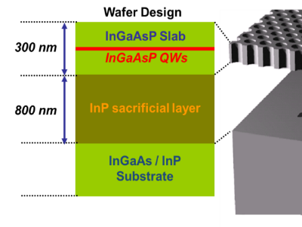
Experimental Results
Including the leakage recombination term in the total recombination rate produces an excellent fit to the experimental data.
Without the leakage term, the ABC model deviates from the experimental data as the injection current increases.

Slide 9
Experimental Results
The leakage terms are extracted using the values of $A, B, C$
The value of $B$ was chosen as $1.2×{10}^{−10}{{cm}^{3}}/s$ for InGaAsP Quantum well emitting at 1.55 um
The values of $A and C$ are derived using the equations
$A=\sqrt{\frac{P_{max}{\left(1−{IQE}_{max}\right)}^{2}B}{4η_{1}{IQE}_{max}}}$ ,
$C=\sqrt{\frac{η_{1}{\left(1−{IQE}_{max}\right)}^{2}B^{3}}{4{{IQE}_{max}}^{3}P_{max}}}$
The value of $η_{1}$ was determined as $1.7×{10}^{−27}$ ${cm}^{3} mW s$
$$A=6.02×{10}^{7}s^{−1}$$
$$C=1.28×{10}^{−29}{cm}^{6}s^{−1}$$
$$f(n)=\frac{β}{B}η_{EQE}−\frac{\left(1−{η_{IQE}}_{max}\right)\sqrt{{η_{EQE}}_{max}η_{EQE}}}{2{η_{IQE}}_{max}}\left[\frac{ε}{C}\frac{η_{EQE}}{{η_{EQE}}_{max}}\sqrt{\frac{P_{PL}}{{P_{PL}}_{max}}}+γ\frac{\sqrt{A}}{C^{3/2}}{\left(\frac{η_{EQE}}{{η_{EQE}}_{max}}\right)}^{3/2}\frac{P_{PL}}{{P_{PL}}_{max}}\right]$$
fit
fit
fit

Slide 10
Conclusion
The internal quantum efficiency of InGaAsP MQW is modelled using $ABC$ recombination model.
To accurately model the experimental observation, the carrier leakage current must be included in the total recombination current.
Fitting the experimental external quantum efficiency data with the model, the leakage coefficients are extracted, and the leakage recombination current is computed.
The contributions of the individual recombination currents shows that the auger recombination rate is responsible for the efficiency droop in our InGaAsP MQW $η_{EQE}$ data.

Slide 11
Thank You

