Slide 1
Inverse Design Method Utilizing a Hybrid Meta-heuristic Algorithm
발표자: 정인철
지도교수: 이규태

Slide 2
Index
Meta-heuristic algorithms
Particle swarm optimization
Genetic algorithm
Differential evolution
Inverse design method
Ex1. Perfect absorber
Ex2. Transmissive color filters
Ex3. Reflective color filters
Appendix
Loss function
Glancing angle deposition
L*a*b* color space

Slide 3
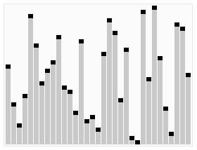
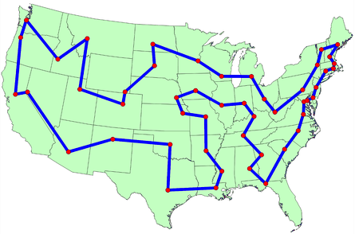
Meta-heuristic algorithms
Exact algorithms:
Heuristic algorithms:
provides an exact solution
High complexity
provides a good solution
Low complexity
Suitable for simple problems
Appliable for complicated problems
Quicksort
Traveling salesman problem

Slide 4
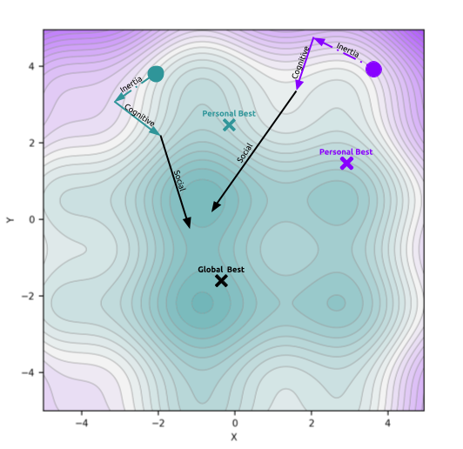
Particle swarm optimization (PSO)
Particle:
$$P_{i}^{t}=\left[x_{0,i}^{t},x_{1,i}^{t},x_{2,i}^{t},⋯,x_{n,i}^{t}\right]$$
Velocity:
$$V_{i}^{t}=\left[v_{0,i}^{t},v_{1,i}^{t},v_{2,i}^{t},⋯,v_{n,i}^{t}\right]$$
$i:$ particle #
$t:$ iteration
$$P_{i}^{t+1}=P_{i}^{t}+V_{i}^{t+1}$$
$$V_{i}^{t+1}=wV_{i}^{t}$$
$+c_{1}r_{1}\left(P_{best}^{t}−P_{i}^{t}\right)$
$+c_{2}r_{2}\left(P_{globalbest}^{t}−P_{i}^{t}\right)$
Inertia
Cognitive
Social
Random coefficients for aggressive exploration
https://towardsdatascience.com/particle-swarm-optimization-visually-explained-46289eeb2e14

Slide 5
Genetic algorithm (GA)
Roulette wheel selection
pop
pop
pop
Run roulette wheel selection as many as the population
pop
pop
pop
pop
pop
pop
Survival of the fittest
Next generation
Crossover
0 | 0 | 0 | 0 | 0 | 0
pop
pop
1 | 1 | 1 | 1 | 1 | 1
pop
pop
Crossover point
pop
pop
Offspring
pop
pop
pop
1 | 1 | 1 | 0 | 0 | 0

Slide 6
Differential evolution (DE)
Trial
Optimal
Optimal
[ Initialization ]
[ Crossover ]
$$u_{i,G+1}=CROSSOVER(v_{i,G+1},x_{i,G})$$
Mutant
Optimal
Optimal
[ Mutation ]
[ Selection ]
$$v_{i,G+1}=x_{r1,G}+F⋅(x_{r2,G}−x_{r3,G})$$
$$x_{i,G+1}=\left\{\begin{matrix}u_{i,G+1} & if f\left(u_{i,G+1}\right)<f\left(x_{i,G}\right) \\ x_{i,G} & else\end{matrix}\right.$$

Slide 7
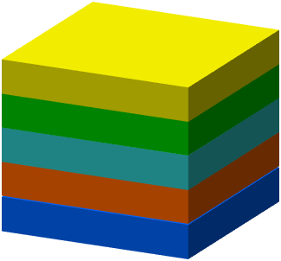
Inverse design of multi-layered thin films
Structure developer
Material Sequence
Discrete parameters
Optimal structure
Layer Thicknesses
Deposition angles
Optimizer
Analogue parameters
Structure developer
Particle swarm optimization (PSO)
Structure
Feedback
Optimizer
Genetic algorithm (GA)
Optimized structure
Evaluation
Differential evolution (DE)

Slide 8
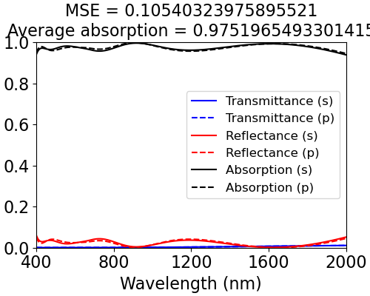
Ex1. Perfect absorber
HYPER PARAMETERS
Test function: Penta-layered broadband absorber utilizing glancing angle deposition
Population number: 500
Generations: 100
Wavelengths: 400~2000 nm, 5 nm interval
Materials: TiO₂ (GLAD), Ge (GLAD), Cr, Ni, Mo, Ti, Au, Al, Ag
Material | Thickness (nm) | dep. ang. (°)
TiO2 | 102.7 | 84.1
TiO2 | 52.80 | 20.6
Ge | 47.66 | 74.8
Ge | 24.17 | 25.0
Cr | 217.2 | 0
Glass | 1 mm
GA-PSO
Loss | 0.523
Generation Reached | 51
Structure Generator | p_{c}/p_{m} 0.9/0.05
Structure Generator | w/c1/c2 D/0.37/0.50
GA-DE
Loss | 0.422
Generation Reached | 15
Structure Generator | p_{c}/p_{m} 0.9/0.05
Structure Generator | F/CR 0.2/0.1
DE-PSO
Loss | 0.422
Generation Reached | 17
Structure Generator | F/CR 0.2/0.1
Structure Generator | w/c1/c2 D/0.37/0.50
DE-DE
Loss | 0.422
Generation Reached | 24
Structure Generator | F/CR 0.2/0.1
Structure Generator | F/CR 0.2/0.1
D: Dynamic

Slide 9
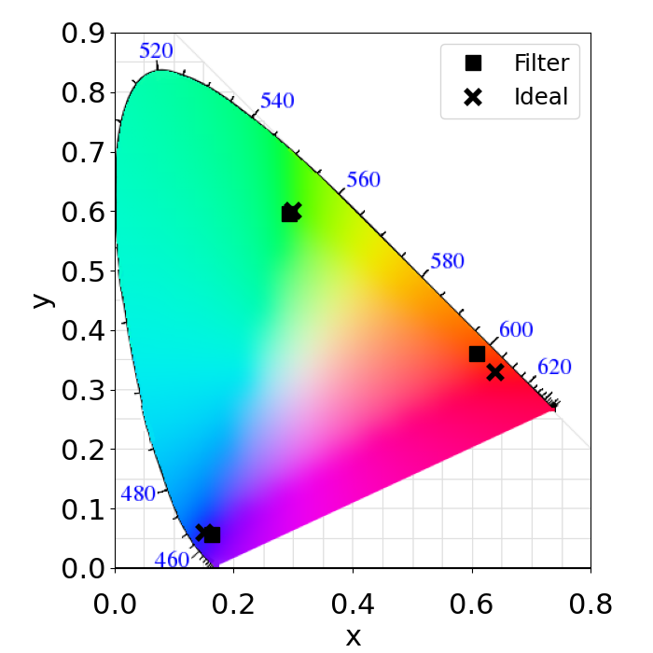
Ex2. Transmissive color filters
BLUE | BLUE |  | GREEN | GREEN |  | RED | RED
Material | Thickness | dep. ang. | Material | Thickness | dep. ang. | Material | Thickness | dep. ang.
TiO2 | 120.9 | 0.000 | TiO2 | 288.0 | 0.000 | TiO2 | 348.6 | 0.000
Ag | 29.32 |  | Ag | 32.01 |  | Ag | 27.85
SiO2 | 249.2 |  | SiO2 | 134.9 |  | TiO2 | 159.8 | 81.00
Ag | 23.73 |  | Ag | 28.95 |  | Ag | 28.54
TiO2 | 219.6 | 0.000 | TiO2 | 170.0 | 0.000 | Si | 20.89
Glass | 1 mm |  | Glass | 1 mm |  | Glass | 1 mm
Thickness: nm deposition angle: deg
 | x | y | Y | Color
Filter | 0.16 | 0.06 | 0.04
Ideal | 0.15 | 0.06 | 0.07
Filter | 0.29 | 0.60 | 0.43
Ideal | 0.30 | 0.60 | 0.72
Filter | 0.61 | 0.36 | 0.14
Ideal | 0.64 | 0.33 | 0.21

Slide 10
Ex3. Reflective color filters
BLUE | BLUE |  | GREEN | GREEN |  | RED | RED
Material | Thickness | dep. ang. | Material | Thickness | dep. ang. | Material | Thickness | dep. ang.
TiO₂ | 160.8 | 31.54 | TiO₂ | 91.37 | 0.000 | TiO₂ | 62.58 | 71.61
SiO₂ | 57.46 |  | SiO₂ | 232.4 |  | Ge | 15.41 | 16.00
Ni | 13.07 |  | Cr | 9.659 |  | SiO₂ | 183.6
SiO₂ | 130.3 |  | SiO₂ | 350.7 |  | Ag | 278.9
Al | 177.0 |  | Ag | 299.0 |  | Au | 66.00
Glass | 1 mm |  | Glass | 1 mm |  | Glass | 1 mm
Thickness: nm deposition angle: deg
 | x | y | Y | Color
Filter | 0.16 | 0.06 | 0.07
Ideal | 0.15 | 0.06 | 0.07
Filter | 0.30 | 0.61 | 0.63
Ideal | 0.30 | 0.60 | 0.72
Filter | 0.60 | 0.34 | 0.20
Ideal | 0.64 | 0.33 | 0.21

Slide 11
Conclusion
An inverse design method that utilizes hybrid meta-heuristic algorithm to obtain an optimized structure is demonstrated.
Since a multi-layered thin films structure consists of two different sequences, that are discrete (material sequence) and analogue (layer thickness or deposition angle).
This approach may pave a way to inverse design methods to provide diverse optical devices such as multilayered thin films, diffraction gratings, plasmonic resonance-based nano structures, and photonic crystals.

Slide 12
Thank You!

Slide 13
Appendix: Loss (Cost) function
Loss function:
Also called as a cost function or an error function.
A function that maps an event or values of one or more variables onto a real number intuitively representing some “cost” associated with the event.
A loss function is used for parameter estimation, and the event in question is some function of the difference between estimated and true values for an instance of data.
Continuous loss
Discrete loss
Mean squared error (MSE)
Cross entropy error (CEE)
$$MSE=\frac{1}{N}\sum_{i=1}^{N}{{\left(y_{i}−\hat{y_{i}}\right)}^{2}}$$
$$CEE=−\sum_{i=1}^{N}{\hat{y_{i}}\log{y_{i}}}$$
Root mean squared error (RMSE)
Categorical cross entropy error
$$RMSE=\sqrt{\frac{1}{N}\sum_{i=1}^{N}{{\left(y_{i}−\hat{y_{i}}\right)}^{2}}}$$
$$CEE=−\sum_{j=1}^{N}{\sum_{i=1}^{C}{\hat{y_{ij}}\log{y_{ij}}}}$$

Slide 14
Appendix: Glancing angle deposition (GLAD)
$$β$$
$$α$$
$$ε_{eff}=\frac{H_{b}+\sqrt{H_{b}^{2}+8ε_{m}ε_{d}}}{4}$$
Shadow effect
$$H_{b}^{2}=\left(2−3c_{m}\right)ε_{d}−\left(1−3c_{m}\right)ε_{m}$$
Bruggman’s model
Substrate
$$\tan{\frac{β}{C}}=\frac{1}{2}\tan{α}$$
GLAD
Modified tangent rule
Change of refractive indices of Ge according to the deposition angles

Slide 15
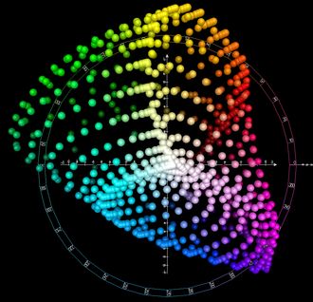
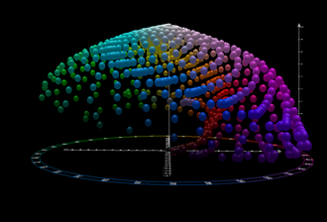
Appendix: L*a*b* color space
The CIELAB color space is proposed by the International Commission on Illumination (CIE) in 1976.
CIELAB was intended as a perceptually uniform space, where a given numerical change corresponds to similar perceived change in color.
[ top view ]
[ front view ]
$$\left\{\begin{aligned}L^{∗}=116f\left(Y/Y_{n}\right)−16 \\ a^{∗}=500\left[f\left(X/X_{n}\right)−f\left(Y/Y_{n}\right)\right] \\ b^{∗}=200\left[f\left(Y/Y_{n}\right)−f\left(Z/Z_{n}\right)\right]\end{aligned}\right.$$
L*: Lightness value
a*: green-red opponent colors
b*: blue-yellow opponent colors
$$\left\{\begin{aligned}\text{0 < }\text{L}\text{∗}\text{ < 100 } \\ \text{−150 < }\text{a}\text{∗}\text{ < 150 } \\ \text{−150 < }\text{b}\text{∗}\text{ < 150} \end{aligned}\right.$$
$$\left[White\right]=\left[\begin{matrix}X_{n} & Y_{n} & Z_{n}\end{matrix}\right]$$
$$=\left[\begin{matrix}0.9507 & 1.0000 & 1.0888\end{matrix}\right]$$
$$f\left(x\right)=\left\{\begin{aligned}t^{1/3}, if t>{\left(6/29\right)}^{3} \\ &\frac{1}{3}{\left(\frac{29}{6}\right)}^{2}t+\frac{4}{29}, otherwise\end{aligned}\right.$$

