Slide 1


Low Energy Nuclear Reactions for some Carbon and Be Isotopes
Kyongsu Heo, K. S. Choi, W. Y. So, Kyungsik Kim, Eunja Ha, Heamin Ko,
K. Hagino, H. Sagawa
Myung-Ki Cheoun (OMEG Institute, Soongsil Univ., Seoul)
Notes:
It is my pleasure to have a seminar here. Title of my talk is “..”. Here are our collaborators in Korea and Japan. I am …

Slide 2
Motivation
1-1. Exotic Light Nuclei
1-2. Low Energy Nuclear Reactions (LENR) for Exotic Nuclei
2. LENR for Carbon isotopes
2-1. Quasi-elastic scattering of C isotopes
2-2. Two nucleon knockout in 12C + 12C scattering
3. LENR for 11Be
3-1. Cosmological Origin of 10Be
3-2. Elastic and non-elastic scattering of 11Be
4. LENR 6He, 17F and 17O for mirror nuclei
5. LENR for Li isotopes
6. Summary and Conclusion
Submitted to PLB (2022)
PRC 104, 034306 (2021)
ArXiv: 2203.13365: ApJS, in press, (2022)
EPJA 56, 42 (2020), LRN for 197Au
PRC 92, 014627 (2015) LRN potential
PRC 92, 044618 (2015) LRN potential
PRC 93, 954624 (2016) Radius
PRC 105, 014601 (2022)
PRC 89, 057601 (2014) 11Li
PRC 90, 054615 (2014) 11Li
PLB 780, 455 (2018) Fusion
JKPS 70, 42 (2017) Fusion
PRC 103, 034611 (2021) Fusion
Notes:
Here is the contents of may talk. After short introduction, I will touch carbon isotope scattering in low energy and medium energy. And then I will present some nuclear reactions relevant to the cosmological origin of 10Be and some reactions for 11Be.
Other topics related to 17F and 17O will be skipped in today talk.

Slide 3
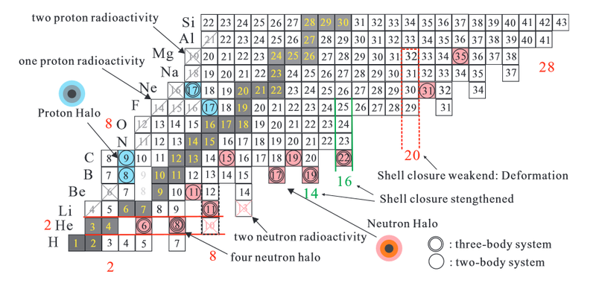
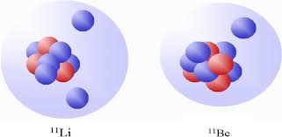
Light Neutron- and Proton-Halo Nuclei I
Notes:
This is a nuclear chart of light nuclei. You can see some exotic nuclei in neutron-rich (11Li, 11Be, 17B, 19B and also 22C) and n–deficient region (8B, 9C, 17F and 17Ne).
Today I focus on Carbon isotopes and 11Be because I have time limit. Other nuclei were studied in our previous papers.

Slide 4
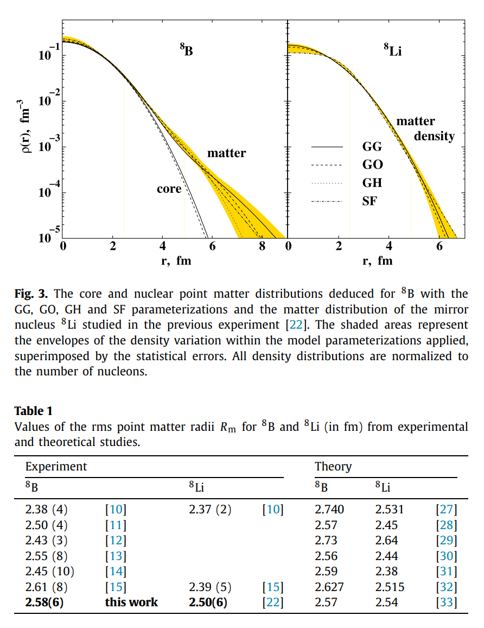
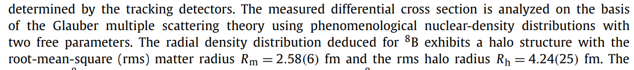
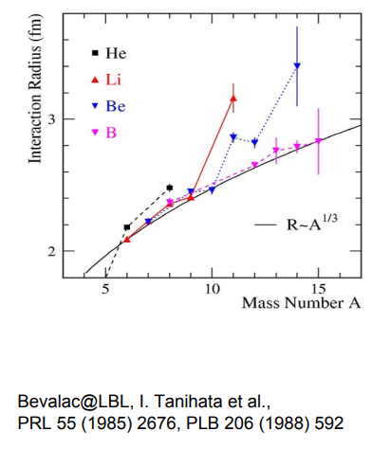
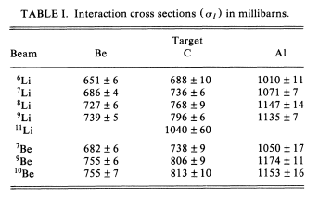
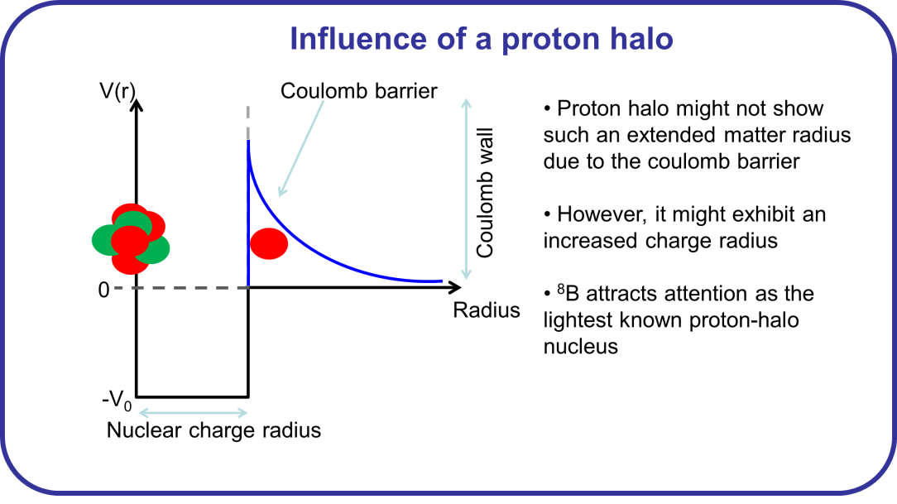
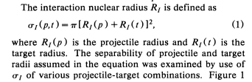
Light Neutron- and Proton-Halo Nuclei II
The distribution(rms) of neutron = 2.20 fm
proton = 2.98 fm
whole nucleus = 2.72 fm
G
p + 8B scattering at GSI
Courtesy of Peter Mueller
/ Physics Letters B 780 (2018) 200–204
Notes:
This is the comparison of the well-known radii of halo nuclei. The radius of 11Li is comparable to that of 208Pb. The first reaction of the halo nucleus is the inverse scattering of the secondary beam (Li isotopes and Be isotopes off 12C target at LBL (Lawrence Berkeley Lab.) They showed the large X-section of 11Li compared to other projectiles. Since then, many advanced techniques have been developed and performed. But today I am going to focus on some specific reactions related to the experiments and some interesting physics which are related to nuclear physis itself and nucleosynehesis.
But the radii of proton halo are still under discussion, which is not larger as the neutron halo nuclei, but seems to a bit swollen.

Slide 5
Motivation
1-1. Exotic Light Nuclei
1-2. Low Energy Nuclear Reactions (LENR) for Exotic Nuclei
2. LENR for Carbon isotopes
2-1. Quasi-elastic scattering of C isotopes
2-2. Two nucleon knockout in 12C + 12C scattering
3. LENR for 11Be
3-1. Cosmological Origin of 10Be
3-2. Elastic and non-elastic scattering
4. LENR 6He, 17F and 17O for mirror nuclei
5. LENR for Li isotopes
6. Summary and Conclusion
Submitted to PLB (2022)
PRC 104, 034306 (2021)
ArXiv: 2203.13365: ApJS, in press, (2022)
EPJA 56, 42 (2020), LRN for 197Au
PRC 92, 014627 (2015) LRN potential
PRC 92, 044618 (2015) LRN potential
PRC 93, 954624 (2016) Radius
PRC 105, 014601 (2022)
PRC 89, 057601 (2014) 11Li
PRC 90, 054615 (2014) 11Li
PLB 780, 455 (2018) Fusion
JKPS 70, 42 (2017) Fusion
PRC 103, 034611 (2021) Fusion

Slide 6
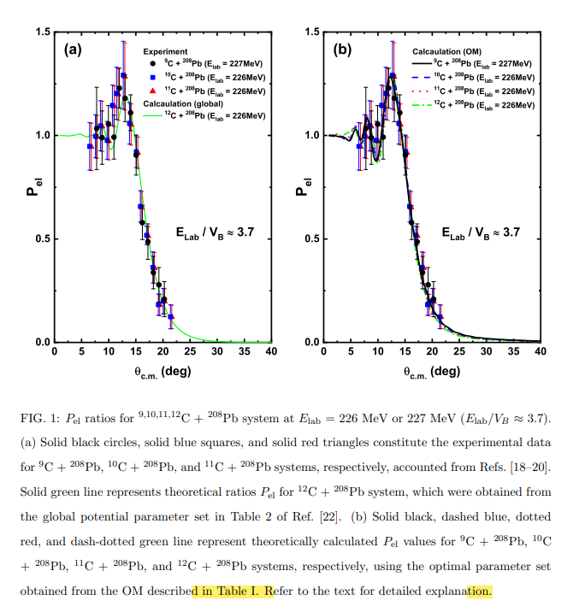
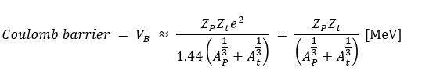
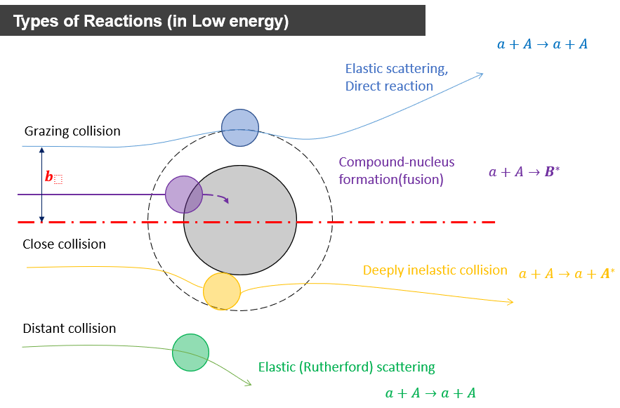
Elastic Scattering of C isotopes I
Brunnian (super Borromean) !
 | 9C | 10C | 11C | 12C
S_n | 14.2 | 21.2 | 13.1 | 18.7
S_p | 12.9 | 4.0 | 8.7 | 15.9
~60 MeV
of carbon
Notes:
Here we show the ratio of the cross section to the Rutherford X-section for Carbon isotopes with Pb target. This ratio is widely used fin LENR because it directly shows the roles of the nuclear force (strong absorption) in the backward direction and also partly the structure of projectile structure by the Fresnel scattering (forward and Coulomb) and Fraunhofer (backward and weak Coulomb) diffraction scattering.
The ratio of the incident energy for the Coulomb barrier is about 3.7, which is relatively higher than the barrier. Although the separation energies are of protons and neutrons are different with each other, specifically, the S_p of 10C is very small, the ratios do not show any remarkable points. We can reproduce the data by the global optical potential. In a nutshell, this energy mostly blinds the nuclear structure.

Slide 7
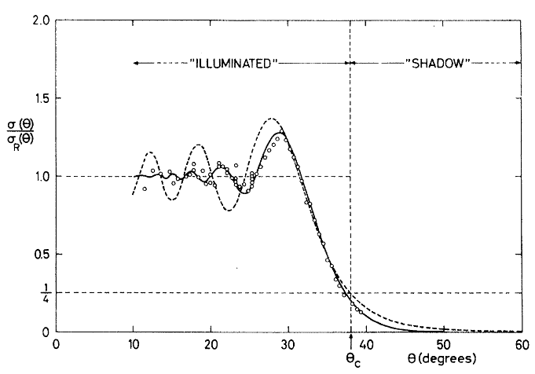
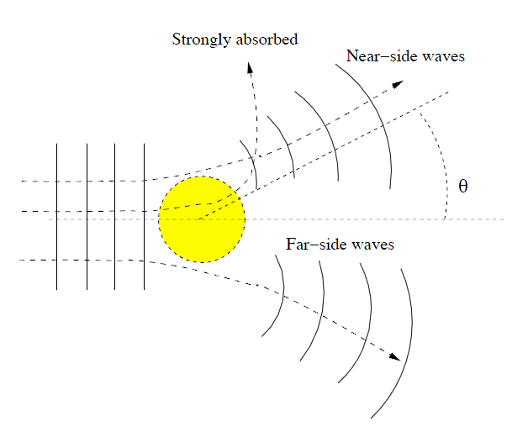
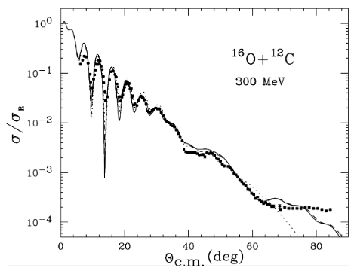
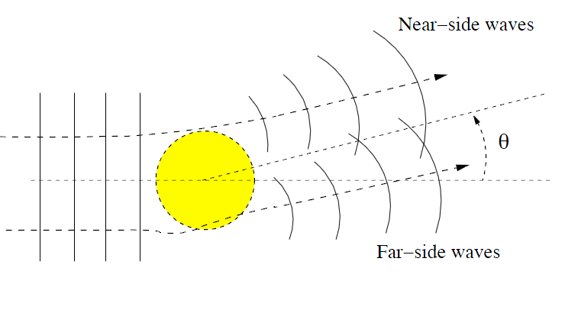
Fresnel scattering: η>>1
Strong Coulomb potential
E≈ Coulomb barrier
“Illuminated” region → interference (Coulomb-nuclear)
“Shadow region” → strong absorption
Fraunhofer scattering: η≤1
Weak Coulomb
E> Coulomb barrier
Near-side/far-side interference (diffraction)
Oscillations in angular distribution→ good angular resolution required

Slide 8
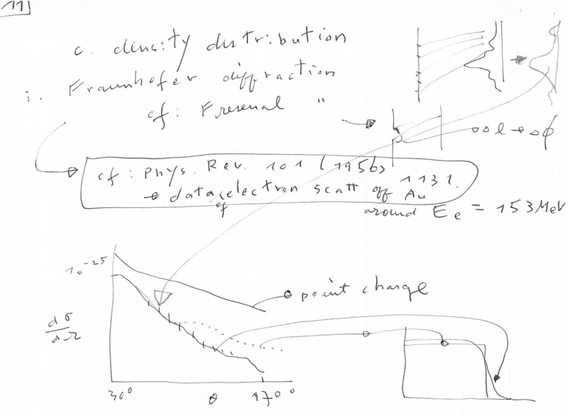
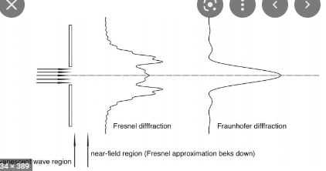

Slide 9
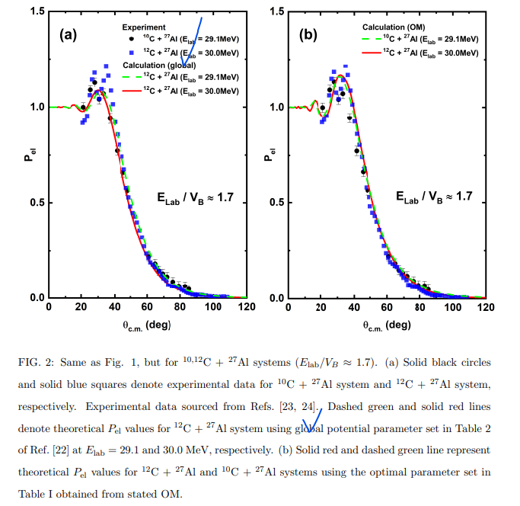
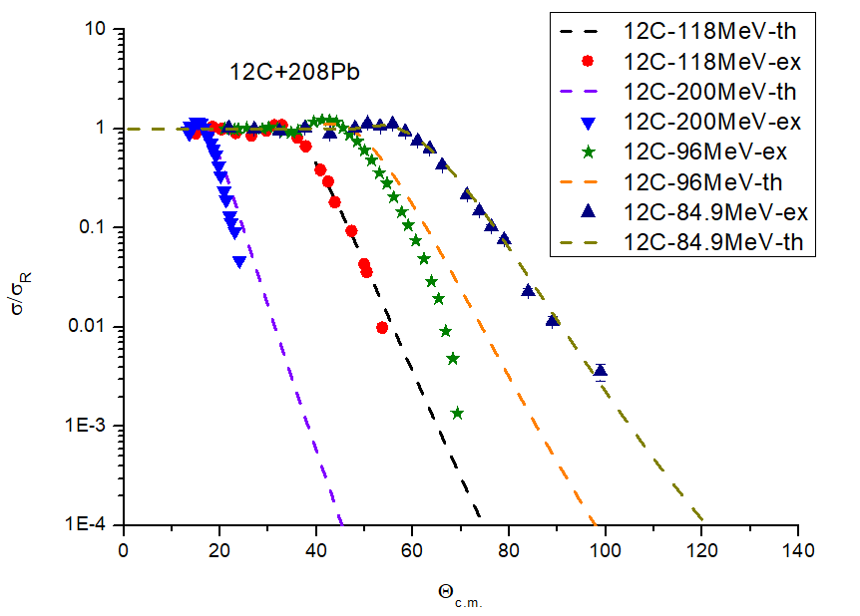
Elastic Scattering of C isotopes II
Notes:
If we exploit different energy, the grazing angle shifts forward with the higher energy. The grazing angle is the boundary between the Coulomb scattering and the scattering by the nuclear force.
But, for different projectiles, if we use still higher energy, we can note, the ratio was not changed so much, still we can reproduce the scattering using the global optical potential constructed from 12C scattering.

Slide 10
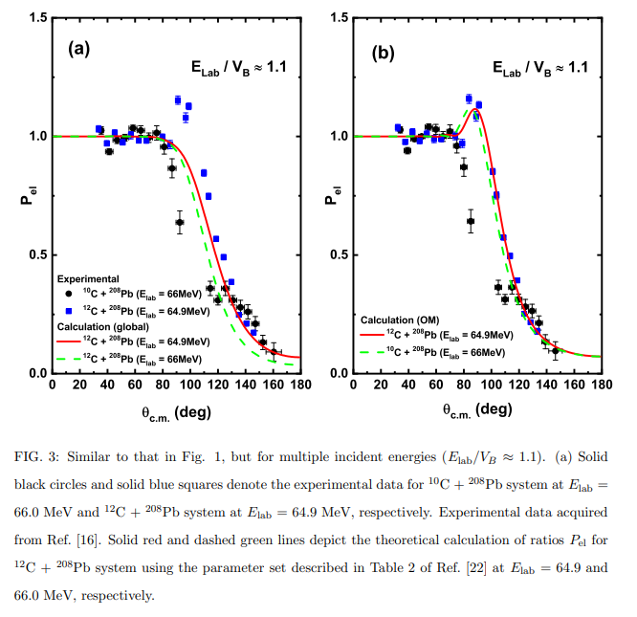
Elastic Scattering of C isotopes III
@Texas A&M
Notes:
At last, the deviation of 10C scattering from 12C scattering appears at the ratio = 1.1, namely, near the Coulomb barrier.
The grazing angle for 10C moves forward. It means that the breakup reactions occurred in the forward angle compared to the 12C case.
Theoretical calculations based on the 12C do not function anymore for 10C.
In the following we discuss regarding how to construct the breakup and inelastic scattering process, by using the optical potential. The OM approach is too naïve, but it can enable us to understand the reaction intuitively and physically.

Slide 11
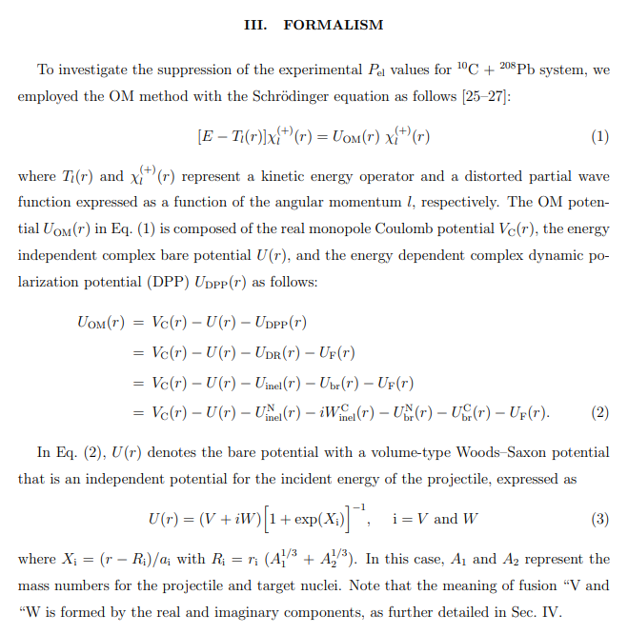
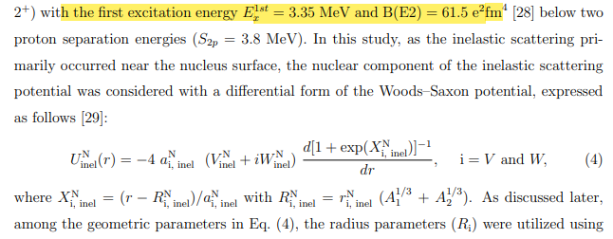
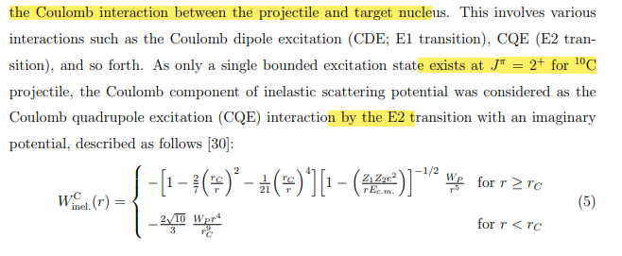
Theoretical approach by extended Optical Model I
Notes:
10C has the 1st excitation energy (2^+ state) with B(E2) = 61.5 e^2 fm^2, but two proton separation energy is higher than the excitation energy. Therefore, we need to include the inelastic scattering by the excitation and the breakup-process simultaneously.
Since the inelastic scattering primarily occurred at the nuclear surface, we construct the potential by the derivative form of the WS potential for the real part.
Also for the imaginary part, we include the Coulomb interaction for the E2 transition as the CQE from.

Slide 12
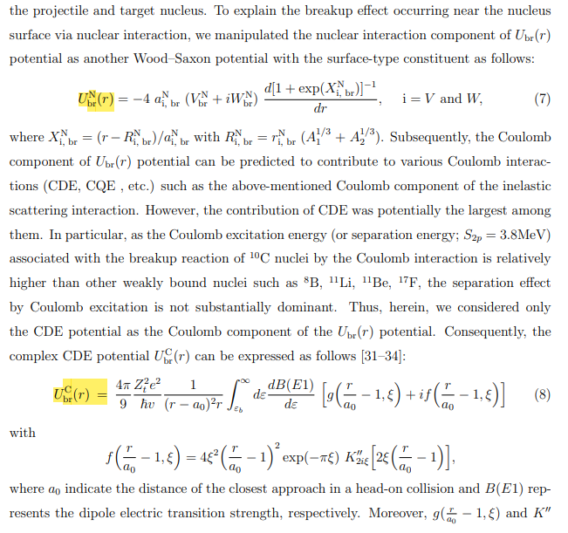
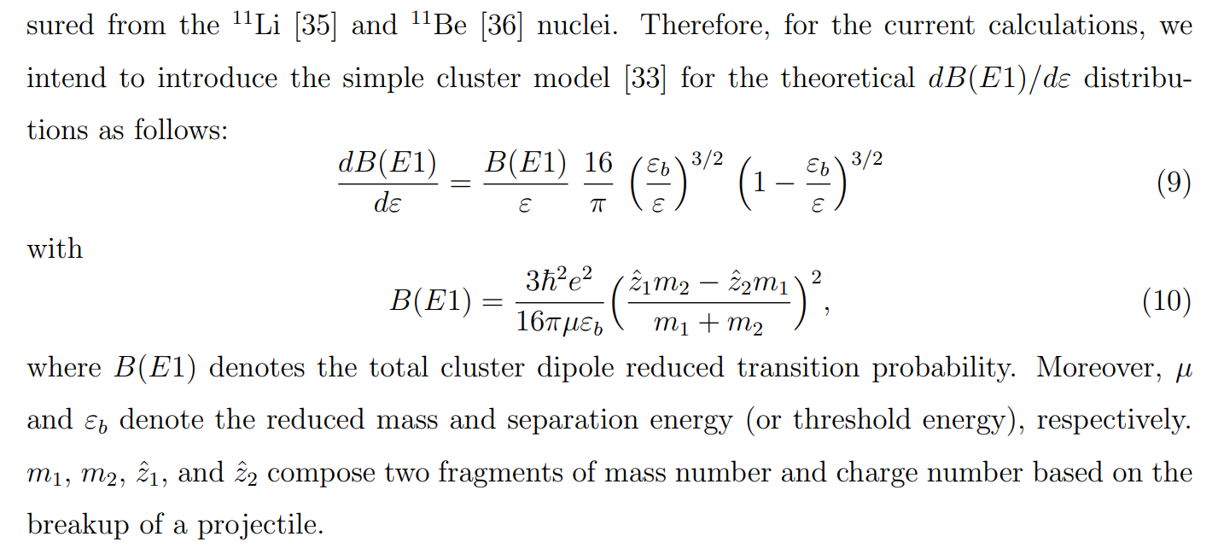
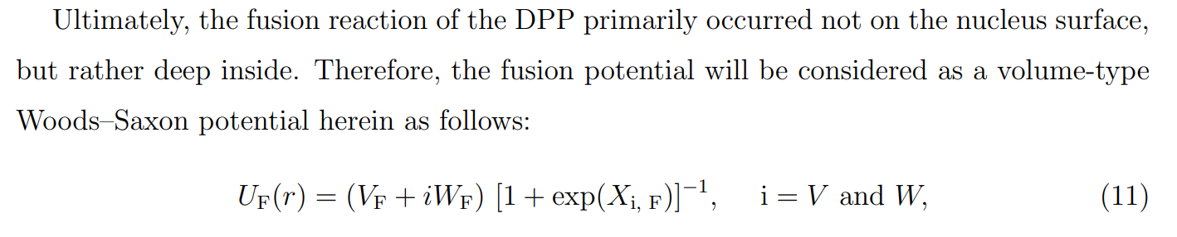
Theoretical approach by extended Optical Model II
Notes:
For the breakup channel we also construct the derivative type of the WS potential for the real part, but for the imaginary part, we take into account the CDE potential for the BR channel.

Slide 13
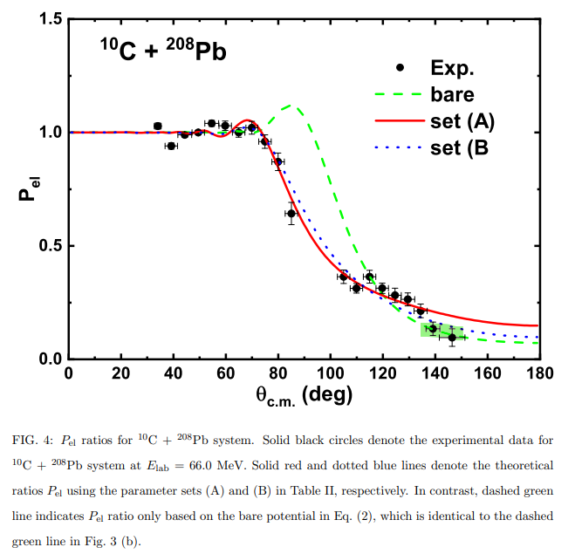
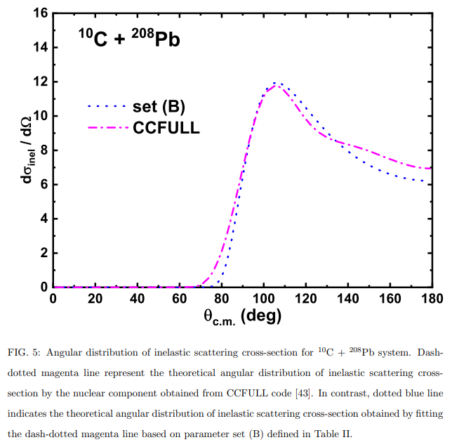
Theoretical approach by extended Optical Model III
Notes:
The we finally reproduce clearly the ratio of the X-sections by including the contribution from the inelastic channel and the BR channel. Since we do not have the BR X-section, we compared the X-section to the results by the coupled channel method using the CCFULL code by Hagino san.

Slide 14
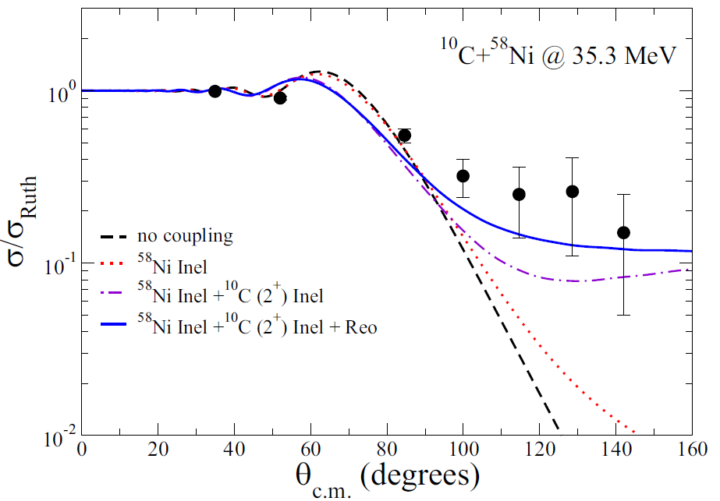
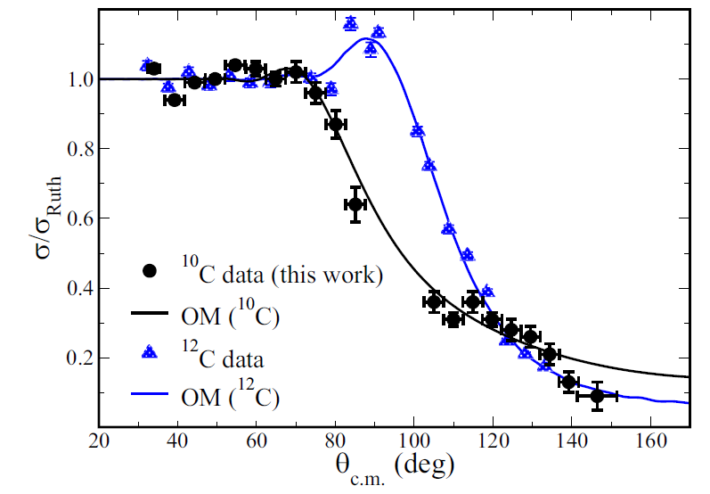
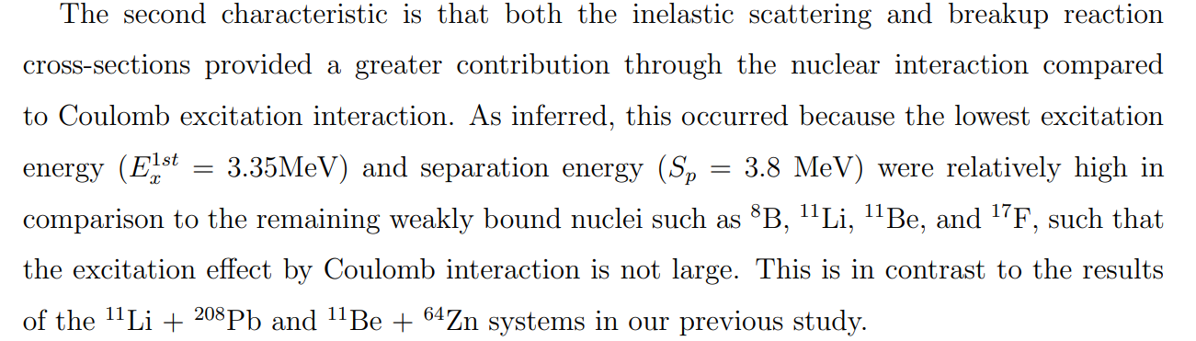
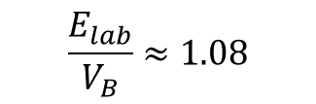
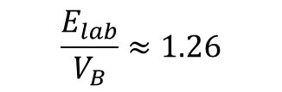
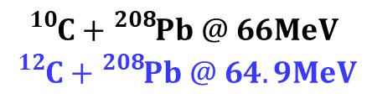

Theoretical approach by extended Optical Model IV
@Notre Dame
$$\frac{E_{lab}}{V_{B}}≈1.08$$
@Texas A&M
$$\frac{E_{lab}}{V_{B}}≈1.26$$
$${}_{}^{10}C+{}_{}^{58}{Ni} @ 35.3MeV$$
$${}_{}^{10}C+{}_{}^{208}{Pb @ 66MeV}$$
$${}_{}^{12}C+{}_{}^{208}{Pb @ 64.9MeV}$$
${}_{}^{10}C+{}_{}^{58}{Ni}$ : PHYSICAL REVIEW C 100, 034603 (2019) V. Guimarães et al.
${}_{}^{10}C+{}_{}^{208}{Pb }$: PHYSICAL REVIEW C 103, 044613 (2021) R.Linares et al.
Submitted to PLB (2022)
Notes:
We also check the BR channel for the different target 58Ni and found a good agreement with the data.

Slide 15
Motivation
1-1. Exotic Light Nuclei
1-2. Low Energy Nuclear Reactions (LENR) for Exotic Nuclei
2. LENR for Carbon isotopes
2-1. Quasi-elastic scattering of C isotopes
2-2. Two nucleon knockout in 12C + 12C scattering
3. LENR for 10Be
3-1. Cosmological Origin of 10Be
3-2. Elastic and non-elastic scattering
4. LENR 6He, 17F and 17O for mirror nuclei
5. LENR for Li isotopes
6. Summary and Conclusion
Submitted to PLB (2022)
PRC 104, 034306 (2021)
ArXiv: 2203.13365: ApJS, in press, (2022)
EPJA 56, 42 (2020), LRN for 197Au
PRC 92, 014627 (2015) LRN potential
PRC 92, 044618 (2015) LRN potential
PRC 93, 954624 (2016) Radius
PRC 105, 014601 (2022)
PRC 89, 057601 (2014) 11Li
PRC 90, 054615 (2014) 11Li
PLB 780, 455 (2018) Fusion
JKPS 70, 42 (2017) Fusion
PRC 103, 034611 (2021) Fusion

Slide 16
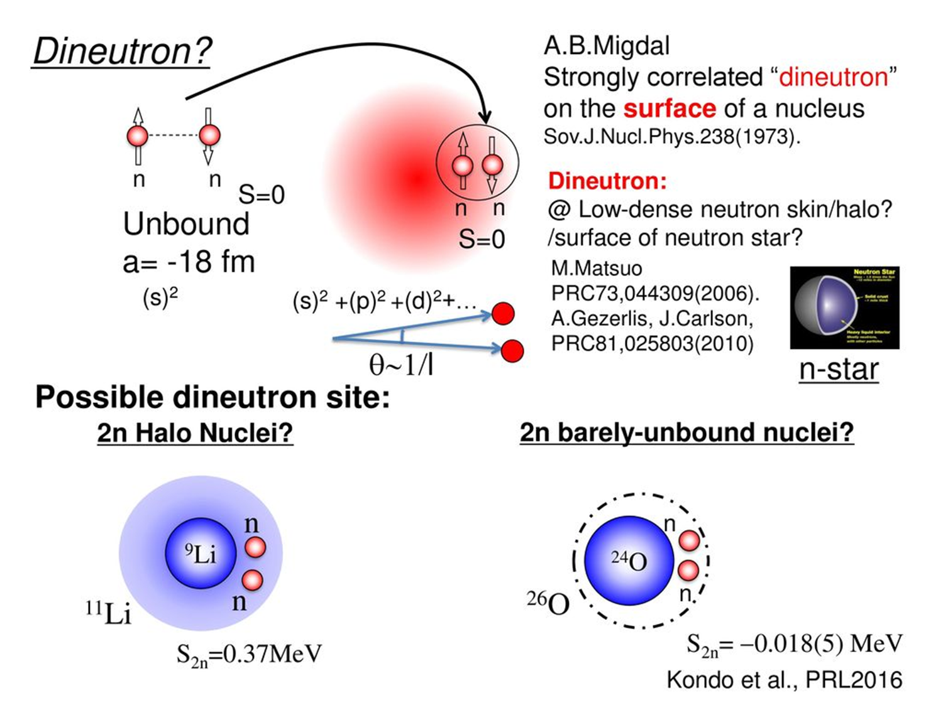
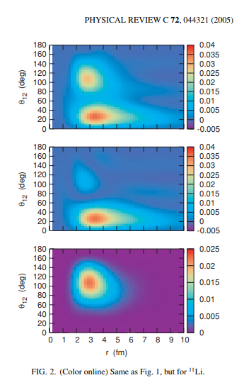
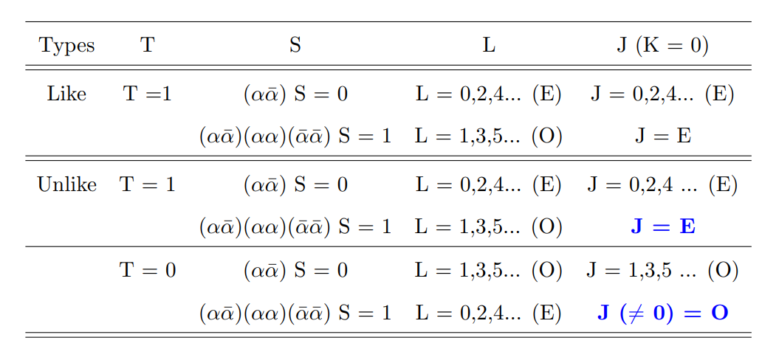
Dineutron in Nuclei
S=0
S=1
Courtesy of J. Lee
Notes:
In nuclear physics, the dineutron has been a hot topic since the paper by A. Migdal because it is not stable in free space. But it can reside in nuclei. For example, two neutron halo nuclei, such as 11Li and 26O, could be such example we can study the di-neutron properties.

Slide 17
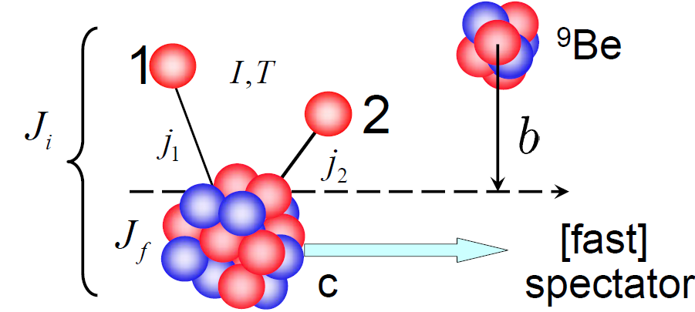
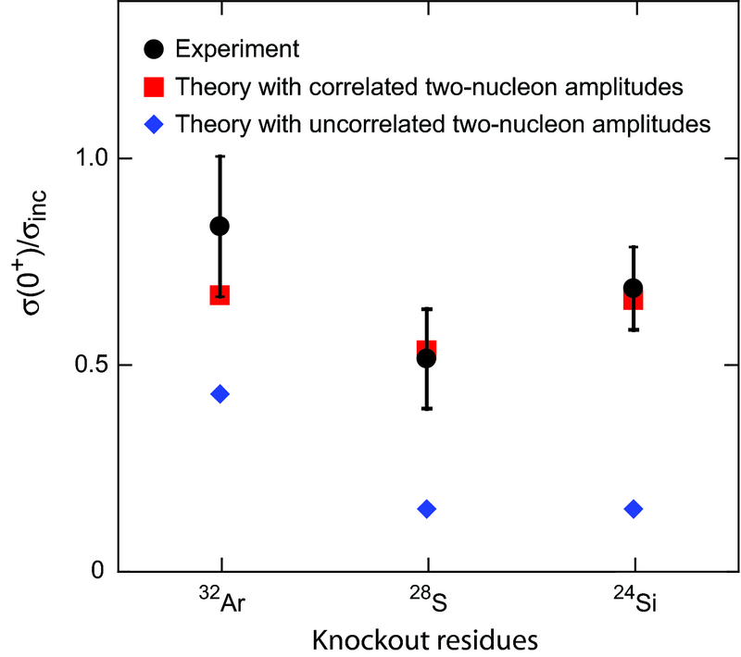
Two-nucleon knockout reactions I
Target
Theoretical Cross sections:
⁹Be/ ¹²C
Reaction: Eikonal & Sudden approximation
Structure: 2N Overlap from Shell Model
J. Tostevin, B.A. Brown, PRC 74, 064604 (2006)
Projectile (fast beam)
E.C. Simpson and J. Tostevin et al., PRL 102, 132502 (2009)
- 2n knockout from ³⁴Ar, ³⁰S, ²⁶Si
2n or 2p knockout (T=1)
K. Yoneda et al., Phys. Rev. C 74 , 021303(R) (2006)
D. Bazin et al., Phys. Rev. Lett. 91, 012501 (2003)
A. Gade et al., Phys. Rev. C 74 , 021302(R) (2006)
P. Fallon et al., PRC 81, 041302(R) (2010)
2N knockout cross sections → carry information of 2N correlations
Framework to quantitatively assess descriptions of 2n & 2p T=1 correlations
MSU
Courtesy of J. Lee
Notes:
If we have unstable light nuclear beam, we also can study of the two-nucleon correlations inside nuclei. Since the unstable beam is weakly bound, valence nucleons can be easily knock out. Already many experiments have been done for the study. For example, 34Ar, 30S, 26Si nuclei can be used to search for the two-neutron knock out reactions. As you see the two nucleon correlations are necessary to explain the data.
However, even the stable beam can be used for studying the two-nucleon correlations.

Slide 18
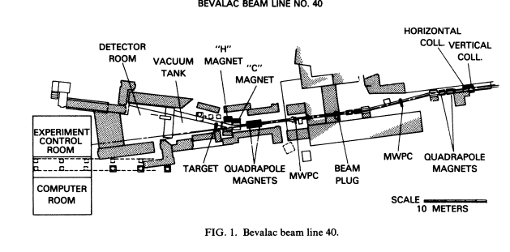
Two-nucleon knockout reactions II
1. Use the carbon beam from fragmentation by HIC
and scatter off Carbon target.
2. Measure light ion and collect A=10 nuclei.
Notes:
One can measure the knock-out two nucleons or measure the A=10 isotopes. This experiment has been done about 30 years ago at Bevalac. They used fragment 12C beam and scattered off 12C target, and measured various nuclei after scattering. After that other experiments using different energies have been performed.

Slide 19
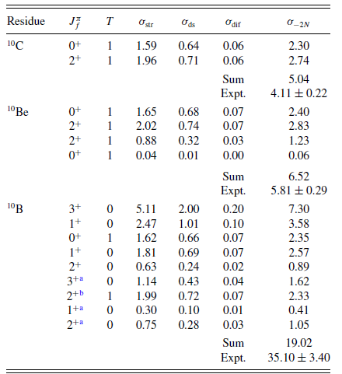
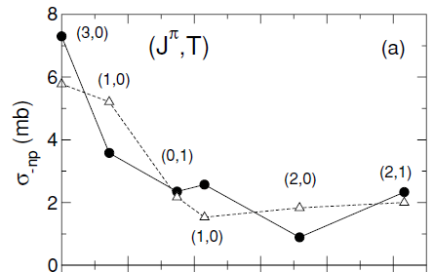

Two-nucleon knockout reactions III
Advanced Model np removal with T=0
First Calculations : np removal from ¹²C (with Shell Model Calc. from B.A. Brown)
E.C. Simpson and J.A. Tostevin, PRC 83, 014605 (2011).
-2n
¹⁰B
Shell model
-2p
PJT interaction
WBP
-np
p-shell
T = 0 cross-sections – sensitive to different effective interactions !
T=0 np-spatial correlations in the wave functions are insufficient
Courtesy of J. Lee
Notes:
One of the typical example is the comparison of -2n, -2p and –np knockout reaction in 12C + 12C scattering. The energy range is much higher i.e. 0.25-2.10 GeV/u. Interesting point to note is the ratio of np breakup reaction, whose data is much larger than those for nn and pp knockout reactions.
Moreover the results are very sensitive to the interaction used in the SM calculations.

Slide 20
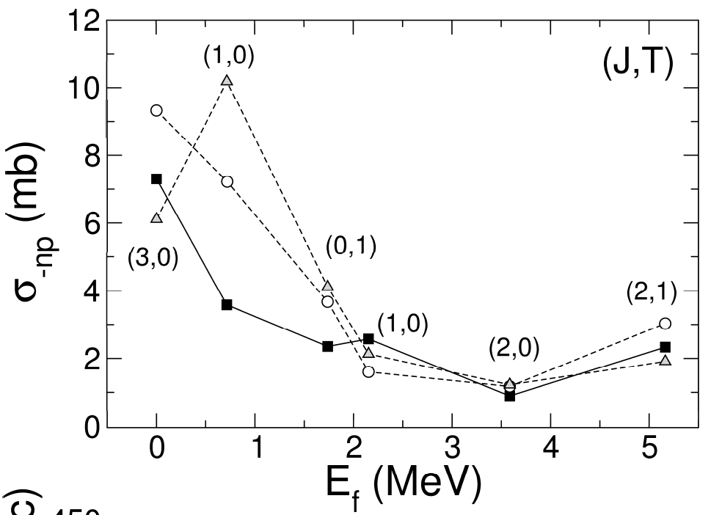
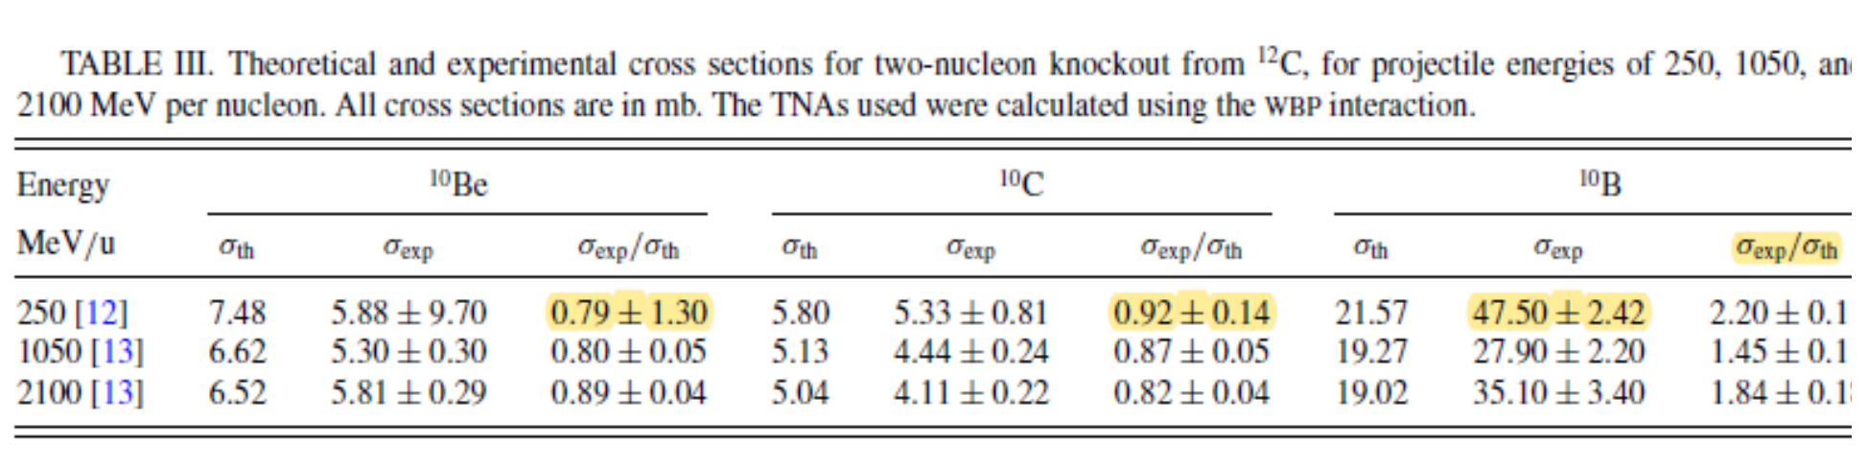
Two-nucleon knockout reactions IV
np-Correlations & 3-body Force
Structure Model
Eikonal-Theory Reaction Model
σ(theo)
Conventional Shell Model B.A. Brown (MSU)
np-removal of ¹²C on ¹²C target
Ο NCSM (NN+3N)
No-core Shell Model (NCSM)
(realistic 2-body and 3-body forces )
P. Navratil (TRIUMF)
∆ NCSM (NN, w/o3N)
theo. σ_{-np} (mb)
¹⁰B
Significant Increase in the T=0 Cross Sections !
T=0 cross section Sensitive to 3N-force !
■ Conventional
Shell model
E. C. Simpson, P. Navrátil, R. Roth, and J. A. Tostevin
Phys. Rev. C 86, 054609
TOSM (tensor-optimized shell model) T. Myo (Osaka Tech)
Final-State-Exclusive Data needed to pin-point the physics !
Courtesy of J. Lee
Notes:
Even the 3-N force and the NCSK did not explain the data.

Slide 21
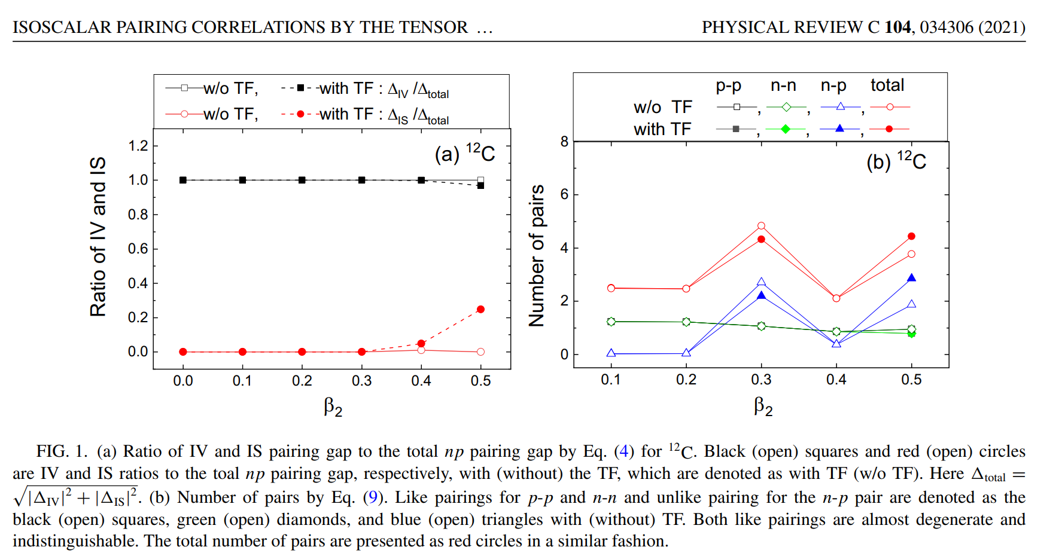
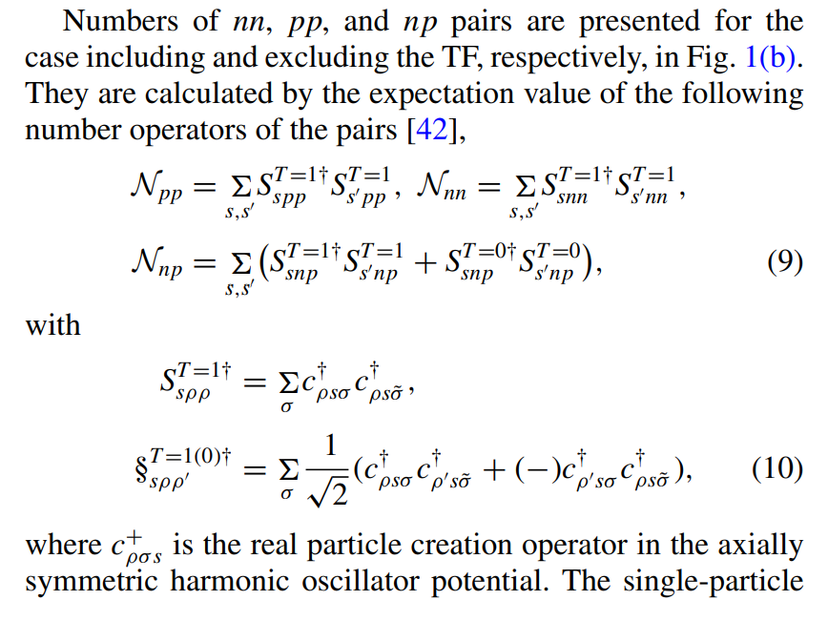
Two-nucleon knockout reactions and Tensor Force I

Slide 22
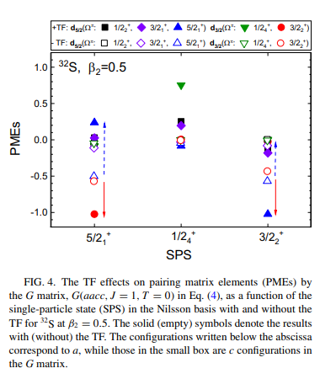
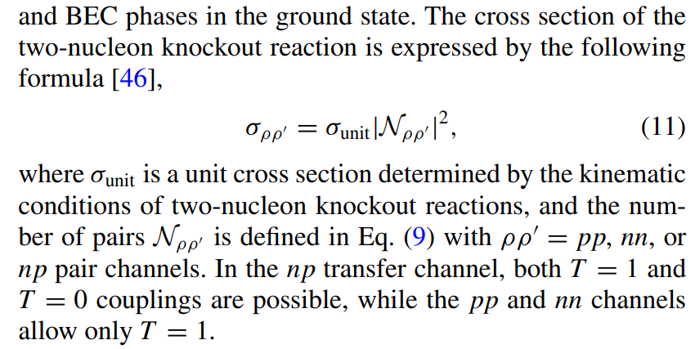
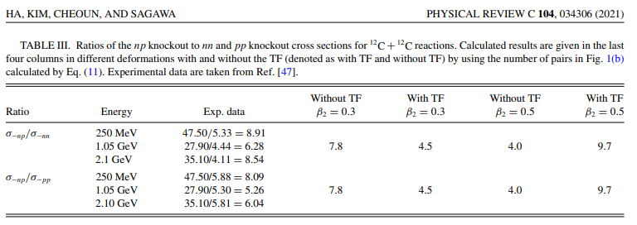
Two-nucleon knockout reactions and Tensor Force II
Notes:
However, if we include explicitly the TF, we can explain the large ratio of –np production (T=0) to the T=1 pairing i.e. nn and pp pairing knockout using the pairing interaction calculated by the G-matrix. But we have to consider the deformation effects as well as the TF in order to deduce the final conclusion.

Slide 24
Motivation
1-1. Exotic Light Nuclei
1-2. Low Energy Nuclear Reactions (LENR) for Exotic Nuclei
2. LENR for Carbon isotopes
2-1. Quasi-elastic scattering of C isotopes
2-2. Two nucleon knockout in 12C + 12C scattering
3. LENR for 10Be
3-1. Cosmological Origin of 10Be
3-2. Elastic and non-elastic scattering
4. LENR 6He, 17F and 17O for mirror nuclei
5. LENR for Li isotopes
6. Summary and Conclusion
Submitted to PLB (2022)
PRC 104, 034306 (2021)
ArXiv: 2203.13365: ApJS, in press, (2022)
EPJA 56, 42 (2020), LRN for 197Au
PRC 92, 014627 (2015) LRN potential
PRC 92, 044618 (2015) LRN potential
PRC 93, 954624 (2016) Radius
PRC 105, 014601 (2022)
PRC 89, 057601 (2014) 11Li
PRC 90, 054615 (2014) 11Li
PLB 780, 455 (2018) Fusion
JKPS 70, 42 (2017) Fusion
PRC 103, 034611 (2021) Fusion

Slide 25
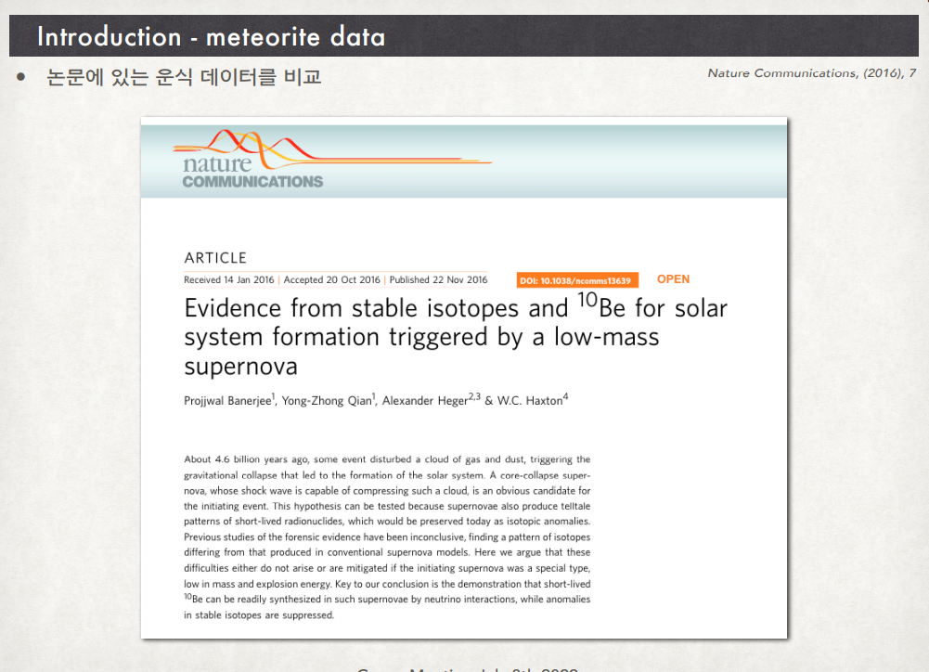
10Be production in the universe
10Be can produced from the SN ?

Slide 26


10Be production in the universe & Meteorite data of 10Be/9Be
Moreover the data of the ratio 10Be/9Be was obtained from the meteorite analysis.
Note that 10Be is unstable and 9Be is stable.
But previous calculation predicted that 10Be cannot be produced by the neutrino-process
because the destruction channel 10Be(a,n)13C was overestimated i.e. 10Be was destructed fully.

Slide 27

10Be production in the universe
But, even if we use the correct rate for the (a,n) reaction,
the production rate is smaller than the production by the cosmic ray, which
is a kind of the spallation by cosmic rays.
That is the reason why the main mechanism is the spallation by the CR. Is it true?

Slide 28

Main nuclear reactions for the production of 10Be in the neutrino process
Destruction Reactions (a,n) and (p,a) are fixed
by data and new calculations.
But the problem remained is the (p,n) reaction
and its inverse reactions,
because we do not have data and
theoretical calculations are still questionable.

Slide 29


Slide 30


Main nuclear reactions for the production of 10Be in the neutrino process
(n,p) and (p,n) reactions
by Talys which was used in the process
(0.01 T9 < T <10 T9)
0.00086 MeV (= 0.086 keV) < E < 0.86 MeV)
1MeV=1.16*10^10 Kelvin
Destruction reaction 10Be(p,n)10B is too large.
It is calculated by Talys !
That is the reason 10Be was too small O(-22)
in the previous calculation which used the Talys results!!

Slide 31


Main nuclear reactions for the production of 10Be in the neutrino process
(n,p) and (p,n) reactions
10B(n,p)10Be rection from JENDL-5

Slide 32



10Be(p,n)10B rection by Chiba using 10B(n,p)10Be reaction data from JENDL-5
(n,p) and (p,n) reactions

Slide 33

If we use the new data for the (n,p) and (p,n) reactions deduced from JENDL data,
The destruction becomes small, and the construction is larger than those by the Talys. Be10 abundance is up !!

Slide 34


Slide 35





Summary 1
As suggested by Nature, we used new data
for 10Be(a,n)13C from JINA REACLIB .
But 10Be abundance is very small.
Summary 2
Previous calculation used the Talys results
for 10Be(p,n)10B, which destroyed 10Be.
But new calculations based on JENDL-5
showed that the (p,n) reaction is small,
so that
10Be abundance increases.
The CEX is really important and needs the experimental data !!

Slide 36

Main nuclear reactions for the production of 10Be in the neutrino process
However, there are other production channels
from Be and B, for example, 11Be(g,n)10Be….

Slide 37


Slide 38

Main nuclear reactions for the production of 10Be in the neutrino process
We used the (n,g) data from NNDC and calculated reverse reaction by the balance equation.
The contribution turns out to be critical for the 10Be production process.
Of course, we need experimental data to justify these reactions.

Slide 39
Motivation
1-1. Exotic Light Nuclei
1-2. Low Energy Nuclear Reactions (LENR) for Exotic Nuclei
2. LENR for Carbon isotopes
2-1. Quasi-elastic scattering of C isotopes
2-2. Two nucleon knockout in12C + 12C scattering
3. LENR for 10Be
3-1. Cosmological Origin of 10Be
3-2. Elastic and non-elastic scattering of 11Be
4. LENR 6He, 17F and 17O for mirror nuclei
5. LENR for Li isotopes
6. Summary and Conclusion
Submitted to PLB (2022)
PRC 104, 034306 (2021)
ArXiv: 2203.13365: ApJS, in press, (2022)
EPJA 56, 42 (2020), LRN for 197Au
PRC 92, 014627 (2015) LRN potential
PRC 92, 044618 (2015) LRN potential
PRC 93, 954624 (2016) Radius
PRC 105, 014601 (2022)
PRC 89, 057601 (2014) 11Li
PRC 90, 054615 (2014) 11Li
PLB 780, 455 (2018) Fusion
JKPS 70, 42 (2017) Fusion
PRC 103, 034611 (2021) Fusion

Slide 40


Low Energy Nuclear Reaction of 11Be
Mashiro Isaka
Notes:
11Be is known as a one neutron halo. The structure shows a really interesting shell evolution. That is the inversion of the ½+ state below ½- state, which is the spin parity of the ground state. This inversion comes from the residual interaction. But it is still unknown why the inversion occurs. Maybe it is strongly related the deformation of the nucleus.

Slide 41



Neutron Halo
Elastic scattering
$E_{c.m.}$=37.1 MeV
$${}_{}^{11}{Be+}{}_{}^{197}{Au}$$
Breakup reaction
$E_{c.m.}$=29.6 MeV
Inelastic scattering
Notes:
Now compare the aforementioned potential with the experimental data. We check the reaction of be 11 and au 197 for elastic scattering, inelastic scattering and breakup reaction.
The center of mass energies between the two nuclei are 37.1 mev and 29.6 mev.
이제 앞서 제시한 포텐셜을 실험값과 비교해보자. 우리는 Be 11과 197 Au 의 반응 중에서 탄성 산란, 비탄성 산란 그리고 깨짐 반응을 확인한다.
두 핵 사이의 center of mass energy는 37.1과 29.6이 이다.

Slide 42
Low Energy Nuclear Reaction of 11Be
Dynamics of Halo Nuclei
Notes:
Because of the small excitation energy, which is 0.32 MeV with neutron separation energy is 0.502 MeV. Therefore, we have to consider the breakup reaction of 11Be. Since the valence neutron can be located to the opposite side we consider the long range nuclear potential (LRN) instead of the continuum states of the excitation as well as the CDE potential.

Slide 43









Low Energy Nuclear Reaction of 11Be
Coulomb Dipole Excitation Potential
M. V. Andres et al.,NPA.579.273-294(1994)
W. Y. SO et al.
PRC.92.014627(2015)
Unbound
$$U_{CDE}^{br}\left(r\right)=V_{CDE}^{br}\left(r\right)+iW_{CDE}^{br}\left(r\right)$$
$$=\frac{4π}{9}\frac{Z_{t}^{2}e^{2}}{ℏv}\frac{1}{{\left(r−a_{0}\right)}^{2}r} \int_{ε_{b}}^{∞}{dε}\frac{dB\left(E1\right)}{dε}×\left[g\left(\frac{r}{a_{0}}−1,ξ\right)+if\left(\frac{r}{a_{0}}−1,ξ\right)\right]$$
Bound
$$U_{CDE}^{inel}\left(r\right)=V_{CDE}^{inel}\left(r\right)+iW_{CDE}^{inel}\left(r\right)$$
$$=\frac{4π}{9}\frac{Z_{t}^{2}e^{2}}{ℏv}\frac{B\left(E1;ε_{x}^{1st}\right)}{{\left(r−a_{0}\right)}^{2}r} ×\left[g\left(\frac{r}{a_{0}}−1,ξ\right)+if\left(\frac{r}{a_{0}}−1,ξ\right)\right]$$
$$\frac{dB\left(E1\right)}{dε}=N\frac{\sqrt{ε_{b}}{\left(ε−ε_{b}\right)}^{3/2}}{ε^{4}}$$
$$∗ε_{X}^{1st}=0.32 MeV$$
$$∗if\left(\frac{r}{a_{0}}−1,ξ\right)=4ξ^{2}{\left(\frac{r}{a_{0}}−1\right)}^{2}e^{−πξ}K_{2iξ}^{"}\left[2ξ\left(\frac{r}{a_{0}}−1\right)\right]$$
$∗g\left(\frac{r}{a_{0}}−1,ξ\right)=\frac{P}{π}\int_{−∞}^{∞}{\frac{dξ^{′}}{ξ−ξ^{′}}f\left(\frac{r}{a_{0}}−1,ξ^{′}\right)}$
$$∗ξ=a_{0}ε/ℏv,{ a}_{0}=Z_{p}Z_{t}e^{2}/2E_{cm}$$
$∗ε_{b}$is equal to the separation energy $S_{n}=0.5 MeV$
$∗N=3.1$ is the proportional constant
$∗dB\left(E1\right)/dε$ is the Coulomb strength distribution.
Notes:
To explain the inelastic scattering and breaup reaction between the be 11 and the target, we explain it through this Coulomb dipole excitation. This is e1 transition.
First, be 11 has just one excited state under separate energy. Therefor, it is explained using only one value of the B(E1)
Secoundly, to express the unbound state of be 11, we use the coulomb strength distribution.
The real part and imaginary part are represented here by modified Bessel function.
Beriliyum 11과 표적체 사이의 비탄성 산란과 깨짐 반응을 설명 하기위해서는 coulomb dipole excitation을 통해서 설명을 한다.
첫번째로, berylium 11은 분리 에너지 아래에 하나의 excited state가 있다. 이런 경우에는 단 하나의 B(E1) 값을 통해서 설명을 하였다.
두번째로, berylium 11의 unbound 상태를 표현하기 위해서는 coulomb strength distribution을 이용하였다.
Real 파트와 imaginary 파트는 여기 수정된 bessel 함수로 각각 표현 되어져있다.

Slide 44


Low Energy Nuclear Reaction of 11Be
Long Range Nuclear Potential for Continuum …!!
$$U_{0}^{lo}\left(r\right)=\left(V_{0}^{lo}+iW_{0}^{lo}\right)4a_{0}^{lo}\frac{df\left(X_{0}^{lo}\right)}{dr}$$
$f\left(X_{0}^{lo}\right)=[1+\exp\left(X_{0}^{lo}\right)] , X_{0}^{lo}=\frac{r−R_{0}^{lo}}{a_{0}^{lo}} and R_{0}^{lo}=r_{0}^{lo}(A_{1}^{\frac{1}{3}}+A_{2}^{\frac{1}{3}})$
Notes:
This is final term of the potentials. This potential is LRN potential. this potential is made by the second derivative woods-saxon form. And this potential is also made up of two part. Real part and imaginary part. Unfortunately we can not find proper potential parameter set. So in the case of these potentials, chi-square analysis was performed using experimental data of elastic scattering cross section and breakup cross section. It can be understood that it explains the overall remaining effect for the interation after applying the previous potential. . This table is for the LRN potential parameter set. This first part is the beam energy and this is set number,this is depth for real part and imag part and diffuseness and radius for woods saxon’s geometric pararmeter. As you can see these optical model parameter sets are not general value. These geometric parameters show a much larger than general types.
This is final term of the potentials. This potential is LRN potential. this potential is made by the second derivative woods-saxon form. And this potential is also made up of two part. Real part and imaginary part. Unfortunately we can not find proper potential parameter set.이 포텐셜의 경우에는 탄성 산란과 깨짐 반응을 이용해서 chi-square 분석을 하였다.
이전에 앞선 포텐셜을 적용한 후에 남은 전체적인것을 설명해준다고 이해하면된다. This table is for the LRN potential parameter set. This first part is the beam energy and this is set number,this is depth for real part and imag part and diffuseness and radius for woods saxon’s geometric pararmeter. As you can see these optical model parameter sets are not general value. 이 값들의 경우는 일반적인 값들에 비해서 훨씬 큰값을 보여준다.
So we can understand these geomatic values as the Long ranger property.

Slide 45

Low Energy Nuclear Reaction of 11Be
(Inelastic Scattering Cross- section)
Kyoungsu Heo et al. EPJA. 56:42 (2020)
$$T_{inel;l}=\frac{8}{ℏv}\int_{0}^{∞}{{\left|χ_{l}^{+}\left(r\right)\right|}^{2}[W_{CDE}^{inel}}]dr$$
Notes:
this is the inelastic scattering cross section. This y axis is the differential cross section and this x-axis is the center of mass angle. this results also very satisfied with the experimental data.
However, there is still no difference among each calculation.

Slide 46

Low Energy Nuclear Reaction of 11Be (Breakup reactions cross sections)
Long Range Nuclear (LRN) Force rather than CDE !!
$$T_{BU;l}=\frac{8}{ℏv}\int_{0}^{∞}{{\left|χ_{l}^{+}\left(r\right)\right|}^{2}[W_{CDE}^{br}}+W^{lo}]dr$$
Notes:
As you see, the the CDE was not enough to explain the BR reaction. But if we include the LRN, the X-section becomes the data. Interesting point is that with the increase of the incident energy the LRN contribution becomes small.

Slide 47

Low Energy Nuclear Reaction of 11Be
(Elastic Scattering Cross- section)
Kyoungsu Heo et al. EPJA. 56:42 (2020)
$$P_{E}= dσ_{el.}/dσ_{Ruth}$$
Notes:
this is elastic scattering cross section. And this x axis is the center of mass angle. This y axis – PE is the elastic differential crossection over Rutherford cross section. So this value equal to one is meaning of the projectile’s trajectory moves like the coulomb trajectory. In other words, the projectile is located in the long range between the target and projectile. Anyway, this red points are the experience data and this CDE is the meaning of the excluded LRN potential. that is only include the bare and cde potential. but these dashed lines are for the LRN potential sets as I mentioned. This graph is for the 29.6MeV and this graph is for the 37.1MeV. as you can see, we can difficult distinguish among these calculations. So maybe you can think we don’t need LRN potential. but you can see necessity for the LRN potential at the breakup cross section. Anyway these calculations satisfy the experiment data.

Slide 48
Motivation
1-1. Exotic Light Nuclei
1-2. Low Energy Nuclear Reactions (LENR) for Exotic Nuclei
2. LENR for Carbon isotopes
2-1. Quasi-elastic scattering of C isotopes
2-2. Two nucleon knockout in 12C + 12C scattering
3. LENR for 11Be
3-1. Cosmological Origin of 11Be
3-2. Elastic and non-elastic scattering of 11Be
4. LENR 17F and 17O for mirror nuclei
5. LENR for 6He and Li isotopes
6. Summary and Conclusion
Submitted to PLB (2022)
PRC 104, 034306 (2021)
ArXiv: 2203.13365: ApJS, in press, (2022)
EPJA 56, 42 (2020), LRN for 197Au
PRC 92, 014627 (2015) LRN potential
PRC 92, 044618 (2015) LRN potential
PRC 93, 954624 (2016) Radius
PRC 105, 014601 (2022)
PRC 89, 057601 (2014) 11Li
PRC 90, 054615 (2014) 11Li
PLB 780, 455 (2018) Fusion
JKPS 70, 42 (2017) Fusion
PRC 103, 034611 (2021) Fusion

Slide 49




Proton Halo
$E_{lab}$=98 MeV
Elastic scattering
Inelastic scattering
$${}_{}^{17}{F+}{}_{}^{208}{Pb}$$
$E_{lab}$=120 MeV
Breakup reaction
Total Fusion reaction
$E_{lab}$=170 MeV
Notes:
This time, we compare F17, Proton halo nucleus with experimental data using an optical model. We check the three beam energies.
I’m talking about elastic scattering, inelastic scattering, breakup reaction and total fusion reaction.
이번에는 양성자 후광핵인 F17에 대해서 광학 모델을 이용하여 실험데이터와 비교한다. 17F와 208PB 사이의 3개의 center of mass 에너지에 대해서 확인해본다. 우리는 탄성 산란, 비탄성 산란, 깨짐 반응 그리고 전체 융합 반응에 대해서 확인해본다.

Slide 50

Optical model potential (1)
Elastic scattering process
Why Elastic scattering is important?
- Show interactions(potential) between the projectile and the target
- This distinguish between Coulomb force and Nuclear force
- We can distinguish between elastic scattering and non-elastic scattering
-This creates Model wave function by optical potential
Rutherford scattering (Coulomb scattering)
  Coulomb interaction between incident electron and the electric charge of the electron clouds and the nuclei.
  Elastic scattering
  Q-Value=0
Impact parameter: b
Notes:
So far, we have examined several propeties of the halo nucleus.
To examined the reactions between the halo nucleus and target, I use the optical model potential.
Before talking about the optical model potential, the most important thing in the optical model is the explanation of elastic scattering.
The elastic scattering explains the interaction between the target and projectile. And this distinguishes between the Coulomb part and nuclear part.
And this distinction can also be divided into elastic part and non-elastic part. Taking method of this, we also use this optical model for like the DWBA, Coupled channel …
So it is very important for us to create an optical model that can determine elastic scattering.
금까지는 후광핵의 특징을 몇가지 살펴보았다.
이러한 후광핵의 핵반응을 살펴보기 위해서는 입사체와 표적체 사이의 상호작용을 표현할 방법이 필요하다.
오늘 사용할 모델은 OPTICAL 모델이다.
옵티컬 모델을 얘기 하기에 앞서 옵티걸 모델에서 가장 중요한 핵들 사이의 반응은 ELASTIC SCATTERING입니다. 엘락스틱 스케터링의 경우는
타겟과 프로젝타일 사이의 상호작용을 명확하게 핵력과 클롱력을 통해서 구분지어 보여 줄수 있으며 이를 통해 모델 파동함수를 기술하여 optical model 처럼 one channel에 대한 설명 외에도
Dwba,coupled channe등에서 반드시 한번은 거쳐가야할 단계 입니다. 그리고 이러한 elastic scatterin의 경우는 클롱에 의한 스케터링이 가장 도미넌트 하기때문에 엘라스틱 스케터링에서는
가장 중요한 부분이 이 러더포드 스케터링을 통한 엘라스틱 스케터링과 핵력에 non-elastic scattering으로 구분 지어질수 있는 것입니다.

Slide 51





Optical model potential (3)
Extended Optical model potential
$U_{OM}^{}\left(r\right)=V_{C}\left(r\right)−V_{0}^{}\left(r\right)−$ $U_{DPP}^{}\left(r\right)$
=$V_{C}\left(r\right)−V_{0}^{}\left(r\right)−{\{U}_{CDE}^{BU}\left(r\right){+U}_{sur}^{BU}\left(r\right)+U_{}^{TF}\left(r\right)+U^{inel.}\}$
=$V_{C}\left(r\right)−V_{0}^{}\left(r\right)−{\{{\{V}_{CDE}^{BU}\left(r\right)+iW_{CDE}^{BU}+V}_{sur}^{BU}\left(r\right)+iW_{sur}^{BU}+V_{}^{TF}\left(r\right)+iW^{TF}+{iW}^{inel.}\}$
$$\left[E−T_{l}\left(r\right)\right]χ_{l}^{(+)}=U_{OM}\left(r\right)χ_{l}^{\left(+\right)}(r)$$
Angular distribution
$$\frac{dσ_{i}}{dΩ}=\frac{ka_{0}}{16π}\frac{1}{\cos\left(\frac{θ_{c.m.}}{2}\right)\sin^{3}\left(\frac{θ_{c.m.}}{2}\right)}\sum_{l}{\frac{π}{k}\left(2l+1\right)T_{i;l}}, i=BU, Inel and TF$$
$$T_{i;l}=\frac{8}{ℏv}\int_{0}^{∞}{{\left|χ_{l}^{+}\left(r\right)\right|}^{2}W^{i}\left(r\right)}dr$$
$$∗b=\frac{l}{k}=\frac{a_{0}}{2}\cot\left(\frac{θ_{c.m.}}{2}\right)$$
Notes:
There is little difference from the potential for the be 11 described earlier. However, this is for the proton halo 17F, So a different choice was made.
Equally, there are Coulomb part, nuclear part and DPP part.
This dpp part is divided by some parts. This potential is for the breakup , this part is for the total fusion and this part is for inelastic part.
And each potential has real part and imaginary part.
These potentials are used to create distorted wave. This partial wave and potential satisfy the schrodinger equation.
Use each imaginary potential to obtain T-coefficient. And use this to find each cross section.
앞서 설명한 11be를 위한 포텐셜과의 차이는 거의 없다. 하지만 핵종이 달라졌기 때문에 몇가지 다른 선택을 하였다. 동일하게 쿨롱 파트와 핵력 파트 그리고 dpp 파트가 있다.
여기의 dpp 파트는 breakup 을 기술할 부분, total fusion을 설명할 부분 그리고 inelastic 을 기술할 부분으로 나눈다. 그리고 각 포텐셜은 동일하게 real 파트와 imaginary 파트가 있다.
이러한 포텐셜을 이용하여 왜곡된 파동함수를 만든다. 그리고 이 파동 함수와 포텐셜은 schrodinger 방정식을 만족한다. 각 imaginary 포텐셜을 이용하여 t-coefficient를 구한다. 그리고 이것을 이용하여 각 cross section을 구한다.

Slide 52










Bare Potential.
$$r_{12}$$
Extended Optical model potential.
$$r_{1}$$
$$r_{2}$$
$U_{OM}^{}\left(r\right)=V_{C}\left(r\right)−V_{0}^{}\left(r\right)−$ $U_{DPP}^{}\left(r\right)$
$$r$$
$$U_{DPP}^{}\left(r\right)={\{U}_{CDE}^{BU}\left(r\right)+U_{sur}^{BU}\left(r\right)+U_{}^{TF}\left(r\right)+U^{inel.}\}$$
Projectile
$${}_{}^{17}F$$
Double Folding potential.
Target
$${}_{}^{208}{Pb}$$
$V_{0}^{}\left(r\right)=\int{dr_{1}}\int{dr_{2}ρ_{T}\left(r_{2}\right)ρ_{P}\left(r_{1}\right)v_{nn}(r_{12}=\left|r−r_{1}+r_{2}\right|)}$
$$⋅N−N interaction\left(M3Y\right) : v_{nn}\left(r\right)=7999\frac{{ e}^{−4r}}{4r}−2134\frac{{ e}^{−2.5r}}{2.5r}−276δ(r)$$
${⋅Target Density : ρ}_{T}\left(r\right)=ρ_{0}/\left[1+exp⁡(\frac{r−c}{z})\right]$
with $ρ_{o}=0.164 fm^{−3}, c=6.624 fm, z=0.549 fm$
$$⋅{Projectile Density : ρ}_{P}\left(r\right)=ρ^{{}_{}^{16}O}\left(r\right)+ρ^{p}\left(r\right)$$
$ρ^{{}_{}^{16}O}\left(r\right)=0.1317\left(1+0.6457r^{2}\right)\exp\left(−0.3228r^{2}\right)$
$ρ^{p}\left(r\right)={\left(\frac{3}{2πR_{h}^{2}}\right)}^{\frac{3}{2}}\exp\left(−\frac{3r^{2}}{2R_{h}^{2}}\right)$ with $R_{h}=3.78 fm$
Notes:
First, let me explain the bear potential. This potential is a real type potential. This potential expresses the nuclear interation between the target and the projectile.
And this potential is energy independent. The interaction between the target and projectile is created using the double folding potential.
This double folding potential uses the density profile of the target and the projectile.
This is for the nucleon-nucleon interaction part. This part explain the interaction between the inner nucleons.
The density of the target uses the woods Saxons form. And this is projectile’s density part. It would be nice to have accurate F17 density information, but it is not.
Thus, the sum of 16O and valence proton expresses this 17F.
일단 bare 포텐셜에 대해서 설명하겠다. 이 포텐셜은 입사체와 표적체 사이의 핵력을 표현해주는 real type의 포텐셜이다.
이 projectile과 target 사이의 상호작용은 double folding 포텐셜을 이용해서 만들었다. 여기에는 표적체의 density profile과 입사체의 density profile을 이용한다.
그리고 이것은 내부의 nucleon 사이의 상호작용을 표현해줄 nn-interaction 파트이다.
Nn-interactio은 M3Y 를 이용한다.
표적체의 밀도는 woods-saxon의 형태를 이용한다. 입사체의 경우에는 정확한 F17의 밀도 정보가 있으면 좋겠지만 없다. 따라서 16o와 양성자의 합으로 17f를 표현한다.

Slide 53









Inelastic scattering (For E2 Transition).
$$hν$$
W.G. LOVE et al.,NPA.291.183-205(1977)
Extended Optical model potential.
$U_{OM}^{}\left(r\right)=V_{C}\left(r\right)−V_{0}^{}\left(r\right)−$ $U_{DPP}^{}\left(r\right)$
$$U_{DPP}^{}\left(r\right)={\{U}_{CDE}^{BU}\left(r\right)+U_{sur}^{BU}\left(r\right)+U_{}^{TF}\left(r\right)+U^{inel.}\}$$
Projectile
$${{}_{}^{17}F}^{∗}$$
Coulomb Quadrupole Excitation(CQE) potential
$$U_{}^{inel.}\left(r\right) = −\left[1−\frac{2}{7}{\left(\frac{R_{C}}{r}\right)}^{2}−\frac{1}{21}{\left(\frac{R_{C}}{r}\right)}^{4}\right]K_{C}\left(r\right)\frac{W_{P}}{r^{5}} \left( r ≥R_{C}\right) =−\frac{2}{3}K_{C}\left(r\right)\frac{W_{P}r^{4}}{R_{C}^{9}} ( r<R_{C} )$$
$$K_{C}(r) = {\left[1−\left(\frac{Z_{a}Z_{A}e^{2}}{rE_{CM}}\right)\right]}^{−\frac{1}{2}} ( r<\frac{R_{d}}{0.9} )$$
$=3.16 ( r≥\frac{R_{d}}{0.9} )$
$${ ∗R}_{D}=\left(\frac{Z_{a}Z_{A}e^{2}}{E_{CM}}\right)$$
$$∗ξ=\frac{1}{2}η∆E/E_{c.m.}$$
$W_{P}=0.01676\frac{μZ_{i}^{2}}{k}B\left(E2\right)g_{2}\left(ξ\right)$ $MeV fm^{5}$ $\left(i=1 or 2\right)$
$Z_{i}$ is the charge on the ion which is causing the excitation.
$g_{2}\left(ξ\right)$ is the adiabaticity correction factor
Notes:
This time, it is the DPP part that explains non-elastic scattering. The first is CQE potential. This Coulomb quadrupole excitation potential describes 17F’s exciation.
This potential is part of the E2 transition. F17 has justo one excited state under the separate energy.
Like other potentials, this potential also has real and imaginary part. However, the contribution of the real part is negligible.
Therefore, only the imaginary potential is considered in this case.
이번에는 non-elasti을 설명할 부분인 dpp 파트 이다. 첫번째로 17F의 excitation을 기술할 CQE potential이다.
이 포텐셜은 17f의 E2 transtion을 설명하기 위한 파트이다. F17 has just one excited state under separate energy.
이 포텐셜 또한 다른 포텐셜 처럼 real 파트와 imaginary 파트가 존재한다. 하지만 이 포텐셜의 real 파트에 대한 기여는 무시 할만큼 작다. 따라서 이 경우에는 imaginary 파트만 고려한다.
이제는 elastic scattering의 absorption을 생각해 보아야합니다. 첫번째로 17f 의 excitation을 기술할 클롱 쿼드라폴 익사이테이션 포텐셜입니다.
w.g.love에 의해서 1977년 발표되어진 e2 transtion을 기술하기 위한 dpp로써 17F의 하나 존재 하는 1ST EXCTATION을 기술하기 위한 포텐셜입니다.
이 포텐셜 또한 다른 포텐셜처럼 리얼파트와 이메지너리 파트가 존재하지만 이 포텐셜의 리얼파트의 대한 기여는 러브가 얘기했듯이 무시할만 하기 때문에
여기서는 IMAG 만 존재한다고 보시면 되십니다. 모노폴에의한 클롱과 마찬가지로 RC를 중심으로 포텐셜의 형태가 살짝 바뀌게 되며 여기 WP를 통해서 E2 트렌지션의 확률을 고려하게 됩니다.

Slide 54


Elastic scattering and Inelastic Cross section
$$P_{i}=dσ_{i}/dσ_{Ruth}$$
$with i=elastic, quasi elastic and inelastic$
Notes:
This left side is for elastic scattering and this right side is for inelastic scattering. This x-axis is center of mass angle. And this y-axis is the Rutherford ratio.
This red points are the experimental data. Unfortunately, this experiment can not distinguish between elastic and inelastic. So this experimental points is for the quasi-elastic scattering.
The quasi elastic is meaning of the elastic plus inelastic. These lines are the result of theoretical calculations. This black represent just elastic scattering. And this blue line is for the quasi elastic calculation.
As I said, the experimental data can not distinguish between ground and excited. They are not inelastic scattering data. So this is just theoretical calculation.
여기의 포인트들이 각 에너지에 따른 elastic scattering data의 angular distribution 이다. 보시다 싶이 각 포텐셜은 elastic scatterin과 breakup reaction을 동시에 잘 기술해 낸것을 볼수 있습니다.
그리고 현재 여기에서의 elastic scatterin은 17F의 1ST 익사이테션을 분리하지 못하여 INELASTIC 플럭스가 포함되어져 있는 QUASI-ELASTIC SCATTERING입니다. 따라서 지금의 계산에는 ELASTIC 이 아닌 QUASI를 표현해야
하기에 INELASTIC에 대한 DPP는 고려하지 않은 상태에서 나머지만을 고려하여 기술하였습니다.

Slide 55



Breakup Reaction Process (by Nuclear)
Extended Optical model potential.
$U_{OM}^{}\left(r\right)=V_{C}\left(r\right)−V_{0}^{}\left(r\right)−$ $U_{DPP}^{}\left(r\right)$
$$U_{DPP}^{}\left(r\right)={\{U}_{CDE}^{BU}\left(r\right)+{U_{sur}^{BU}\left(r\right)+U}_{}^{TF}\left(r\right)+U^{inel.}\}$$
Projectile
$${{}_{}^{16}O}^{}+proton$$
Woods-Saxon potential for Break-up process
$$U_{0}^{BU}\left(r\right)=\left(V_{}^{BU}+iW_{}^{BU}\right)4a_{i}^{BU}\frac{df\left(X_{i}^{BU}\right)}{dr}$$
$f\left(X_{i}^{BU}\right)=[1+\exp\left(X_{i}^{BU}\right)] , X_{i}^{BU}=\frac{r−R_{i}^{BU}}{a_{i}^{BU}} and R_{i}^{BU}=r_{i}^{BU}(A_{1}^{\frac{1}{3}}+A_{2}^{\frac{1}{3}})$
Notes:
This dpp is the potential to describe the 17F breakup reaction. Basically, many direct reactions are done on the surface of the nucleus.
Therefore, we use differential woods saxon potential. This potential was obtained from chi-square analysis by fixing radius according to each energy.
In this case, unlike the previous Be11, it has general form of geometric value.
이번 DPP는 17F의 브레이크업을 기술할 포텐셜이다. 기본적으로 많은 direct reaction의 경우에는 핵의 표면에서 이루어지게 됩니다.
따라서 이번 또한 우드삭슨의 미분형태로 핵의 surface 부근을 기술한다. 포텐셜을 각 에너지에 따라서 RADIUS를 고정하여 chi-square 분석을 통해 얻어냈다.
이 경우에는 아까 11be 과 다르게 일반적인 형태의 값을 갖고있다.

Slide 56


Breakup reactions
$$T_{BU;l}=\frac{8}{ℏv}\int_{0}^{∞}{{\left|χ_{l}^{+}\left(r\right)\right|}^{2}W_{sur}^{BU}}dr$$

Slide 57


Breakup Reaction Process (by Coulomb)
Extended Optical model potential.
$U_{OM}^{}\left(r\right)=V_{C}\left(r\right)−V_{0}^{}\left(r\right)−$ $U_{DPP}^{}\left(r\right)$
$$U_{DPP}^{}\left(r\right)={\{U}_{CDE}^{BU}\left(r\right)+U_{sur}^{BU}\left(r\right)+U_{}^{TF}\left(r\right)+U^{inel.}\}$$
Projectile
$${{}_{}^{16}O}^{}+proton$$
Coulomb Dipole Excitation(CDE) potential
$$U_{CDE}^{cont.}\left(r\right)=V_{CDE}^{cont.}\left(r\right)+iW_{CDE}^{cont.}\left(r\right)$$
$$=\frac{4π}{9}\frac{Z_{t}^{2}e^{2}}{ℏv}\frac{1}{{\left(r−a_{0}\right)}^{2}r} \int_{ε_{b}}^{∞}{dε}\frac{dB\left(E1\right)}{dε}×\left[g\left(\frac{r}{a_{0}}−1,ξ\right)+if\left(\frac{r}{a_{0}}−1,ξ\right)\right]$$
$$U_{CDE}^{disc.}\left(r\right)=V_{CDE}^{disc.}\left(r\right)+iW_{CDE}^{disc.}\left(r\right)$$
$$= \frac{4π}{9}\frac{Z_{t}^{2}e^{2}}{ℏv}\frac{B\left(E1;ε_{x}^{1st}\right)}{{\left(r−a_{0}\right)}^{2}r} ×\left[g\left(\frac{r}{a_{0}}−1,ξ\right)+if\left(\frac{r}{a_{0}}−1,ξ\right)\right]$$
Notes:
This dpp is the potential to describe the 17F breakup reaction. Basically, many direct reactions are done on the surface of the nucleus.
Therefore, we use differential woods saxon potential. This potential was obtained from chi-square analysis by fixing radius according to each energy.
In this case, unlike the previous Be11, it has general form of geometric value.
이번 DPP는 17F의 브레이크업을 기술할 포텐셜이다. 기본적으로 많은 direct reaction의 경우에는 핵의 표면에서 이루어지게 됩니다.
따라서 이번 또한 우드삭슨의 미분형태로 핵의 surface 부근을 기술한다. 포텐셜을 각 에너지에 따라서 RADIUS를 고정하여 chi-square 분석을 통해 얻어냈다.
이 경우에는 아까 11be 과 다르게 일반적인 형태의 값을 갖고있다.

Slide 58






What is the reasonable value for B(E1)?
$$2^{nd}$$
$$1^{st}$$
$$3^{rd}$$
DE GREGORIO, KNAPP, LO IUDICE, AND VESELÝ PHYSICAL REVIEW C 95, 034327 (2017)

Slide 59




Lorentzian form for E1 strength
J. Phys. G: Nucl. Part. Phys. 47 (2020) 115107 E Guliyev et al

Slide 60





Breakup Reaction Process (by Coulomb)
Experimental $B\left(E1\right)= 0.00153 W.U.at E_{x}=2.609 MeV$
Delta : Theoritical $B\left(E1\right)=0.13e^{2}fm at E_{x}=2.92 MeV(Guide line)$
$$T_{BU;l}=\frac{8}{ℏv}\int_{0}^{∞}{{\left|χ_{l}^{+}\left(r\right)\right|}^{2}{[W}_{sur}^{BU}{+W}_{CDE}^{BU}]}dr$$
Notes:
This dpp is the potential to describe the 17F breakup reaction. Basically, many direct reactions are done on the surface of the nucleus.
Therefore, we use differential woods saxon potential. This potential was obtained from chi-square analysis by fixing radius according to each energy.
In this case, unlike the previous Be11, it has general form of geometric value.
이번 DPP는 17F의 브레이크업을 기술할 포텐셜이다. 기본적으로 많은 direct reaction의 경우에는 핵의 표면에서 이루어지게 됩니다.
따라서 이번 또한 우드삭슨의 미분형태로 핵의 surface 부근을 기술한다. 포텐셜을 각 에너지에 따라서 RADIUS를 고정하여 chi-square 분석을 통해 얻어냈다.
이 경우에는 아까 11be 과 다르게 일반적인 형태의 값을 갖고있다.

Slide 61





Total Fusion Reaction Process
Extended Optical model potential.
$${}_{}^{16}{\begin{aligned}O \\ +\end{aligned}}$$
$U_{OM}^{}\left(r\right)=V_{C}\left(r\right)−V_{0}^{}\left(r\right)−$ $U_{DPP}^{}\left(r\right)$
$$p$$
$$U_{DPP}^{}\left(r\right)={\{U}_{}^{BU}\left(r\right)+U_{}^{TF}\left(r\right)+U^{inel.}\}$$
Projectile
$${}_{}^{17}F$$
Target
$${}_{}^{208}{Pb}$$
Woods-Saxon potential for Total fusion process
$$U_{}^{TF}\left(r\right)=\left(V_{}^{TF}+iW_{}^{TF}\right)f\left(X_{i}^{TF}\right)$$
$f\left(X_{i}^{TF}\right)=[1+\exp\left(X_{i}^{TF}\right)] , X_{i}^{TF}=\frac{r−R_{i}^{TF}}{a_{i}^{TF}} and R_{i}^{TF}=r_{i}^{TF}(A_{1}^{\frac{1}{3}}+A_{2}^{\frac{1}{3}})$
Notes:
The last DPP potential is needed to describe the total fusion reaction. Basically, the fusion reaction is done inside the nucleus, so it is described using a volume type’s Woods-Saxons potential.
At each energy, the geometric parameters are held. And only depths are described differently.
마지막으로 설명한 포텐셜은 Total fusion 리액션을 기술하기 위해 필요하다. 기본적으로 fusion reaction의 반응은 핵의 내부에서 이루어지기 때문에 볼륨 형태의 woods-saxons 포텐셜을 이용하여 기술한다. 각 에너지에서의 geometric parameter를 하나로 고정하고 depth만을 바꾸어 각 시스템에 대해서 기술한다.

Slide 62



Total Cross section
$$DWBA Cal. :116mb\left(98Mev\right), 75mb\left(120MeV\right) and 50mb(170MeV)$$
Notes:
This graph is for the breakup reaction cross section. X-axis is angular distribution. Y-axis is differential cross section. These red points are for inclusive breakup data.
And these blue points are for exclusive breakup data. In the case of inclusive breakup, only O16 was identified through experiments. And exclusive data is a simultaneous identification of O16 and proton fragment.
Our calculation explain only inclusive data. So we are doing additional calculations to explain exclusive data.
이 그래프는 breakup reaction data 이다. X-axis는 angular distribution 이다. Y-axis는 differential cross section 이다. 빨간 points들은 inclusive breakup 실험값이다.
그리고 여기 파란색 points들은 exclusive breakup 실험값이다. Inclusive breakup의 경우는 실험을 통해 16o만을 확인한 것이다. Exclusive의 경우는 16o와 proton을 동시에 확인한 것이다.
우리의 계산 결과는 inclusive data 만을 설명해주고 있다. 그래서 우리는 Exclusive data를 설명하기 위해 추가적인 계산을 하고있다.

Slide 63



Conclusion and summary
$${}_{}^{11}{Be+}{}_{}^{197}{Au}$$
$${}_{}^{17}{F+}{}_{}^{208}{Pb}$$
We checked the breakup reactions according to each halo nucleus(11Be, 17F)
Comparing these two potentials, the difference between the geometric parameters is significant
- This show the geometric properties of each halo nucleus.
- In the case of neutron halo nuclei, this potential is understood as breakup reaction by diffraction dissociation.
-In the case of proton halo nuclei, this potential is understood as breakup reaction by proton stripping
Notes:
In the case of F17, it is difficult to reach a specific conclusion because it is still in the calculation process.
Therefore, I present a brief conclusion. This upper side is for LRN potential of Be11. this bottom side is for the breakup potential of 17F.
As I said, the lrn potential parameter sets are not general. Comparing these two potential parameter sets, we can see that be11 has very large geometric parameter.
This makes it simple to undserstand that the properties of proton halo show a much smaller radius.
And the above breakup potential, I think, this potential can explain the effect of diffraction dissociation. And this potential for F17 can explain the effect of stripping reaction by nuclear interaction.
F17의 경우는 아직 계산 과정에 있기 때문에 특별한 결론을 내리기는 어렵다. 따라서 간단한 결론은 내보겠다.
위의 테이블은 아까 보았던 BE11의 LRN 포텐셜이다. 아래는 F17의 BREAKUP을 표현하던 포텐셜 set이다. 이 둘을 비교하면 be11의 경우가 굉장히 큰 geometric parmater를 갖고 있음을 볼수있다.
이를 통해서 간단하게 나마 proton halo의 특성이 훨씬 작은 반경을 보여준다고 이해할수있다.
그리고 위의 breakup 포텐셜의 경우는 대체적으로 diffraction breakup의 효과를 설명해준다. 그리고 아래의 경우는 stripping의 효과를 주로 설명해준다.

Slide 64
Motivation
1-1. Exotic Light Nuclei
1-2. Low Energy Nuclear Reactions (LENR) for Exotic Nuclei
2. LENR for Carbon isotopes
2-1. Quasi-elastic scattering of C isotopes
2-2. Two nucleon knockout in12C + 12C scattering
3. LENR for 10Be
3-1. Cosmological Origin of 10Be
3-2. Elastic and non-elastic scattering of 11Be
4. LENR 17F and 17O for mirror nuclei
5. LENR for Li and 6He isotopes and Fusions
6. Summary and Conclusion
Submitted to PRC (2022)
PRC 104, 034306 (2021)
ArXiv: 2203.13365: ApJS, in press, (2022)
EPJA 56, 42 (2020), LRN for 197Au
PRC 92, 014627 (2015) LRN potential
PRC 92, 044618 (2015) LRN potential
PRC 93, 954624 (2016) Radius
PRC 105, 014601 (2022)
PRC 89, 057601 (2014) 11Li
PRC 90, 054615 (2014) 11Li
PLB 780, 455 (2018) Fusion
JKPS 70, 42 (2017) Fusion
PRC 103, 034611 (2021) Fusion

Slide 65
Coulomb Barriers of Halo Nuclei in Fusion Reactions !!

Slide 69
Motivation
1-1. Exotic Light Nuclei
1-2. Low Energy Nuclear Reactions (LENR) for Exotic Nuclei
2. LENR for Carbon isotopes
2-1. Quasi-elastic scattering of C isotopes
2-2. Two nucleon knockout in 12C + 12C scattering
3. LENR for 10Be
3-1. Cosmological Origin of 10Be
3-2. Elastic and non-elastic scattering of 11Be
4. LENR 17F and 17O for mirror nuclei
5. LENR for Li and 6He isotopes and Fusions
6. Summary and Conclusion
Submitted to PRC (2022)
PRC 104, 034306 (2021)
ArXiv: 2203.13365: ApJS, in press, (2022)
EPJA 56, 42 (2020), LRN for 197Au
PRC 92, 014627 (2015) LRN potential
PRC 92, 044618 (2015) LRN potential
PRC 93, 954624 (2016) Radius
PRC 105, 014601 (2022)
PRC 89, 057601 (2014) 11Li
PRC 90, 054615 (2014) 11Li
PLB 780, 455 (2018) Fusion
JKPS 70, 42 (2017) Fusion
PRC 103, 034611 (2021) Fusion

Slide 70
Summary and Conclusion
1. For the ratio of the X-section to Rutherford scattering of Carbon isotopes, specifically, for 10C,
we constructed the BU and Inelastic potentials in the OP approach,
and explained the irregular behavior of 10C scattering.
2. For the two nucleon knockout reactions of 12C + 12C scattering,
we explicitly included the TF in the residual interaction inside nuclei and explained
the large ratio of the np to the nn and pp knockout reactions.
3. For understanding the cosmological origin of 10Be, we examined thermal nuclear reactions for the
production mechanism. 10Be(p,a)13C, 10Be(n,p)10B, 10B(p,n)10Be turned out to play crucial roles
as well as the neutrino-induced reactions on 12C. In addition, 11Be(g,n)10B reaction is suggested
to be another key reaction to explain the meteorite abundance ratio.
4. For LENR of 11Be, we calculated the BU reaction, the inelastic scattering by the CDE and finally explained
the ratio of the quasi-elastic scattering.
5. For other halo nuclei, such as 11Li and 6He, we can explain the X-section data by the OM or extended OM
approach. For detailed calculations including fusion reactions, we refer to the references of our previous papers.

Slide 71
Thanks for your attention !!

