Slide 1
FPGA SEMINAL
2023-02-08
Wonjun-Jeong

Slide 2
Status report
Make project( and gate )
Simulation(use testbench)
Multiplexer
4. Demultiplexer

Slide 3
Make project
File – New Project Wizard
Define project name
Select
device
Summary
check

Slide 4
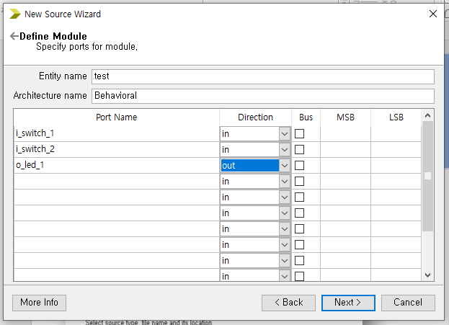
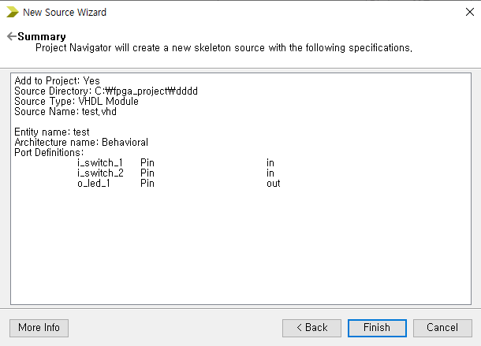
Make Module
Device name – New source wizard
Select VHDL Module
Define module
Summary
check

Slide 5
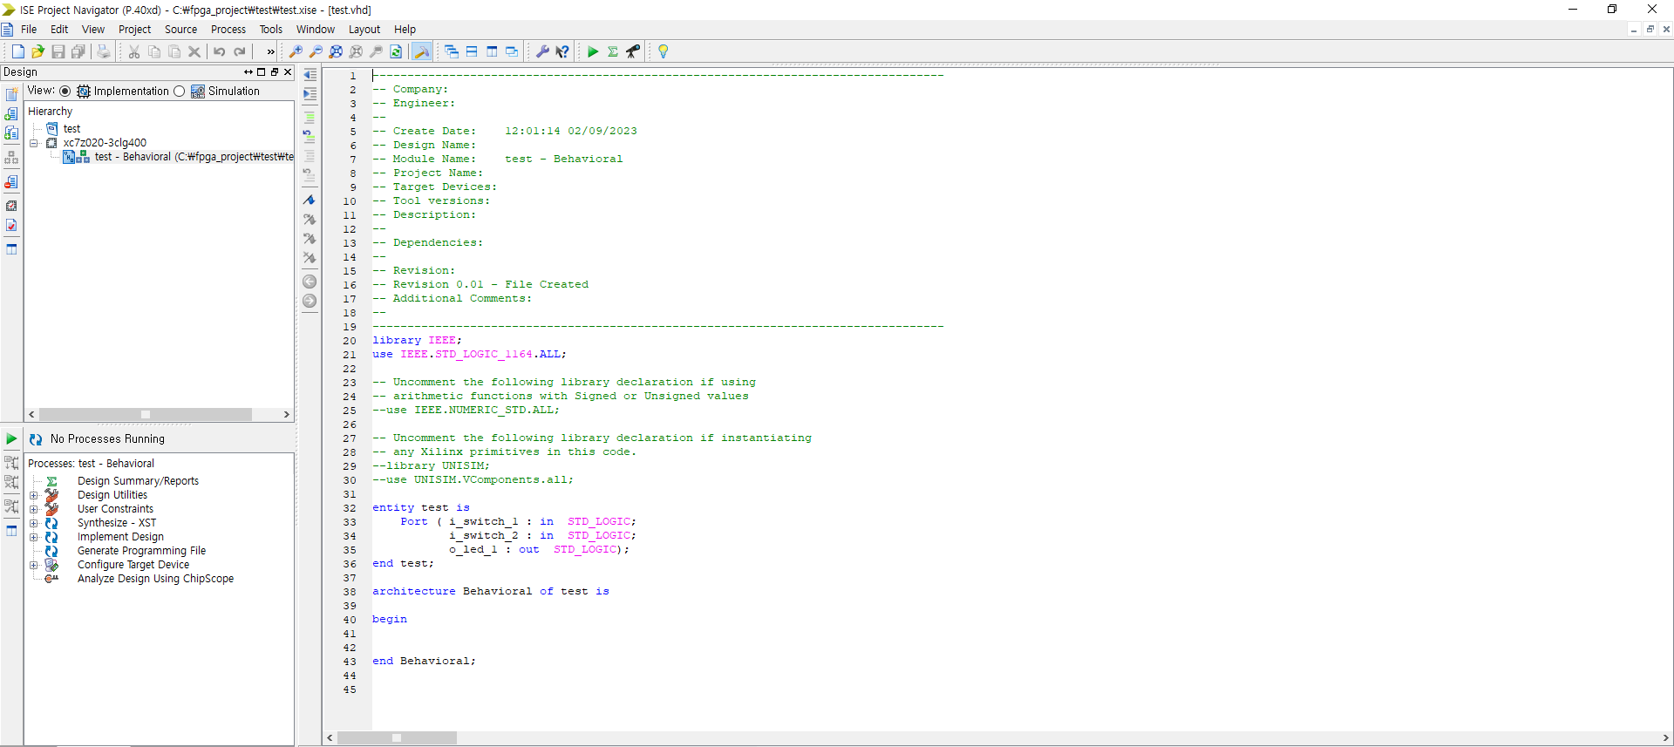
Write code

Slide 6
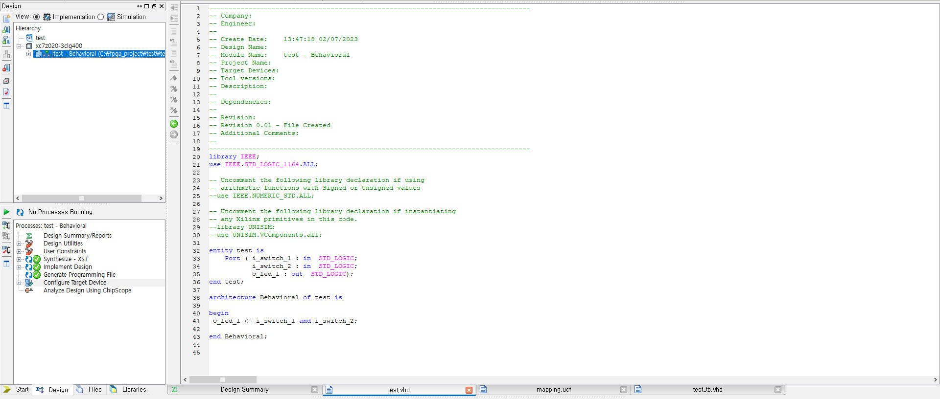
Write code
o_switch_1
And
gate
o_led_1
o_switch_2

Slide 7
Write code
Device name
Error check

Slide 8
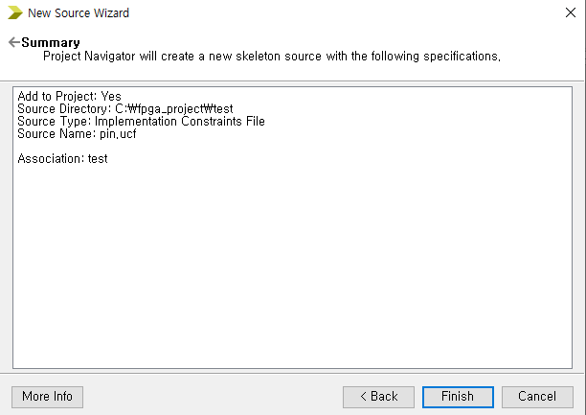
Mapping
Device name – New source wizard
Select
Implementation
Constraints file
Summary
check

Slide 9
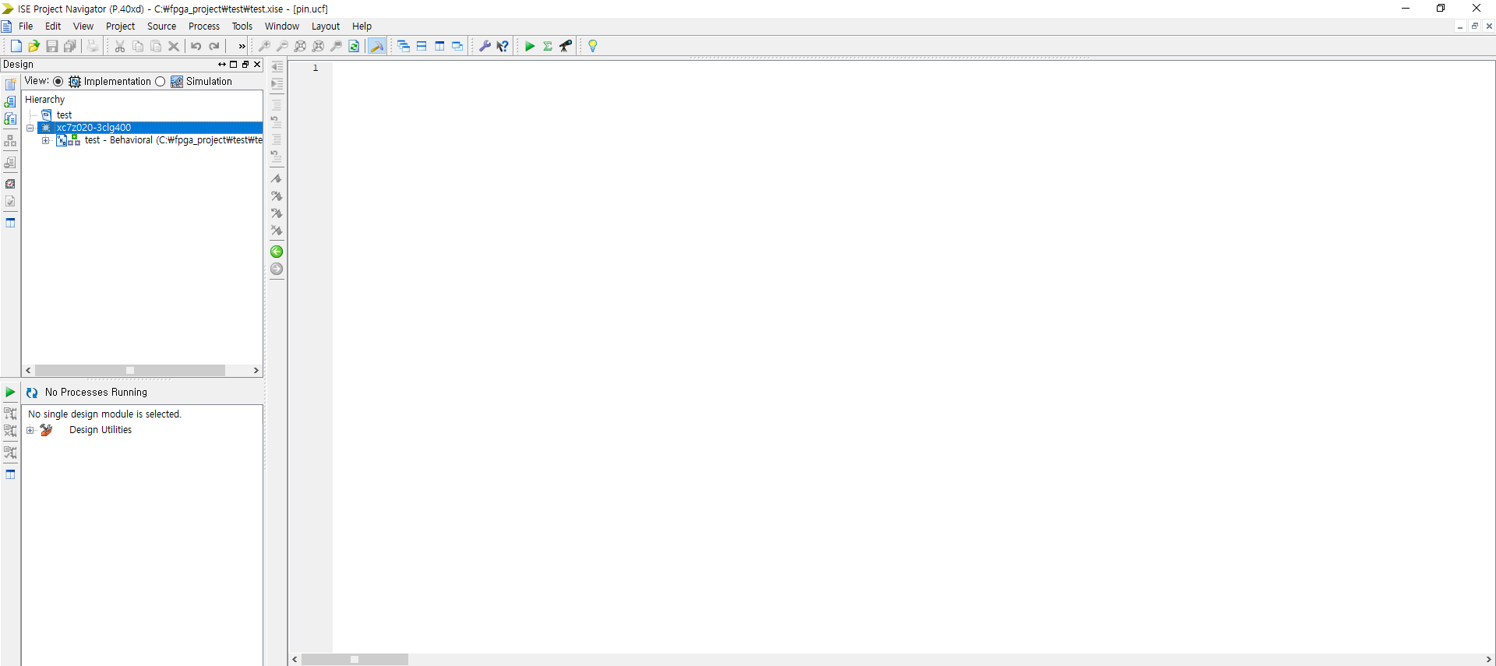
Mapping

Slide 10
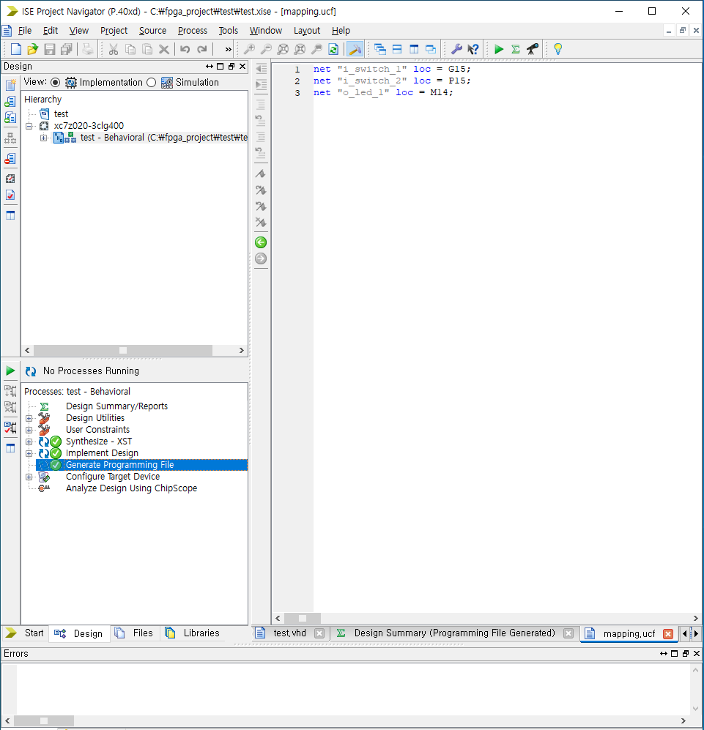
Mapping
Mapping
port and FPGA pin
Error check

Slide 11
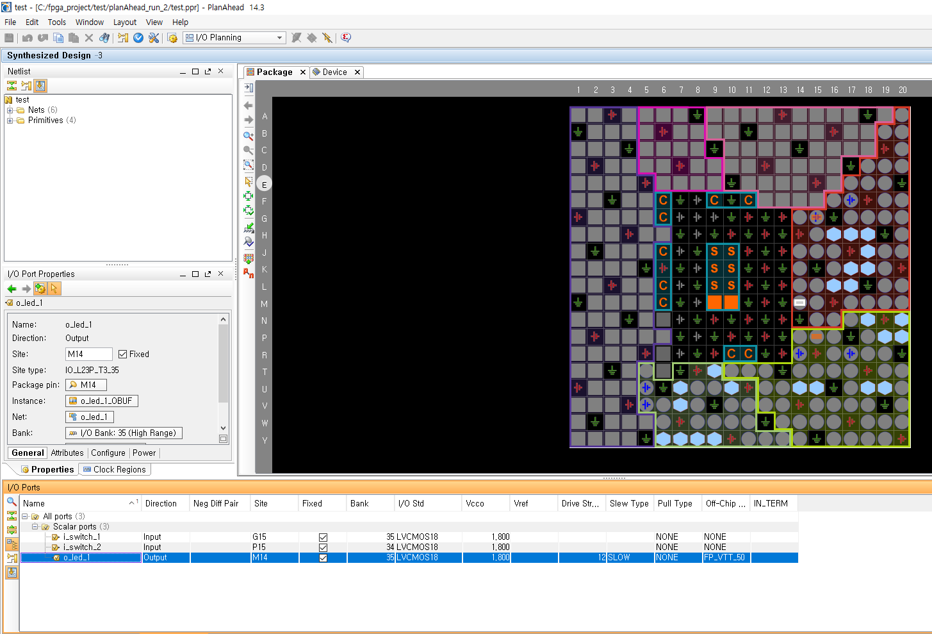
Mapping
Tools
Plan ahead
I/O pin planning
(plan ahead)-post-synthesis

Slide 12
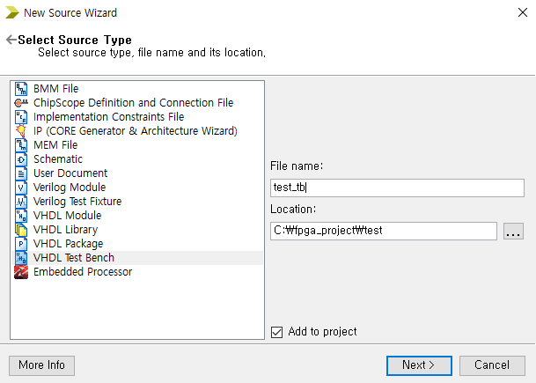
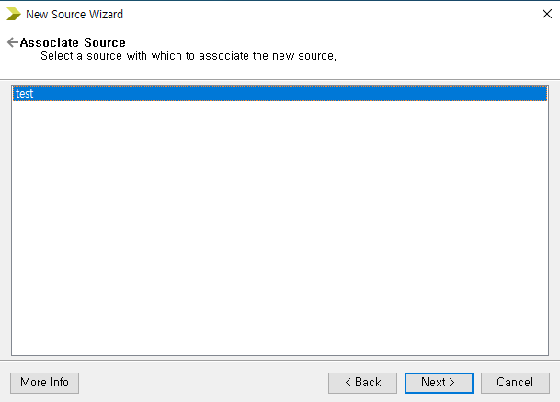
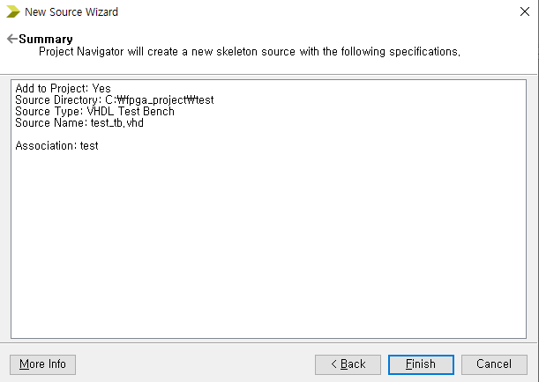
Simulation(make testbench)
File – New Project Wizard
Select
VHDL Test Bench
Select file
Summary check

Slide 13
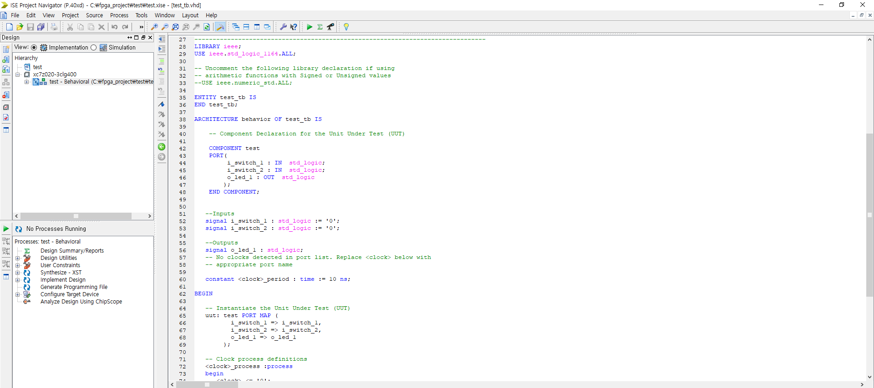
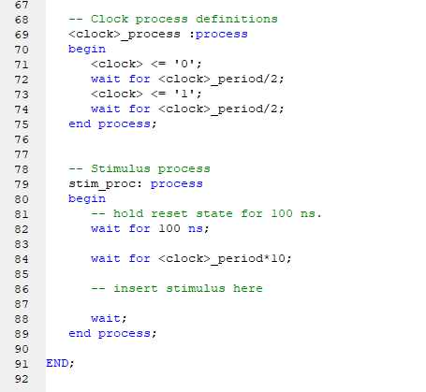
Simulation(make testbench)

Slide 14
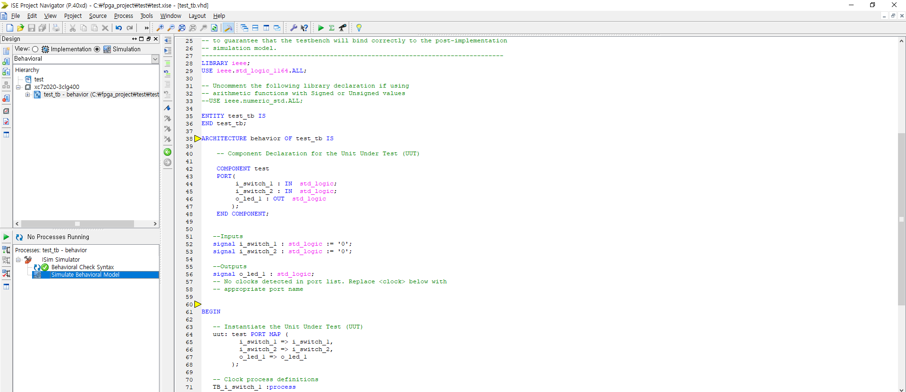
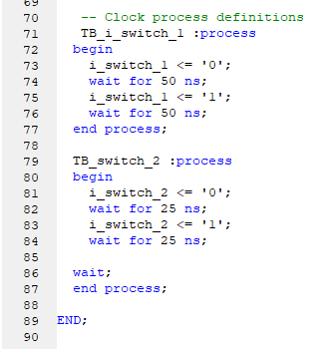
Simulation(make signal)
Make
Input signal

Slide 15
Simulation
Error check
Simulate module

Slide 16
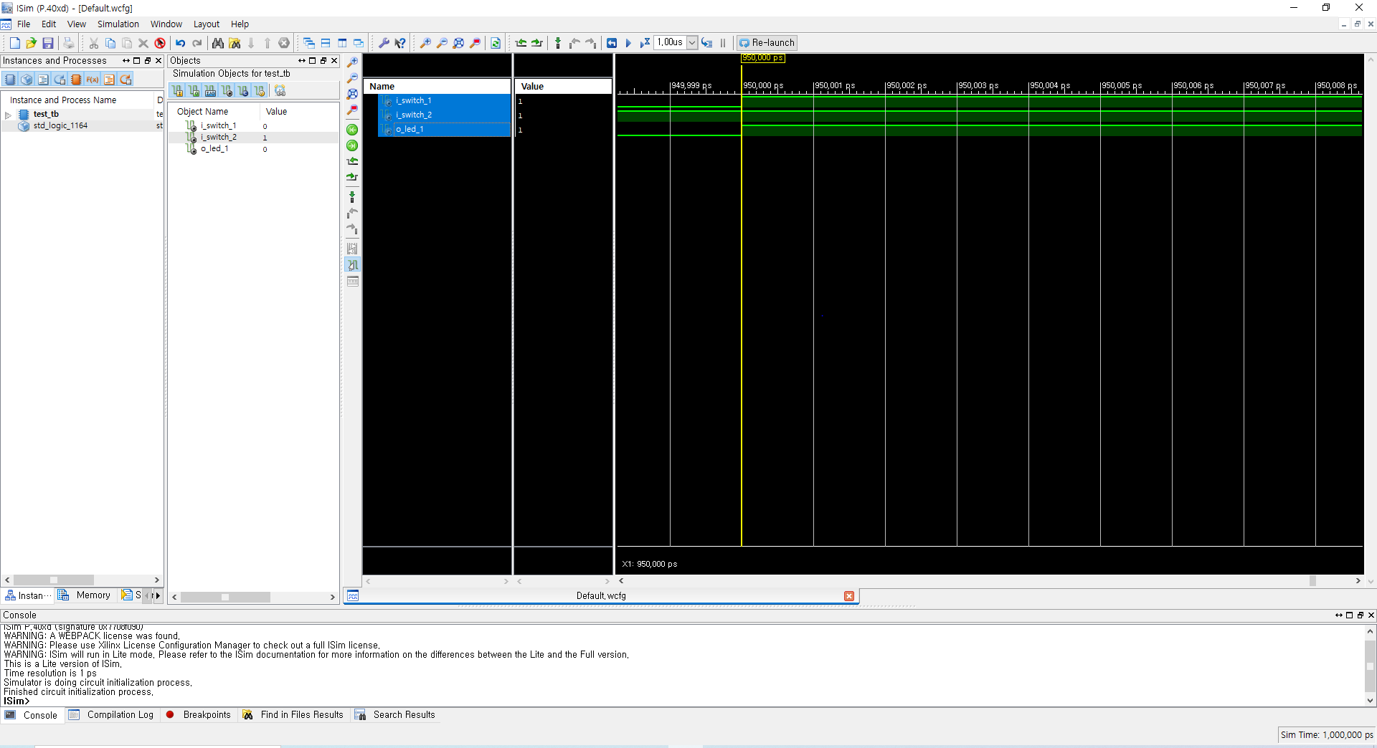
Simulation

Slide 17
Make bit file
Make bit file

Slide 18
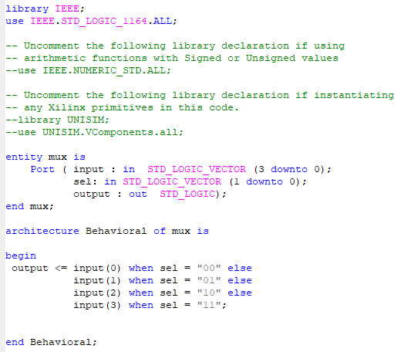
Multiplexer
Multiplexer = combination circuit that selects one of several input lines and connects it to a single output line.
Truth table
Input | Sel 1 | Sel 2 | output
Input 0 | 0 | 0 | Input 0
Input 1 | 0 | 1 | Input 1
Input 2 | 1 | 0 | Input 2
Input 3 | 1 | 1 | Input 3

Slide 19
Multiplexer
Input | Sel 1 | Sel 2 | output
Input 0 | 0 | 0 | Input 0
Input 1 | 0 | 1 | Input 1
Input 2 | 1 | 0 | Input 2
Input 3 | 1 | 1 | Input 3
Output=input0
Output=input1
Output=input2
Output=input3

