Slide 1


2023-2nd CENuM Workshop for Hadron Physics
Heavy meson properties in the instanton model of QCD vacuum
Speaker: Ki-Hoon Hong
In collaboration with Rakhimov Nurmukhammad

Slide 2
Outline
Introduction
Instanton contributions to heavy and light quarks
Heavy-light interaction term in ILM
Heavy mesons decay constants

Slide 3
Introduction
  In the previous talk by Dr. Rakhimov, we have showed the instanton contributions in the light and heavy quark systems and led to heavy-light quark interaction term.
  In this talk, we will show that how we use this interaction Lagrangian:
    Bosonization (Working on it)
    Effective field theoretical method
    The decay constants of pseudoscalar (D,B) and vector heavy mesons (D*,B*) (in the heavy quark limit)

Slide 4
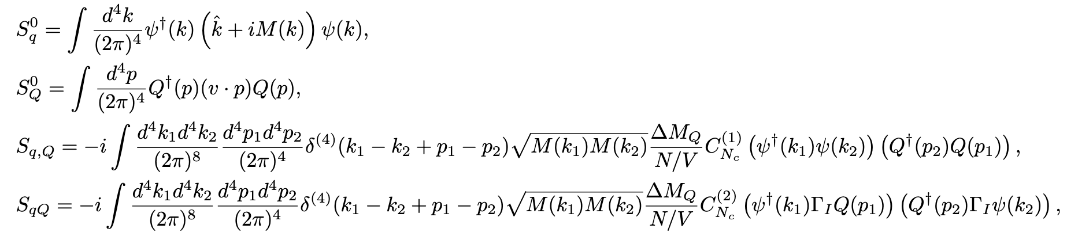
Instanton contributions to heavy and light quarks
QCD partition function can be rewritten as
Heavy-light interaction action

Slide 5
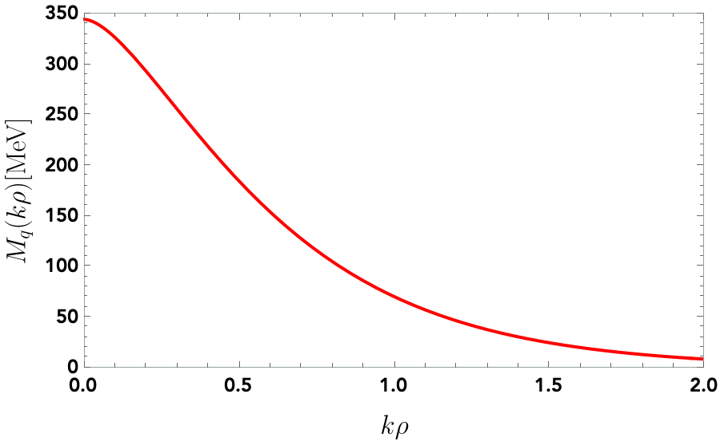

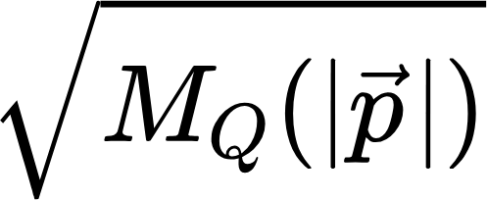
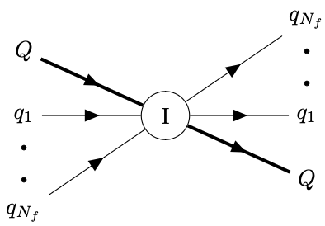
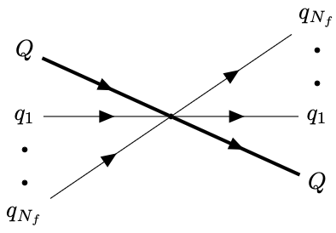
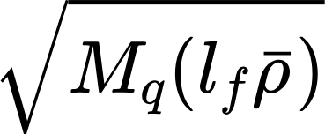
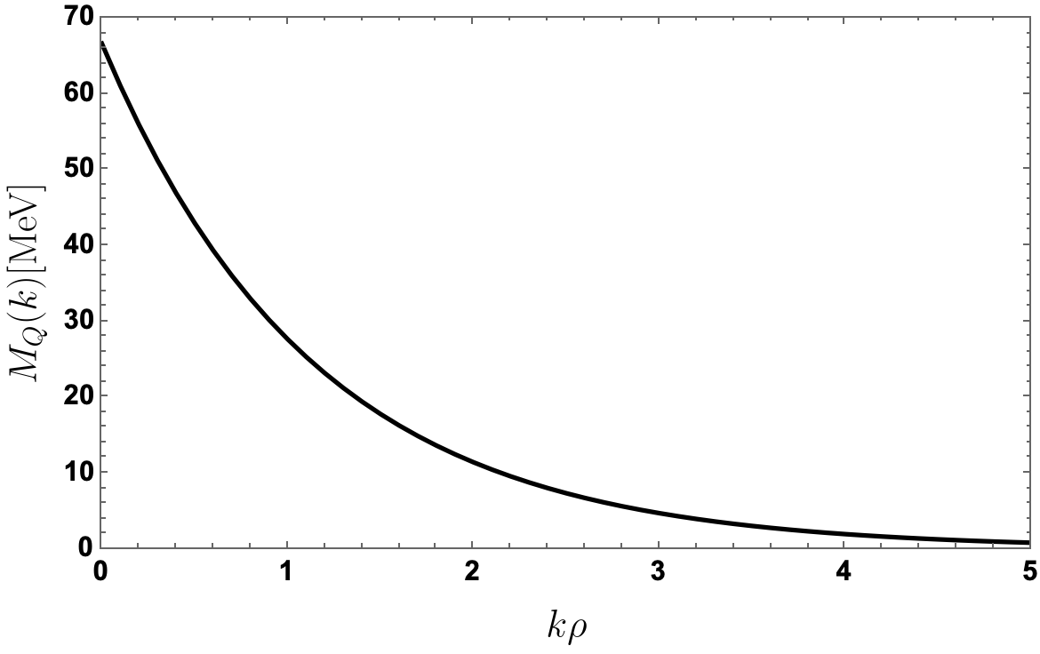

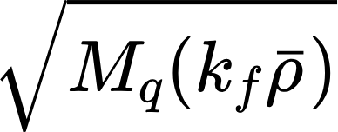
Instanton contributions to heavy and light quarks
HQ and light quarks interaction:
I
I

Slide 6
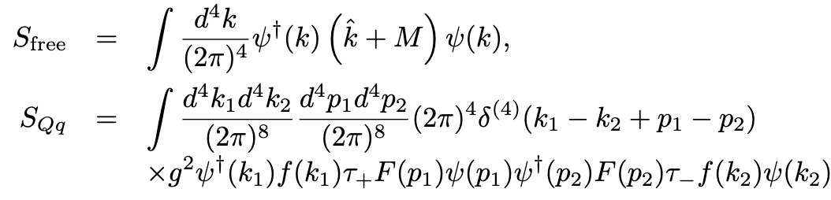
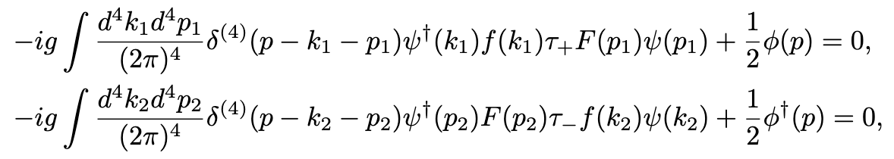
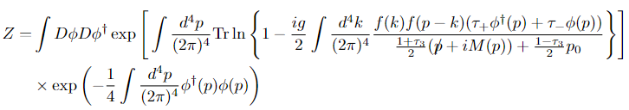
Heavy-light interaction term in ILM (Bosonization)
If we assume , the general form of the partition function becomes
In the saddle point
  we obtain the partition function of the heavy meson

Slide 7
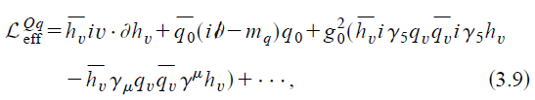
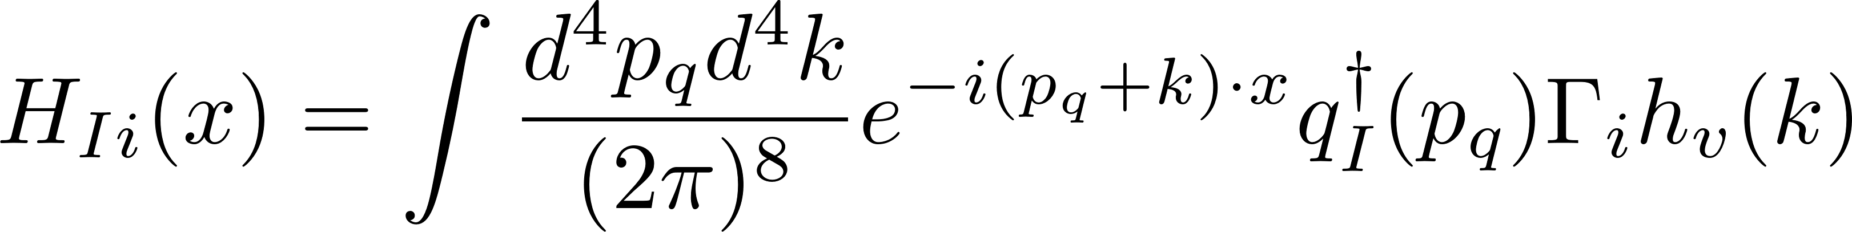


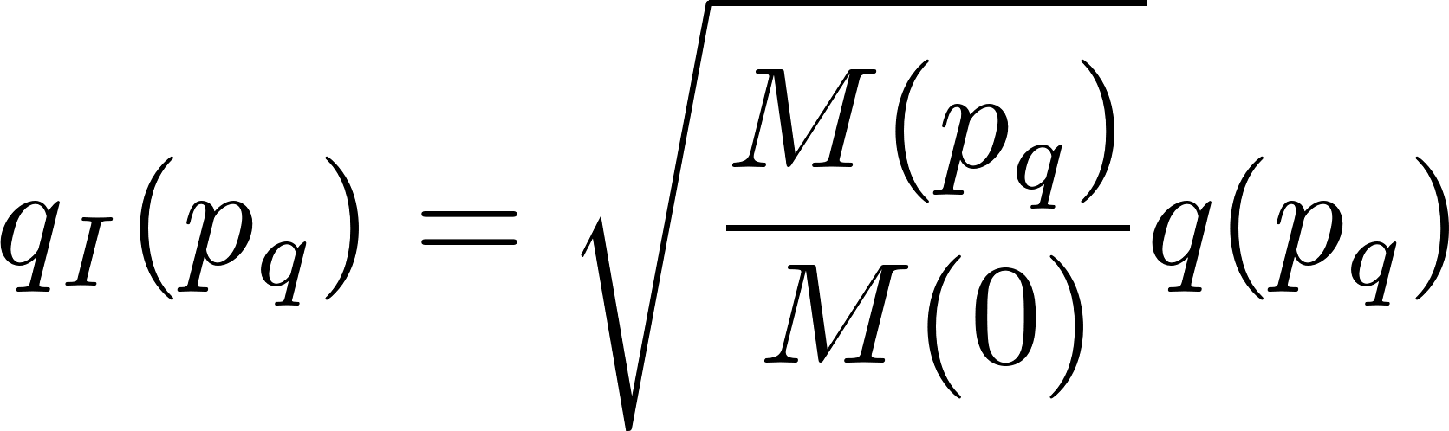
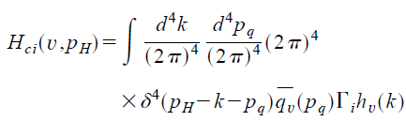
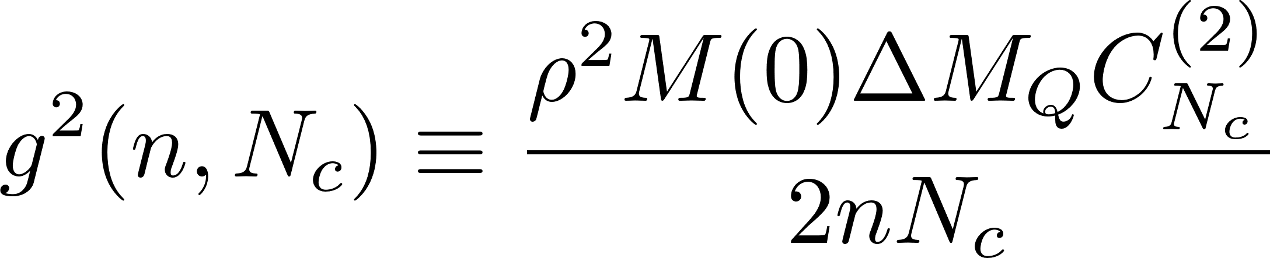
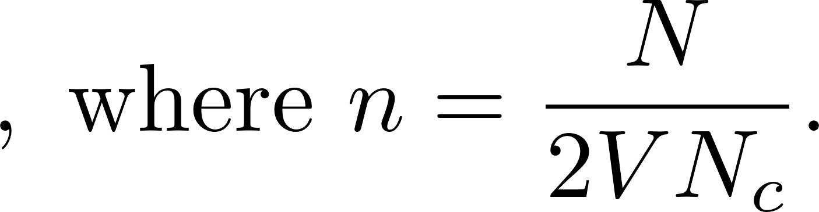

Heavy-light interaction term in ILM (EFT)
In Effective Field Theory [1]
Assume that the effective Lagrangian is obtained by the integrate out of the gluon degrees of freedom
In this model
In the heavy quark limit
F.T
Form factor: related to $\overline{q}q$ pairs and gluons
Composite field operator of the heavy mesons :
[1] Hai-Yang Cheng, Chi-Yee Cheung, and Wei-Min Zhang, PhysRevD.58.074003

Slide 8
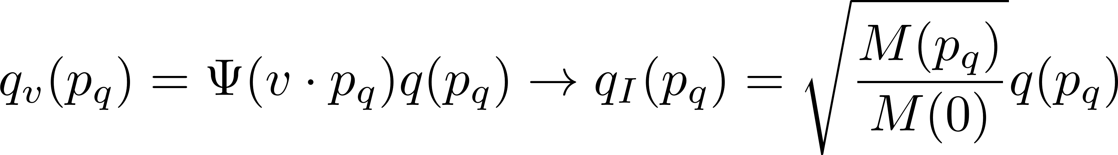

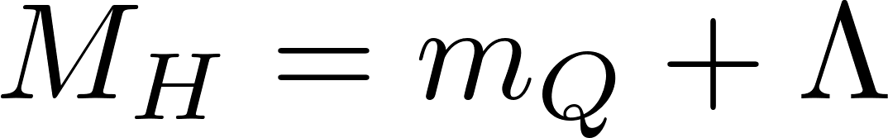
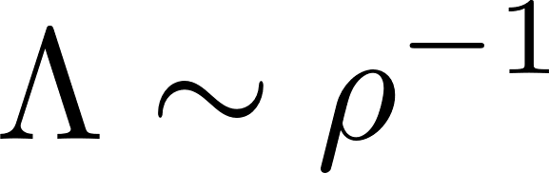
Decay constants in the heavy quark limit
The instanton model gives the exact form factors and the coupling constant of the effective field theory
In the heavy quark limit, the decay constants of the pseudoscalar and vector meson can be rewritten as
The heavy meson mass
Residual mass of the heavy meson (cut off energy)
In the instanton model, because we assume that the instanton contribution is dominant in the light quark sector.

Slide 9
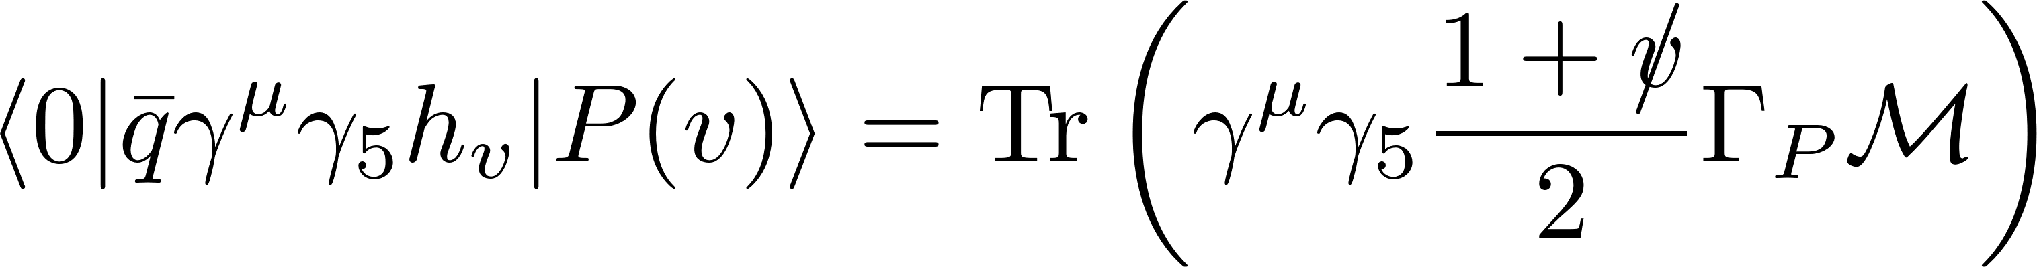
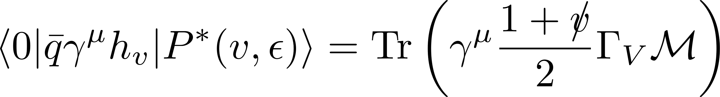
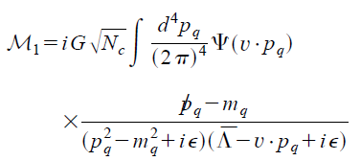
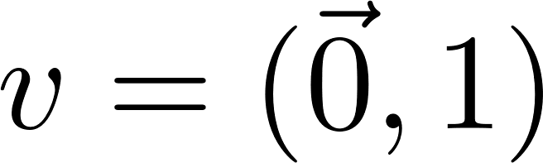

Decay constants in the heavy quark limit
In the heavy quark limit, we cannot distinguish the pseudoscalar and vector meson (we need $1/m_{Q}$ correction in Lagrangian)
In EFT
In the instanton model
Modified version
Here we assume that the static heavy quark :
In order to see the mass splitting between D and D*, we need to consider $1/m_{Q}$ correction in Lagrangian (Future works)

Slide 10
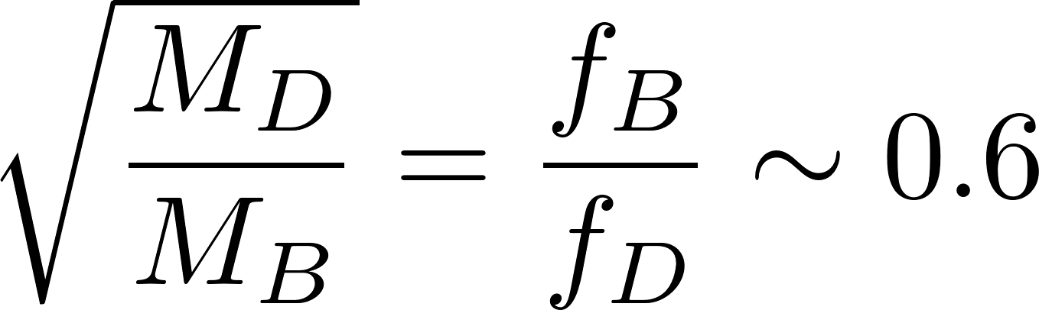
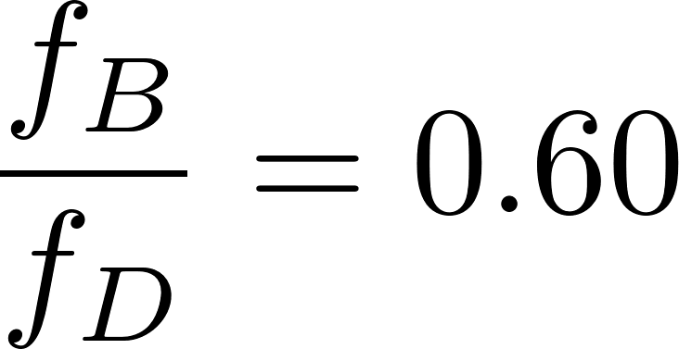
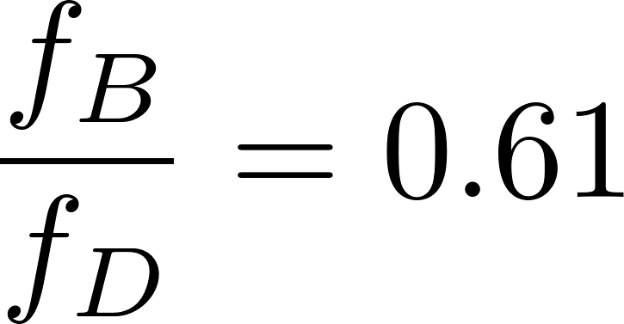
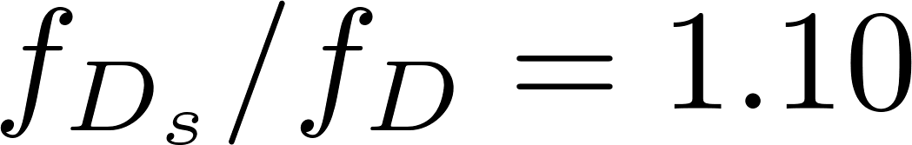
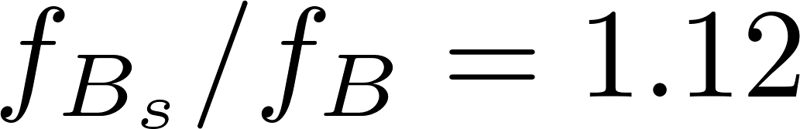
Decay constants in the heavy quark limit
In the heavy quark theory, the ratio is expected that
In the instanton model, we obtain B and D meson decay constants
Similary, Bs and Ds mesons are
The ratio of the D and Ds mesons and the B and Bs mesons are obtained as

Slide 11
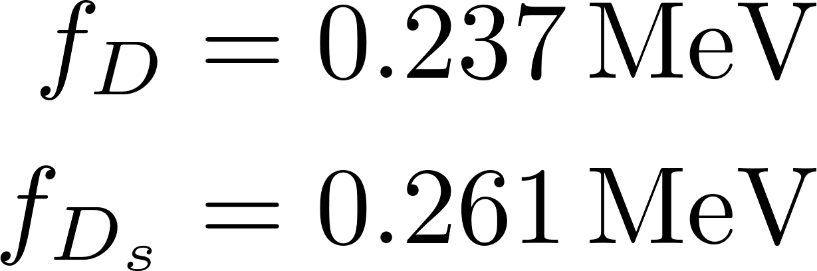
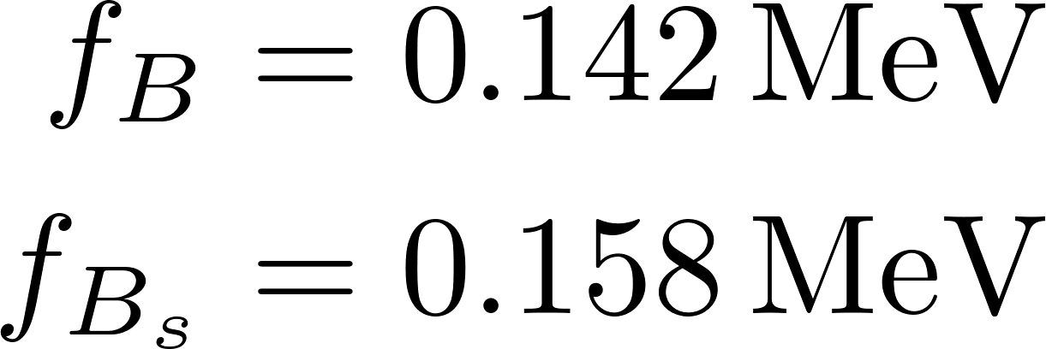
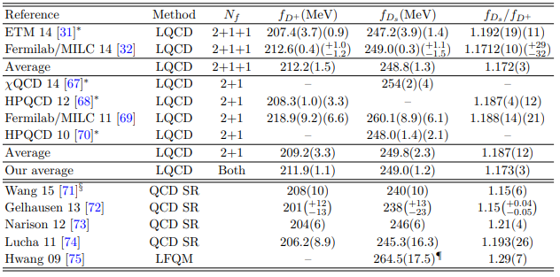
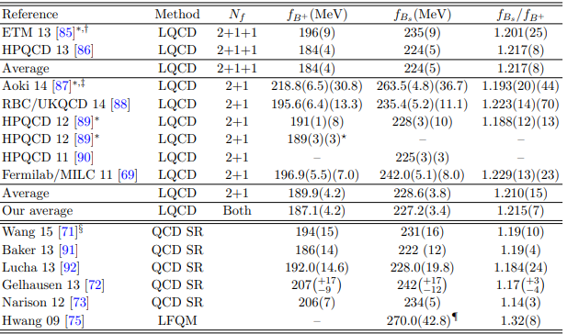
Decay constants in the heavy quark limit
The decay constants from the instanton vacuum
Other predictions from Ref. [2]
[2] J. L. Rosner, S. Stone and R. S. Van de Water, arXiv:1509.02220 [hep-ph].

Slide 12
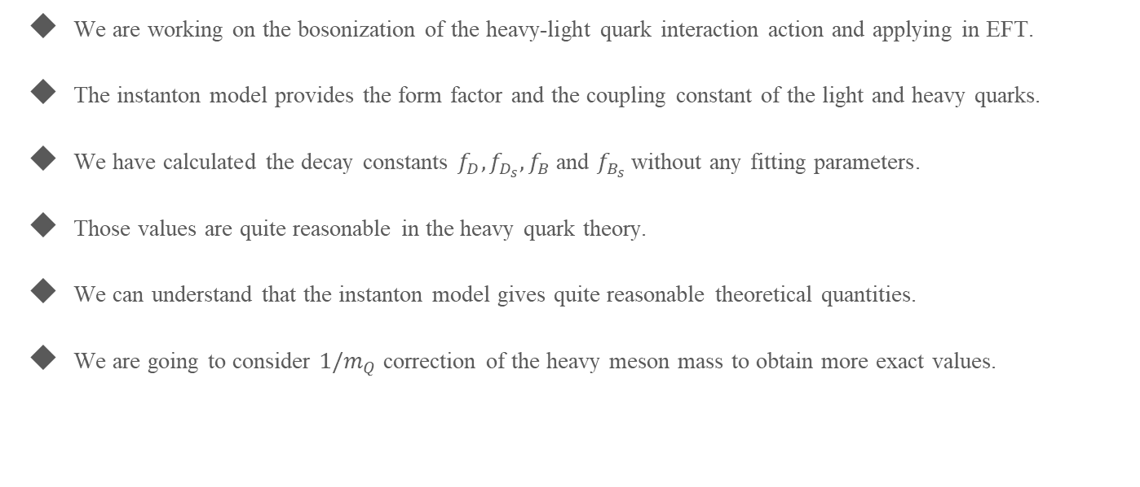
Summary
We are working on the bosonization of the heavy-light quark interaction action and applying in EFT.
The instanton model provides the form factor and the coupling constant of the light and heavy quarks.
We have calculated the decay constants $f_{D}, f_{D_{s}}, f_{B}$ and $f_{B_{s}}$ without any fitting parameters.
Those values are quite reasonable in the heavy quark theory.
We can understand that the instanton model gives quite reasonable theoretical quantities.
We are going to consider $1/m_{Q}$ correction of the heavy meson mass to obtain more exact values.

Slide 13
Thank you for your attention

