Slide 1
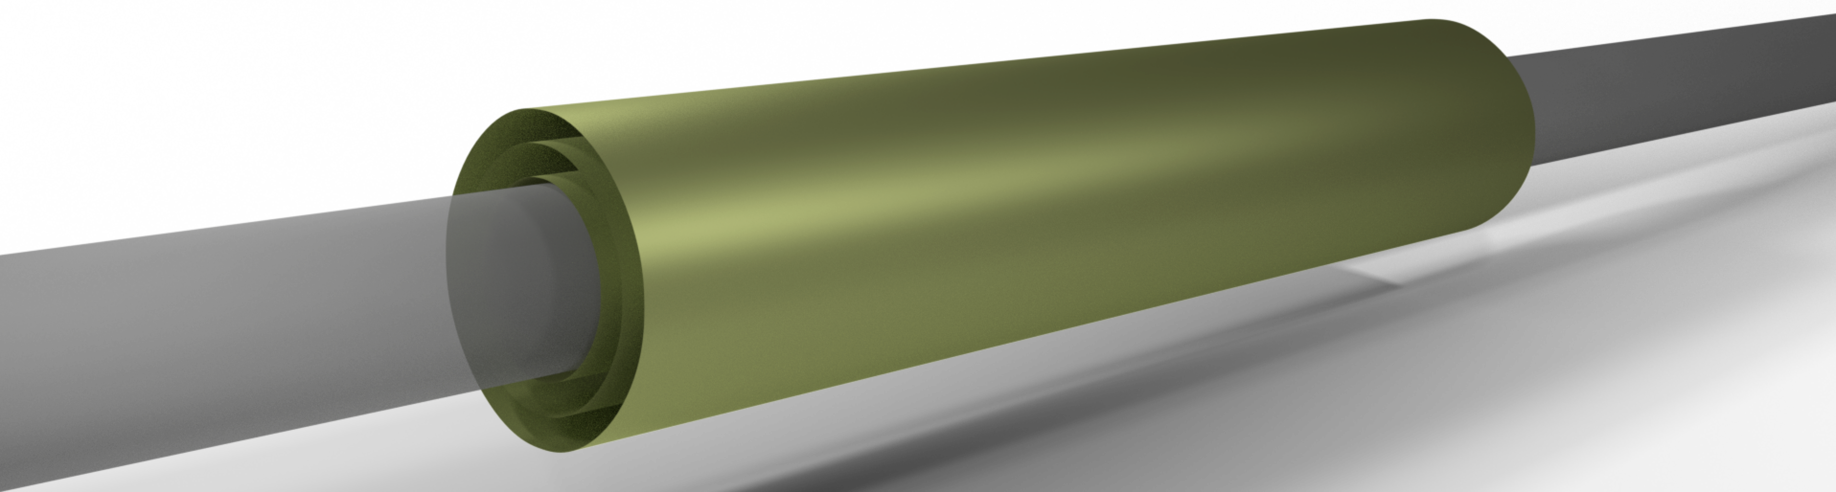
Principles of CMOS-based Semiconductor Detectors for High Energy Physics
Geunhee Hong
Qualitas Semiconductor

Slide 2
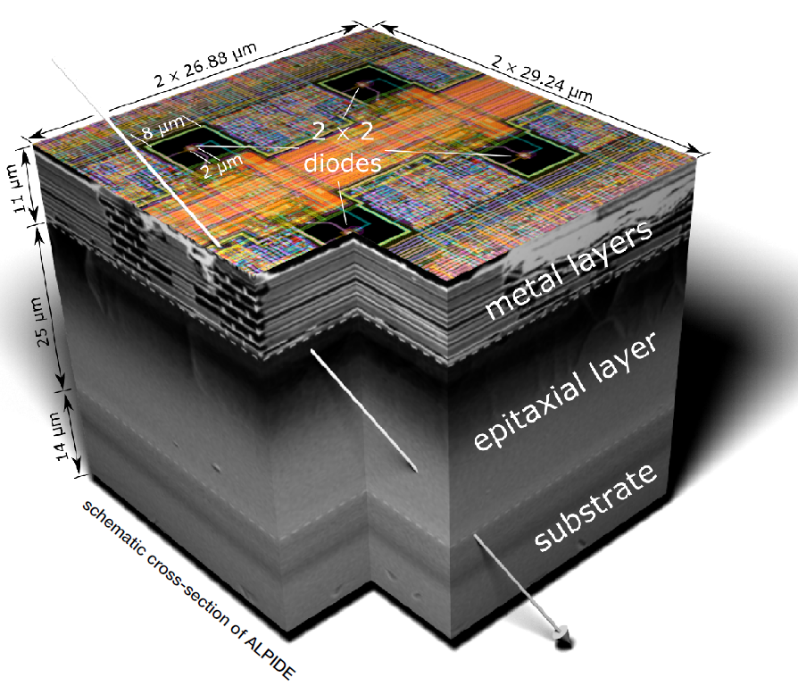
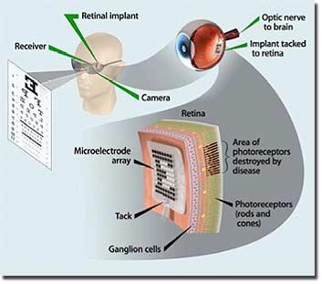

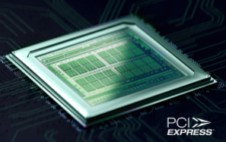
Semiconductor device and circuit design
Yonsei university (2011.09 – 2020)
CERN (2020.01 – 2023.08)
Qualitas Semiconductor (2023.10 – )
Retinal prosthesis
Particle detector
High-speed interface

Slide 3
Content
Introduction
  CERN EP R&D WP1.2 Monolithic pixel detector
  Inner Tracking System(ITS) 3 - Roadmap
ALPIDE (ALICE PIxel DEtector)
  Collection diode
  Pixel analog front-end
  Pixel digital logic
  Matrix readout – Priority Encoder
MOSS (MOnolithic Stitched Sensor)
  Motivation
  MOnolithic Stitched Sensor (MOSS) prototype and challenges
  MOSS power plan and pad ring design
  Summary and outlook

Slide 4
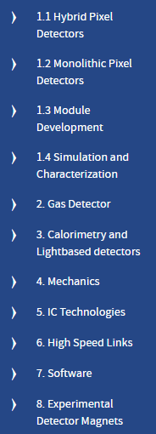
CERN EP-R&D
CERN EP Department has defined a strategic R&D programme to address the primary technological challenges of future experiments. Started up in January 2020, the programme is structured in 11 work packages focusing on tracking, calorimetry and particle ID, as well as on equally demanding challenges in the domains of electronics, mechanics, cooling, magnets and software.
A large part of the R&D work is carried out jointly with external groups from universities and research labs, and in close cooperation with industrial partners. We profit from cooperation with dynamic and efficient structures like the RD50 and RD51 collaborations, and networking on the European level (e.g. AIDA, Cremlin+).
This R&D programme is in the tradition of previous similar initiatives - the DRDC projects in the 1990s and the White Paper R&D programme (2008-2011). The scientific programme is largely aligned with the ECFA Roadmap defined in 2021.

Slide 5
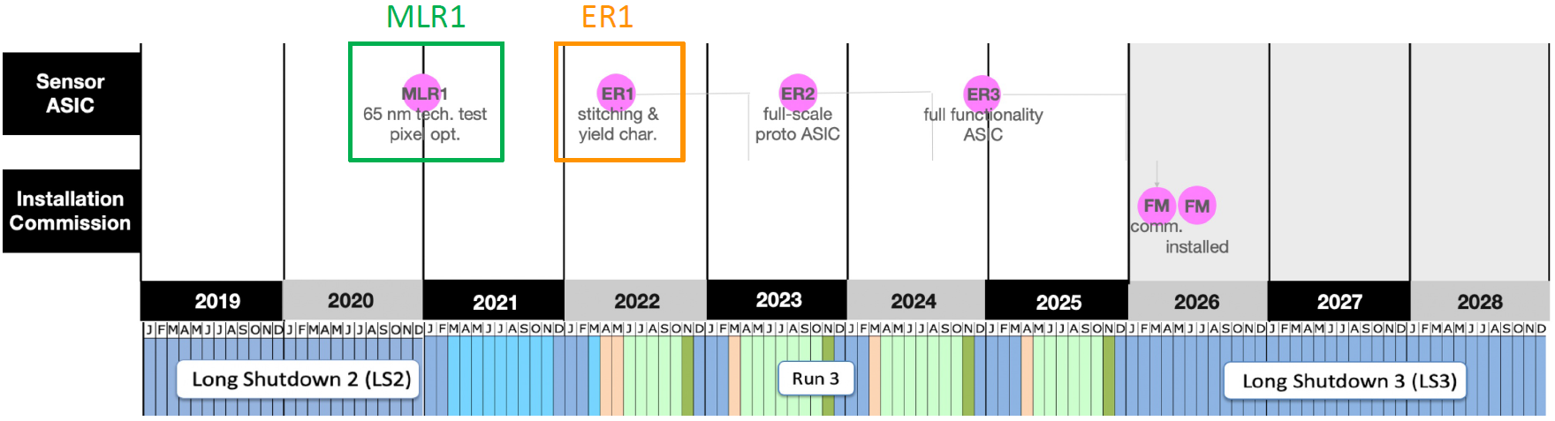
ALICE ITS3 Development Roadmap
ALPIDE in ITS2
ITS3
ITS : Inner tracking system
ASIC : Application-Specific Integrated Circuit
MLR : Multi-Layer per Reticle service / MPW : Multi Project Wafer service
ER: Engineering Run
FM: Final Module

Slide 6
Content
Introduction
  CERN EP R&D WP1.2 Monolithic pixel detector
  Inner Tracking System(ITS) 3 - Roadmap
ALPIDE (ALICE PIxel DEtector)
  Collection diode
  Pixel analog front-end
  Pixel digital logic
  Matrix readout – Priority Encoder
MOSS (MOnolithic Stitched Sensor)
  Motivation
  MOnolithic Stitched Sensor (MOSS) prototype and challenges
  MOSS power plan and pad ring design
  Summary and outlook

Slide 7
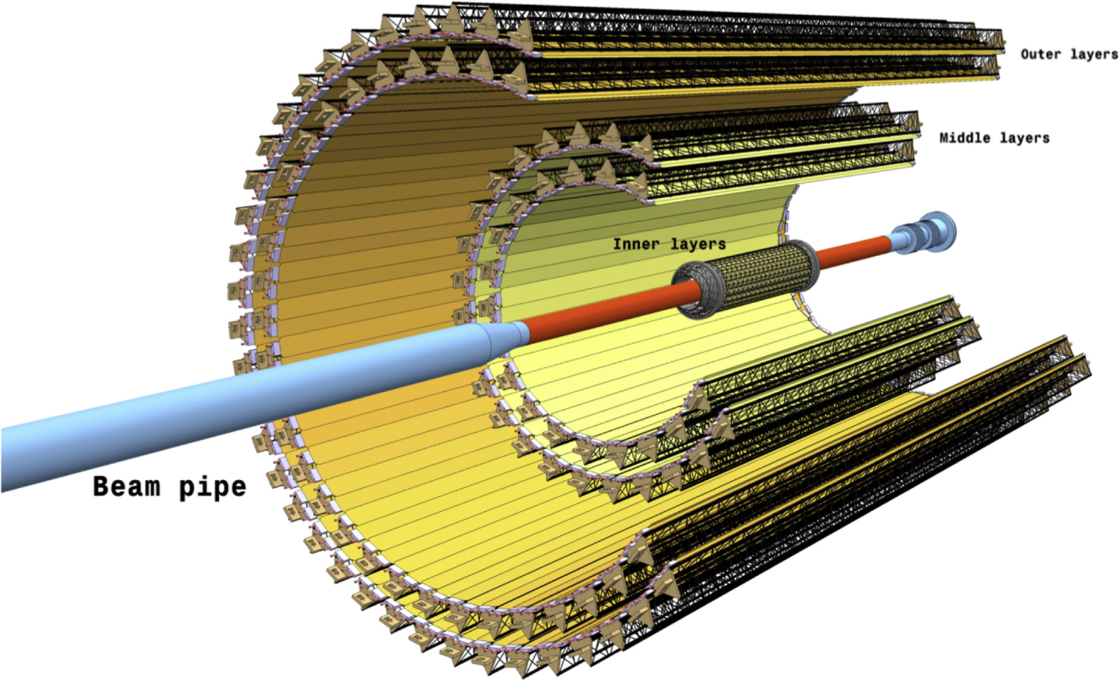
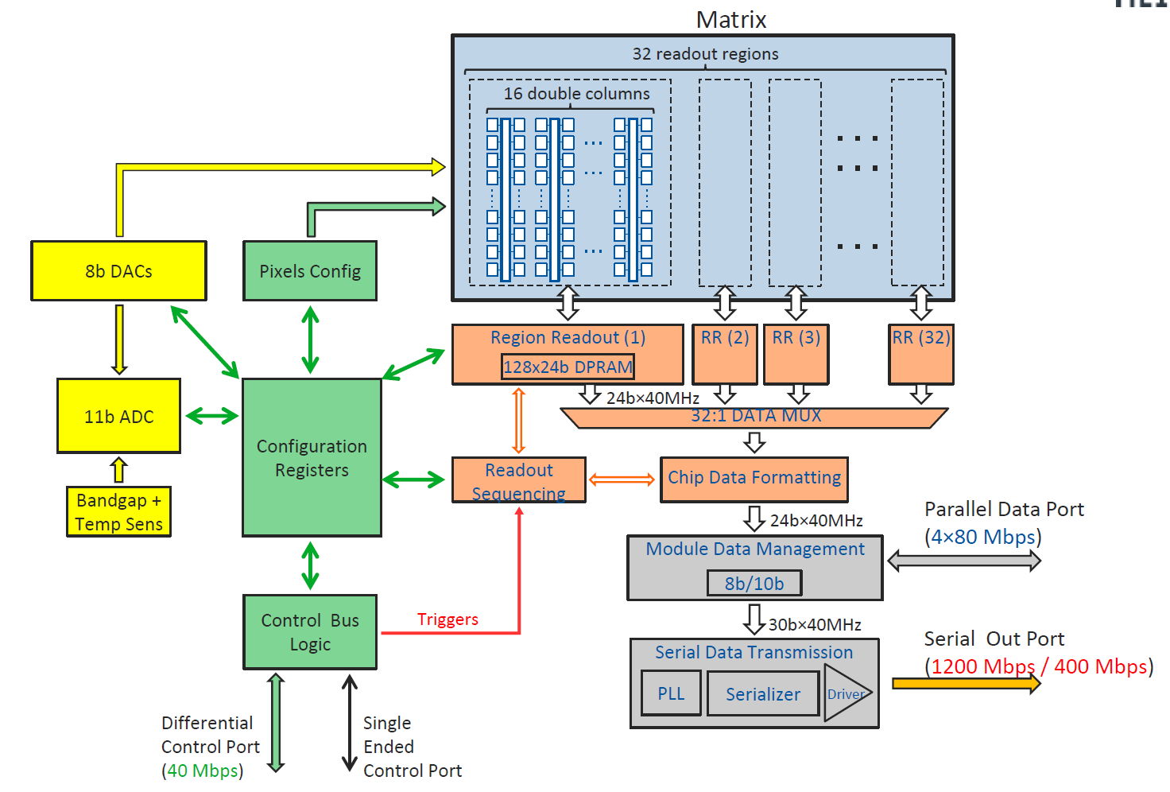
ALPIDE in the upgraded ALICE ITS
Upgraded ALICE ITS
  24,120 ALPIDE chips
  10 m² active area
  ~12.5 Gpixels
ALPIDE architecture

Slide 8
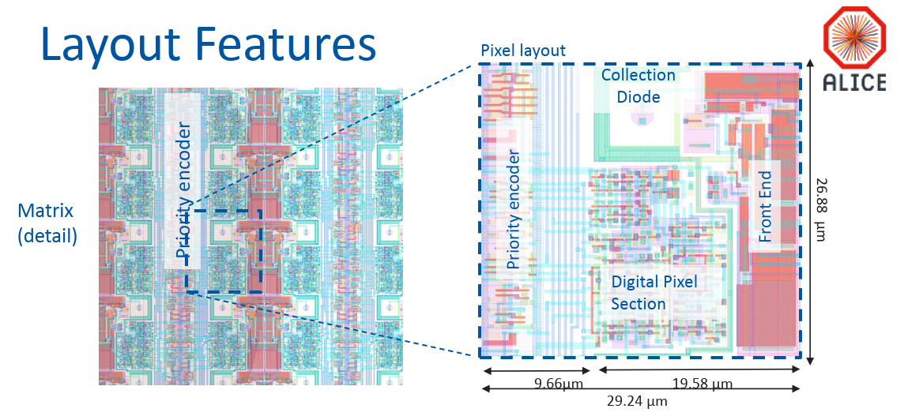
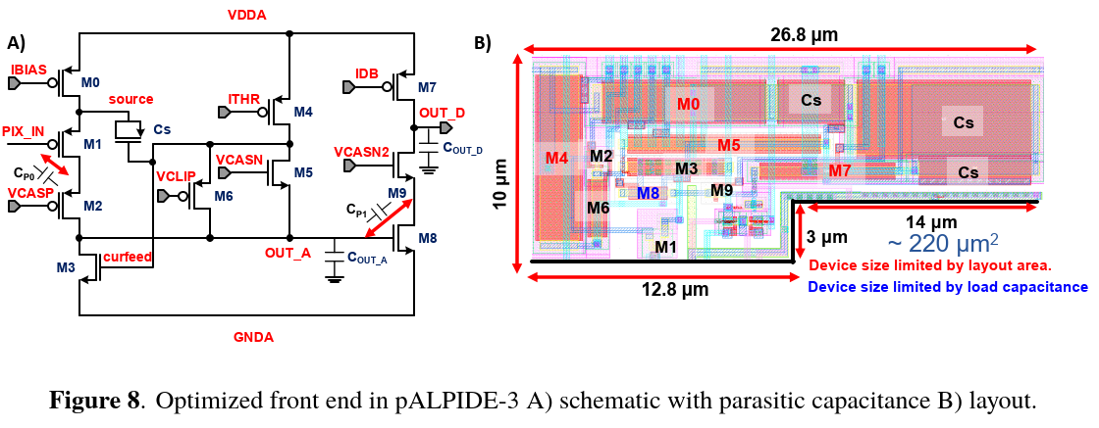
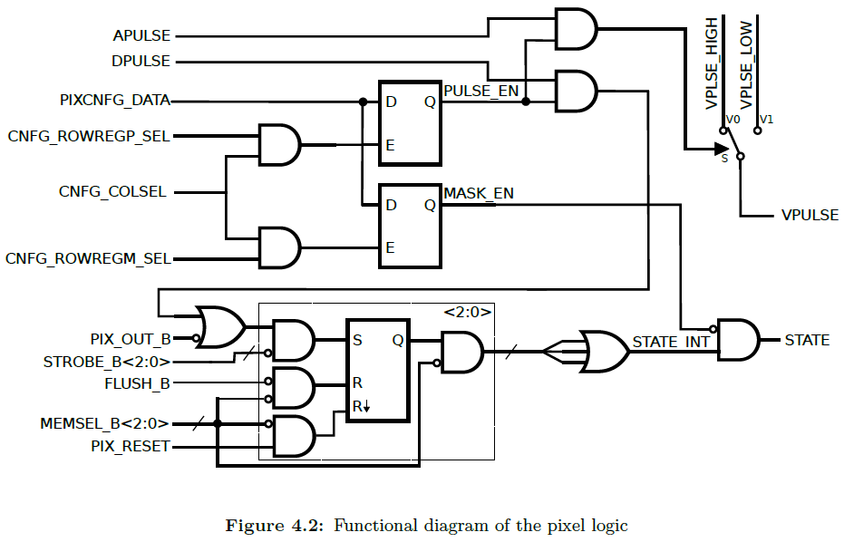
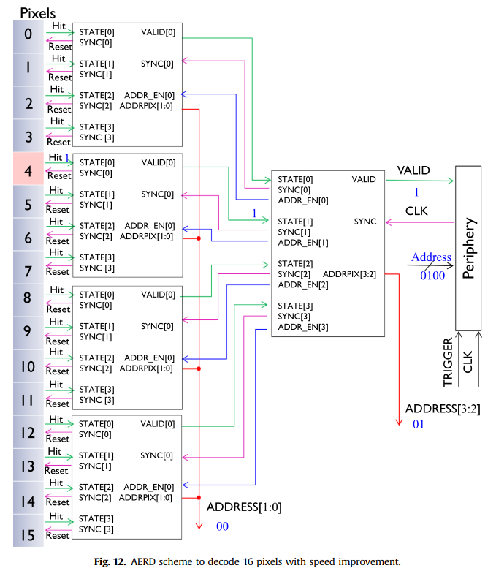
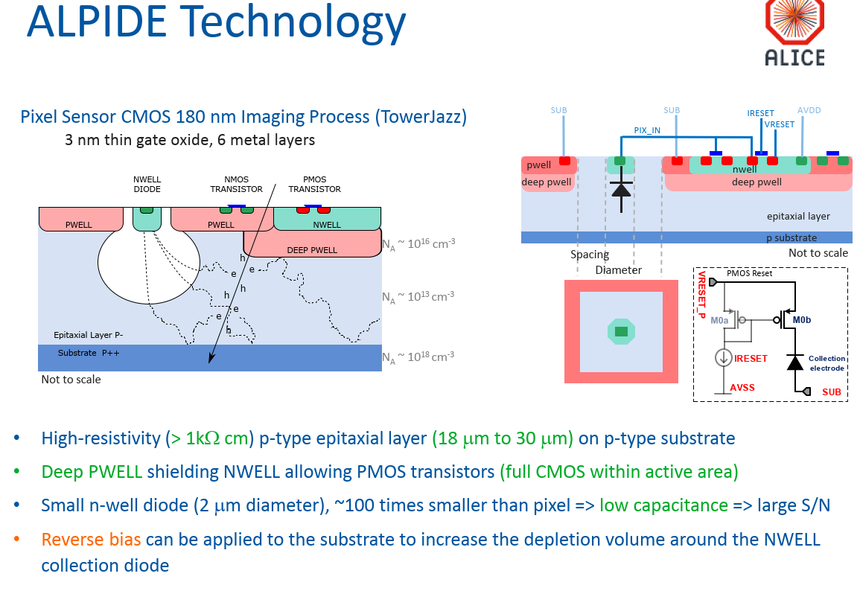
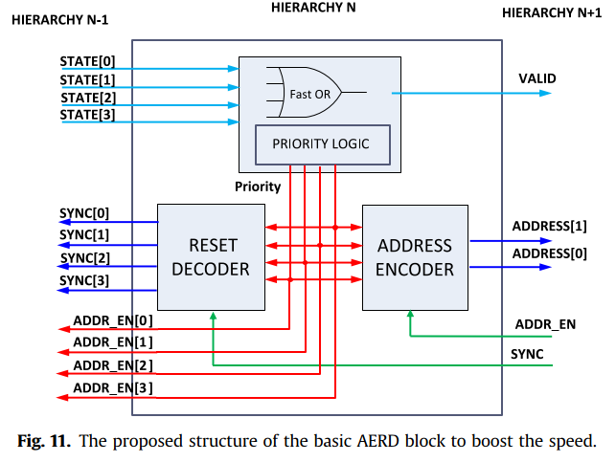
Hit data flow from PIXEL to MATRIX periphery
1
2
4
3
1. Collection diode
2. Pixel analog front-end
3. Pixel digital logic
4. Priority Encoder

Slide 9
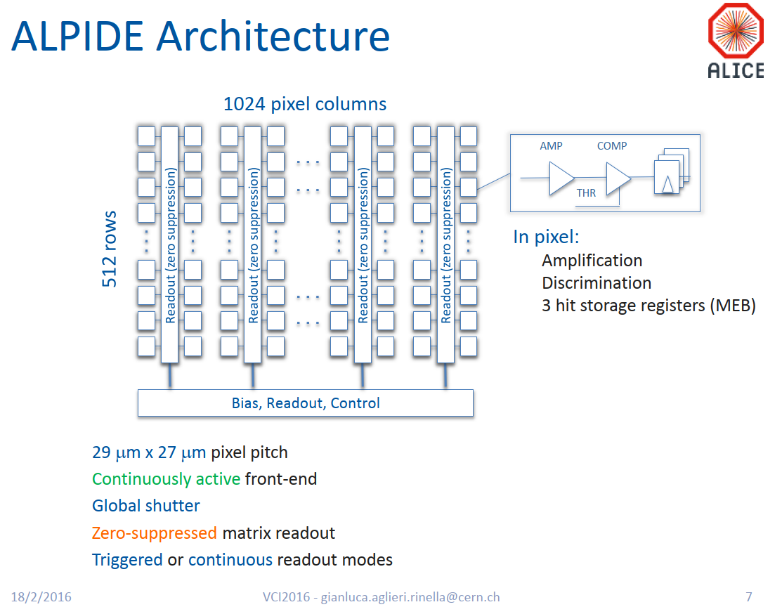
Diagram vs Layout
2. Front End
1
2
4
3

Slide 10
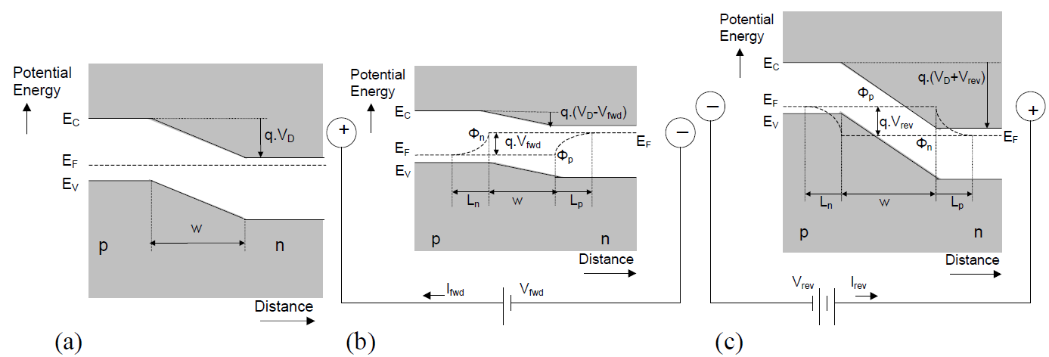
Potential energy band diagram of a PN junction
~ 80 electrons generated per um
L_{n,p}: minority carrier diffusion length
V_{D}(V_{bi}): built-in potential
W: Depletion region width
No bias
Forward bias
Reverse bias
Charge transfer across the PN junction
  Drift in W vs Diffusion in L
  Radiation damage severely affects L
  W increases with increasing reverse bias
Dervos, Constantine T., et al. "pn junction photocurrent modelling evaluation under optical and electrical excitation." Sensors 4.5 (2004): 58-70.

Slide 11
ALPIDE Technology

Slide 12
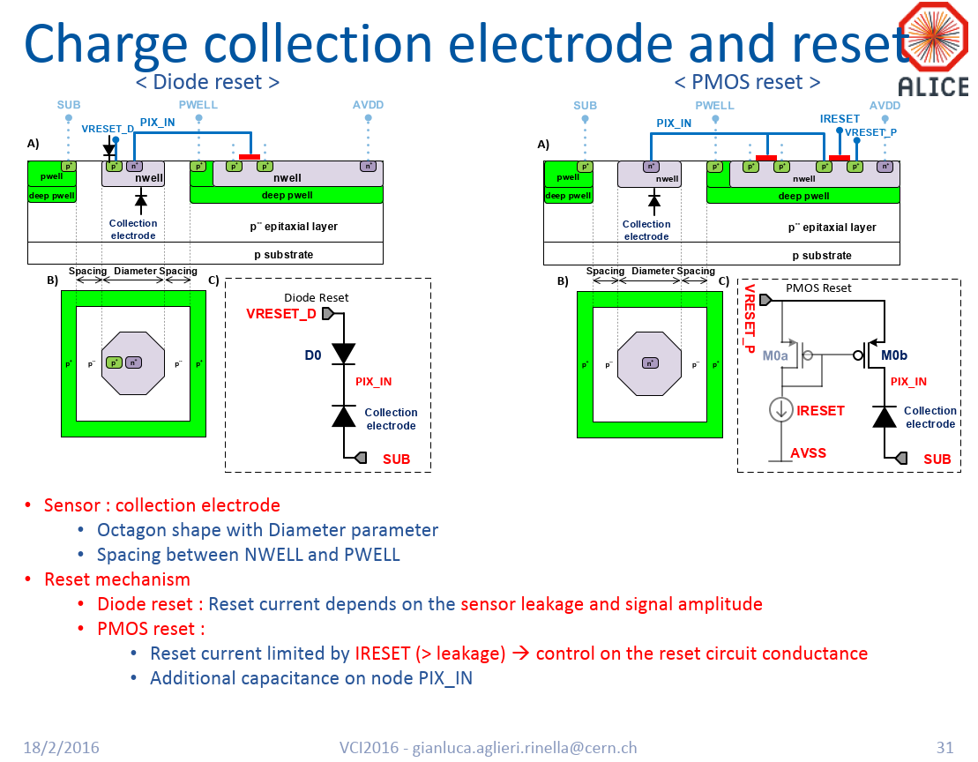
Charge collection electrode and reset

Slide 13
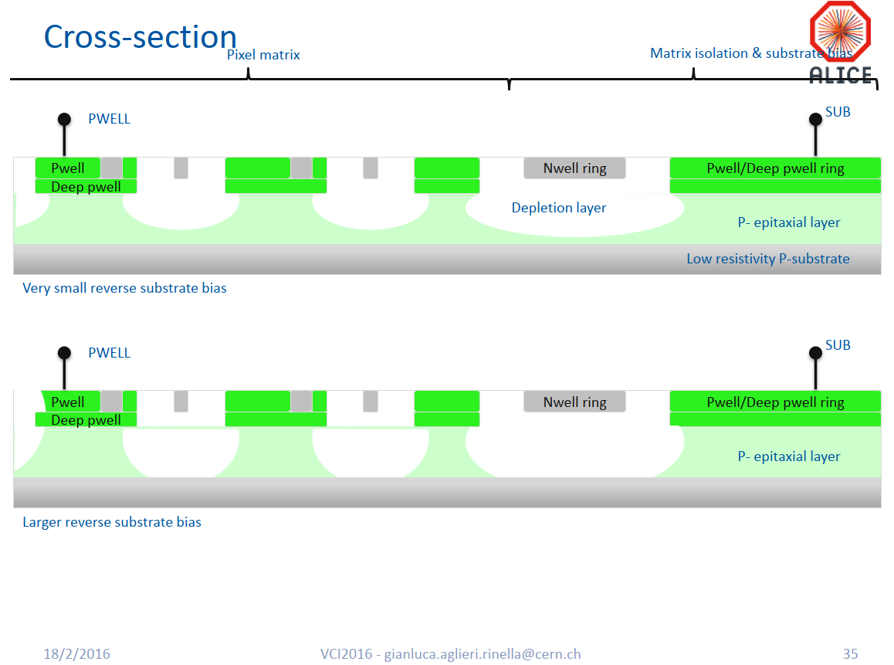
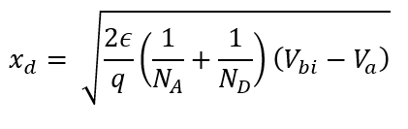
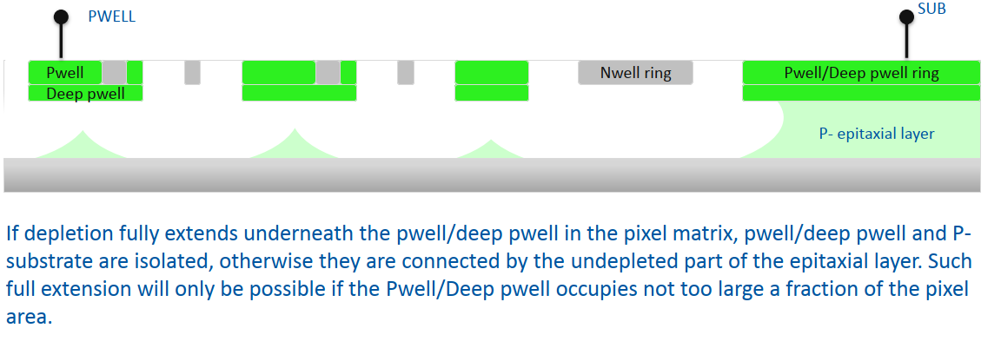
Depletion region under pwell/deep pwell
Depletion region thickness
x_{d} directly affects sensor performance
N_{A} , N_{D} , V_{bi} ← Device designer

Slide 14
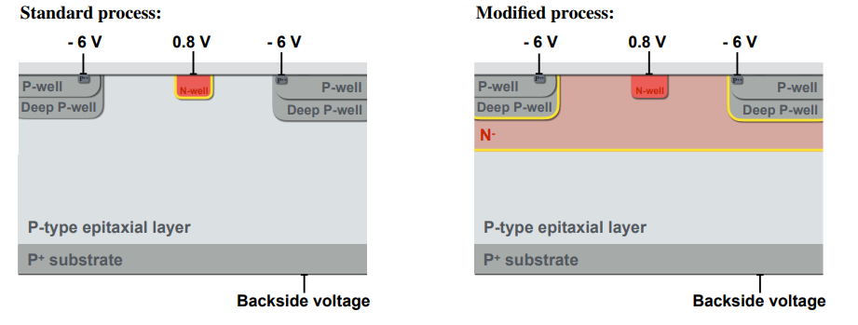
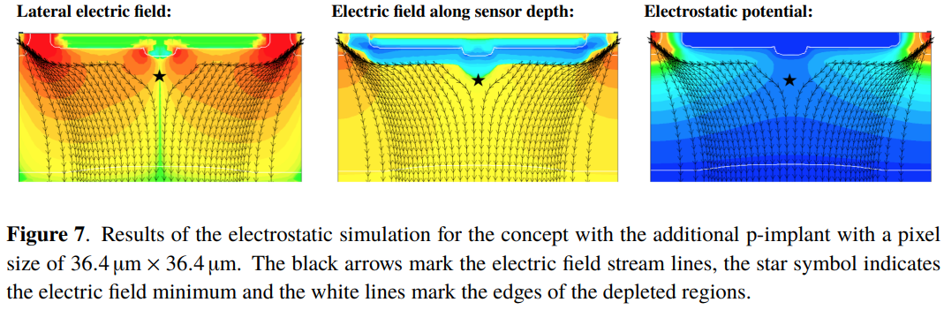
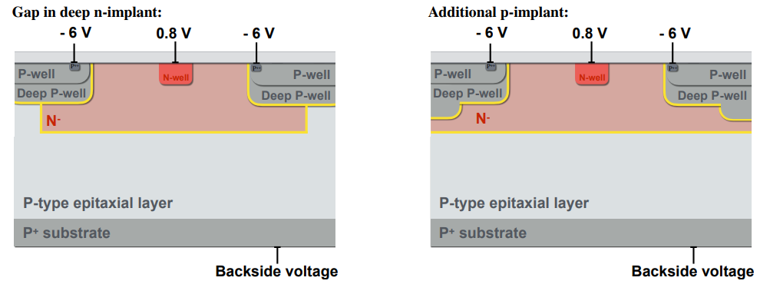
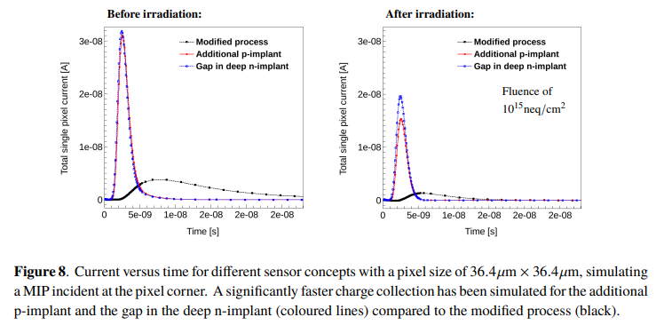
Sensor improvement for a faster charge collection
Magdalena Munker, Simulations of CMOS pixel sensors with a small collection electrode, improved for a faster charge collection and increased radiation tolerance

Slide 15
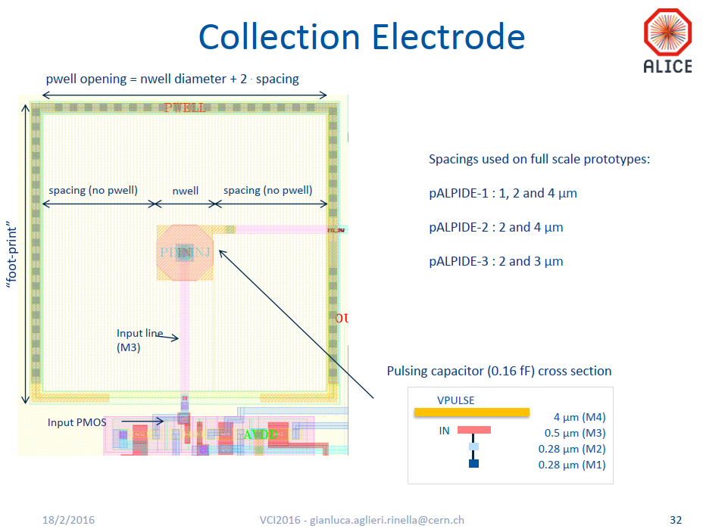
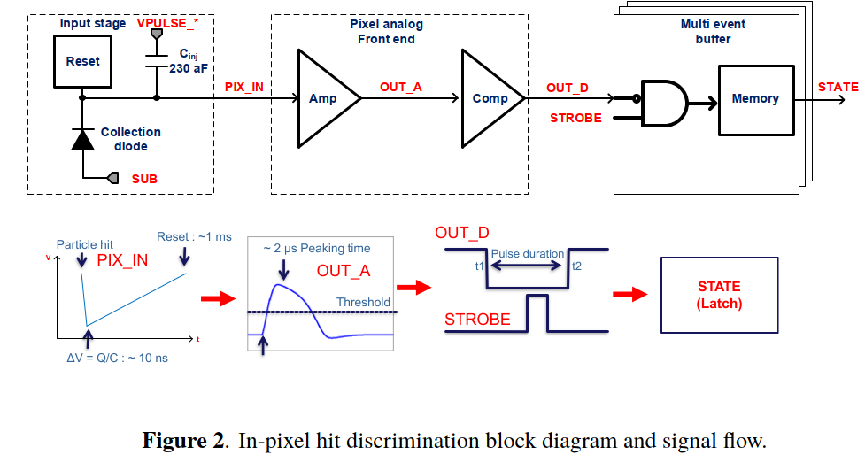

Slide 16
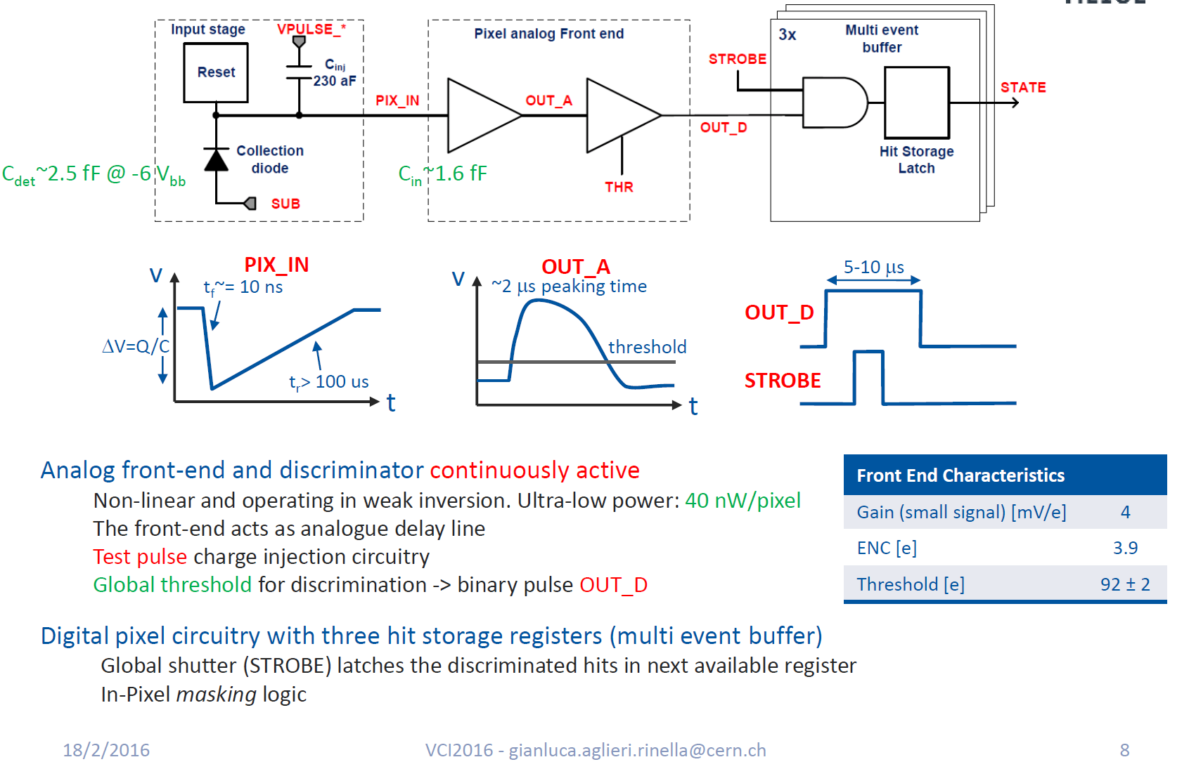
Pixel

Slide 17
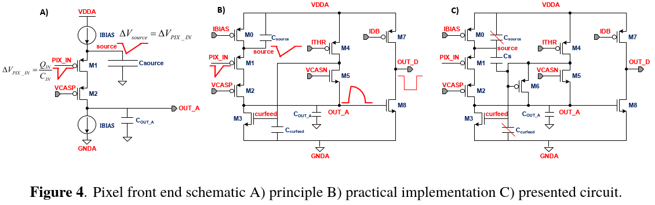

Pixel Analog Front-end
1) Source Follower (M1, M0)
2) Charge transfer and amplification (C_{source} vs. C_{OUT_A})
Q = C_{source} ∙ V_{source}=C_{OUT_A} ∙ V_{OUT_A}
3) Discriminator (M8, M7)
Discriminator threshold :
Baseline value of OUT_A (M5, M4) vs. IDB current
Clipping mechanism to limit the pulse duration (Diode connected M6)

Slide 18
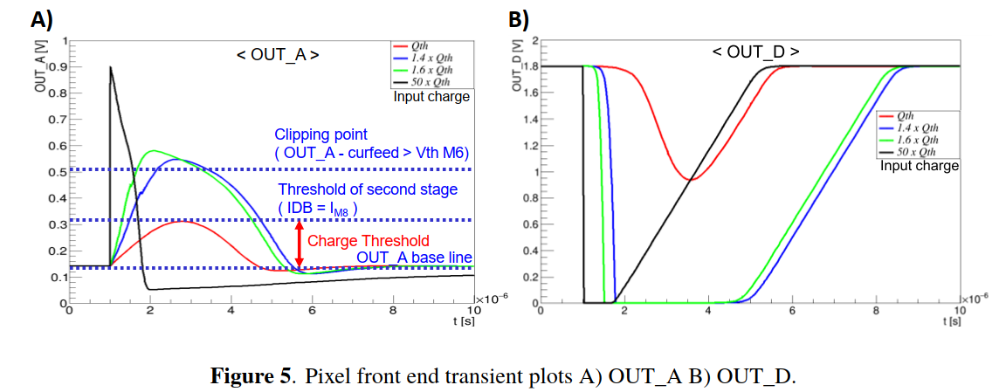
Pixel Analog Front-end

Slide 19
Pixel Analog Front-end: Circuit schematic vs layout

Slide 20
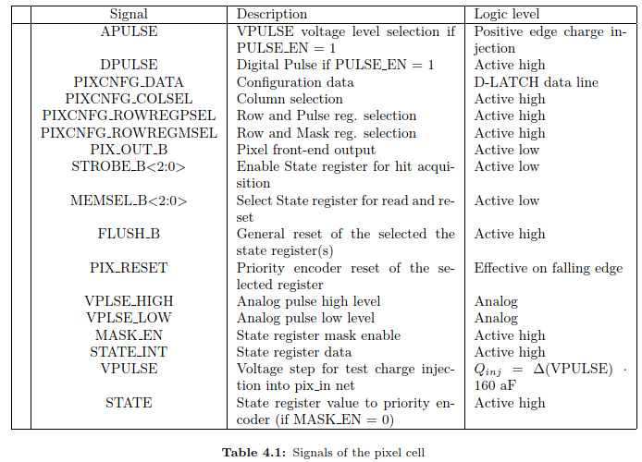
Pixel Digital Logic
3 state registers (SetReset Latch) :
  set by FE output or DPULSE (Testability) if the corresponding STROBE_B
    is asserted simultaneously:
  STATE REGISTER <0> ← STROBE_B<0>, etc.
  reset either by a PIX_RESET(at falling edge) or by a global FLUSH_B signal
STATE is the input of the first hierarchical block of the Priority Encoder
Two D-latches for analog/digital pulsing and pixel masking functionality :
  set by PULSE_EN and MASK_EN configuration bits

Slide 21
Priority Encoder

Slide 22
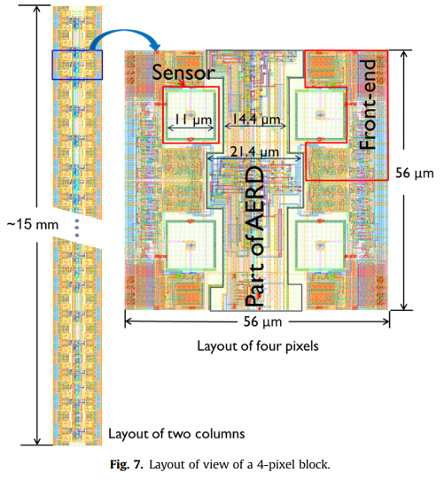
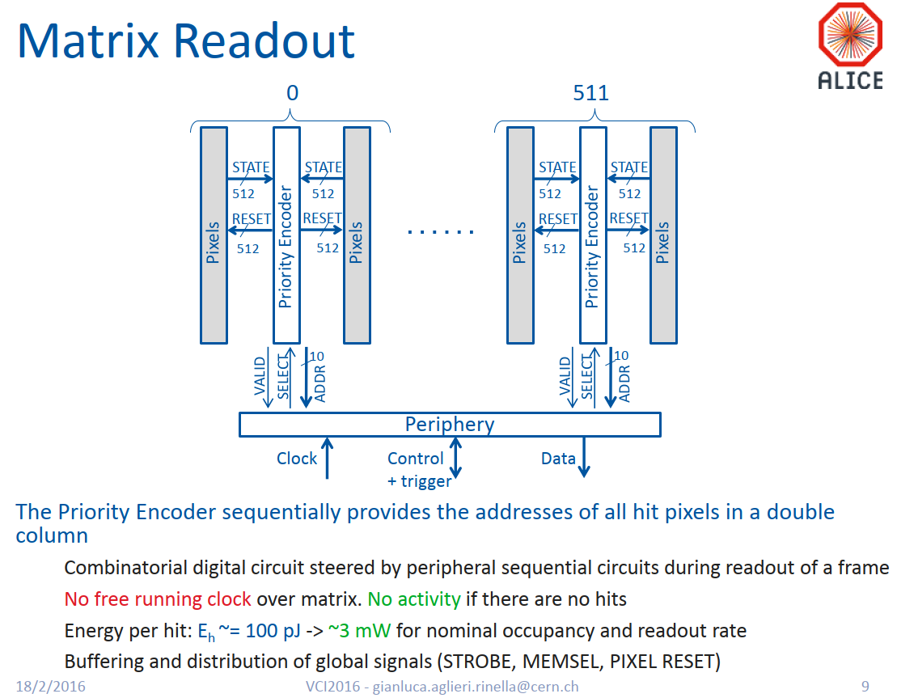
Priority Encoder
1
1

Slide 23
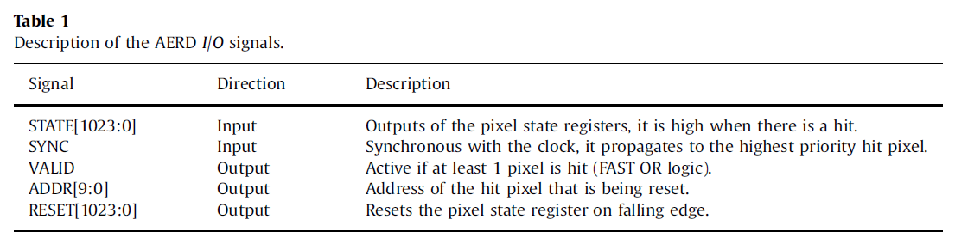
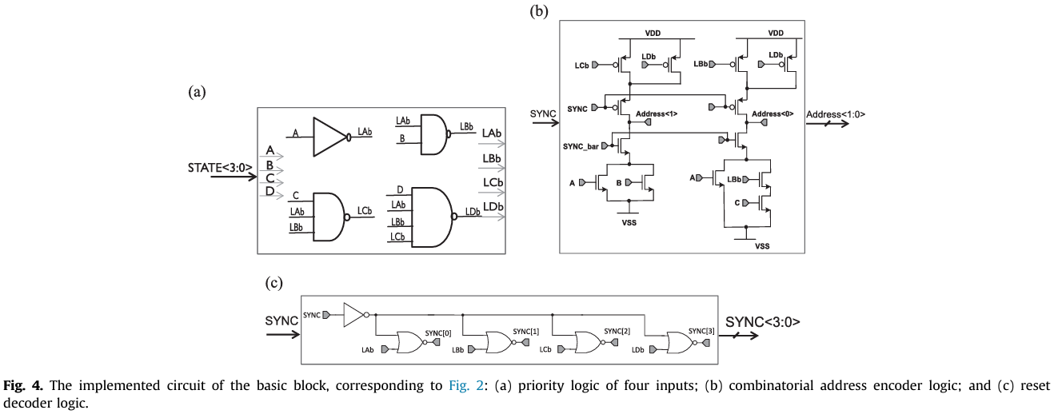
Priority Encoder
PIX_RESET
SELECT
ADDR_EN

Slide 24
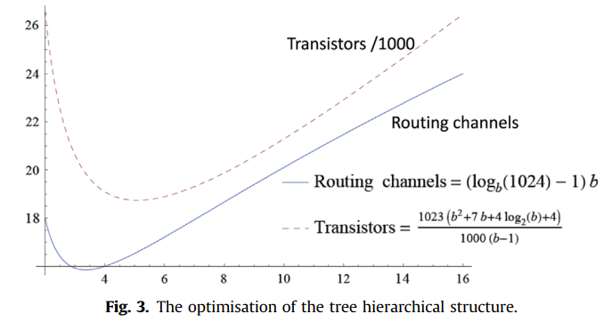
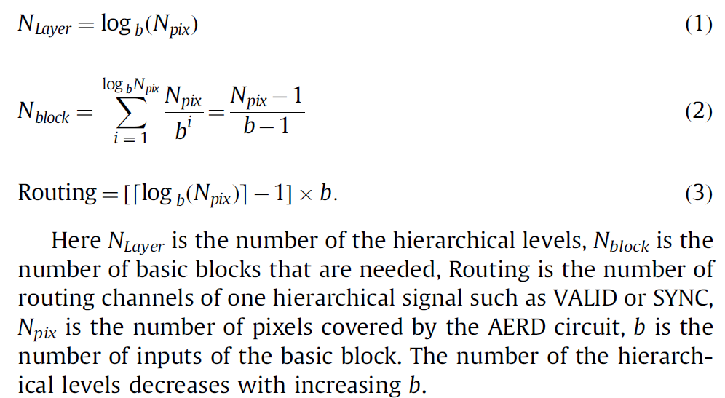
Priority Encoder
N_{PIX}=1024
b=4
N_{Layer} = 5
N_{block} = 1023/3 = 341
Routing = 16

Slide 25
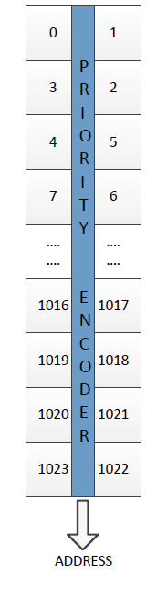
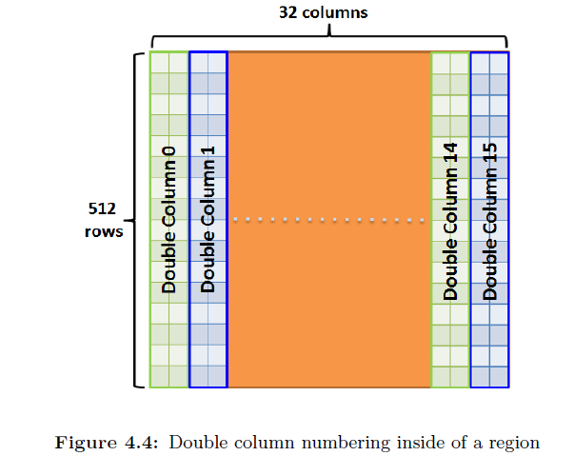
Readout from matrix

Slide 26
From PIXEL to MATRIX
1
2
4
3
1. Collection diode
2. Pixel analog front-end
3. Pixel digital logic
4. Priority Encoder

Slide 27
Content
Introduction
  CERN EP R&D WP1.2 Monolithic pixel detector
  Inner Tracking System(ITS) 3 - Roadmap
ALPIDE (ALICE PIxel DEtector)
  Collection diode
  Pixel analog front-end
  Pixel digital logic
  Matrix readout – Priority Encoder
MOSS (MOnolithic Stitched Sensor)
  Motivation
  MOnolithic Stitched Sensor (MOSS) prototype and challenges
  MOSS power plan and pad ring design
  Summary and outlook

Slide 28
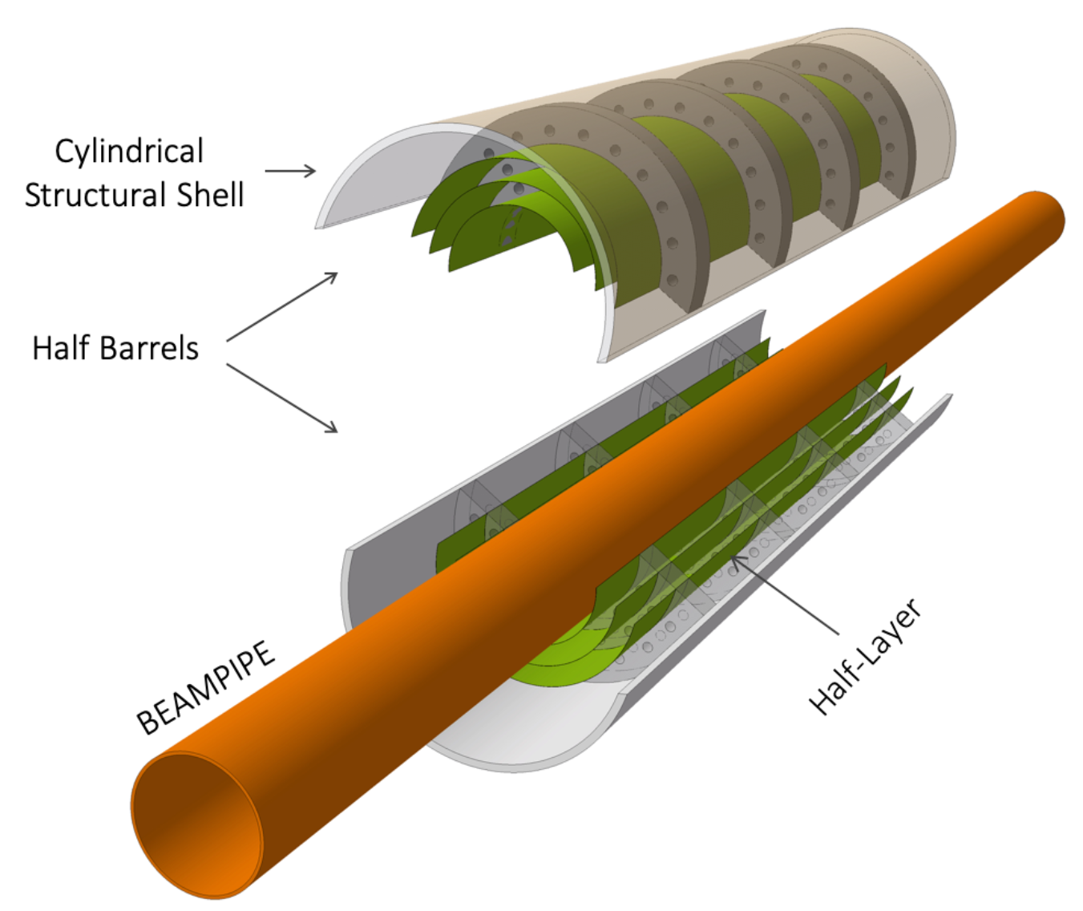
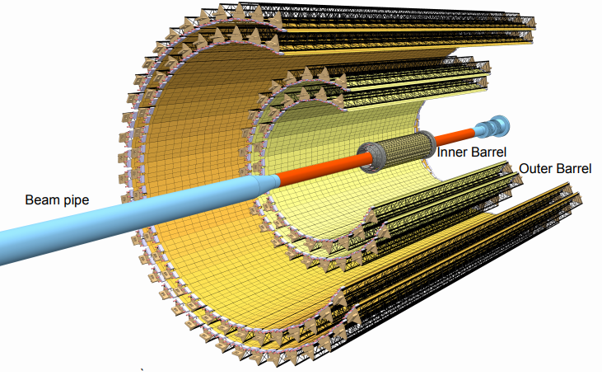
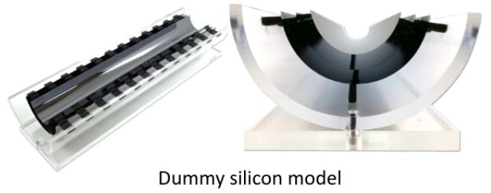
ALICE ITS3 upgrade
ALICE (A Large Ion Collider Experiment) ITS2 (Inner Tracking System) to ITS3
  Wafer-scale bendable monolithic CMOS particle sensor measuring up to 270mm x 94mm
  Less and homogeneous material leads to better results for physics
    Bent Si wafer alone allows a stable and self-supporting mechanical structure; Wafers thinned down to about 50um are bendable
    No circuit board required for electrical connection
    Cooling by air flow; power density limit is 20 mW/cm²
  6 large sensors make up the entire ITS3 production
  First application of stitching technology in high energy physics
More details on ITS3 upgrade:
https://indico.cern.ch/event/1071914, ALICE ITS3 – a next generation vertex detector based on bent, wafer-scale CMOS sensors, Magnus Mager (CERN)
https://cds.cern.ch/record/2703140/files/LHCC-I-034.pdf - Letter of Intent for an ALICE ITS Upgrade in LS3

Slide 29
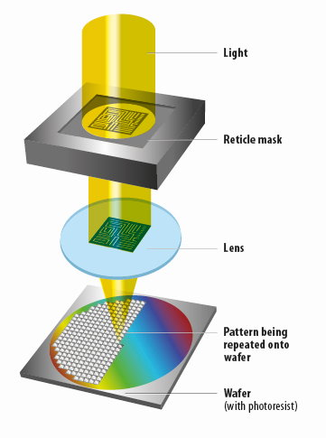
Photolithography and reticle
Photolithography is a patterning process in which a photosensitive polymer is selectively exposed to light through a mask(or a reticle), leaving a latent image in the polymer that can then be selectively dissolved to provide patterned access to an underlying substrate.
The reticle size is only a few cm in a commercial standard CMOS process.
https://bits-chips.nl/artikel/euv-for-dummies/

Slide 30
Wafer scale stitched sensors
1D stitching
~30 mm
259 mm
~20 mm
14 mm
Reticle
1D stitched object
2D stitching
270 mm
94 mm
Reticle
2D stitched object

Slide 31
Wafer scale stitched sensors prototype: MOSS
Technology
  TPSCo 65nm Image Sensor CMOS process
  300 mm silicon wafer
  Stitching technique
  Full wafer-scale sensor design
Sensor chips on wafer
MOSS (1 of 6)
Design reticle
I
G
H
Test chips
C
A
B
End caps of stitched chips
259 mm
F
D
E
Core of MOSS stitched chip
14 mm

Slide 32
MOSS Monolithic Stitched Sensor Prototype
Primary goal
  Learn stitching techniques to make a particle detector
  Learn about yield
  Interconnect power and signals on wafer scale chip
  Study leakage, spread, noise, and speed
Stitched object
  Left endcap
  Repeated Sensor Unit x 10
  Right endcap
14 mm
1
2
3
4
5
6
7
8
9
10
259 mm

Slide 33
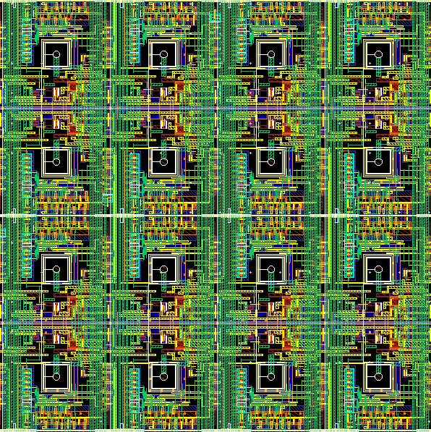
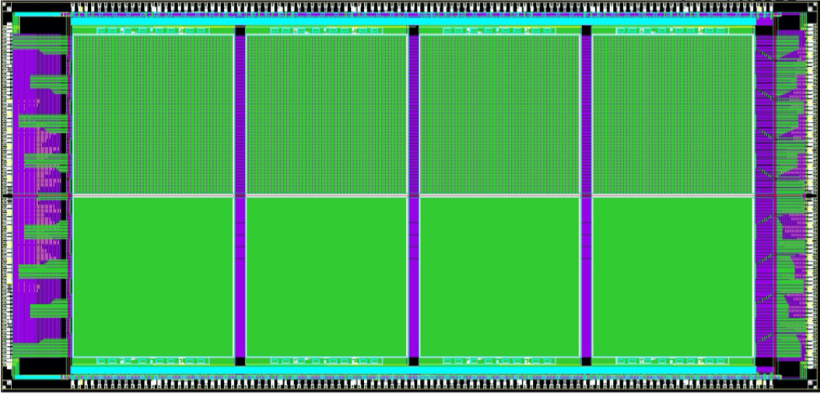
MOSS Monolithic Stitched Sensor Prototype
14 mm
1
2
3
4
5
6
7
8
9
10
259 mm
1 of 10
Half matrix top:
- Large pitch 22.5 µm
- Maximized width and spacing of structures for yield
- 7 mW/cm² from analog FE
256 X 256 pixels
320 X 320 pixels
Half matrix bottom:
- Fine pitch 18 µm
- Compact layout
- 11 mW/cm² from analog FE
Main features
  14 x 259 mm² monolithic stitched sensor
  6.72 million pixels
  736.3 million transistors
  30 nA nominal static current of analog front-end
  Negative bias to the substrate

Slide 34
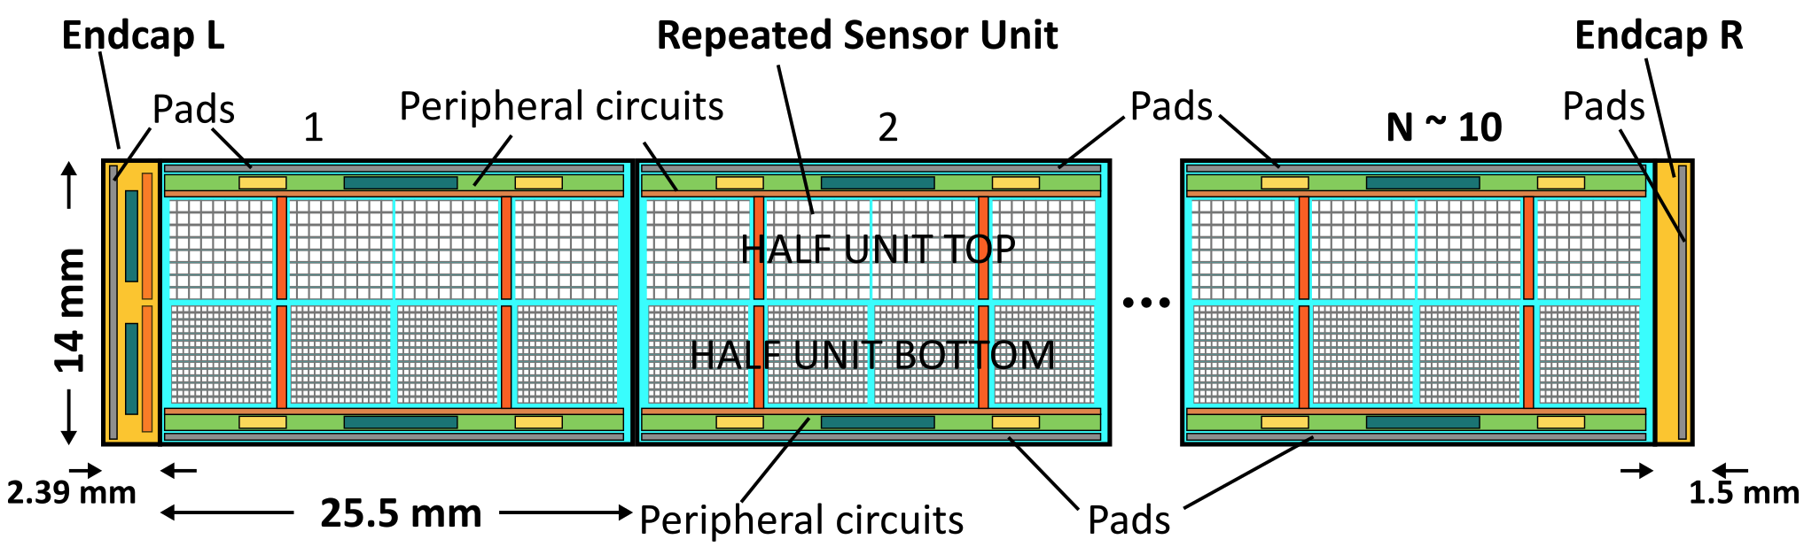
MOSS Monolithic Stitched Sensor Prototype
x10
STROBE
PULSE_EN
MASK_ROW
SELECT_ROW
APULSE
DPULSE
MASK_COL
CLEAR_COL
ROW_OR
COLUMN_OUT
PIXEL LOGIC
Binary readout with parameterizable strobe duration
In-pixel latch with fast OR for row and column output signals
Zero-suppressed readout; sequentially encode address of pixels with hit
Analog charge injection and digital pulse testing per pixel
Masking features

Slide 35
Challenge arising from stitching: Yield
How to learn about yield?
  Architecture for resilience to manufacturing faults
    Granular powering scheme to avoid that a single fault kills the full chip
    Testing sub-units independently
  Layout
    Matrix designed with design-for-manufacturing (DFM) rules
      Maximizing all width and spacing whenever possible
      Multiple vias
    Periphery designed with custom DFM standard cell library

Slide 36
MOSS power plan
Power granularity
  Design is divided in 20 sectors (top and bottom RSU) that can be powered and operated independently
  Any sectors that have fatal short can be turn OFF while others are operative
  Each sector has analog and digital core and IO domain
  Two additional domains for each inter-domain communication circuit at top and bottom
  One global net for the substrate bias
  In total, 65 power domains
Power from Short edge (Left Endcap) and/or Long edge
Top inter-domain communication circuit
Supply
tRSU
Supply
Supply
bRSU
Supply
Bottom inter-domain communication circuit

Slide 37
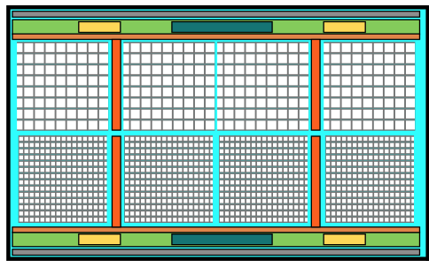
Measuring Yield
An example of MOSS testing scenarios
  Top RSU2 and RSU4 are controlled and read out through the top inter-domain communication circuit and the left endcap
  RSU9 is electrically disconnected from the top inter-domain communication circuit
  RSU9 is controlled by means of the long edge
  All the other domains are off
Study manufacturing yield
  Functional yield at half chip, half RSU, matrix, column/row/pixel level granularity
  Possible dependence on pixel pitch and layout density
Supply
Supply
Supply
Control and Readout
Control and Readout
tRSU2
tRSU4
tRSU9

Slide 38
Domain isolation
Challenges with the standard well structure
  Domain isolation by separating wells in the substrate
  Reducing the area of the reverse-biased junction as much as possible
Pad ring separation cells
  Deep N well is separated by deep N well cut cell
  Substrate bias cell in between domains
  Isolation extension cell to reduce the reverse-biased junction in the domains
Domain1
Domain2
Domain1
deep N well cut
domain isolation
with substrate bias
deep n well cut
Domain2
Isolation
extension
SUB
P well
P well
P well
N well
P well
deep P well
deep P well
deep P well
deep P well
deep N well
deep N well
deep N well
P substrate
P substrate

Slide 39
ElectroStatic Discharge protection (ESD)
Challenges with standard ESD structure
  Standard ESD structure is not compatible with the power plan
  Off domains are held at a negative voltage equal to the substrate bias
  The inter-domain communication block must be able to operate while the other domains are off, and vice versa
Inter-domain ESD between the communication block and the other domains
  Introduced 4-diode strings as an inter-domain ESD
  Added power clamp diodes to the inputs of the inter-domain signaling buffer
VSS = 0 at ON state, or VSS = -1.2V at OFF state
Inter-domain communication block
Inter-domain ESD
Inter-domain ESD
ON: VSS= 0V
OFF: VSS= -1.2V
Digital domain 1
Digital domain 2
Standard ESD
Standard ESD
• • •
Analog domain 1
Analog domain 2

Slide 40
Summary and outlook
MOSS developed as a proof-of-concept of a stitched monolithic particle detector for ITS3
Submitted in Nov 2022 and started testing from May 2023
Much learning and complex design challenges in order to maximize the yield
  Power granularity
  Design-for-manufacturing
  Domain isolation
  Inter-domain ESD protection
Outlook
  Quantify yield on MOSS by testing
  Adopt the learning from the testing into the future prototype development
First ever wafer-scale monolithic CMOS sensor applied to high-energy physics

Slide 41
References
Dervos, Constantine T., et al. "pn junction photocurrent modelling evaluation under optical and electrical excitation." Sensors 4.5 (2004): 58-70.
Rinella, Gianluca Aglieri, and ALICE Collaboration. "The ALPIDE pixel sensor chip for the upgrade of the ALICE Inner Tracking System." Nuclear Instruments and Methods in Physics Research Section A: Accelerators, Spectrometers, Detectors and Associated Equipment 845 (2017): 583-587.
ALICE ITS ALPIDE development team. "ALPIDE Operations Manual." July 25, 2016. Version: 0.3
Munker, Magdalena, et al. "Simulations of CMOS pixel sensors with a small collection electrode, improved for a faster charge collection and increased radiation tolerance." Journal of Instrumentation 14.05 (2019): C05013.
Kim, Daehyeok, et al. "Front end optimization for the monolithic active pixel sensor of the ALICE Inner Tracking System upgrade." Journal of Instrumentation 11.02 (2016): C02042.
Yang, P., et al. "Low-power priority Address-Encoder and Reset-Decoder data-driven readout for Monolithic Active Pixel Sensors for tracker system." Nuclear Instruments and Methods in Physics Research Section A: Accelerators, Spectrometers, Detectors and Associated Equipment 785 (2015): 61-69.
Hong, G. H., and Alice Collaboration. "Monolithic Stitched Sensor (MOSS) Development for the ALICE ITS3 Upgrade." 10th International Workshop on Semiconductor Pixel Detectors for Particles and Imaging; 12-16 December 2022. 2023.
Leitao, P. Vicente, et al. "Development of a Stitched Monolithic Pixel Sensor prototype (MOSS chip) towards the ITS3 upgrade of the ALICE Inner Tracking system." Journal of Instrumentation 18.01 (2023): C01044.

Slide 42
SPARE SLIDES

Slide 43
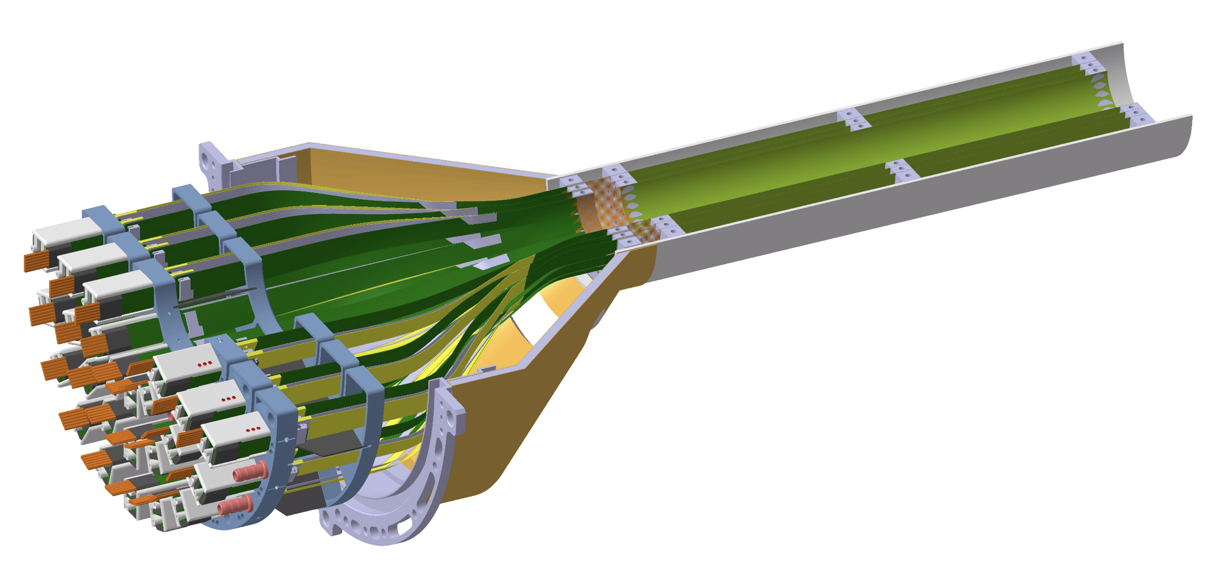
Requirements of flux and radiation levels
Pb-Pb Interaction Rate | 50 kHz
Particle Flux | 2.2 MHz/cm²
TID | <10 kGy
NIEL | 1×10¹³ 1 MeV n_{eq} cm⁻²

Slide 44
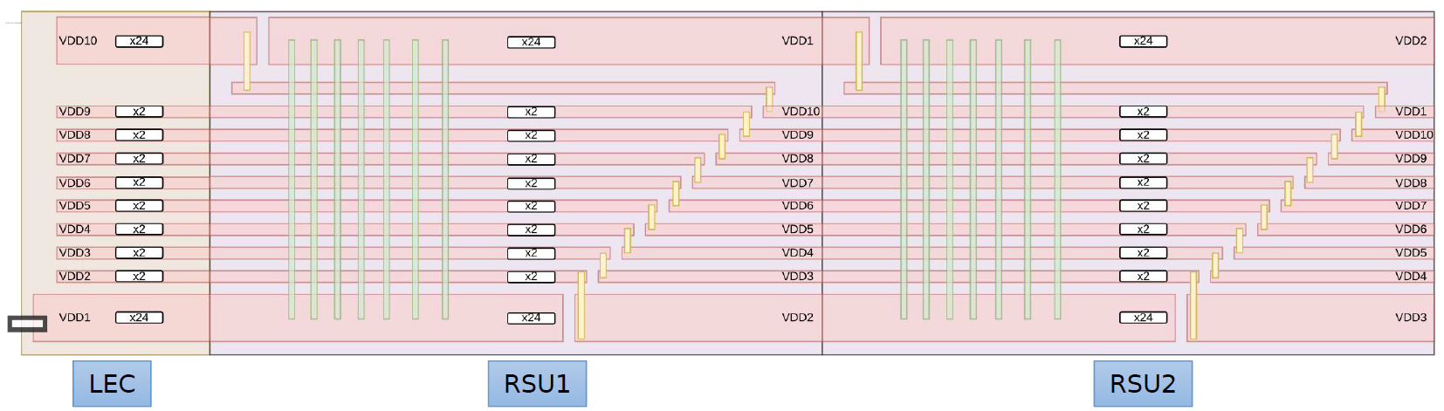
MOSS power distribution
With the same physical RSU, it is necessary to forward power from the short edges to the most far RSUs
We achieve this by performing line-hopping
Powering & monitoring from the short-edge (example of VDD)
• • •

Slide 45
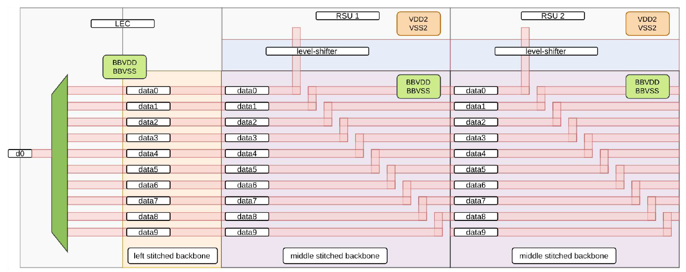
Data readout through Left Endcap
Data readout through the inter-domain communication block (Stitched backbone)
  Readout requests are sent over the serial slow control
  We can read one RSU at a time (1x15Mbps)
  Line-hopping allows to connect all 10 RSUs to a mux in the Left Endcap
  The mux is controlled by means of the slow control
Special readout mode: all RSUs at once (10x 3.75 Mbps)

Slide 46
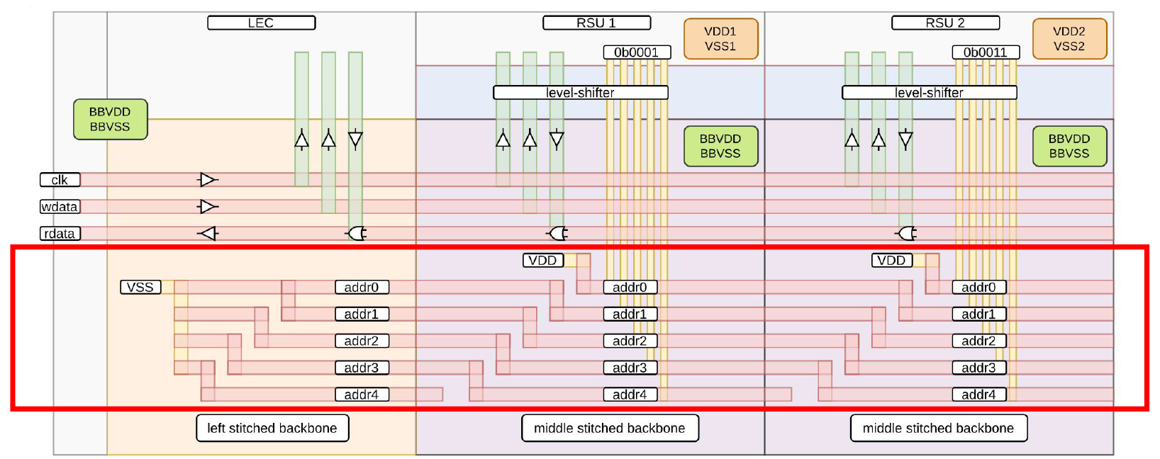
RSU addressing
RSU addressing in the inter-domain communication block (Stitched backbone)
  Each RSU address is set by means of line-hopping in the stitched backbone
  A local tie-high cell ensures the address increment

