Slide 1

Recent results on exotic and heavy hadrons from Belle II experiment
Kiyoshi Tanida <kytanida@gmail.com>
(Japan Atomic Energy Agency)
New Perspectives on exotic and heavy hadrons
@Inha Univ.
25 Aug. 2025

Slide 2
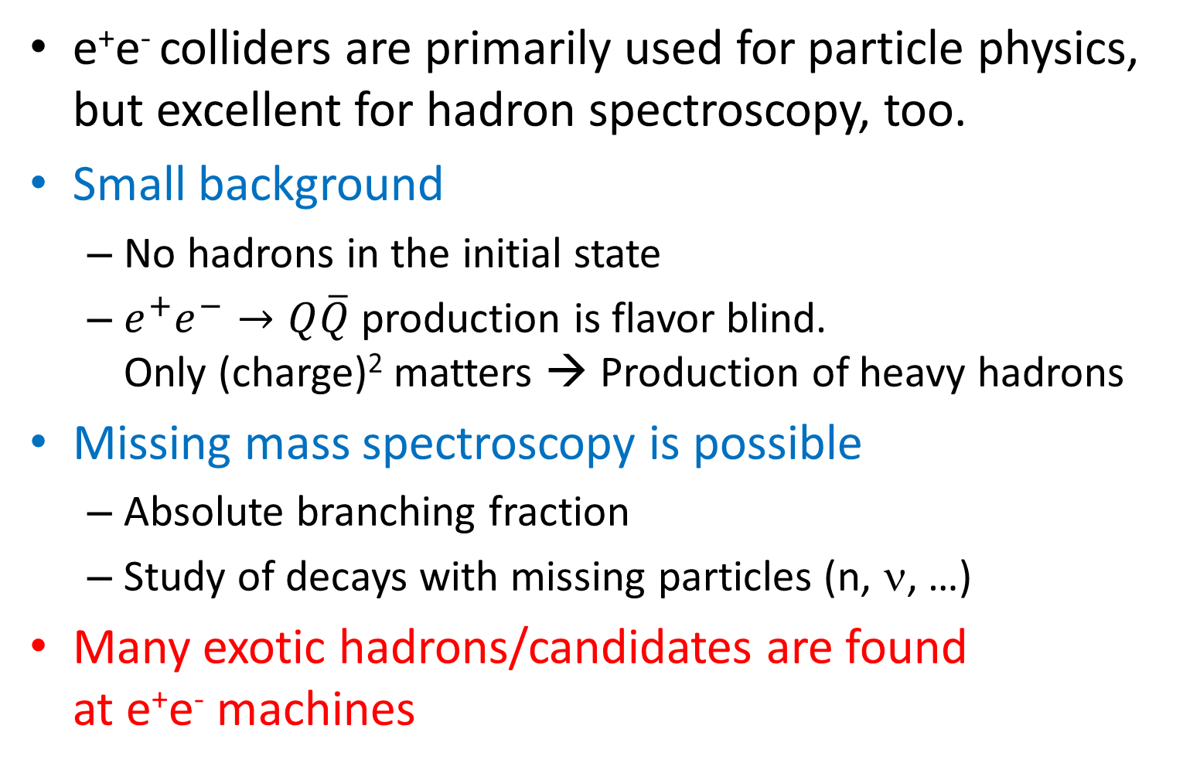
Introduction
e⁺e⁻ colliders are primarily used for particle physics, but excellent for hadron spectroscopy, too.
Small background
  No hadrons in the initial state
  $e^{+}e^{−}→Q\overline{Q}$ production is flavor blind.
  Only (charge)² matters → Production of heavy hadrons
Missing mass spectroscopy is possible
  Absolute branching fraction
  Study of decays with missing particles (n, ν, …)
Many exotic hadrons/candidates are found
at e⁺e⁻ machines

Slide 3
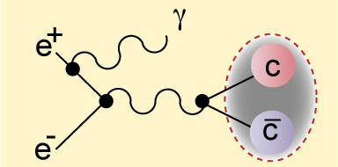
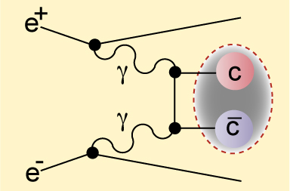
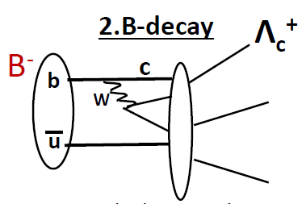

Hadron production in e⁺e⁻
Direct resonance production
  1⁻⁻ states: $ψ, Υ, Y$
  Initial state radiation allows
  lower mass than √s
  2-photon process: 0⁺⁺, 2⁺⁺,…
Indirect production
  Quark fragmentation from $Q\overline{Q}$
  Cascade decays
  b → c, $Υ$ decays, …

Slide 4

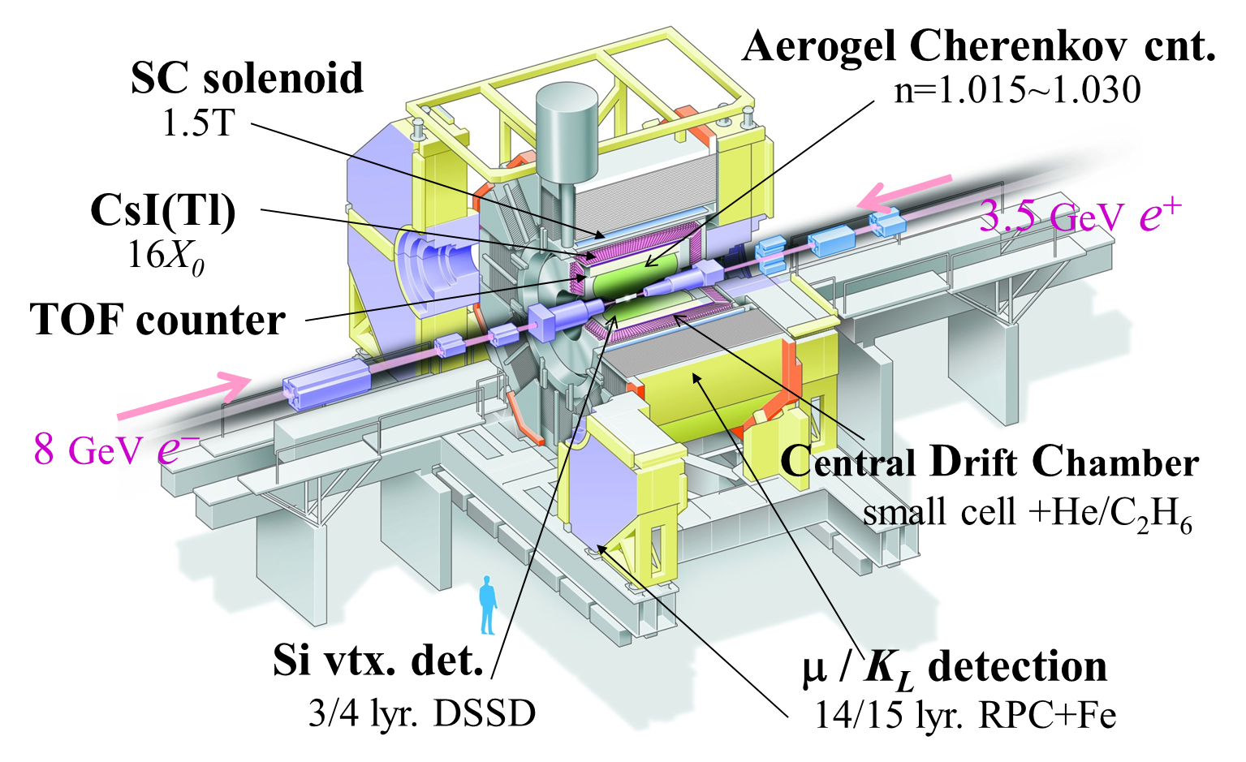
Belle experiment
√s~10.6 GeV
Almost 4π, good momentum resolution (Δp/p～0.1%),
EM calorimeter, PID & Si Vertex detector
Data taking: 1999-2010, Integrated Luminosity ~ 1 ab⁻¹

Slide 5
SuperKEKB and Belle II
Upgrade for SuperKEKB and Belle II to achieve 30x peak L
Goal: x50 more statistics than Belle

Slide 6
Upgraded from Belle

Slide 7
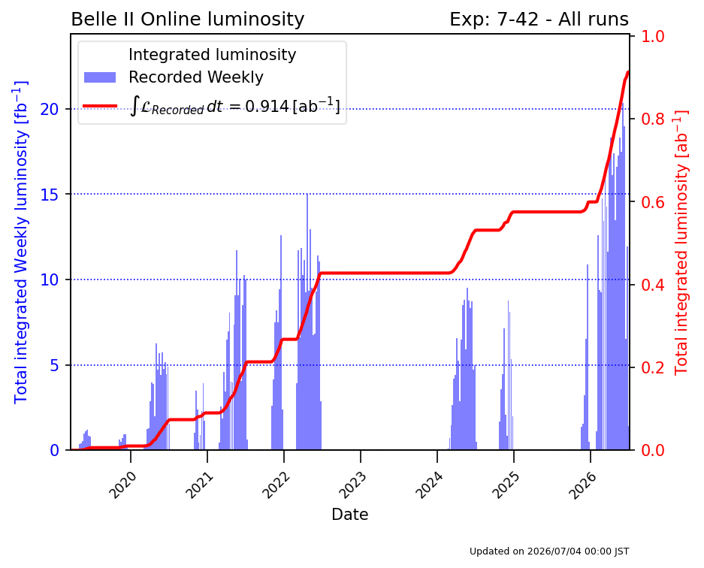

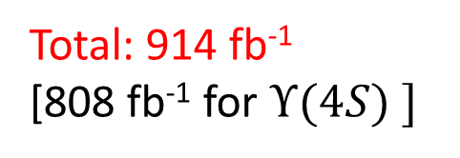
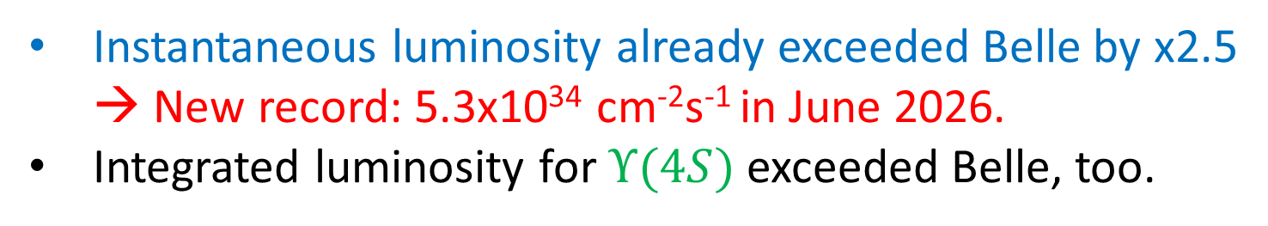
Belle II integrated luminosity
Total: 914 fb⁻¹
[808 fb⁻¹ for $Υ(4S) ]$
Instantaneous luminosity already exceeded Belle by x2.5
→ New record: 5.3x10³⁴ cm⁻²s⁻¹ in June 2026.
Integrated luminosity for $Υ(4S)$exceeded Belle, too.

Slide 8
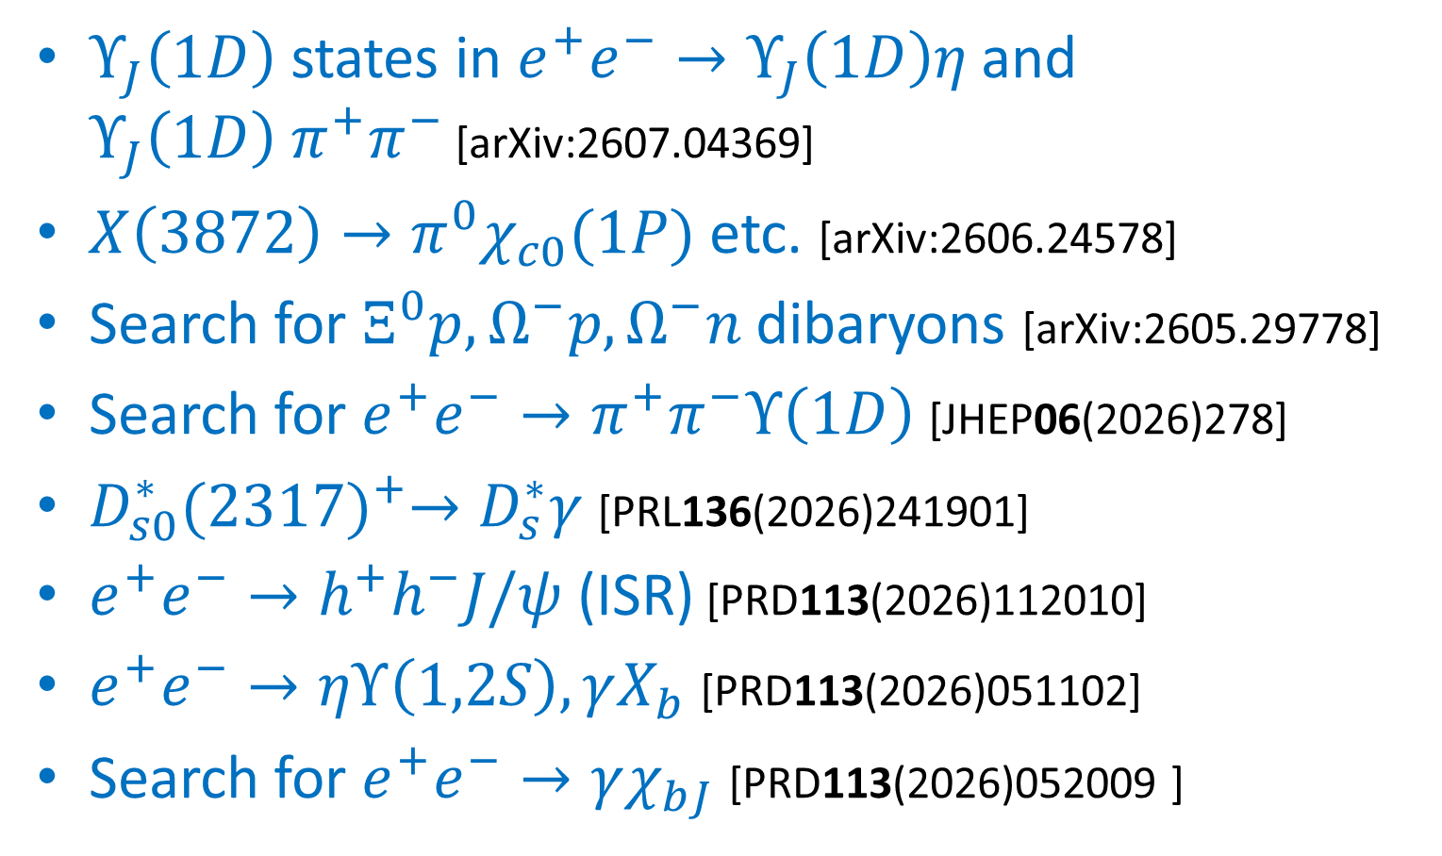
List of recent (~ 2 years) results
$Υ_{J}\left(1D\right)$ states in $e^{+}e^{−}→Υ_{J}\left(1D\right)η$ and
$Υ_{J}\left(1D\right)$ $π^{+}π^{−}$ [arXiv:2607.04369]
$X\left(3872\right)→{π^{0}χ}_{c0}(1P)$ etc. [arXiv:2606.24578]
Search for $Ξ^{0}p, Ω^{−}p,Ω^{−}n$ dibaryons [arXiv:2605.29778]
Search for $e^{+}e^{−}→π^{+}π^{−}Υ\left(1D\right)$ [JHEP06(2026)278]
$D_{s0}^{∗}{(2317)}^{+}→D_{s}^{∗}γ$ [PRL136(2026)241901]
$e^{+}e^{−}→h^{+}h^{−}J/ψ$ (ISR) [PRD113(2026)112010]
$e^{+}e^{−}→ηΥ\left(1,2S\right), γX_{b}$ [PRD113(2026)051102]
Search for $e^{+}e^{−}→γχ_{bJ}$ [PRD113(2026)052009 ]

Slide 9
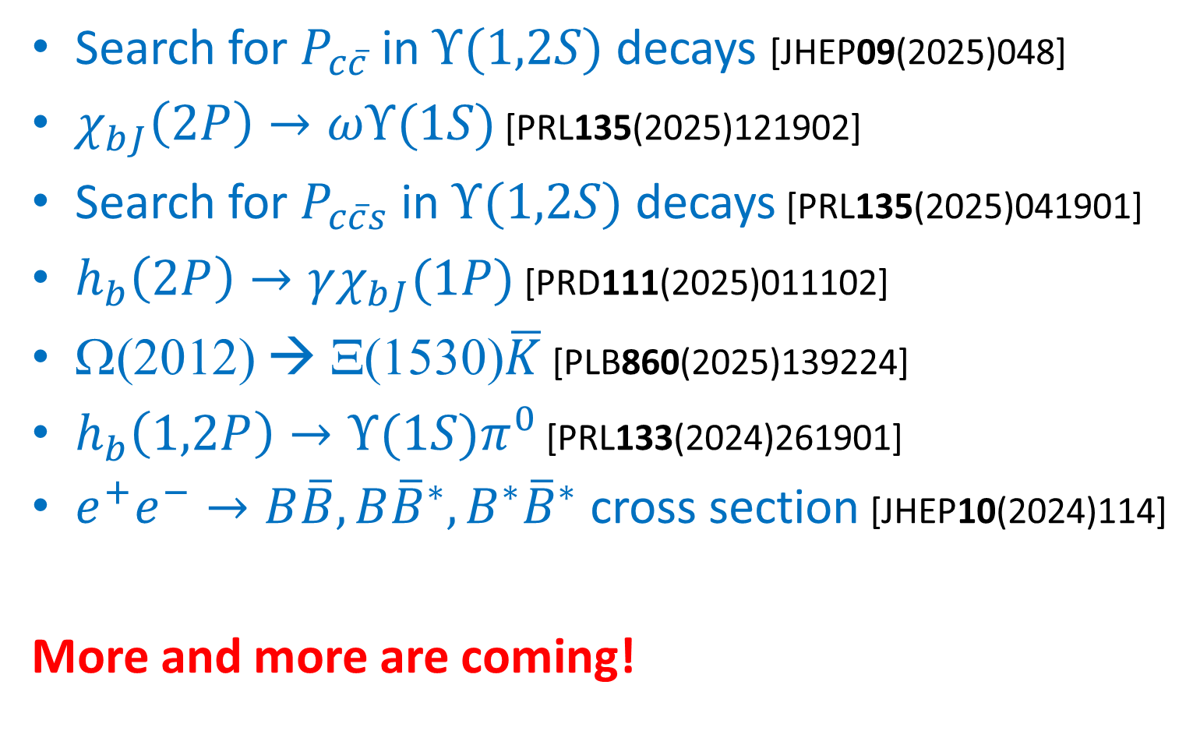
List of recent (~ 2 years) results (cont.)
Search for $P_{c\overline{c}}$ in $Υ(1,2S)$ decays [JHEP09(2025)048]
$χ_{bJ}\left(2P\right)→ωΥ(1S)$ [PRL135(2025)121902]
Search for $P_{c\overline{c}s}$ in $Υ(1,2S)$ decays [PRL135(2025)041901]
$h_{b}\left(2P\right)→γχ_{bJ}(1P)$ [PRD111(2025)011102]
Ω(2012) ◊ Ξ(1530)$\overline{K}$ [PLB860(2025)139224]
$h_{b}\left(1,2P\right)→Υ(1S)π^{0}$ [PRL133(2024)261901]
$e^{+}e^{−}→B\overline{B},B{\overline{B}}^{∗},B^{∗}{\overline{B}}^{∗}$ cross section [JHEP10(2024)114]
More and more are coming!

Slide 10
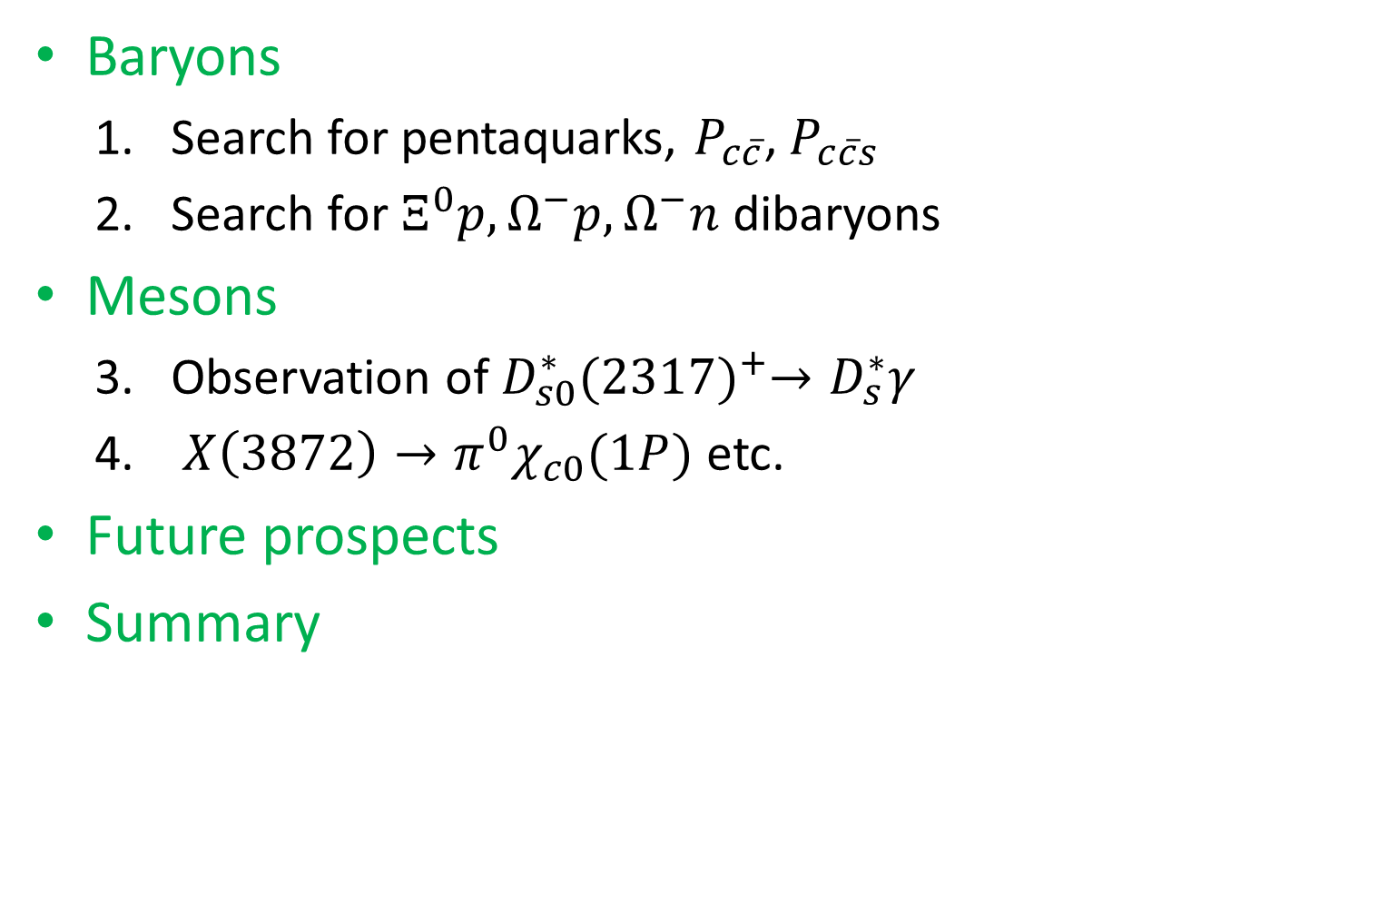
Topics of the day
Baryons
  Search for pentaquarks, $P_{c\overline{c}}$, $P_{c\overline{c}s}$
  Search for $Ξ^{0}p, Ω^{−}p,Ω^{−}n$ dibaryons
Mesons
  Observation of $D_{s0}^{∗}{(2317)}^{+}→D_{s}^{∗}γ$
  $X\left(3872\right)→{π^{0}χ}_{c0}(1P)$ etc.
Future prospects
Summary

Slide 11
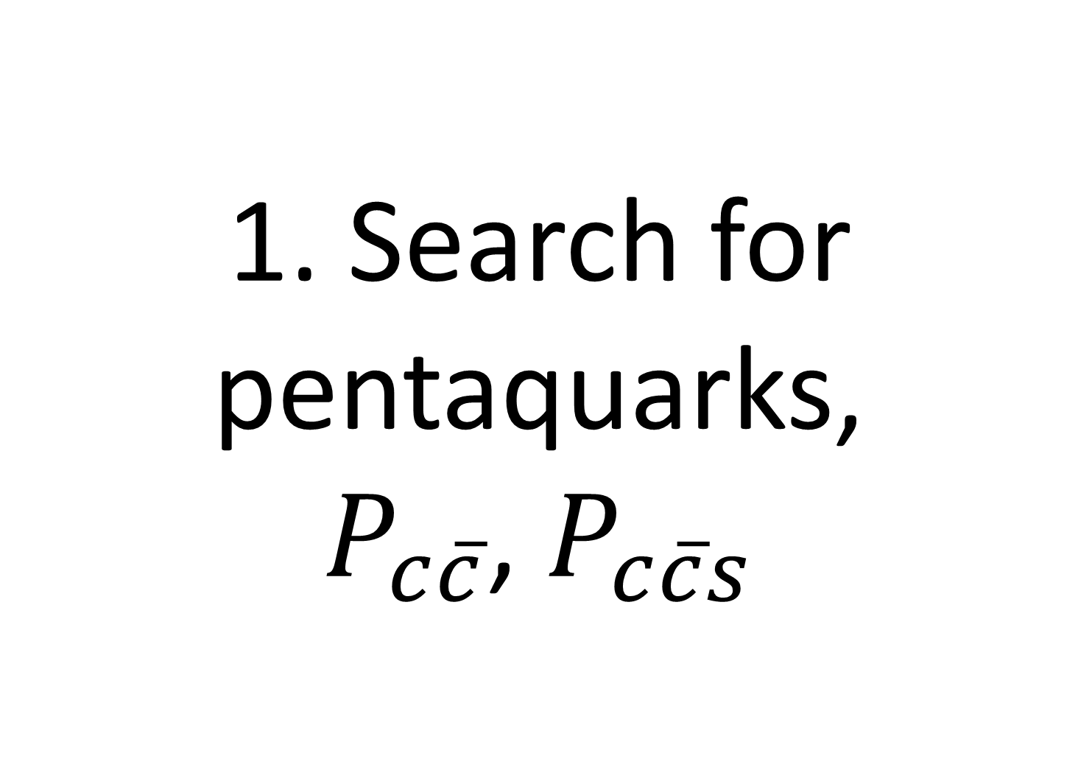
1. Search for pentaquarks,
$P_{c\overline{c}}$, $P_{c\overline{c}s}$

Slide 12

Pentaquarks observed by LHCb
Observed in pJ/ψ & ΛJ/ψ from decays of Λ_{b}, Ξ_{b}, …
  Hidden charm, ($uudc\overline{c}$) or ($udsc\overline{c}$)
Belle (II) search with $Υ$ decays

Slide 13

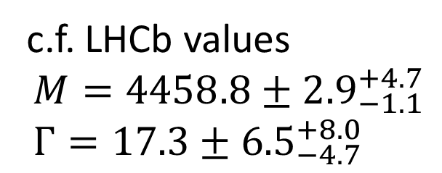

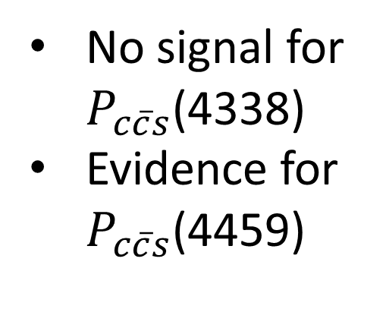
$P_{c\overline{c}s}$ search in $Υ(1,2S)$ decays
In the mode $ΛJ/ψ+X$
Data used: 30.5 fb⁻¹ for $Υ(1S)$ +$Υ(2S)$
No signal for
$P_{c\overline{c}s}$(4338)
Evidence for
$P_{c\overline{c}s}$(4459)
[PRL135 (2025)041901]
c.f. LHCb values
$$M=4458.8±{2.9}_{−1.1}^{+4.7} \\ Γ=17.3±{6.5}_{−4.7}^{+8.0}$$

Slide 14
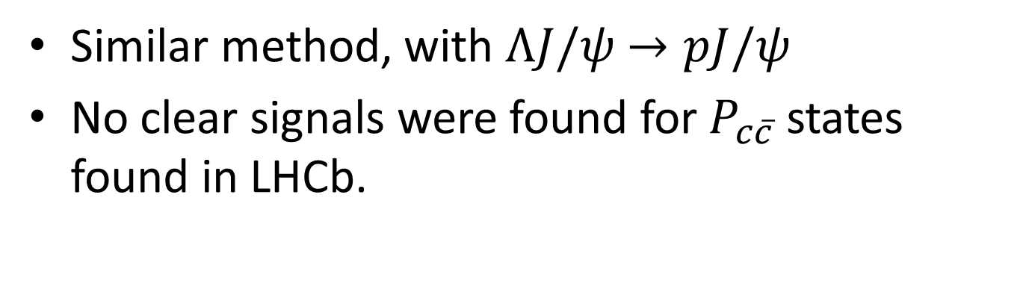

$P_{c\overline{c}}$ search in $Υ(1,2S)$ decays
[JHEP09(2025)048]
Similar method, with $ΛJ/ψ$ $→pJ/ψ$
No clear signals were found for $P_{c\overline{c}}$ states found in LHCb.

Slide 15

Branching ratios (upper limits)
Inclusive branches/cross section
Upper limits for $P_{c\overline{c}}$

Slide 16
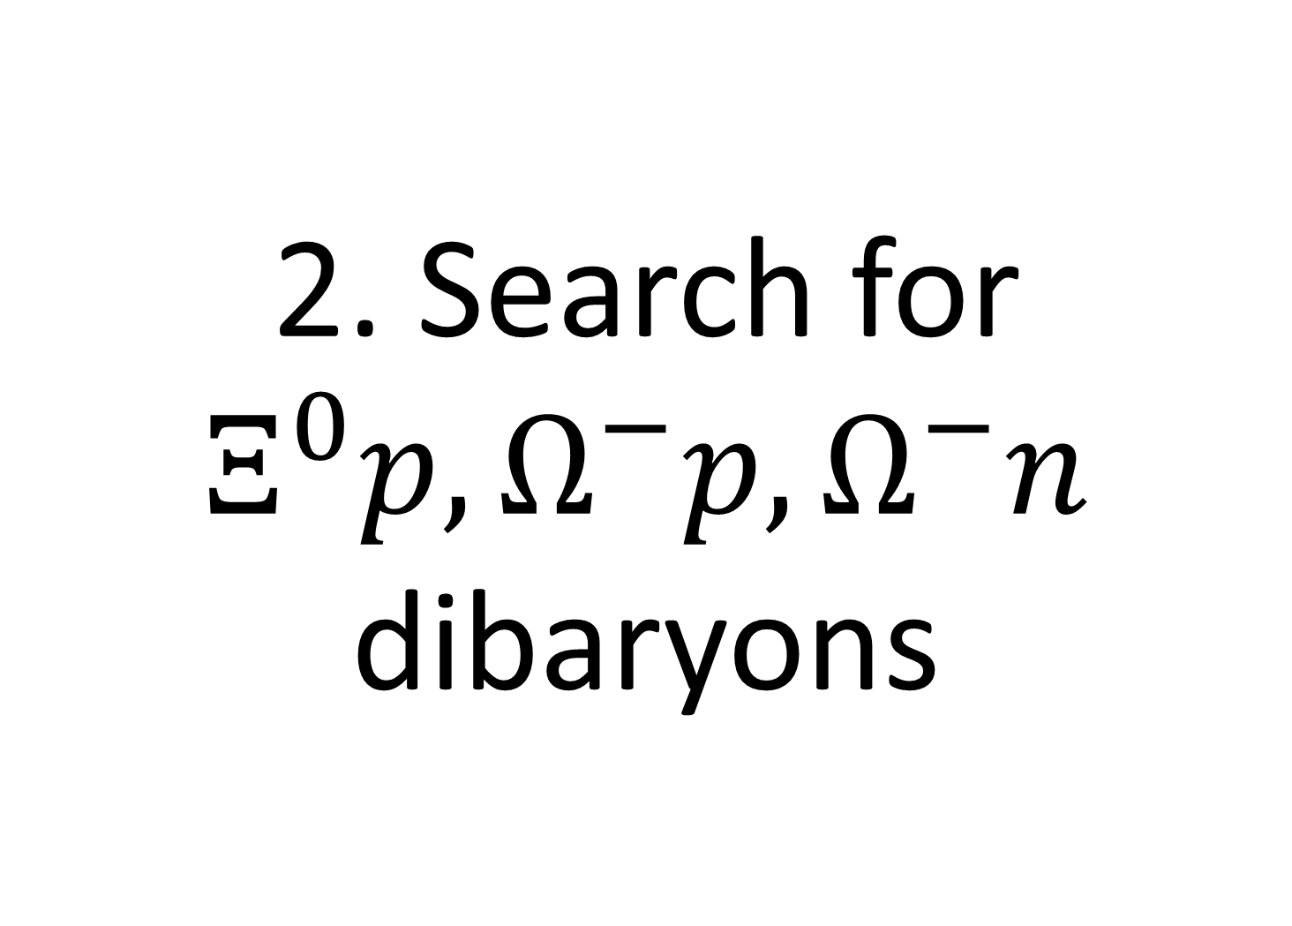
2. Search for $Ξ^{0}p, Ω^{−}p,Ω^{−}n$ dibaryons

Slide 17

Possibility of bound states
Some interaction models predict BB bound states (dibaryons)
  Especially, $Ω^{−}N$ bound state is predicted by LQCD and quark model

Slide 18
Analysis channels

Slide 19
Result
[arXiv:2605.29778]
No significant signals were observed in all the channels…

Slide 20
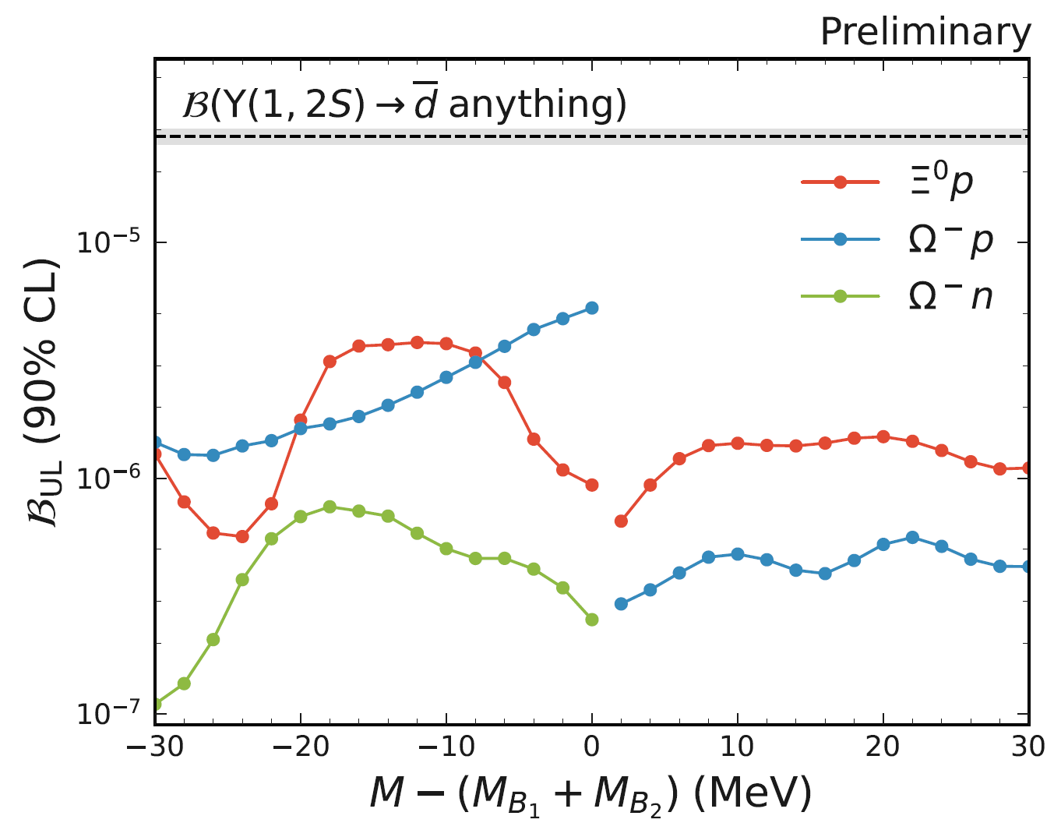
Upper limits
[arXiv:2605.29778]
UL is O(10-100) lower than $\overline{d}$ -- stringent constraints

Slide 21
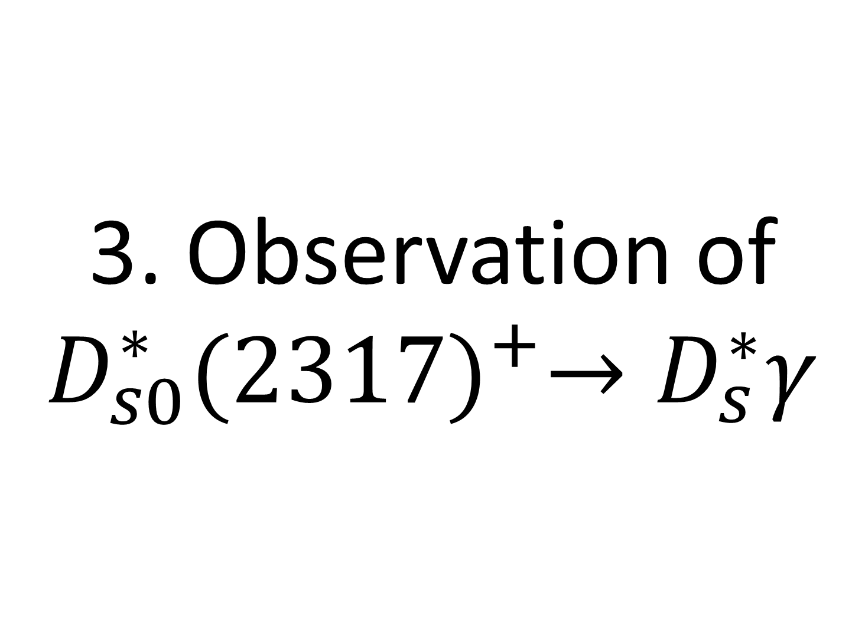
3. Observation of $D_{s0}^{∗}{(2317)}^{+}→D_{s}^{∗}γ$

Slide 22
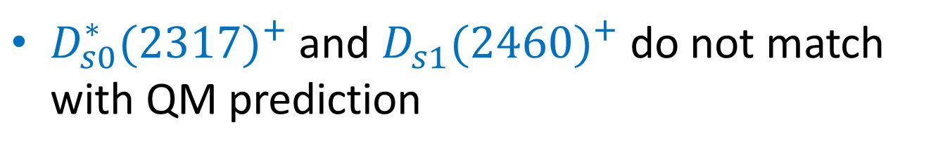

$$D_{s0}^{∗}{(2317)}^{+}$$
$D_{s0}^{∗}{(2317)}^{+}$ and $D_{s1}^{}{(2460)}^{+}$ do not match with QM prediction

Slide 23
Observation of Radiative decay
Clear peaks are observed both in Belle and Belle II
Efficiency corrected yields
are consistent

Slide 24


Relative ratio
$$=7.13±0.70±0.26\%$$
matches rather well with QM
→ Could be a mixture of $c\overline{s}$ and molecular state??

Slide 25
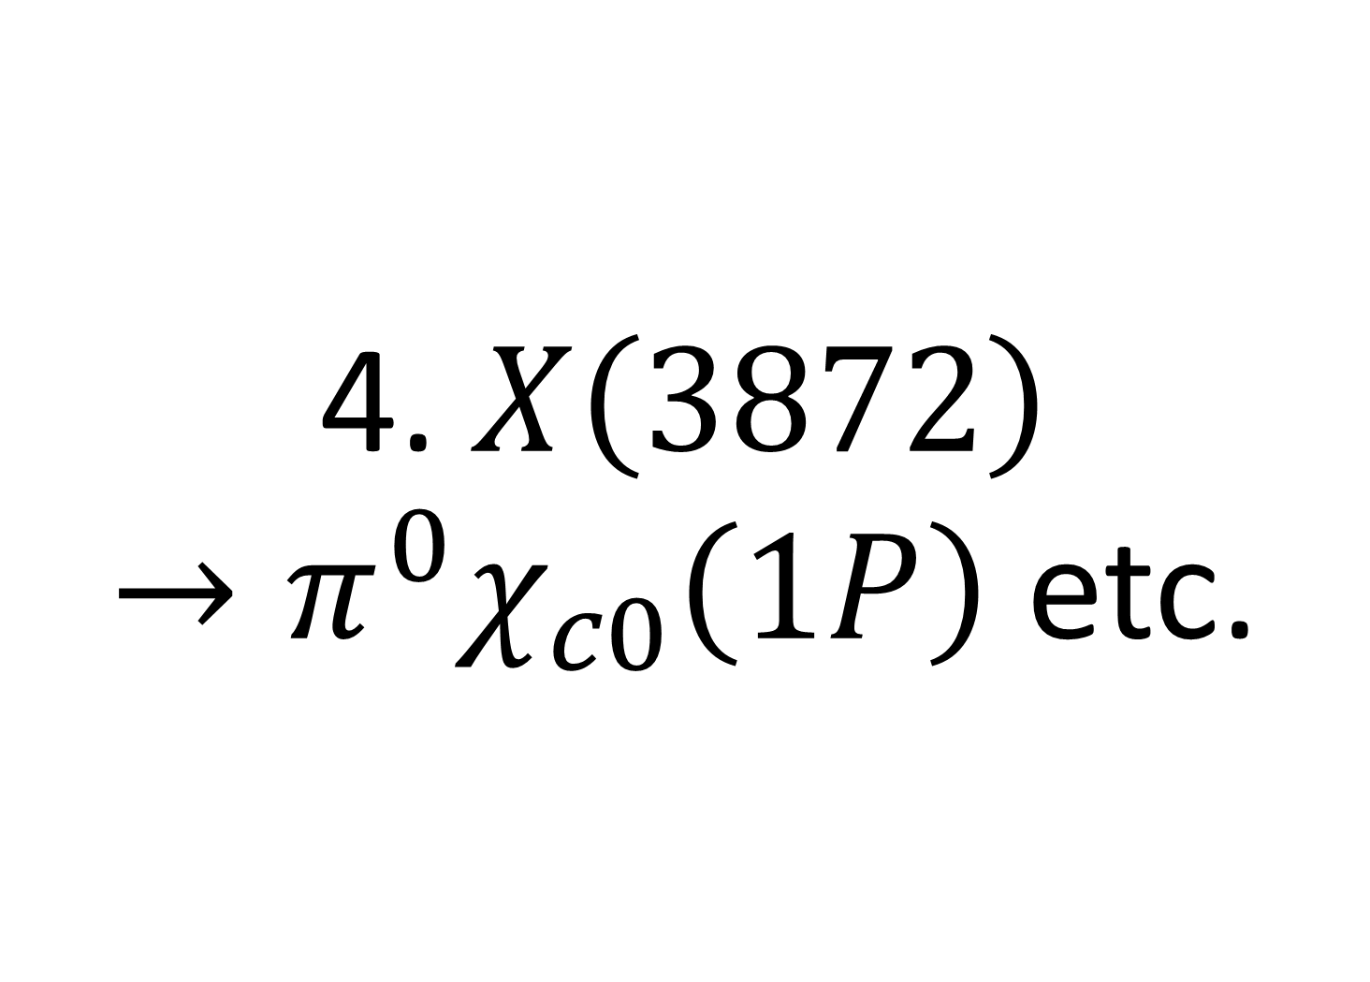
4. $X\left(3872\right)$
$→{π^{0}χ}_{c0}\left(1P\right)$ etc.

Slide 26
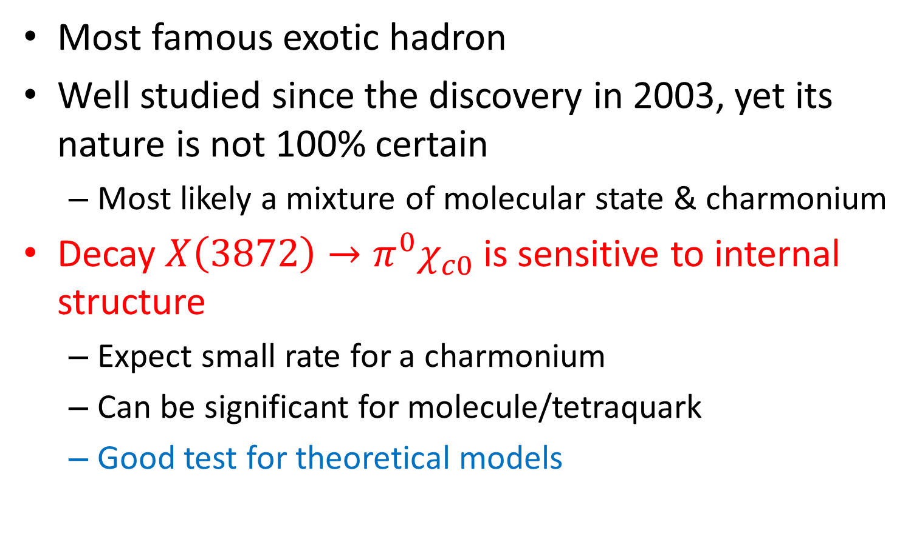
X(3872)
Most famous exotic hadron
Well studied since the discovery in 2003, yet its nature is not 100% certain
  Most likely a mixture of molecular state & charmonium
Decay ${{X\left(3872\right)→π}^{0}χ}_{c0}$is sensitive to internal structure
  Expect small rate for a charmonium
  Can be significant for molecule/tetraquark
  Good test for theoretical models

Slide 27
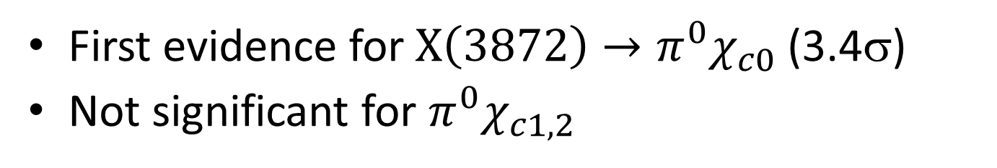
Result
First evidence for $X\left(3872\right)→{π^{0}χ}_{c0}$ (3.4σ)
Not significant for ${π^{0}χ}_{c1,2}$

Slide 28
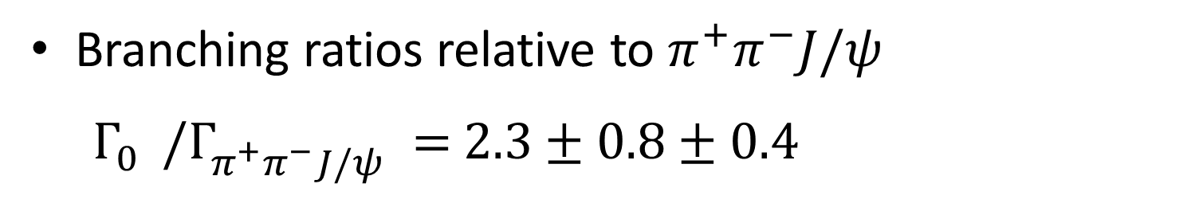
Discussion
Branching ratios relative to $π^{+}π^{−}J/ψ$
$Γ_{0}^{}/Γ_{π^{+}π^{−}J/ψ }^{}=$ $2.3±0.8±0.4$
Disfavors pure quarkonium
Consistent with most molecular/
tetraquark models

Slide 29
Future prospects

Slide 30
Luminosity Projection
Short term goal: L=1x10³⁵ cm⁻²s⁻¹
Longer term:
  up to L=
  6x10³⁵ cm⁻²s⁻¹
  Integrated luminosity:
  10 ab⁻¹ by LS2
  50 ab⁻¹ eventually

Slide 31
Some possibilities
Search for further states
  E.g., Ξ* and Ω* as well as charmed baryons and quarkonia
  Exotic states may be hidden in baryons
Search for bound states
  Baryonium, dibaryon, etc.
Elucidating the nature of exotic candidates
  E.g., X(3872): Absolute branching ratio measurement
  & precise lineshape measurements in both
  DD* & J/ψππ
Many more

Slide 32
Summary
Belle (II) is actively producing data for hadron spectroscopy
  Excellent for flavored hadrons with small background
  Hyperons, charmed baryons/mesons, quarkonia,
  exotic hadrons…
Belle II will acquire x50 more statistics than Belle
  Instantaneous luminosity already surpassed
  → New record: 5.3x10³⁴ cm⁻²s⁻¹ achieved
  Expecting a lot of further discoveries in the future
Thank you!

Slide 33
Backup

Slide 34
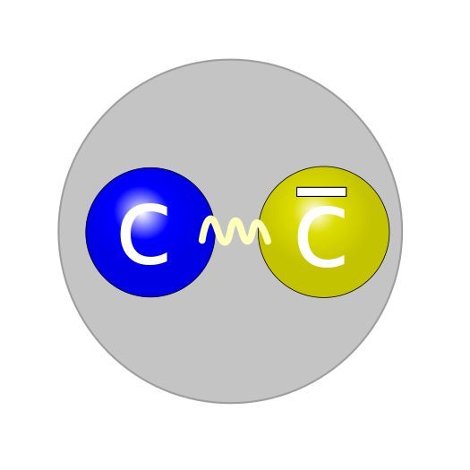
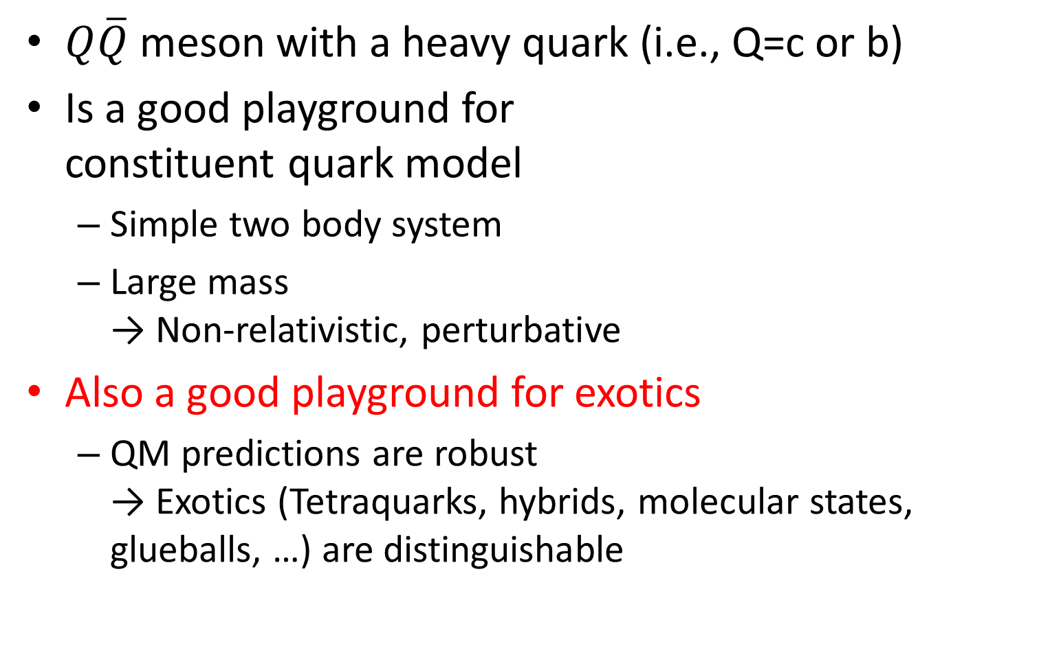
Quarkonium
$Q\overline{Q}$ meson with a heavy quark (i.e., Q=c or b)
Is a good playground for
constituent quark model
  Simple two body system
  Large mass
  → Non-relativistic, perturbative
Also a good playground for exotics
  QM predictions are robust
  → Exotics (Tetraquarks, hybrids, molecular states, glueballs, …) are distinguishable

Slide 35
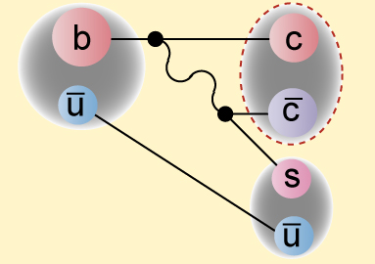
Production mechanisms in e⁺e⁻
B decays – charmonia
Direct production/Initial State
Radiation (ISR)
  J^{PC}=1⁻⁻
Two photon collision
  J^{PC}=0⁺⁺, 2⁺⁺, …
Quarkonium transitions
  Feed-down from higher states

Slide 36
Quarkonia summary
Good agreement below open flavor threshold
Exotic candidates, so called XYZ states, discovered

Slide 37
W_{b}
Z_{b}(10610) & Z_{b}(10650) are
molecular states?
  Explains the fact they can
  decay both spin triplet states
  and singlet states
If so, there should be
Heavy-quark-spin-symmetry
partner states nearby: W_{b}
  Simplest one: J^{P}=2⁺ state (B*B*)
Can be searched in radiative transitions & ππ decay from Υ(5S) and Υ(6S)
±

